Slide 1
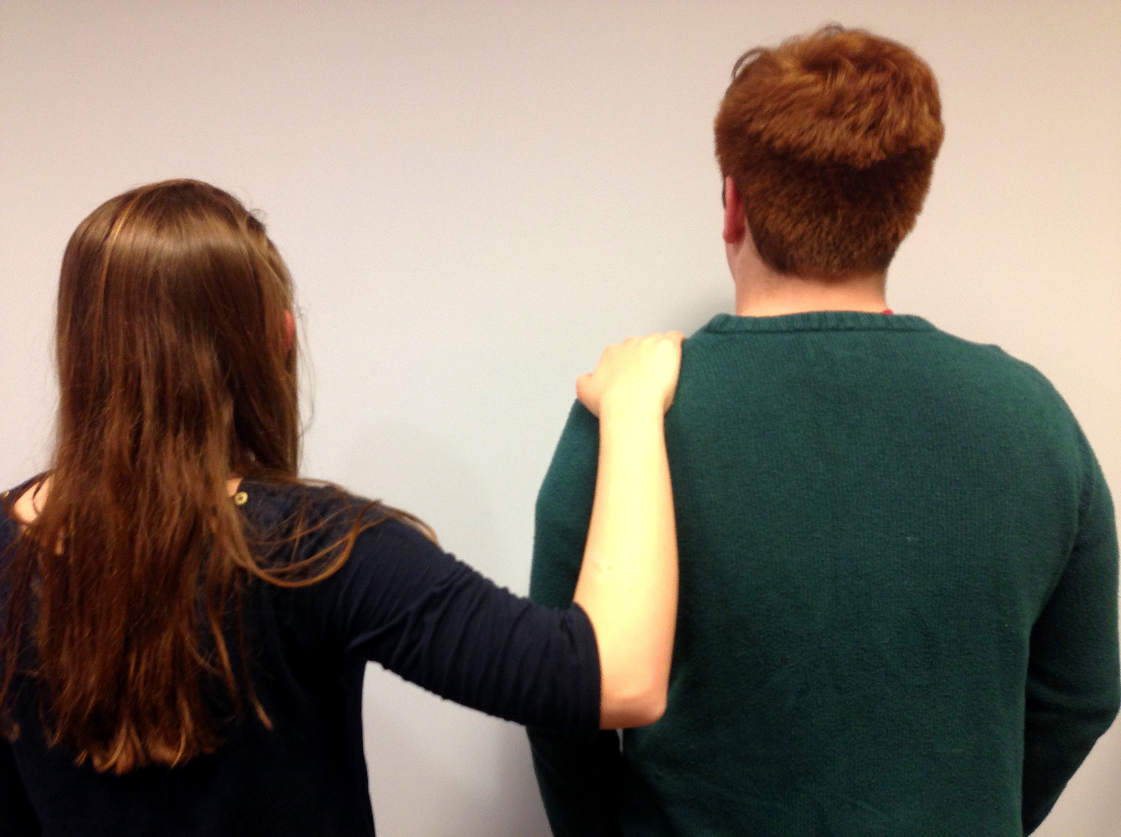
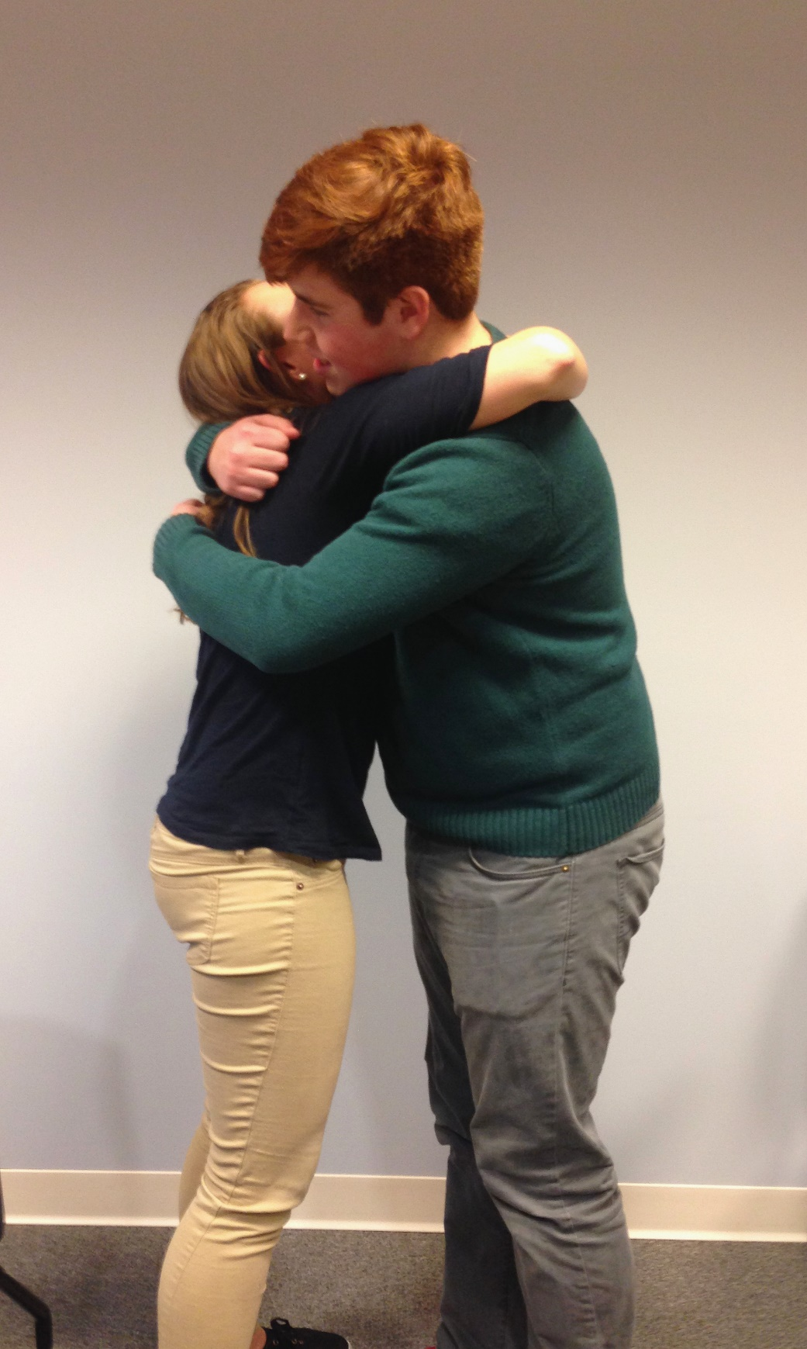
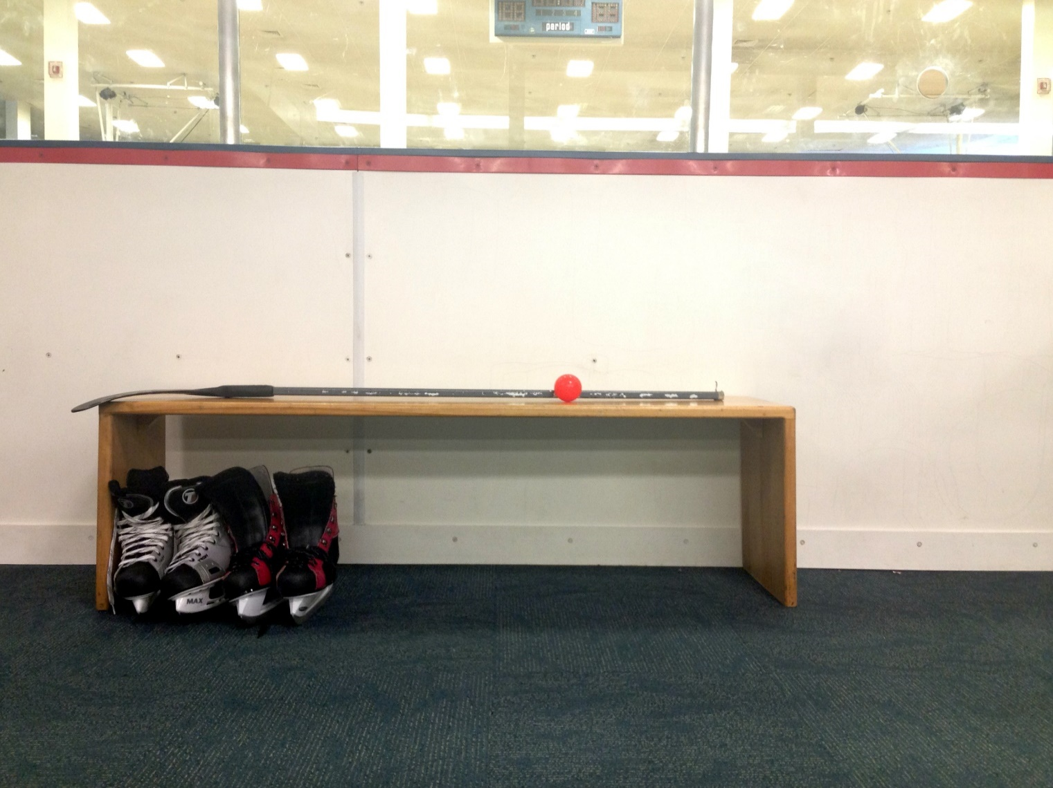
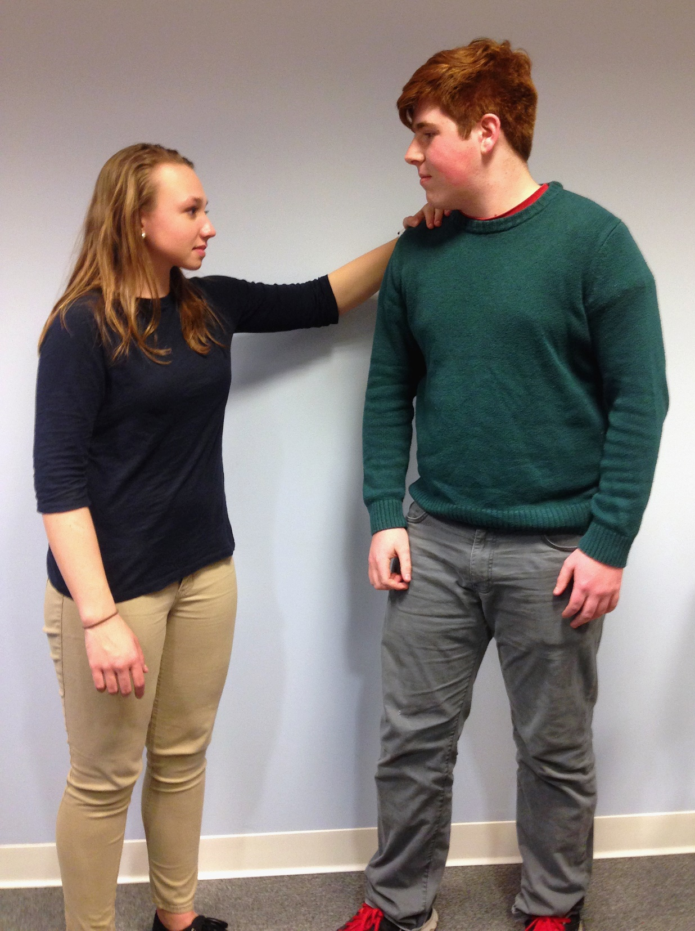
Through My Eyes: The Effect on Family Life of Having Siblings With
Autism Spectrum Disorder as Experienced by a Typically Developing Adolescent
Samantha Brand, OTS
University of New Hampshire
Bidirectional Relationship: Between siblings’ person factors, family’s performance context, and Ellen’s identity
Family’s Performance Context: An important mediator for siblings’ person factors to establish Ellen’s identity
Activities and Routines: Support relationships among individuals with ASD and their siblings
Activities and Relationships: Support shared interests among siblings and fosters positive personality characteristics
Results
Background
Autism Spectrum Disorder (ASD)
A neurodevelopmental disability characterized by difficulties in social-emotional reciprocity, nonverbal communication, and in forming and sustaining relationships
Sibling Relationships
Adolescents have reported positive and negative impacts of having a sibling with ASD (Petalas, Hastings, Nash, Reilly & Dowey, 2012)
Family Routines
Family life revolves around circumstances related to the individual(s) with ASD (DeGrace, 2004)
Individuals with ASD’s preference for routine can create stress within daily family life (Larson, 2006)
Shared routines support family time, bonding, and togetherness (Boyd, McCarty, & Sethi, 2014)
Identity in Adolescence
A stable sense of identity allows adolescents to adapt and respond to personal and social demands (Vroman, 2015)
Siblings’ Person Factors
Behaviors
“Sometimes [Ben will] shake his hands more, or he'll just get louder, start crying, [or] he'll start doing his little hobble.”
“Mostly with Kevin he's a lot louder, he'll say things that aren't always necessary.”
Interests
“We can go to hockey games, we can go bowling, and we can go swimming in the summer.”
“We kind of share a lot of [interests], like we all share ice skating… Other activities are kind of
hard to do.”
Diagnoses
“Ben is nonverbal, and he does struggle with communication.”
“Kevin's got autism, a little bit of ADHD, anxiety, and stuff like that.”
Personality
“[Kevin] has the guts to go do and say whatever he wants. He doesn't hold back, which is something I'm jealous of.”
“[Ben] understands how other people feel, like whenever I’m sad [he] notices , and he’ll come and hug me.”
Family’s Performance Context
Routines
“When my mom comes home it’s chaos for dinner, especially since Kevin is so picky and Ben’s on a diet, there’s three different meals going.”
Relationships
“I do relate to Kevin a bit more… and then with Ben the relationship is more silly and laid back… Both of the relationships I have are good, just the way they are expressed is definitely different.”
Activities
“ [At] hockey games, Kevin and I play, [and] my dad coaches. Ben will stand on the bench and then Dad will [say] "Hey Ben throw the puck." And then Ben will just throw it.”
Research Aims
Purpose:
To understand how a typically developing (TD) adolescent with siblings with ASD experiences the effects of their siblings on family routines and activities
Research Questions:
How does a TD adolescent describe the effects of the actions and behaviors of her siblings with ASD on family routines and activities?
What does it mean to a TD adolescent to have siblings with ASD in the context of family life?
Ellen’s Identity
Advocacy
“I had this argument… and then I brought it back to the point where Kevin was able to come back and jump in… and he [says] ‘I have the right to go into the next class and I have the right to go see the guidance counselor.’ ”
Insight
“ I can tell how he feels, but he has a hard time identifying them… So I have to explain to him that he's nervous and sometimes when people get nervous they bite their fingers or they shake a lot.”
Support
“They just assumed because he was a nonverbal kid that he wouldn't want to do it, and I'm like ‘No, the kid knows how to paint. He can handle tools. You teach him anything, and he can do it.’ ”
Understanding
“For the siblings it means to have pride in people around you and you just accept more people. You tend to understand more people, and you just have more pride within
your family.”
Methodology
Phenomenological approach
3 semi-structured interviews
Participatory observation of a family activity
Participant
Ellen:
Age 16
Has 2 brothers with ASD, both age 16
Lives with brothers and mother, parents divorced
Implications for Occupational Therapy
Utilize a family-centered approach
Attend to the needs of siblings
Address the activities, routines, and relationships within a family to support the needs of all
Acknowledgements
Hamel Center for Undergraduate Research, UNH
Lou Ann Griswold, PhD, OTR/L, FAOTA (mentor)
Susan Merrill, PhD, OTR/L, FAOTA (mentor)

