Slide 1


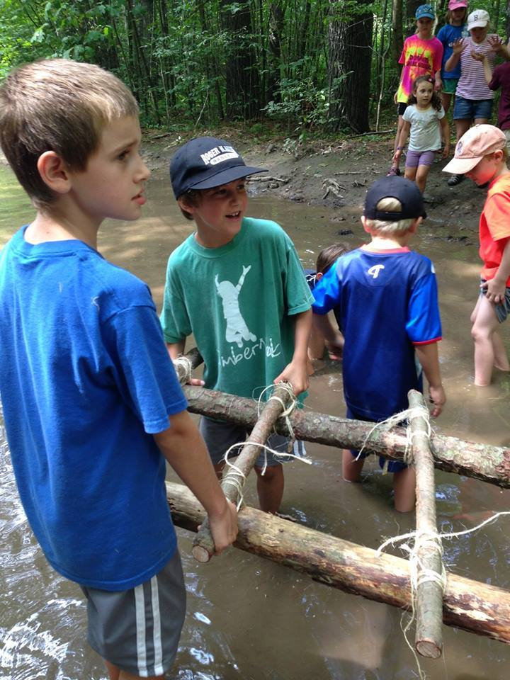
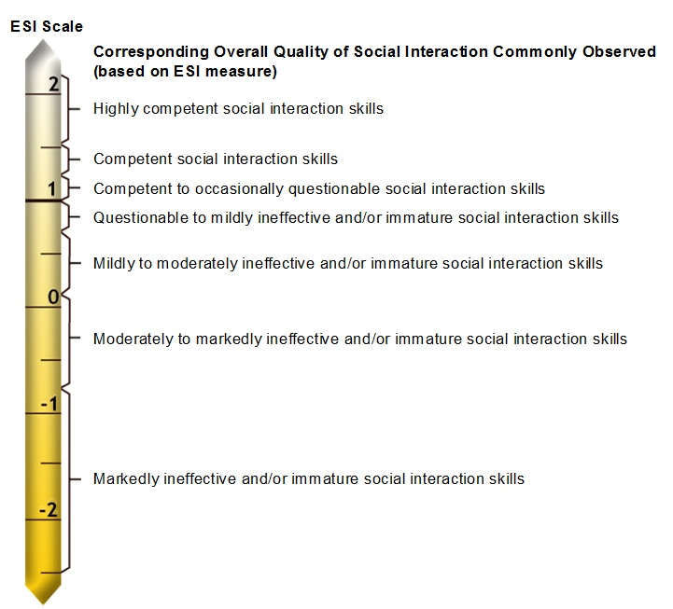
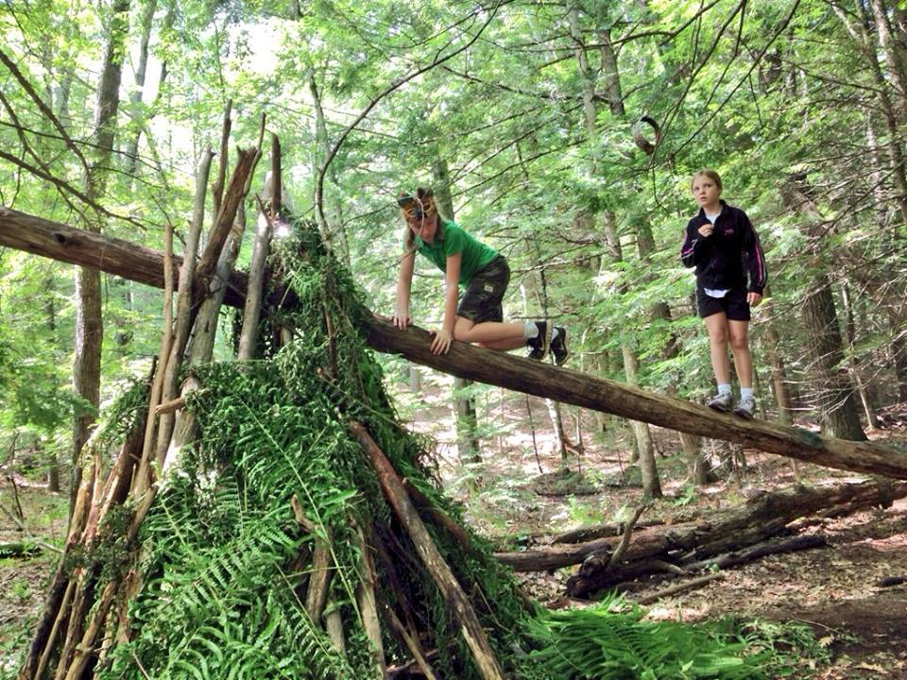
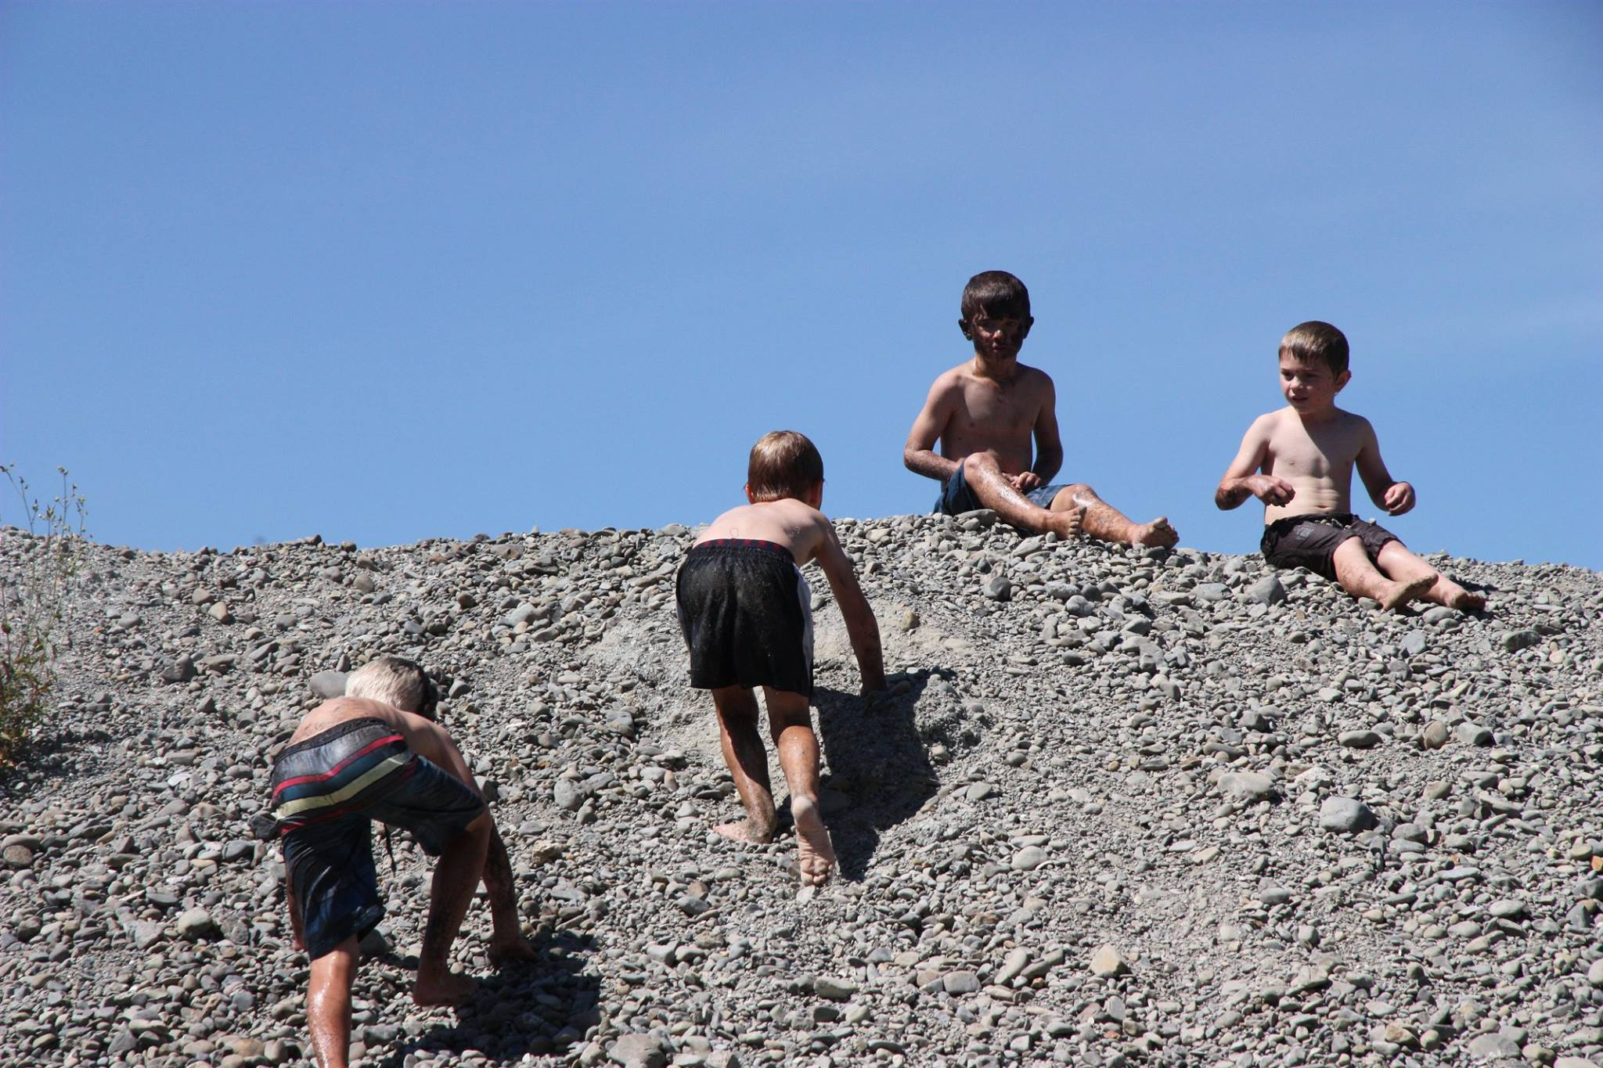
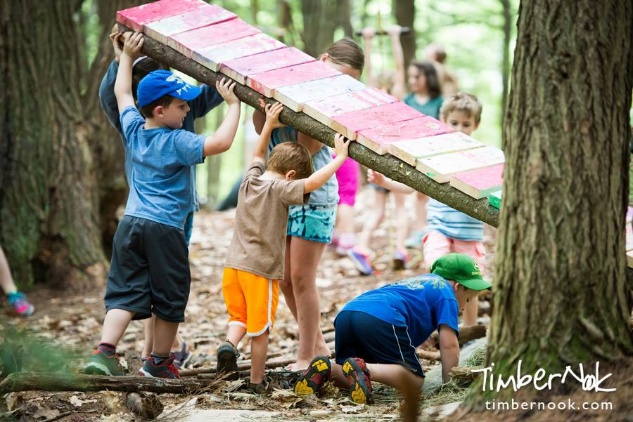

Effectiveness of an Outdoor One-Week Camp Experience
in Promoting Children's Quality of Social Interaction
Alexandra Roscoe, OTS & Lou Ann Griswold, PhD, OTR, FAOTA
University of New Hampshire
Background
Play promotes skills in all areas of development (Ginsburg, 2007)
Unstructured, free-play facilitates the development of social skills (Ramstetter, Murray, & Garner, 2010)
Playfulness increases with intrinsic motivation, internal control, freedom to suspend reality, and framing (Bundy 1997)
Adults often interfere rather than support children’s social development (Belknap & Halzer, 2014)
Children’s free-play and playfulness are decreasing, limiting opportunities for natural development of social skills (Burdette & Whitaker, 2005)
Results
No change in the quality of social interaction for any of the children after Camp
Age | Gender | Time 1 | Time 2 | Time 3
8 | Female | 0.7 | 0.7 | 0.7
8 | Male | 0.7 | 0.7 | 0.7
7 | Male | 0.6 | 0.7 | 0.7
7 | Female | 0 | 0.7 | 0.6
7 | Male | 0.5 | 0.5 | 0.6
7 | Female | 0.5 | 0.6 | 0.6
6 | Female | 0.5 | 0.5 | 0.5
6 | Female | 0.4 | 0.4 | 0.5
6 | Female | 0.2 | 0.3 | 0.4
6 | Male | 0.5 | 0.5 | 0.5
5 | Female | 0.1 | 0.3 | 0.2
5 | Male | -0.5 | 0.1 | 0.2
5 | Female | 0.3 | 0.3 | 0.3
ESI Scale
ESI Scale
Corresponding Overall Quality of Social Interaction Commonly Observed
(based on ESI measure)
Age
Range
Highly competent social interaction skills
Competent social interaction skills
Mildly to moderately ineffective and/or immature social interaction skills
Moderately to markedly ineffective and/or immature social interaction skills
Competent to occasionally questionable social interaction skills
7 - 8
{
Questionable to mildly ineffective and/or immature social interaction skills
5 - 6
{
Research Questions
Does a one-week camp experience, in a nature-based setting, improve the quality of social interaction for children?
What strategies do the camp staff use to promote social interaction among the campers while allowing children control over their play activities?
Moderately to markedly ineffective and/or immature social interaction skills
Markedly ineffective and/or immature social interaction skills
Methodology
Quasi-experimental time-series design
Evaluation of social interaction done twice prior to camp (Times 1 & 2) and once after camp (Time 3)
Documentation of camp staff strategies to promote playfulness and child-initiated interaction
Analysis of Observations
Set up an inviting environment:
Arrange for seating options
Provide open space for play
Visibly place objects to entice children
Limit adult direction:
Explain activity and then step back
Allow children to leave activities
Give only one call to transition
Encourage child interaction:
Allow children to work through conflict
Allow children to create own “rules”
Ask children to problem solve
The Camp
Focuses on how the natural environment enriches and supports children’s development
Encourages complex social interactions, reasonable risk-taking, problem solving, independent thought, creativity, and sensori-motor development
Participants (N = 14)
Age range from 5 – 8 years
Boys: 5 Girls: 8
Assessment Measure
Evaluation of Social Interaction (ESI)
Standardized, criterion-referenced assessment (Fisher & Griswold, 2015)
Occupation-based, as the child engages in natural social exchanges
Sensitive measure (Simmons & Griswold, 2008)
Implications for Future Research
Examine the relationship between the environment and social interaction
Using: Evaluation of Social Interaction (ESI) and
Test of Environmental Supportiveness (TOES)

