Slide 1


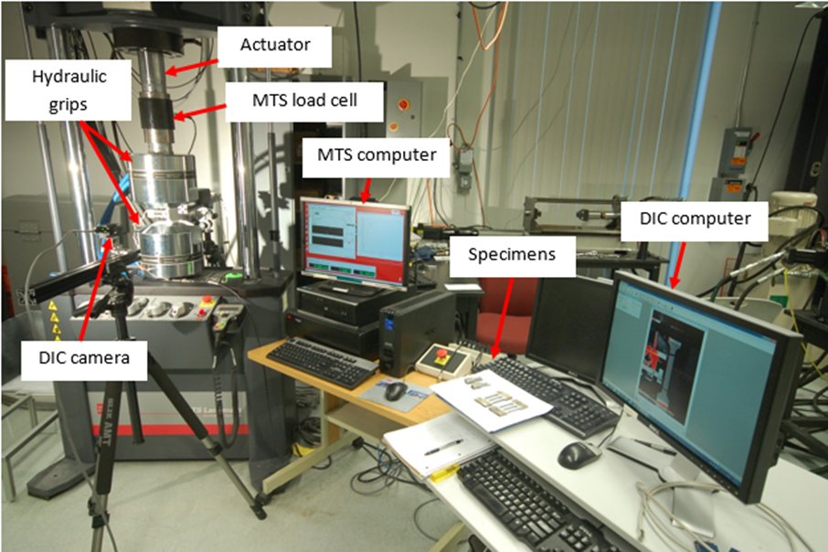
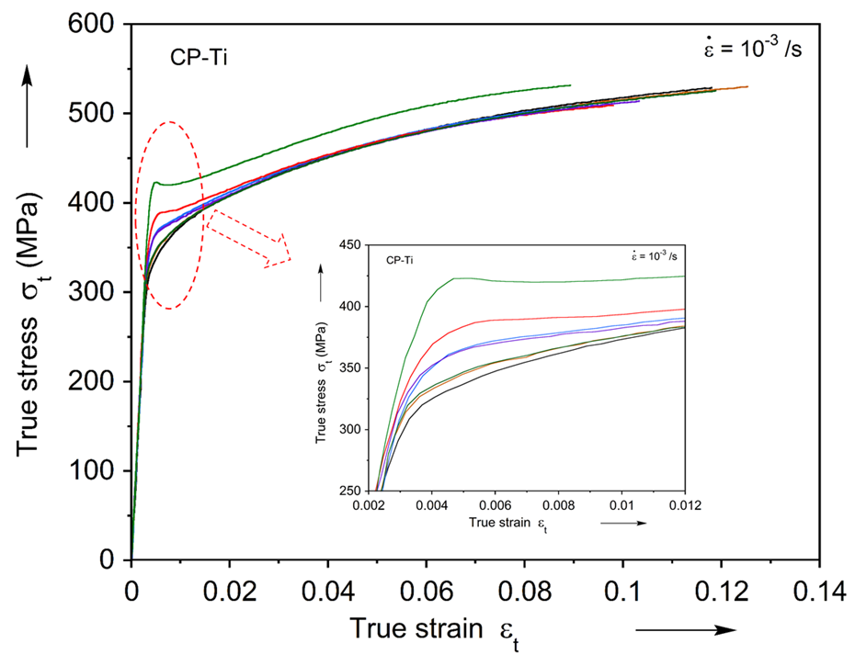
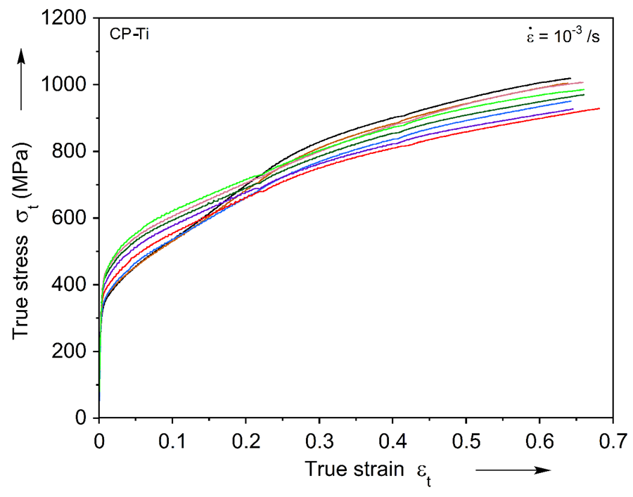
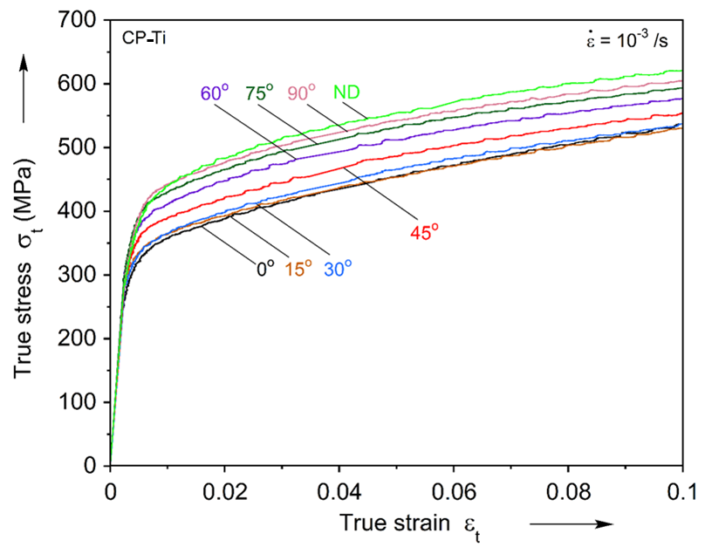
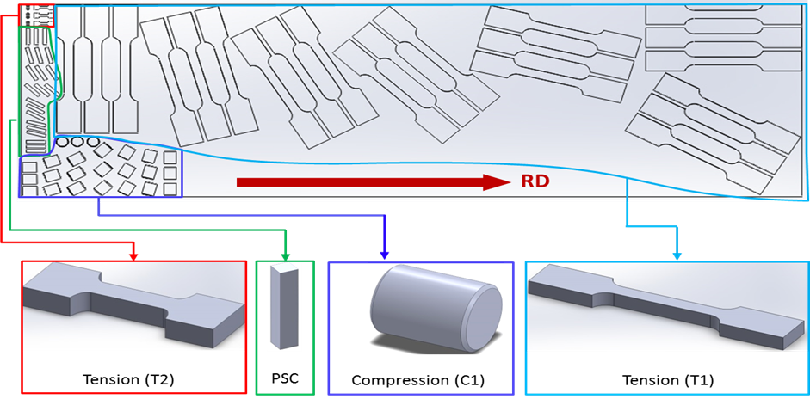
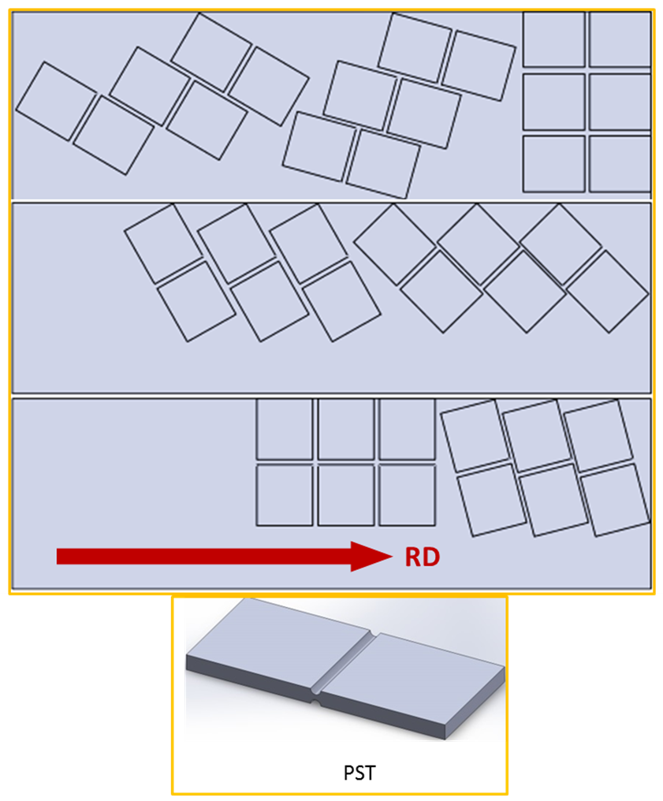
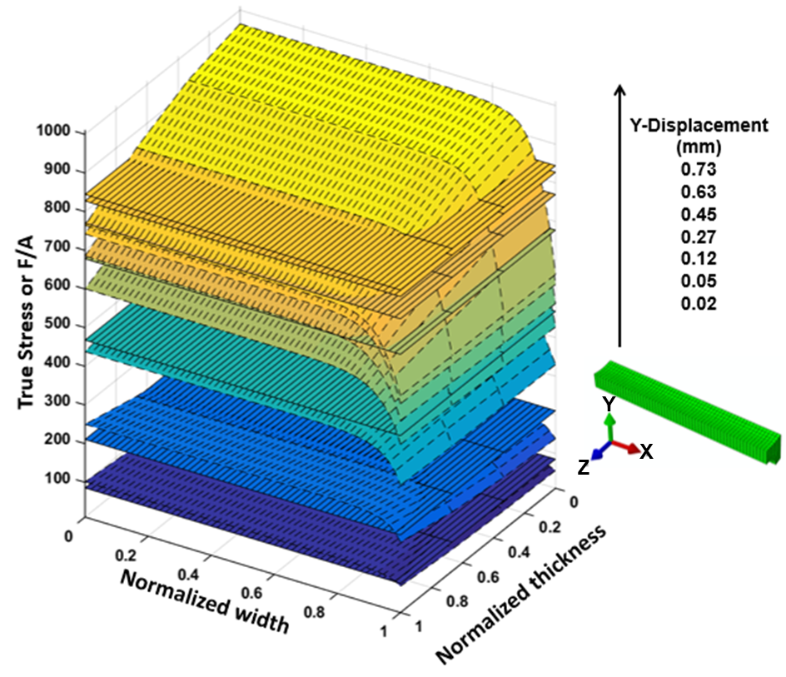
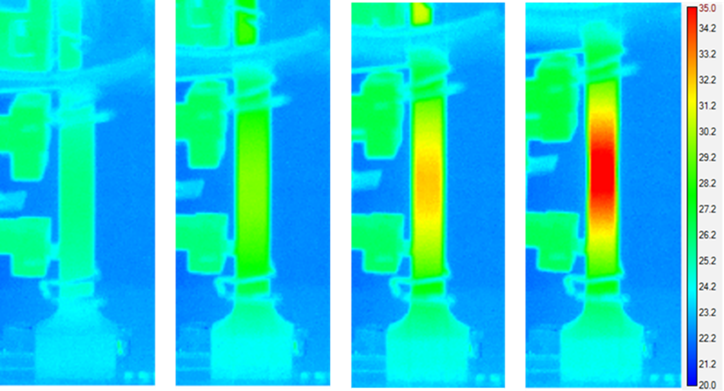
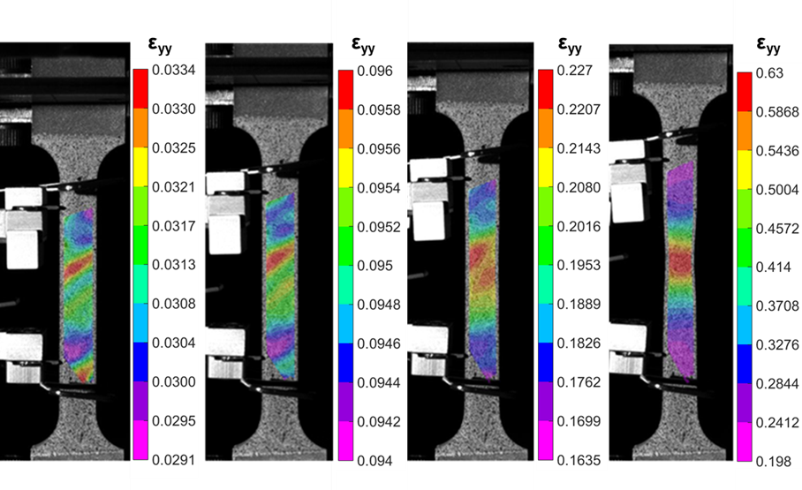
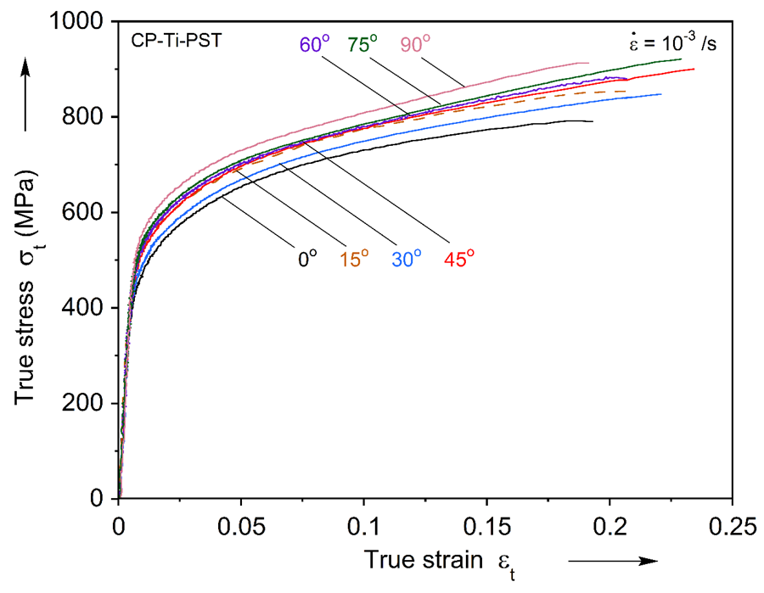
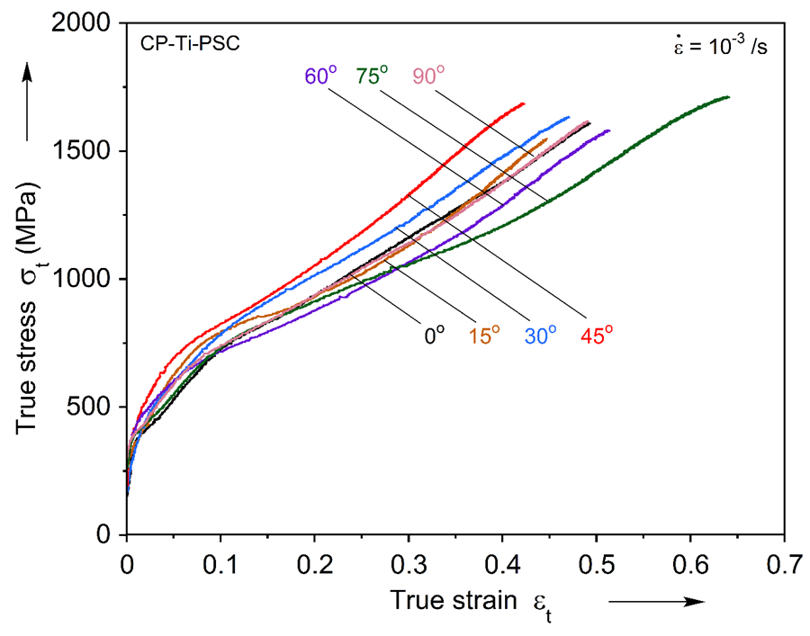
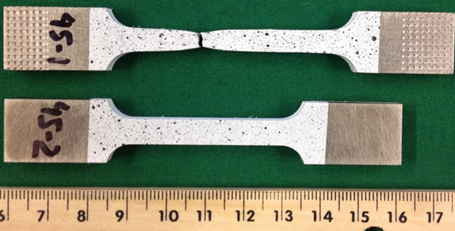
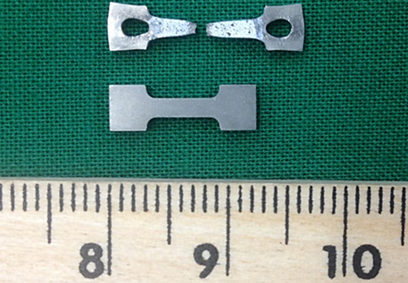
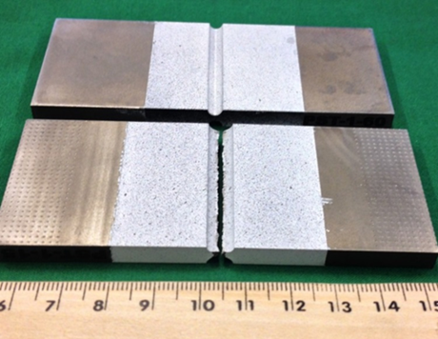
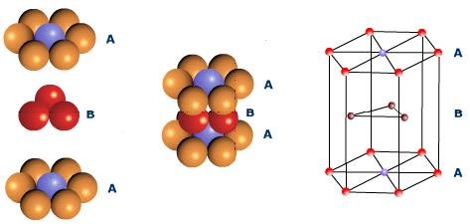
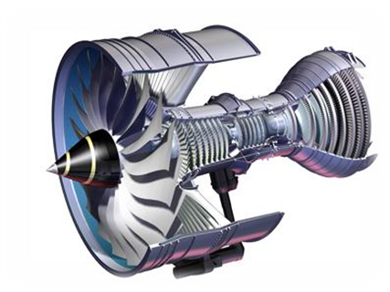
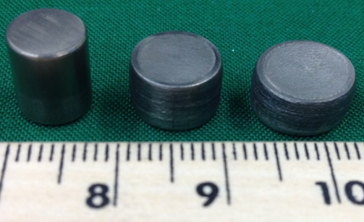
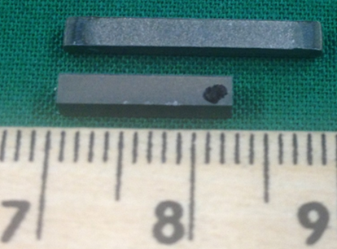
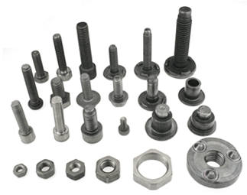
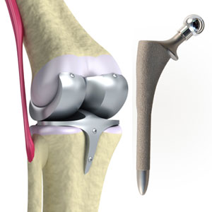

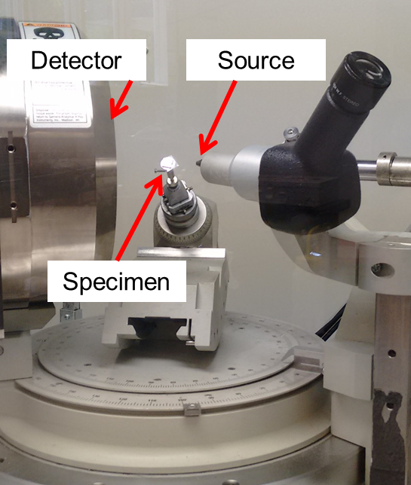
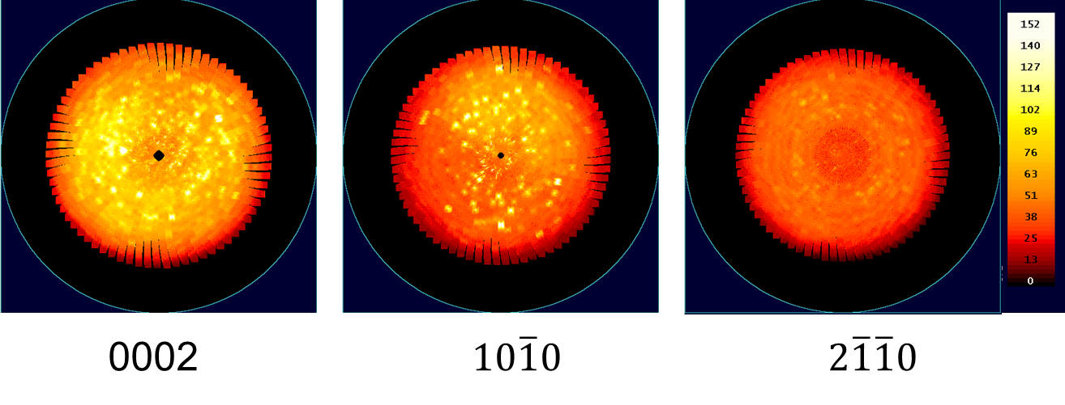
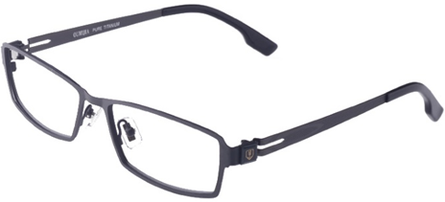
Plastic Anisotropy of CP-Titanium
Madhav Baral (Advisor: Yannis P. Korkolis)
Research Objective:
To probe the plastic anisotropy of Commercially Pure Titanium (CP-Ti) with an extensive set of experiments, performed on a hot-rolled CP-Ti plate of 12.7 mm thickness.
To calibrate commonly used constitutive models (yield functions) that can lead to improved numerical simulations of material response during manufacturing or service for CP-Ti.
Experimental Investigation:
Results:
True stress-strain responses in Uniaxial: (1) Tension and (2) Compression
Layout of CP-Ti specimens on a rolled plate with respect to the rolling direction (RD)
Motivation and Background:
Titanium and its alloys have higher strength to weight ratio, excellent corrosion resistance, and superior temperature resistance than conventional metal alloys. The excellent physical-mechanical properties of Titanium and its alloys have been widely exploited in aerospace, nuclear, automobile, medical, sports, and fashion industries.
CP-Ti crystallizes in the HCP packing so the plastic deformation of this material is accommodated by a combination of slip and twinning, which gives rise to a complex mechanical response. This complex behavior dictates the use of an extensive experimental characterization. Also, during manufacturing processes like rolling, crystallographic texture patterns are created and this induces a preferred grain orientation causing dissimilar stress-strain responses in different orientations (Anisotropy).
Tension experiments using MTS and DIC (Digital Image Correlation) system
Correction of stresses in plane-strain tension experiments using FEA
Infra-red thermal Images and DIC Images and of a specimen during test
True stress-strain responses in Plane-Strain: (1) Tension and (2) Compression
Uniaxial Tension (T1)
Uniaxial Tension (T2)
Plane-Strain Tension (PST)
HCP crystal structure
Uniaxial Compression (C1)
Plane-Strain Compression (PSC)
Yield Surfaces predicted from (1) von-Mises, (2) Hill 1948, and (3) CPB-06 criteria
Conclusions:
The anisotropy and asymmetry of CP-Ti in tension and compression is established by performing uniaxial, through-thickness, and plane strain tension and compression tests at various orientations with respect to rolling direction of a plate. A novel method for determining the stresses in a plane-strain tension experiment was devised using finite element analysis. Finally, three commonly used yield functions are calibrated from the experimental results.
Titanium parts and components
XRD Set-up
Pole Figures of CP-Ti specimen generated using X-Ray Diffraction (XRD) Technique
University of New Hampshire, Department of Mechanical Engineering
Presented at the Annual Graduate Research Conference (GRC); April 11, 2016

