Slide 1


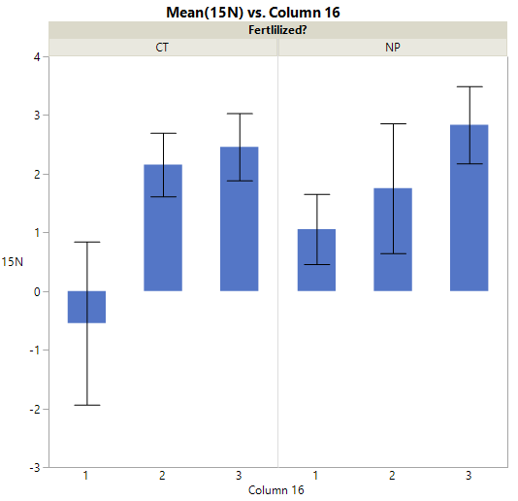
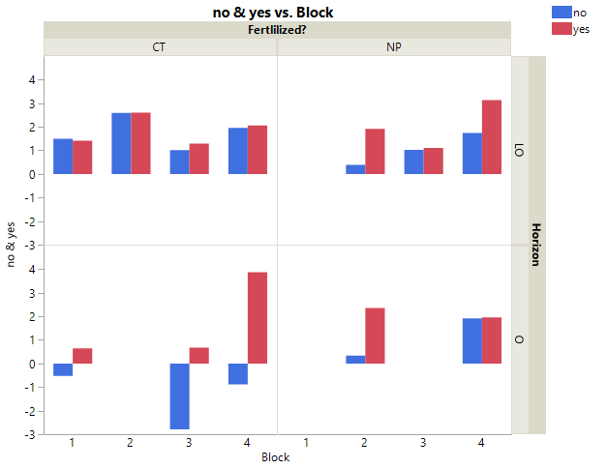
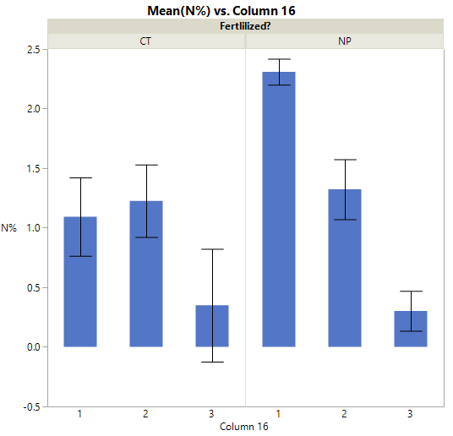
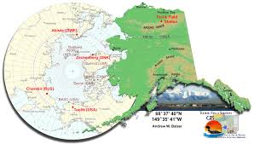
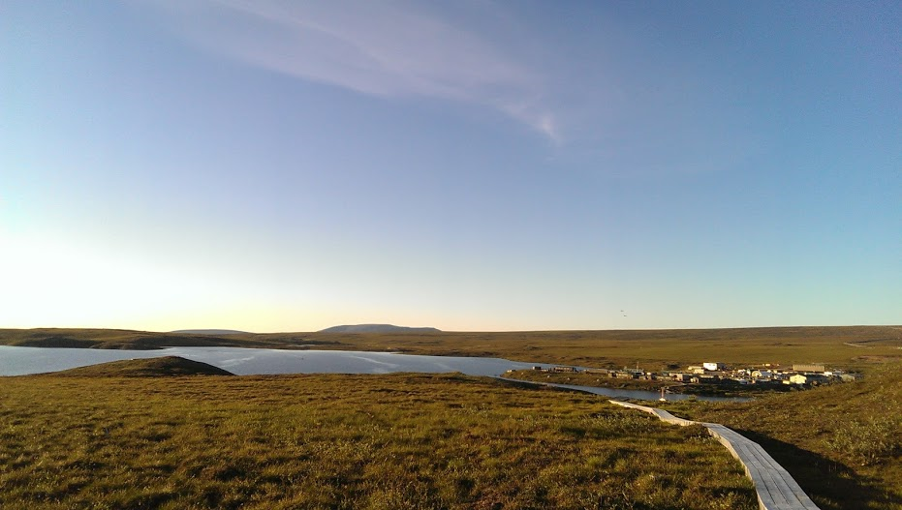
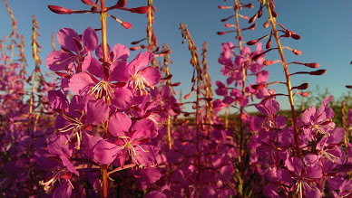
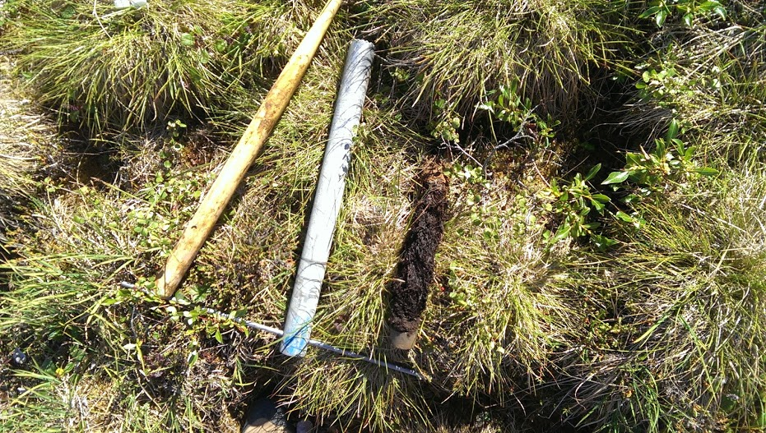
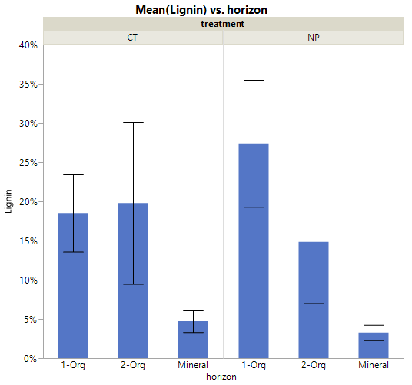
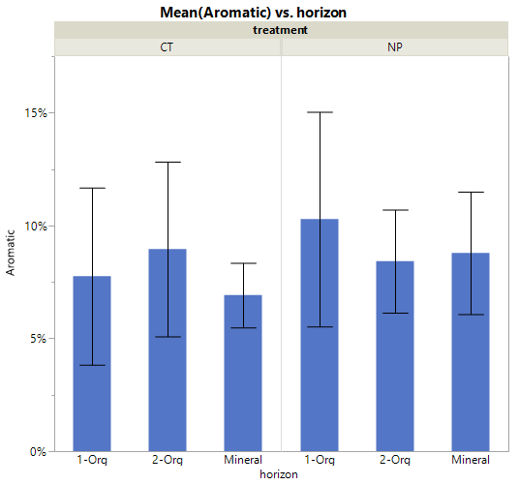
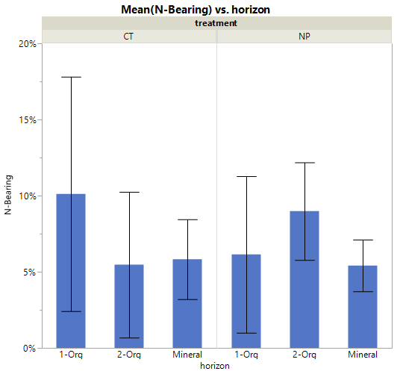
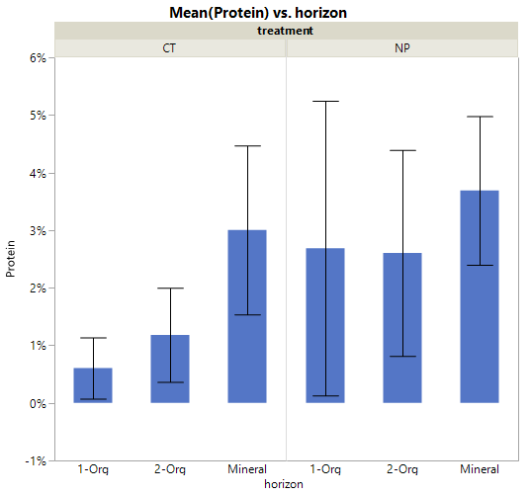
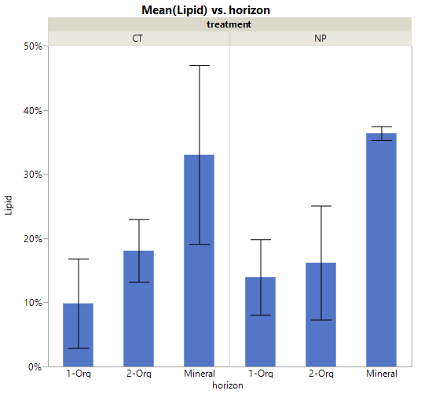
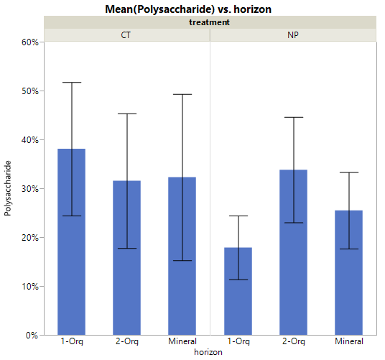
Stable Isotopes, N₂ Fixation, and Carbon Composition After 30 Years Fertilization at Toolik LTER
Nathan R. Thorp and Erik A. Hobbie
Earth Systems Research Center, University of New Hampshire, Durham NH
Introduction
This fertilization experiment was designed to elucidate future biogeochemical feedbacks of global climate change. Expected higher mineralization rates and nutrient availability were hypothesized to mimic changes caused by a warming Arctic.
After thirty five years of fertilization at the Toolik LTER in Arctic Alaska, nitrogen dynamics and shifts in soil carbon composition were assessed.
Stable isotopes illustrate changes in fractionation with changing nutrient pools. This indicates changes in soil microbiota, potentially specific to mycorrhizal fungi and nitrogen-fixing heterotrophs. We examined nitrogen fixation using ¹⁵N₂ incubations.
Control
Fertilized
Control
Fertilized
¹⁵N ‰
Mixed Horizon
¹⁵N (‰)
Organic Horizon
%N
Figure 1. Toolik Alaska LTER Research Station
¹⁵N Enriched
Natural Abundance
Block
%C
Figure 4. N₂ fixation Assay
Methods
Moist acidic tussock tundra has been fertilized with 10 g N m⁻² and 5 g P m⁻² since 1980. The experimental design consists of four blocks of each treatment (control and fertilized (nitrogen and phosphorus)).
Soil cores were dried, ground, and analyzed for % nitrogen, % carbon, ¹³C, ¹⁵N, using a ThermoFisher Delta Plus mass spectrometer coupled with Costech elemental analyzer
Nitrogen fixation was assessed by incubating soil cores with ¹⁵N₂ gas for 24 hours in ambient light conditions. ¹⁵N natural abundance was assessed to calculate fixation rates.
Pyrolysis GC-MS was used to characterize soil carbon composition.
Conclusions
Long term fertilization increased pools of available nitrogen in the organic horizon as indicated by stable isotope fractionation. Fertilization did not change nutrient availability in the mineral and transition layer (mixed horizon).
Moderate increase in organic δ¹⁵N with fertilization (~1.5‰) suggests that ¹⁵N-depleted loss pathways are small.
Higher %C in the fertilized organic layer may indicate lower mineralization rates.
Increased protein and lignin compounds in the organic horizon of fertilized plots suggests lignin decomposition was inhibited by high N levels here.
30 years of fertilization decreased heterotrophic N fixation in the fertilized plots.
Organic
Mixed
Mineral
Organic
Mixed
Mineral
Figure 3. Isotopic and elemental analysis. Values are mean (±sd)
Lignin Aromatic N-Bearing Protein Lipid Polysaccharide
Acknowledgments
We would like to thank the NSF for funding this grant and the 2015 pluck team as well as all Toolik station support staff.
Control
Fertilized
Control
Fertilized
Control
Fertilized
Control
Fertilized
Control
Fertilized
Control
Fertilized
Organic
Mixed
Mineral
Organic
Mixed
Mineral
Organic
Mixed
Mineral
Organic
Mixed
Mineral
Organic
Mixed
Mineral
Organic
Mixed
Mineral
Organic
Mixed
Mineral
Organic
Mixed
Mineral
Organic
Mixed
Mineral
Organic
Mixed
Mineral
Organic
Mixed
Mineral
Organic
Mixed
Mineral
Organic
Mixed
Mineral
Organic
Mixed
Mineral
Figure 2. Pyrolosis GC-MS Carbon composition of soil cores

Slide 2
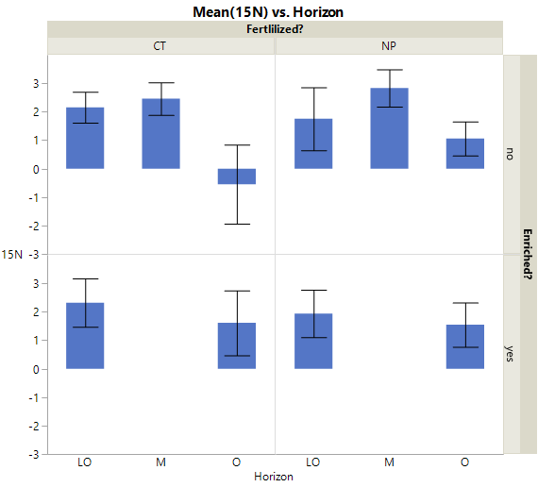
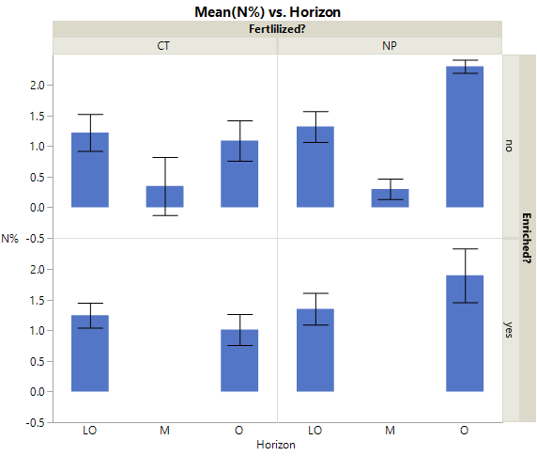
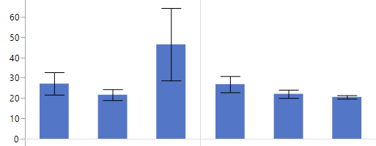
Control
Fertilized
Control
Fertilized
¹⁵N (‰)
¹⁵N (‰)
%N
%N
C/N
%C
Lower Organic
Mineral
Organic
Lower Organic
Mineral
Organic
Organic
Mixed
Mineral
Organic
Mixed
Mineral

Slide 3
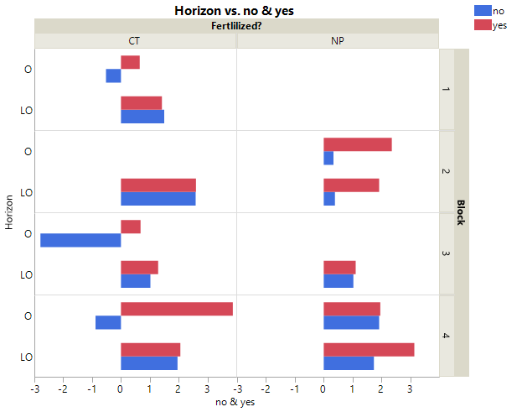
Stable Isotopes Indicate Changing Nitrogen Dynamics After 30 Years Fertilization at Toolik LTER
Control
Fertilized
¹⁵N (‰)
Lower Organic
Mineral
Organic
Lower Organic
Mineral
Organic
%N
Lower Organic
Mineral
Organic
Lower Organic
Mineral
Organic
C/N
Lower Organic
Mineral
Organic
Lower Organic
Mineral
Organic

