Slide 1

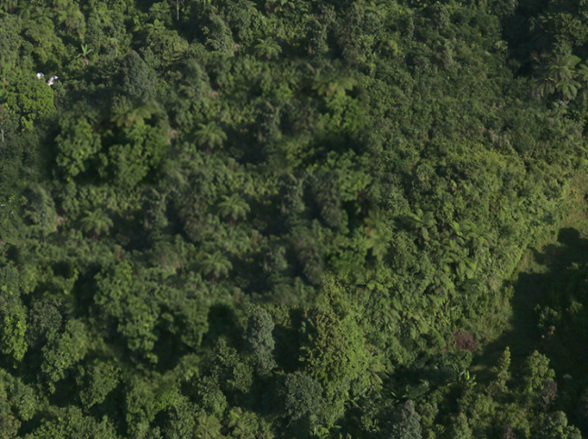
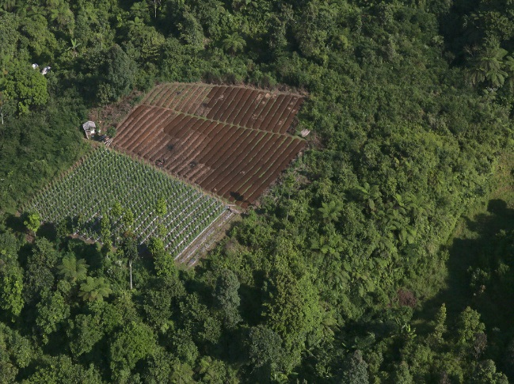
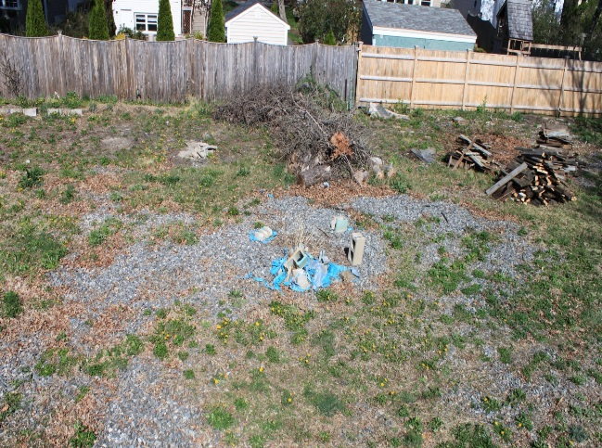
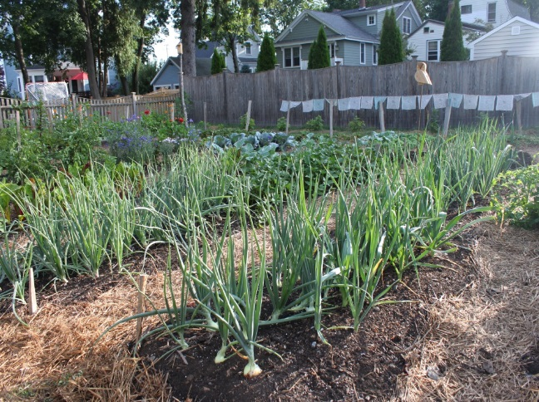
Can urban agriculture cultivate ecosystem services and land sparing?
J. A. Wilhelm*, R. G. Smith; University of New Hampshire, Durham, NH
Department of Natural Resources and the Environment *Contact: jwilhelm@unh.edu
Introduction
Agricultural expansion contributes to the degradation of biodiverse ecosystems and the services these systems provide. Expansion of urban and peri-urban agriculture (UPA), on the other hand, may hold promise to both expand the portfolio of ecosystem services available in built environments, where ecosystem services are typically low, and reduce pressure to convert sensitive non-urban, non-agricultural ecosystems to agriculture. However, few data are available to support these hypotheses.
Objectives
The purpose of this review was to analyze current UPA literature to address four main questions. 1) What is the availability of data regarding UPA, particularly in the context of ES? 2) Based on available data, what specific ES are affected by UPA, and are these higher compared to ES provided by other types of “habitat” found in urban areas? 3) Are there potential ecosystem disservices associated with UPA? 4) What is the evidence that UPA can contribute to land sparing?
Methods
Here we review and summarize the research conducted on urban agriculture from 320 peer-reviewed papers published between 2000 and 2014. Specifically, we explored the availability of data regarding urban agriculture’s impact on ecosystem services and disservices. We also assessed the literature for evidence that urban agriculture can contribute to land sparing.
C
B
Figure 3. Conceptual model of the potential for different urban environments and land uses to provide seven ecosystem services. Differences in ecosystem services shown in each radar plot are hypothetical and not based on standardized values, but were informed by current literature. Each axis of the plot represents a different ecosystem service; the outermost point on the axes represents the highest level of service, with service provisioning decreasing towards the center. The symmetry of each plot indicates the estimated relative balance of all the services; therefore, the larger and more symmetrical, the higher the overall potential ES benefits.
Weak
Food Provisioning Services
A
Strengthened
Food Provisioning Services
Strong Regulating & Supporting Ecosystem Services
Weakened Regulating & Supporting Ecosystem Services
Baseline Rural Landscape
Agricultural Extensification of Rural Landscape
Weak
Food Provisioning Services
C
D
Strengthened
Food Provisioning Services
Weak Regulating & Supporting Ecosystem Services
Strengthened Regulating & Supporting Ecosystem Services?
Baseline Urban Landscape
Agricultural Extensification of Urban Landscape
Photo credits: Image B by Kate Evans/CIFOR, image A altered version of B by authors. Images C and D by Jennifer Wilhelm.
Figure 2. Hypothetical examples of agricultural extensification into rural (A and B) and urban (C and D) landscapes. Images A and C represent the baseline landscape pre- agricultural conversion and images B and D represent the same landscapes post-conversion. The rural baseline landscape is assumed to have weak food provisioning services but strong regulating and supporting services, while conversion to crop production strengthens food provisioning but weakens regulating and supporting services. The urban baseline landscape is assumed to have both weak provisioning and regulating and supporting services, while all services are assumed to increase with conversion to crop production. Though crop production is highest in rural landscapes, potential tradeoffs with ecosystem services are higher. On the other hand, expanding agricultural production into urban landscapes may be more likely to enhance ecosystem services.
50
UPA in developed countries
62% of articles were published between 2010-2014
UPA in developing countries
40
Articles focused on ecosystem services
30
Number of articles
20
Table 1. Calculations used to derive a rough estimate of urban agriculture’s potential role in land sparing.
CONCLUSIONS
We find that the growth in urban agriculture research between 2000-2014 points to the emerging recognition of the potential role that urban agriculture systems play in food production worldwide (Figure 1).
However, few studies (n = 15) place urban agriculture in the context of ecosystem services, and no studies in our review explicitly quantify the land sparing potential of urban agriculture.
Additionally, few studies (n = 19) quantify production potential of urban agriculture, data that are necessary to accurately quantify the role these systems can play in land sparing. However, based on available data we calculated rough estimates, which suggest that agricultural extensification into the world’s urban environments via UPA could spare an area approximately twice the size of Massachusetts (Table 1).
Expanding future urban agriculture research to include ecosystem functions would shed light on the ecological tradeoffs associated with agricultural production in the built environment (Figures 2 & 3).
10
Figure | Description | Source
64.30 Mha | Total global urban space | Martellozzo et al., 2014
0.75 lb/ft² | Average crop production in biointensive agriculture | Algert et al., 2014
0.60 lb/ft² | Average crop production in conventional agriculture | Algert et al., 2014
21.43 Mha | One third of global urban space under biointensive urban agriculture | Authors' calculations
26.79 Mha | Land area needed to meet the same productivity as one third urban agriculture under conventional agriculture | Authors' calculations
5.36 Mha | Area of land spared | Authors' calculations
0
2000
2001
2002
2003
2004
2005
2006
2007
2008
2009
2010
2011
2012
2013
2014
Year
Figure 1. Number of peer-reviewed articles reporting research conducted on urban and peri-urban agriculture (UPA) published each year by region where the study was conducted. Regions were defined as “developed” and included countries in North America, Europe, Japan, Australia, and New Zealand; and “developing” and included countries in Africa, Latin America, Asia, and the Middle East.
Acknowledgements
Nicholas Warren and Charles French provided helpful comments on the manuscript associated with this work. Partial funding was provided by the USDA Sustainable Agriculture Research and Education Program and the NH Agricultural Experiment Station. This is scientific contribution number 2606. This work was supported by the USDA National Institute of Food and Agriculture Hatch Project 0229253. Additional funding to present this work at the Urban Food Systems Symposium is supported by an Urban Food System Symposium student travel grant.
References
Algert, S. J., Baameur, A., and Renvall, M.J. 2014. Vegetable output and cost savings of community gardens in San Jose, California. Journal of the Academy of Nutrition and Dietetics 114(7):1072-1076.
Martellozzo, F., Landry, J.S., Plouffe, D., Seufert, V., Rowhani, P., and Ramankutty, N. 2014. Urban agriculture: a global analysis of the space constraint to meet urban vegetable demand. Environmental Research Letters 9(6):064025.

