Slide 1

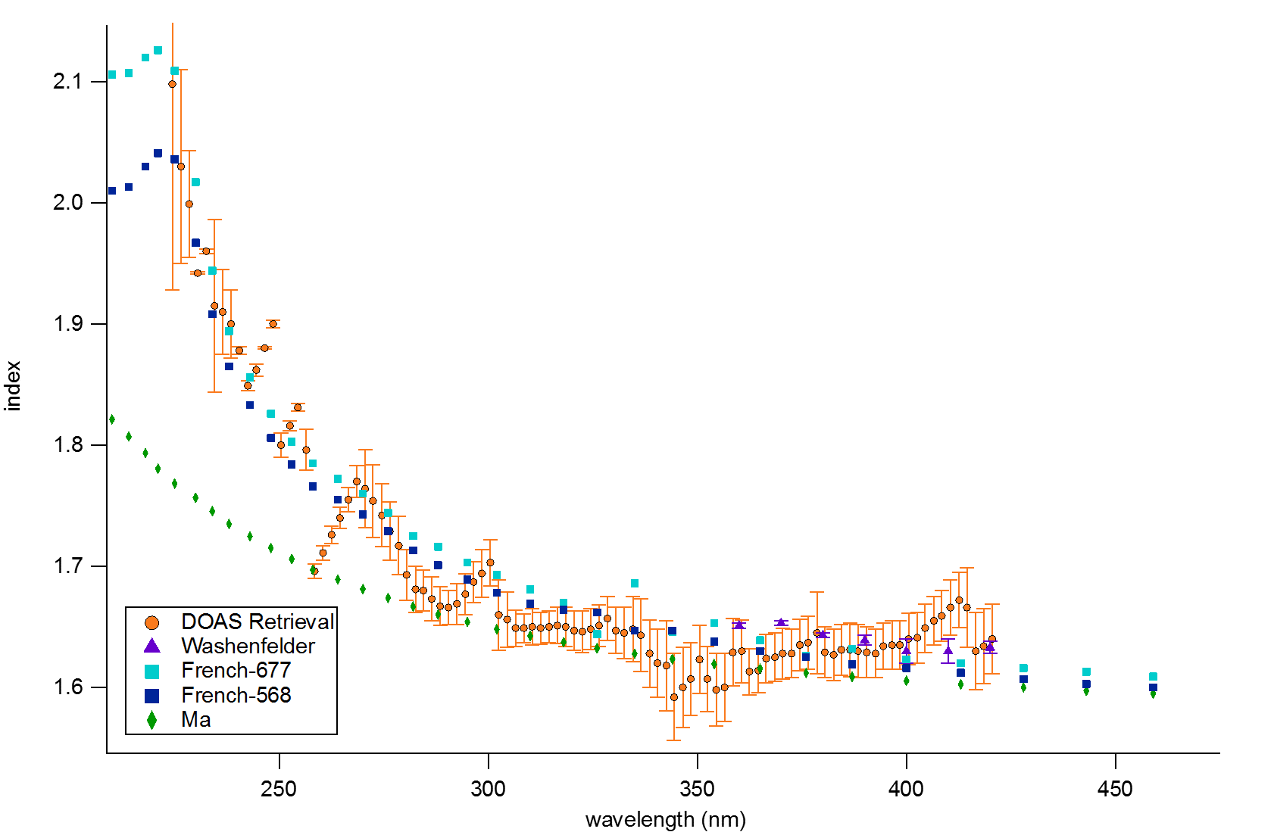
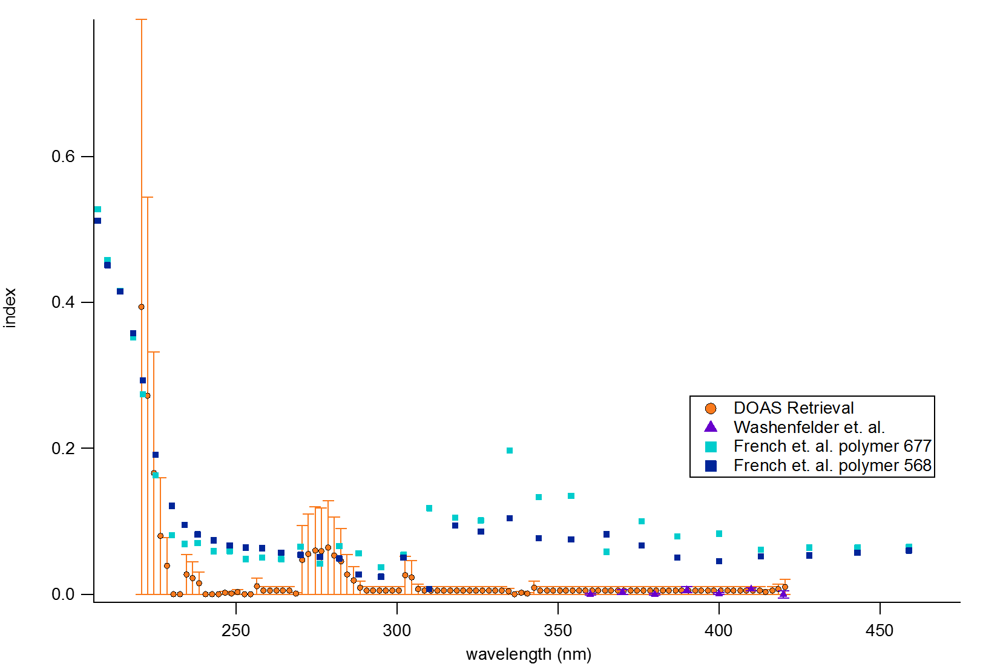
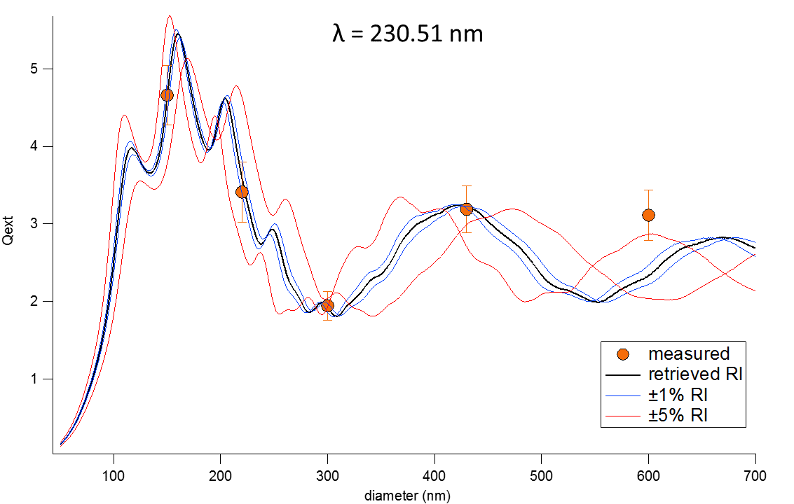
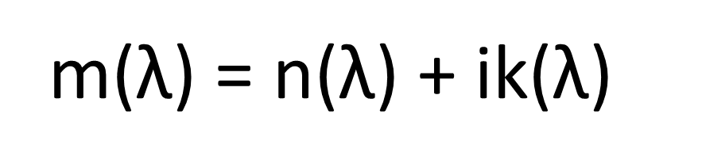
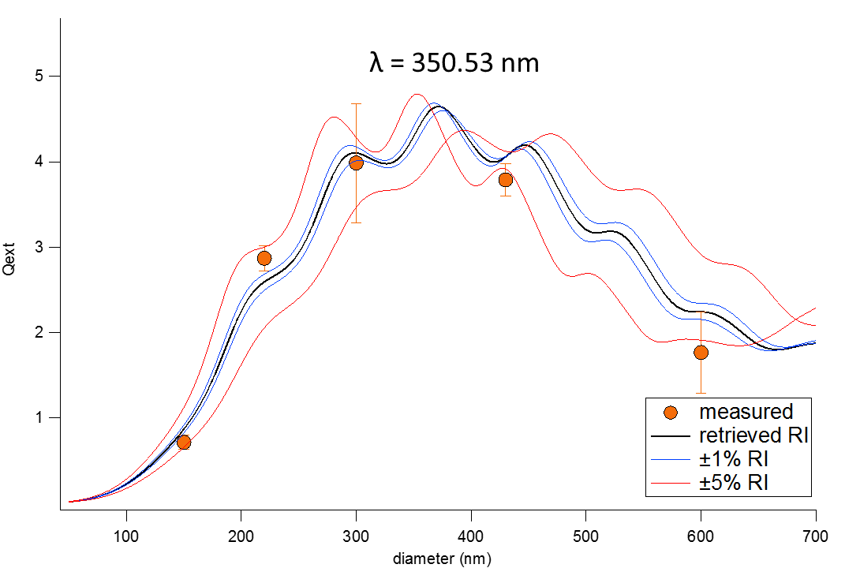
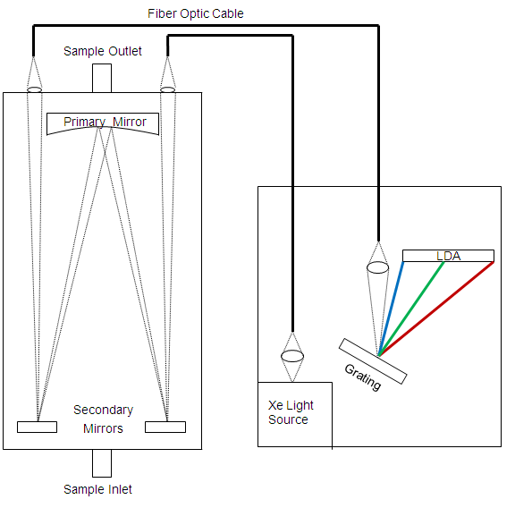
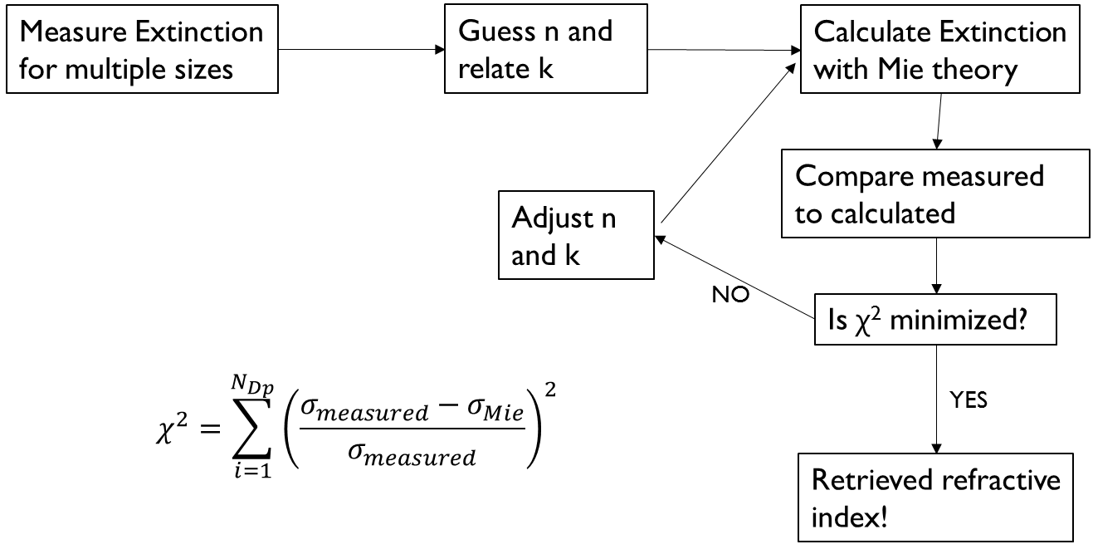
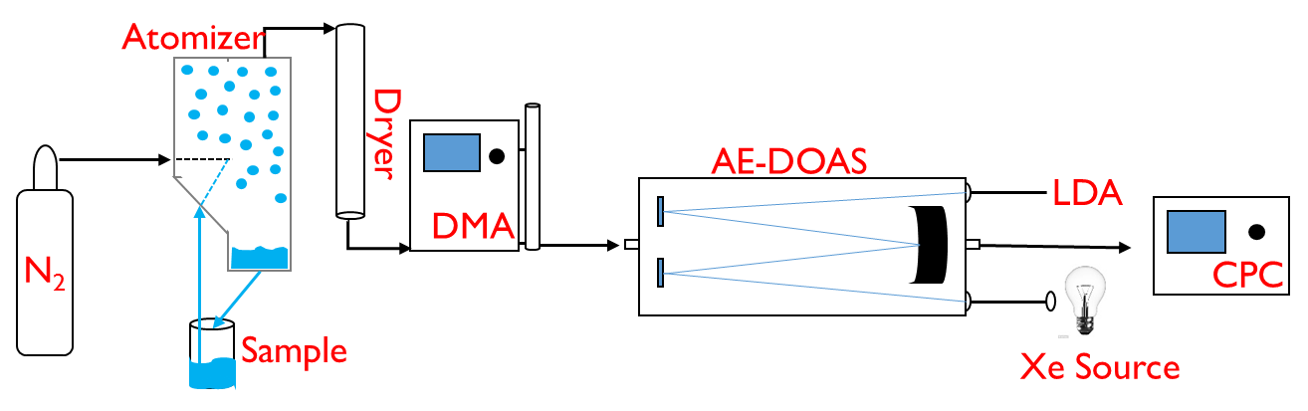
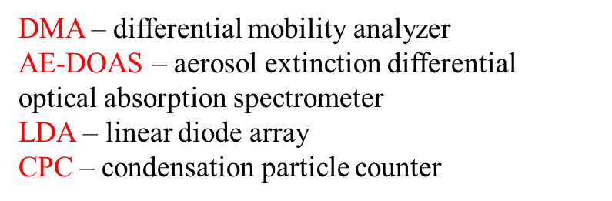
Complex Refractive Index Retrievals for Polystyrene Latex Spheres in the spectral range 220-420 nm
Tyler Galpin, Ryan T. Chartier, Nicholas Levergood, and Margaret E. Greenslade
University of New Hampshire, Chemistry Department
Introduction:
Retrieval Results:
Discussion:
(1)
(3)
(4)
Aerosols are solid or liquid particles suspended in a gas created both biogenically and anthropogenically.
Aerosols interact with available light, altering the Sun to Earth energy balance.
The combination of all scattered (reflected, refracted, diffracted) and absorbed light is known as Extinction.
Real Portion, n
Imaginary Portion, k
Retrieved values show excellent agreement with previous literature indicating an ability for future retrievals of in situ aerosols.
The size of the particles used for a particular wavelength has a huge impact on the ability to retrieve accurate index values.
Q_{ext} curves are most sensitive to small changes in refractive index at small particle sizes; measured extinction values should fall in this region.
Reflected
Refracted
Absorbed
and
Reradiated
Diffracted
http://www.slideshare.net/HORIBA/advanced-laser-diffraction-theory
Extinction is dependent upon:
Composition
Size and shape
Wavelength of incident light
Excellent agreement between DOAS, Washenfelder et al., and French et al. values.
Ma et al. values differ since they are extrapolated from previous measured values using Cauchy coefficients.
Excellent agreement between DOAS and Washenfelder et al. retrieved values, the techniques used are similar.
Differences between the French et al. values may result from using thin films and not aerosols, or possibly from differences in polymer formulation.
Mie Theory:
Absorption and scattering of light by spherical particles can be calculated using Mie Theory. Important to the calculations and the work shown here is the complex refractive index, m,
Figures above and below show modeled extinction using the retrieved refractive indices for selected wavelengths compared to measured DOAS PSL extinction.
(2)
Instrument Design and Experimental Data:
where n is the refractive index and k is the absorption index, both wavelength dependent.
Specifications:
100 W continuous duty Xe lamp with a spectral range of 220-1050 nm
3072 element LDA detector with better than .5 nm resolution
Stainless steel gas cell with a 4 L internal volume
Adjustable path length of ~2-20 m
Fortran Program:
Input parameters
- wavelength of light (nm)
- complex refractive index
- particle diameter (nm)
Output coefficients
- scattered light (cm²/particle)
- absorbed light (cm²/particle)
- extinction (cm²/particle)
Methods:
The average calculated extinction (cm⁻¹) of 6 trials for 150 nm PSLs using a path length of 19.51 m.
References:
Bohren, C.F. and Huffman, D.R.: Absorption and scattering of light by small particles, Wiley
Professional Paperback Series, Wiley-Interscience, New York, USA, 1983.
Chartier, R. T., Greenslade, M. E., Initial investigation of the wavelength dependence of optical
properties measured with a new multi-pass Aerosol Extinction Differential Optical
Absorption Spectrometer (AE-DOAS). Atmos. Meas. Tech., 2012.
French, R. H.; Winey, K. I.; Yang, M. K.; Qiu, W. M., Optical properties and van der Waals
London dispersion interactions of polystyrene determined by vacuum ultraviolet
spectroscopy and spectroscopic ellipsometry. Aust. J. Chem., 2007.
Ma, X., Lu, J.Q., Brock, R.S., Jacobs, K.M., Yang, P., Hu, X-H., Determination of complex
refractive index of polystyrene microspheres from 370 to 1610 nm, Phys. Med. Biol., 2003.
Washenfelder, R. A.; Flores, J. M.; Brock, C. A.; Brown, S. S.; Rudich, Y., Broadband
measurements of aerosol extinction in the ultraviolet spectral region. Atmos. Meas. Tech.,
2013.
AE-DOAS
Dilute samples of 150, 220, 300, 430, and 600 nm PSL in H₂O
Samples are atomized, dried, size selected (DMA), measured for extinction (AE-DOAS) and counted (CPC)
Using an iterative process the complex refractive index is retrieved
Acknowledgments:
Margaret Greenslade and the Greenslade Group
Funding for research from a CEPS start-up
UNH Graduate School and UNH Chemistry Department for travel expenses

