Slide 1
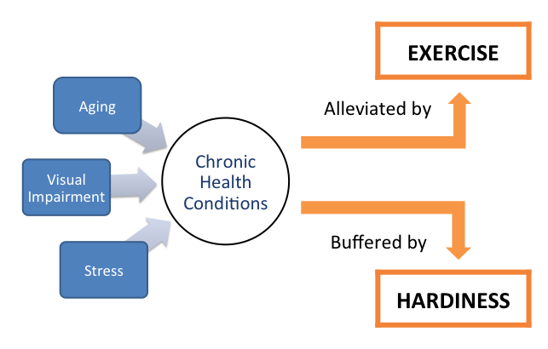
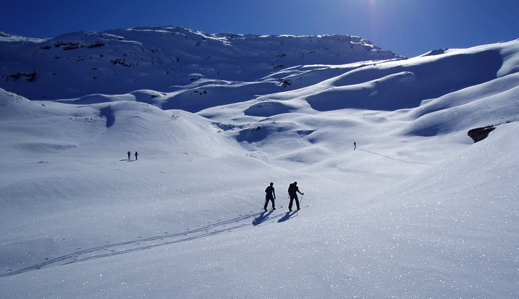
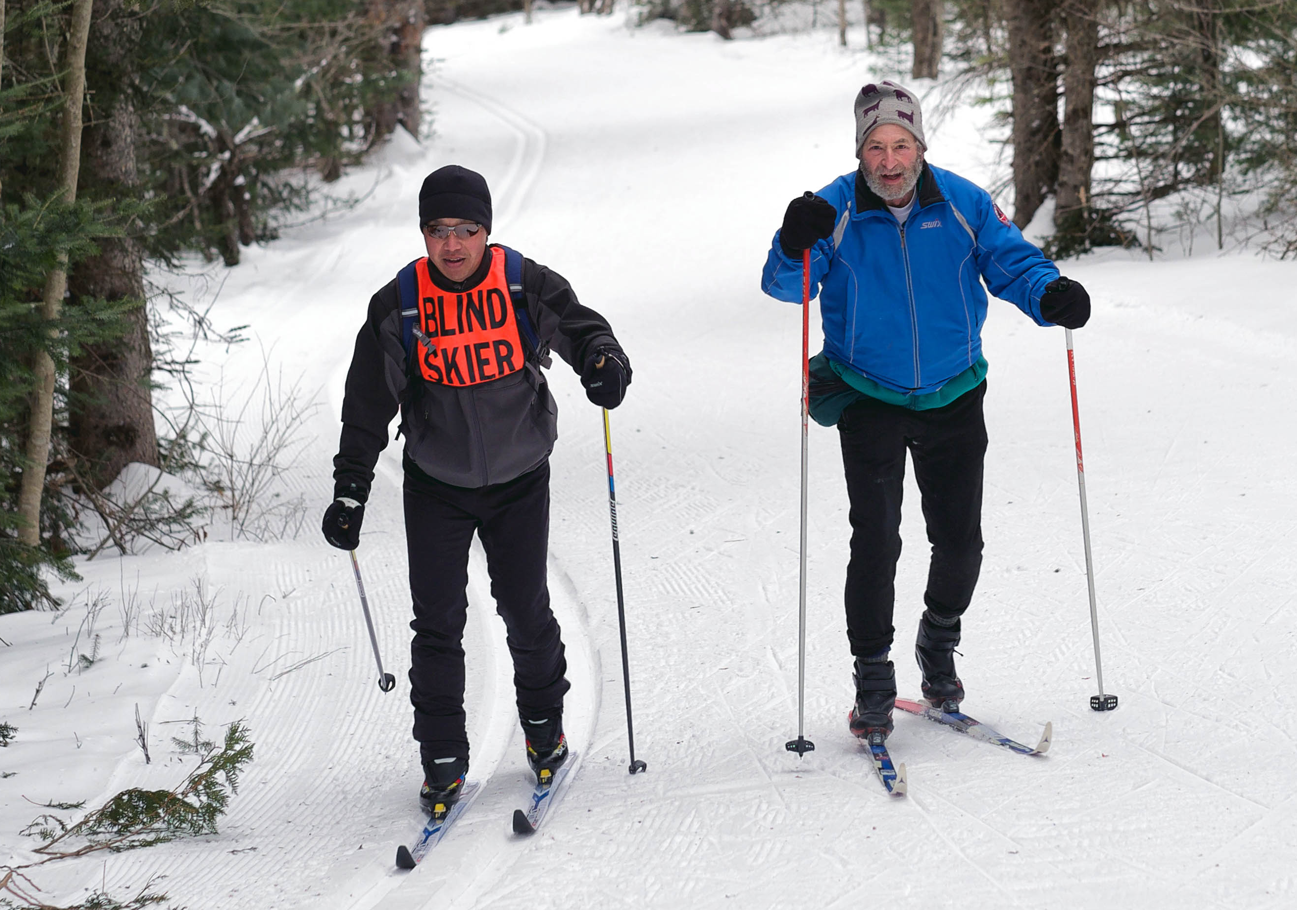
Adaptive Snow Skiing for Persons with Visual Impairments:
Individual Meaning and Personal Hardiness
Eileen M. Finn
The University of New Hampshire: Dept. of Recreation Management and Policy
NEED FOR THE STUDY
FINDINGS
METHOD
Qualitative phenomenological method
Three part, semi-structured interviews conducted over two meetings.
Participants:
  3 females, 2 males
  Ages 50-70 years
  4 with blindness from birth, 1 with degenerative vision
“You meet a lot of very successful visually impaired people, a lot of them working in great jobs and just doing amazing things. …It just gives you confidence to just go back home and do what you want to do.”
- David
THEME 1: Being With Others
Getting to know others with shared experiences of PWVI
Having a support group for learning strategies and
receiving encouragement
Opportunities for developing social skills
Reciprocating help and support for new members
SO WHAT? (Implications)
Perceived benefits of experience tend to reflect participants’ individual needs & aspirations.
Provide programming for PWVI that is social in nature.
Allow participants control and leadership opportunities within their experience.
Provide resources for PWVI to participate alongside people without visual impairments.
HARDINESS (Kobasa, 1979)
“I enjoy the freedom of movement. Without having to think too much or stop or whatever. …I want to enjoy what’s around me as much as I can, and I just want to, I don’t want to work hard at it cognitively.”
- Diane
Set of personality traits that allow an individual to proactively approach stress to reduce illness-inducing effects.
Control: Ability to choose one’s attitude and response to a situation.
Commitment: Dedication and engagement in finding solutions rather than alienation from personal values and other people.
Challenge: Change is a natural part of life and an opportunity for growth.
THEME 2: Freedom
Freedom of movement, unconstrained by the environment
Independence gained through new relationships and resources
Opportunity to be out in nature, especially in winter
“So I just stepped out of the tracks, blew by them, …they see the blind skier bib and she goes, ‘Oh, my god!’ ...I guess she’s never had her doors blown in by a blind skier before.”
- David
THEME 3: Equality
Sense of normalcy in planning and participating in trips
Perception by others as strong and able
High personal expectations as a result of advocacy by parents during childhood
ACKNOWLEDGEMENTS
Patricia Craig, Ph.D., CTRS/L
Allison Wilder, Ph.D., CTRS/L
The University of New Hampshire
Department of Recreation Management and Policy
RESEARCH QUESTIONS
THEME 4: Hardiness
Language relating to hardiness was consistent in recalling early life experiences and experiences in cross-country skiing.
Data suggests hardiness is not developed through ski experiences, but hardiness is exhibited within skiing, and skiing provides an opportunity to utilize traits of control, commitment and challenge.
What is the meaning of adaptive cross-country skiing for individuals with blindness or visual impairments?
What is the meaning of hardiness for individuals with blindness or visual impairments?
REFERENCES
Kobasa, S. C. (1979). Stressful life events, personality, and health: An inquiry into hardiness. Journal of Personality and Social Psychology, 37(1), 1-11. doi:10.1037/0022-3514.37.1.1

