Slide 1
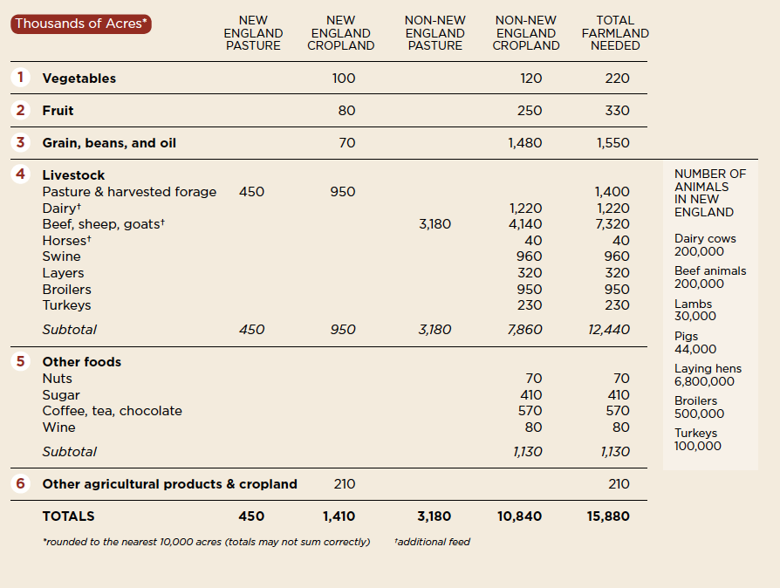
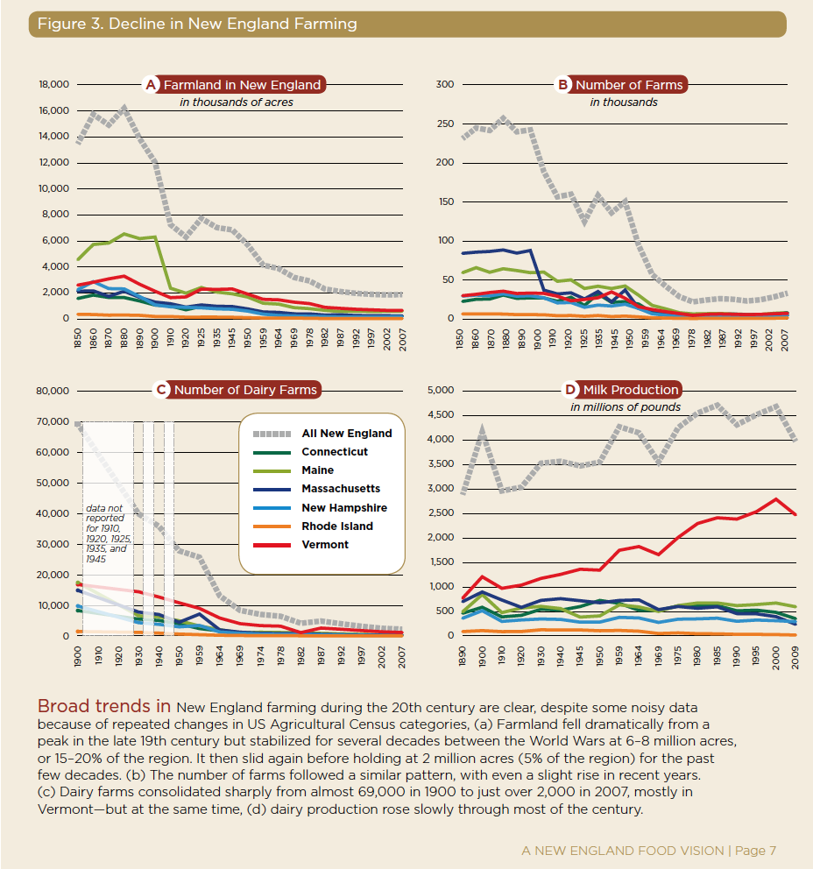
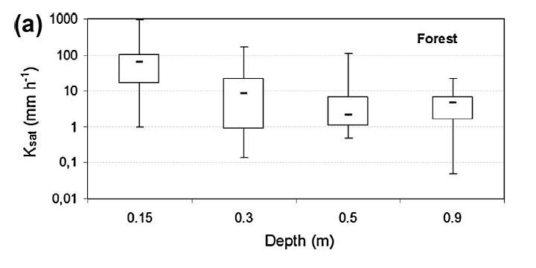
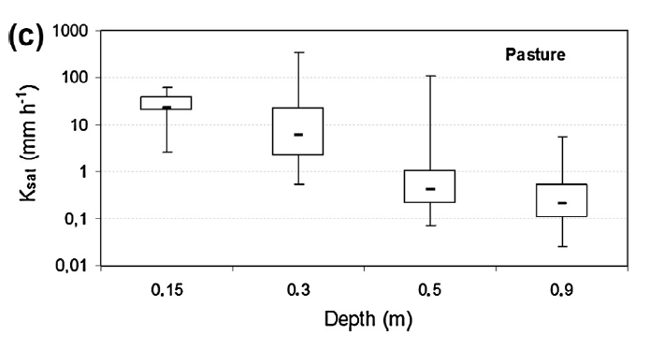
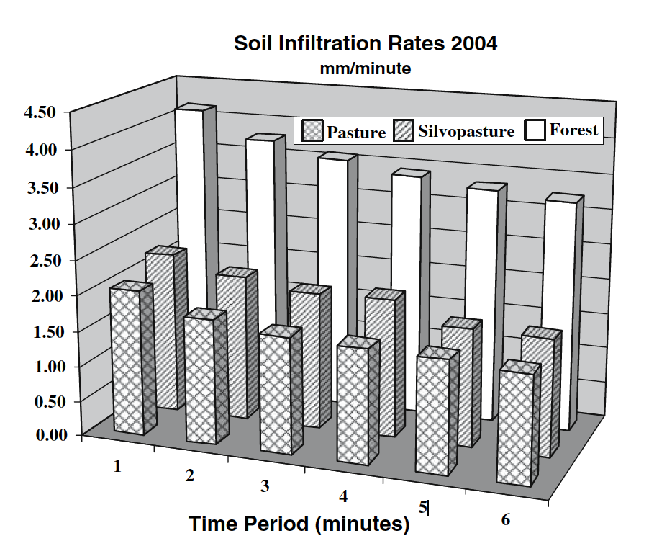
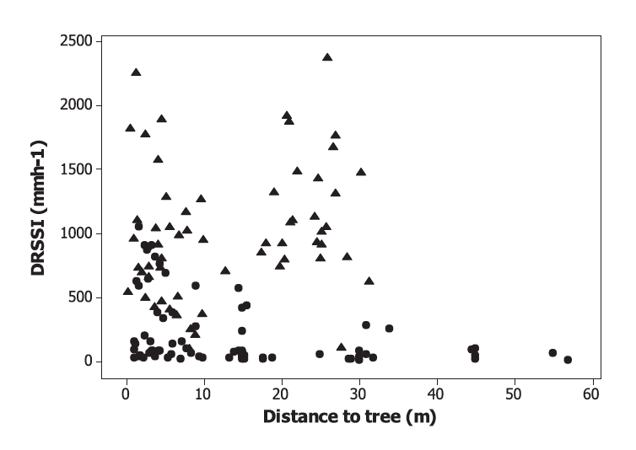
Introduction
There is great potential to increase agricultural production and meet demand in New England. In New Hampshire, over 1 million acres of soil is potentially farmable, yet only 98,000 acres (9.8 %) are used for agricultural (USDA NASS, 2014). A prominent feature of New England agriculture is pasture, used for hay production, forage production, and grazing (USDA NASS 2014). With large potential and growing demand, a serious consideration must be made for expanding agricultural systems into forest areas. The New England region is mostly forested, with tree cover making up 83%, 89%, and 81% of Maine, New Hampshire, and Vermont, respectively and a significant portion of farmable land in these states (Nowak and Greenfield, 2012; USDA NASS, 2014).
New England landowners may opt for less traditional agricultural land uses that incorporate the concept of agroforestry. Silvopasture is one potential land use that refers to an intentional integration of livestock, trees and grasses. The system potentially draws benefits from both ends of the land use spectrum: forage and cattle production from pasture and production of timber and other ecosystem services from forests.
However, the silvopastoral system isn’t thoroughly understood from the perspective of ecosystem services, especially hydraulic services. My research will address questions related to the soil hydrological component of the silvopasture system in relation to forest and pasture systems. Specifically, how do characteristics of soil hydrology, infiltration and soil water flow, differ from forests and pasture soil hydrology? Additionally, I will assess the influence of individual trees within silvopastoral systems on soil hydraulic properties.
Changing Land Use in New England:
Retaining Forest Structure and its Soil Hydraulic Properties Through Silvopasture
Anthony Stewart M.S
Advisor: Heidi Asbjornsen
Research Questions & Hypotheses
Research Questions
What is the impact of compaction on soil hydraulic properties during the conversion from forest to silvopasture?
Is silvopasture an intermediate state between forest and pasture in terms of changes to soil hydraulic properties?
Does tree proximity affect soil hydraulic characteristics?
Hypotheses
Corresponding to Research Questions 1 and 2.
  Surface infiltration or unsaturated hydraulic conductivity and saturated hydraulic conductivity will be lowest in pasture soils and highest in forest soils. Both variables in silvopastores will have intermediate values between those of pasture and forest.
Corresponding to Research Question 3.
  As distance from a single tree increases, soil saturated hydraulic conductivity and surface infiltration will decrease , exhibiting a negative correlation.
Table 1. Bottom, Shows the projected increases for agricultural production in order to meet the needs of 50% of New England’s population. Pasture land area is highlighted
Forest
Fig 1 & 2 Right, Shows decreases in farms and farmland and increases in dairy production
Soil Physical Properties
Soil
Hydraulic Properties
Silvopasture
Proximity
Tree
Proximity
Background
Hydrologic characteristics of forest soils facilitate the process of rainfall entering forest soils which infiltrates rapidly and rarely generates overland flow (Neary, 2009; Bruijnzeel, 2004). Once forests have been cleared, if the area is then used for cattle grazing, trampling and compaction significantly degrades the physical and hydraulic properties of pasture soil (Greenwood and McKenzie, 2001; Drewry et al., 2008). Zimmermann et al. (2006) explored this relationship and observed hydraulic properties of infiltration and K(sat) were negatively correlated with the time land spent under pasture land use. A follow up study also determined that effects degrading hydraulic properties in pasture land use occurred relatively quickly in the establishment of pasturelands (Zimmermann et al., 2010).
Though, specific silvopastoral measurements of hydraulic properties are rare, Sharrow, (2007) showed when compared to the pasture, silvopasture physical properties and infiltration rates were similar, indicating the same magnitude of impact experienced by both systems. However, another silvopasture and agroforestry study in Aguiar et al., (2010) showed slightly higher hydraulic conductivity and lower runoff in silvopasture systems. Both studies and more underline the variable nature of agroforestry and silvopasture systems.
The presence of individual trees could also be conducive to the nearby soil hydraulic properties. This idea is explored in Benegas et al., (2014) and their investigation exhibited soils in pastures closer to trees showed significantly higher infiltration rates than areas further away. Conversely, a study in Utah showed a positive relationship with unsaturated hydraulic conductivity (K(h) at the surface and distance to trees, the inverse of the relationship described in Benegas et al. (2014). It still appears that the relationship between soil hydraulic properties, land use, and tree proximity is variable.
The secondary forests that cover New England landscapes are considerably different than the ecosystems in previous studies. Silvopasture derived from these forests will also be different from previous studies and the combination of forage vegetation, compaction, and mature trees on a landscape involves many sources of influence on infiltration properties.
Pasture
Fig 3 & 4. (Salemi et al., 2013) Saturated hydraulic conductivity differences between Forest (a) and Pasture (c) at different depths
Fig 6.. Hypothesized relationships between land use and soil properties. The arrow size indicates the magnitude of positive influence on soil properties, or influence that is conducive to soil water flow. Relationship between tree proximity and soil properties is shown where positive influence decreases further from trees
Fig 7. Right. (Sharrow, 2007) Soil Infiltration rates between forest, pasture and silvopasture. Bars in front are pasture, middle bars are silvopasture, and back bars are forest
Fig 5. Right. (Benegas et al., 2014) Relationship between infiltration rates and distance to tree. Circles represent pasture trees where a positive correlation is shown.
Citations
Aguiar, M.I., Maia, S.M.F., Xavier, F.A. da S., de Sá Mendonça, E., Filho, J.A.A., de Oliveira, T.S., 2010. Sediment, nutrient and water losses by water erosion under agroforestry systems in the semi-arid region in northeastern Brazil. Agrofor. Syst. 79, 277–289. doi:10.1007/s10457-010-9310-2
Benegas, L., Ilstedt, U., Roupsard, O., Jones, J., Malmer, a., 2014. Effects of trees on infiltrability and preferential flow in two contrasting agroecosystems in Central America. Agric. Ecosyst. Environ. 183, 185–196. doi:10.1016/j.agee.2013.10.027
Bruijnzeel, L.A., 2004. Hydrological functions of tropical forests: not seeing the soil for the trees?, Agriculture, Ecosystems & Environment. doi:10.1016/j.agee.2004.01.015
Greenwood, K.L., McKenzie, B.M., 2001. Grazing effects on soil physical properties and the consequences for pastures: a review. Aust. J. Exp. Agric. 41, 1231–1250.
Neary, D.G., Ice, G.G., Jackson, C.R., 2009. Linkages between forest soils and water quality and quantity. For. Ecol. Manage. 258, 2269–2281. doi:10.1016/j.foreco.2009.05.027
Nowak, D.J., Greenfield, E.J., 2012. Tree and impervious cover in the United States. Landsc. Urban Plan. 107, 21–30. doi:10.1016/j.landurbplan.2012.04.005
Sharrow, S.H., 2007. Soil compaction by grazing livestock in silvopastures as evidenced by changes in soil physical properties. Agrofor. Syst. 71, 215–223. doi:10.1007/s10457-007-9083-4
USDA NASS. 2014. United States Department of Agriculture, National Agricultural Statistics Service. 2012 Census of Agriculture. Available at: http://www.agcensus.usda.gov/index.php

