Slide 1

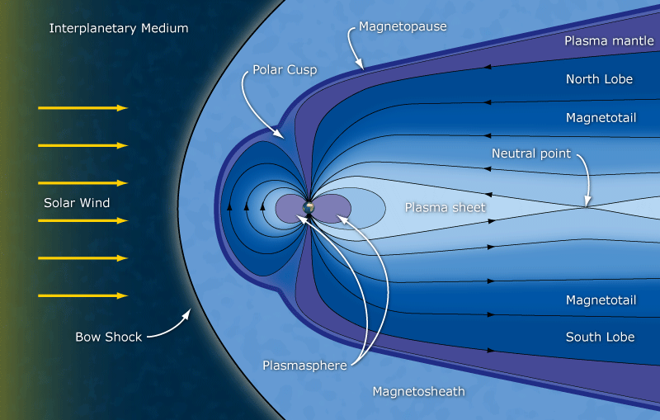
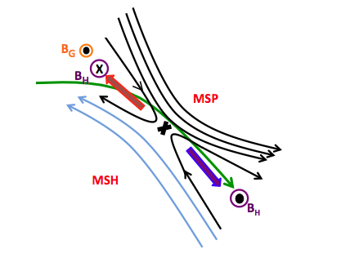
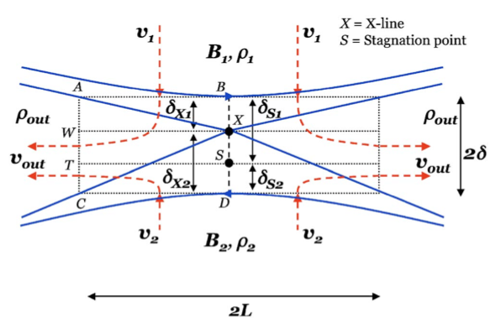





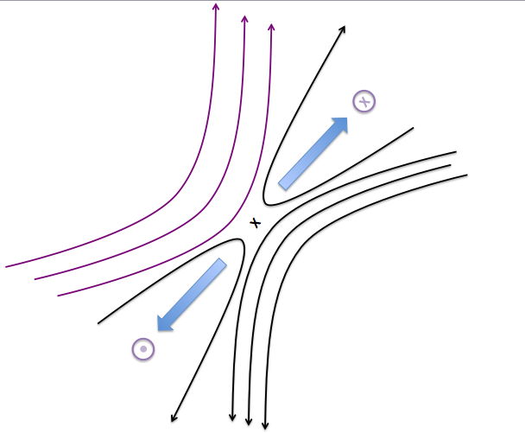
Observational Study of Ion Diffusion Region Tailward of the Cusp:
Cluster Observations in 2001-2008
F.M. Muzamil¹ (fmt7@wildcats.unh.edu), C.J. Farrugia¹, R.B. Torbert¹
¹Space Science Center, University of New Hampshire, Durham, NH, USA.
Outline
Earth’s Magnetoshpere
Case Study 1:
Small NAsym + Large BG
Case Study 2:
Moderate NAsym + Small BG
We focus on one specific area; Reconnection Poleward of the Cusp (POC). Large range of density asymmetries (N_{Asym}) and guide fields (B_{G}) are surveyed
Surveyed 8 yrs of magnetopause (MP) crossings at high latitudes POC by Cluster
    16 crossings of the Ion Diffusion Region (IDR)
    Wide range of
      Density asymmetries (~10 to 103)
      Magnetic field asymmetries (~0.2 to 0.9)
      Guide fields (~5% to 65%)
Emphasis is on Observations:
Focus on
  Effect of N_{Asym}
  Effect of N_{Asym} + B_{G} on the 2D IDR structure
3 case studies (including limiting cases)
<6 cm⁻³>
<0.7 cm⁻³>
C3
NAsym | 8.6
BAsym | 0.5
BG | -13 nT (62%)
C3
NAsym | 25
BAsym | 0.58
BG | 0.85 nT (4%)
<-20.57 nT>
<42.71 nT>
Jet #1
BM is negative during sunward jet
Theoretical Scaling Relations
Hall Fields
Jet #2
BM is positive
during anti-sunward jet
MSH
Quadrupolar B_{M} structure is still preserved, although there is a small density asymmetry
However, BM is asymmetric
Bi polar EN feature is asymmetric
Reversal in Hall fields, BM and EN, does not occur at the center of the CS
Similar effect was seen by Eastwood et. al., [2010b] in a magnetotail event for no density asymmetry (NAsym = 1) and BG = 20%
Hall B field is symmetric for very small guide field
Motivating Questions
Case Study 3:
High NAsym +Moderate BG
What is a “small”, “moderate”, “large” N_{Asym}?
What is a small B_{G} vs. moderate B_{G}?
At what value of the N_{Asym}/B_{G} do the features of the IDR start to deviate from features observed in symmetric reconnection?
How can we compare in-situ observations against current theory and simulations?
MSP
N_{i}
C3
NAsym | 1300
BAsym | 0.54
BG | 22 nT (56%)
Cassak and Shay et al. 2007, 2009
T_{i}
Assumptions :
B1 and B2 are antiparallel/ No guide field
B_{L}
B_{M}
IDR Identification
B_{N}
MSH
Muzamil, Farrugia et al. 2016, submitted
B
X
Conclusions
V_{L}
References
No absolute criterion for identifying the IDR
Plausible arguments for IDR identification
  1a. Sharp reversal of flow direction in the middle of the crossing
  1b. Correlated reversal in VX and BZ (VL and BN)
  2a. E+(Vi × B) ≠0 for ions but E+(Ve × B) =0 for electrons
  2b. Adiabatic expansion parameter, δi > 1
  3. Peak values of the total
  DC electric field > several tens mV/m
  4. Deep minimum in total B
  5. Existence of expected Hall field
  Features
  Adopted a confidence level 1-3
  depending on how many criteria were fulfilled
V_{M}
We presented 3 case studies with different BG and NAsym to study the features of the 2D IDR. All 3 cases had very similar BAsym.
For a small NAsym of ~9 the Hall B fields was still quadrupolar
For a very large BG of 60%, Hall B field was asymmetric about the BL reversal and not centered at the CS crossing
For a moderate NAsym of ~25 we observed bipolar Hall fields
For a very small BG of 4%, the effect was negligible since the normalized Hall B field was symmetric
For a very large NAsym of ~ 1300 we found a well define S line (slow expansion fan) where the flow velocity goes to 0 during a very sharp density gradient.
X line and S line are separated very clearly which is an effect of the very large density asymmetry
V_{N}
MSP
Borovsky, J. E., and M. Hesse (2007), Phys. Of Plasmas, 14, 102309, 2007
Cassak, P. A., and M. A. Shay, Phys. Of Plasmas, 14, 102114, 2007
Cassak, P. A., and M. A. Shay, Phys. Of Plasmas, 16, 055704, 2009
Eastwood, J.P., T. D. Phan, M. Øieroset, and M. A. Shay, 115, A08215, JGR, 2010a
Eastwood, J. P., M. A. Shay, T. D. Phan, et al., PRL, 104, 205001, 2010b
Levy, R. H., H. E. Petschek, and G. L. Siscoe, AIAA J., 2, 2065, 1964
Lybekk, B., A. Pedersen, S. Haaland, et al., JGR, 117, A01217, 2012
Mozer et al., PRL, 89, 015002, 2002
Mozer, F. S., P. L. Pritchett, et. al., JGR, 113, A00C03, 2008
Muzamil, F. M., Farrugia, C. J., et al., JGR, 119, A019879, 2014
Pritchett, P.L., JGR, 113, A06210, 2008,
Pritchett, P. L., and F. S. Mozer, JGR, 114, A11210, 2009
Scudder, J. D., R. D. Holdaway, et. al., JGR, 113, A10208,2008
Tanaka, K. G., et al., Ann. Geophys., 26, 2471–2483, 2008
Twitty, C., T. D. Phan, G. Paschmann, et. al., GRL, 31, L19808, 2004
Wang, S., L. M. Kistler, et. al., JGR, 120, A021524, 2015
V
Case Study 1
Summary + Conclusions
We examined in situ data to investigate the structure of 2D reconnection layer for Poleward of the Cusp (POC) a wide range of NAsym and BGs
Found numerous crossings with NAsym up to 3 orders of magnitude
Worthwhile to conduct numerical simulations with a higher density asymmetry than usually done
Measured values of the outflow velocity and density in POC observations are in good agreement with expectations and theory
Analysis of the separation of the X line and Stagnation line are being conducted
Case Study 2
Observations:
Range of NAsymm & BG covered
Case Study 3
Acknowledgements
This work was supported by NASA grants: Wind grant NNX13AP39G and Cluster grant NNX11AH03G.
Ability compare the effect of
B_{G} for a range of N_{Asym}
N_{Asym} for a range of B_{G}

