Slide 1
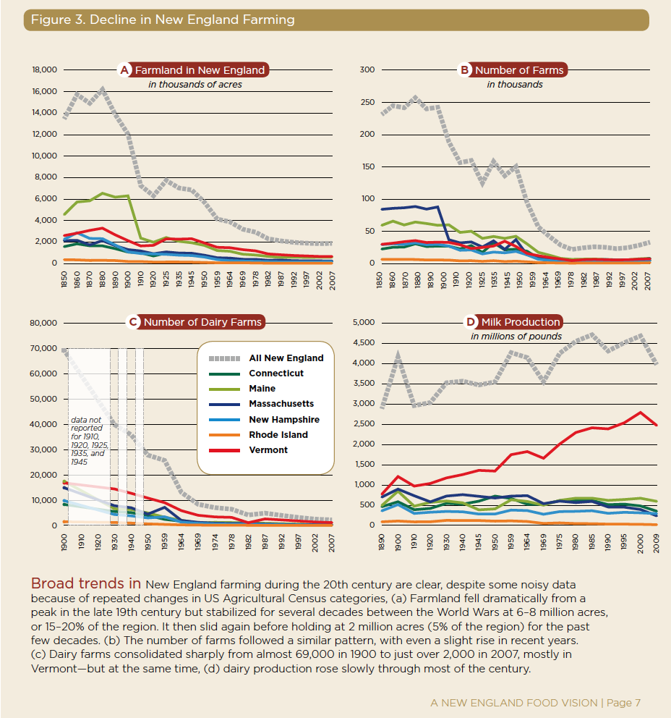
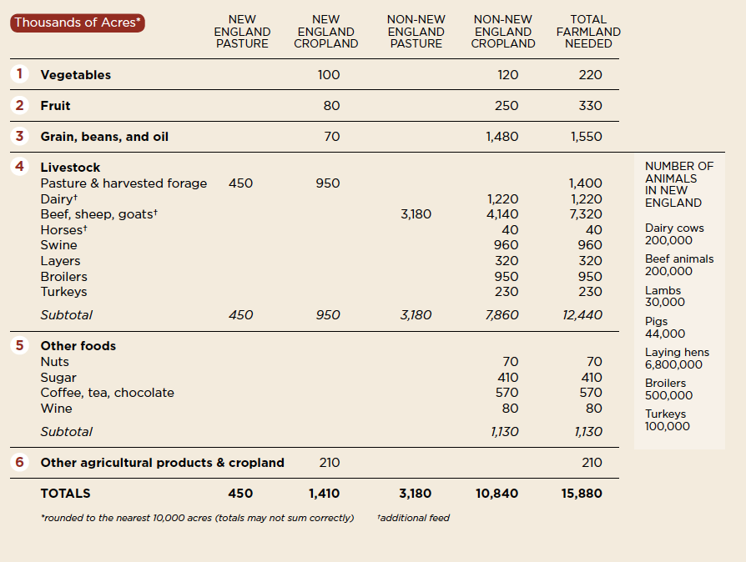
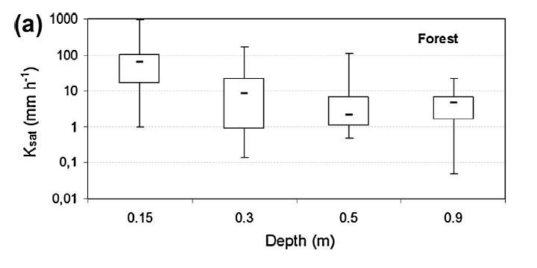
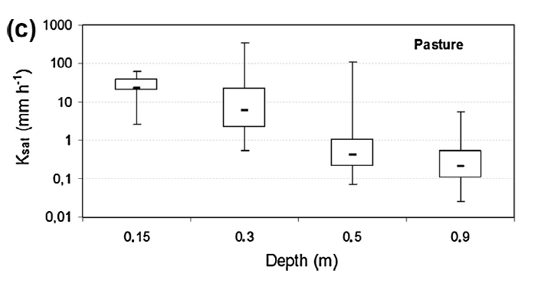
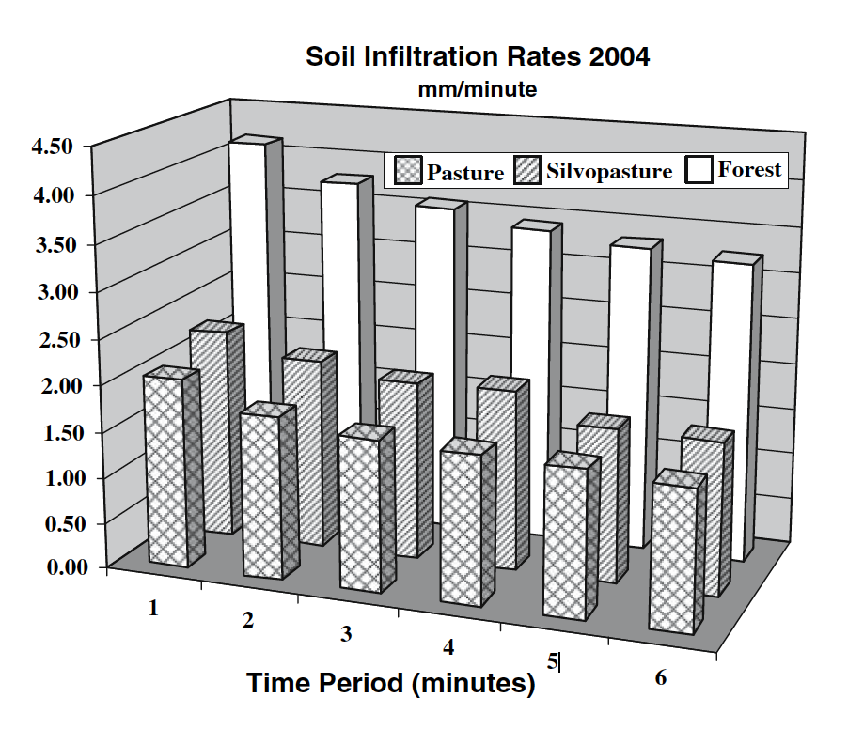
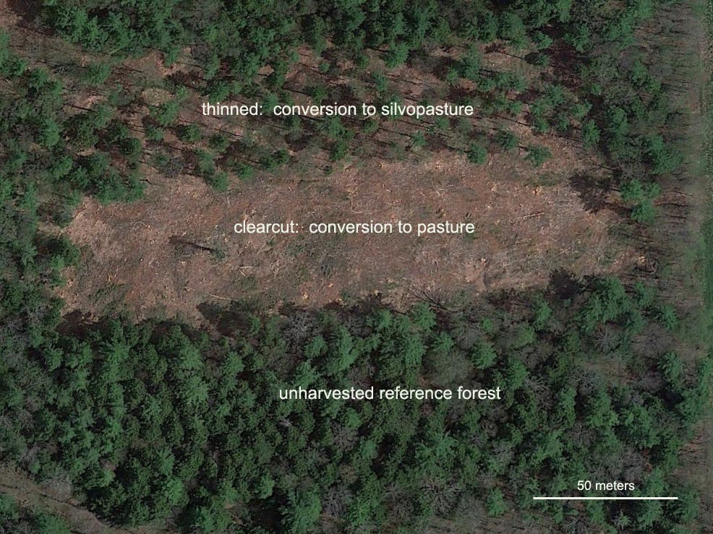
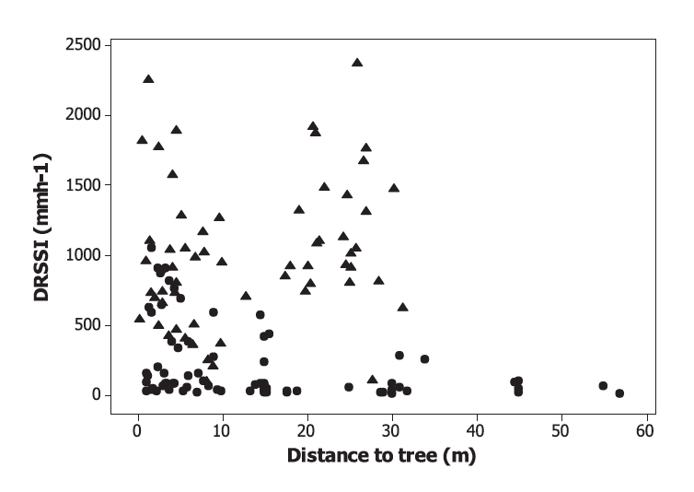
Introduction
There is potential to increase agricultural production and meet demand in New England. In New Hampshire, over 1 million acres of soil are potentially farmable, yet only 9.8 % are used for agriculture (USDA NASS, 2014). A prominent feature of New England agriculture is pasture, used for hay production, forage production, and grazing (USDA NASS 2014). A consideration must be made for expanding pasture systems into forest areas with forest cover making up 83%, 89%, and 81% of Maine, New Hampshire, and Vermont respectively (Nowak and Greenfield, 2012; USDA NASS, 2014).
New England landowners may opt for less traditional agricultural land uses that incorporate the concept of agroforestry. Silvopasture is one potential land use that refers to an intentional integration of livestock, trees, and grasses. The system potentially draws benefits from both ends of the land use spectrum: forage and cattle production from pasture and production of timber and other ecosystem services from forests.
However, the silvopastoral system isn’t thoroughly understood from the perspective of ecosystem services, especially hydrologic services. My research will address questions related to the soil hydrological component of the silvopasture system in relation to forest and pasture.
Changing Land Use in New England:
Retaining Forest Structure and its Soil Hydraulic Properties Through Silvopasture
Anthony Stewart M.S
Advisor: Heidi Asbjornsen
Research Questions & Hypotheses
Research Questions
What is the impact of compaction on soil hydraulic properties during the conversion from forest to silvopasture?
Is silvopasture an intermediate state between forest and pasture in terms of changes to soil hydraulic properties?
Does tree proximity affect soil hydraulic characteristics?
Hypotheses
Corresponding to Research Questions 1 and 2.
  Surface infiltration or unsaturated hydraulic conductivity and saturated hydraulic conductivity will be lowest in pasture soils and highest in forest soils. Both variables in silvopastures will have intermediate values between those of pasture and forest.
Corresponding to Research Question 3.
  As distance from a single tree increases, soil saturated hydraulic conductivity and surface infiltration will decrease, exhibiting a negative correlation.
Table 1. Bottom, Shows the projected increases for agricultural production in order to meet the needs of 50% of New England’s population. Pasture land area is highlighted.
Forest
Fig 1 & 2 Show decreases in farms and farmland and increases in dairy production.
Soil Physical Properties
Soil
Hydraulic Properties
Background
Hydrologic characteristics of forest soils facilitate the process of soil water infiltration (Neary, 2009; Bruijnzeel, 2004). Once forests have been cleared for pasture, trampling and compaction significantly degrades the physical and hydraulic properties of the soil (Greenwood and McKenzie, 2001). Zimmermann et al. (2006) and Zimmermann et al., (2010) observed that soil hydraulic properties of infiltration and K(sat) were negatively correlated with the time spent under pasture land use. Furthermore, effects that degrade physical and hydraulic properties in pasture occurred relatively quickly, within 1 year.
Sharrow, (2007) showed with specific silvopasture measurements compared to the pasture, silvopasture physical properties and infiltration rates were similar, indicating the same magnitude of impact experienced by both systems. However, Aguiar et al., (2010) showed slightly higher hydraulic conductivity and lower runoff in silvopasture systems.
At the tree scale Benegas et al., (2014) exhibited soils in pastures closer to trees showed significantly higher infiltration rates than areas further away. However, Madsen et al., (2008) showed decreasing K(h) at the surface with increasing distance to trees.
It still appears that the relationship between soil hydraulic properties, land use, and tree proximity is variable. The secondary forests that cover New England landscapes are considerably different than the ecosystems in previous studies. Silvopasture derived from these forests will also be different from previous studies and the combination of forage vegetation, compaction, and mature trees on a landscape involves many sources of influence on infiltration properties.
Silvopasture
Proximity
Tree
Proximity
Pasture
Fig 4&5. (Salemi et al., 2013) Saturated hydraulic conductivity differences between Forest (a) and Pasture (c) at different depths.
Fig 7. Hypothesized relationships between land use and soil properties. The arrow size indicates the magnitude of positive influence on soil properties, or influence that is conducive to soil water flow. Relationship between tree proximity and soil properties is shown where positive influence decreases further from trees.
Fig 8. Right. (Sharrow, 2007) Soil Infiltration rates between forest, pasture and silvopasture. Bars in front are pasture, middle bars are silvopasture, and back bars are forest.
Fig 3. UNH ODRF treatment plots for silvopasture, pasture, and forest.
Fig 6. Right. (Benegas et al., 2014) Relationship between infiltration rates and distance to tree. Circles represent pasture trees where a positive correlation is shown.
Citations
Aguiar, M.I., Maia, S.M.F., Xavier, F.A. da S., de Sá Mendonça, E., Filho, J.A.A., de Oliveira, T.S., 2010. Sediment, nutrient and water losses by water erosion under agroforestry systems in the semi-arid region in northeastern Brazil. Agrofor. Syst. 79, 277–289. doi:10.1007/s10457-010-9310-2
Benegas, L., Ilstedt, U., Roupsard, O., Jones, J., Malmer, a., 2014. Effects of trees on infiltrability and preferential flow in two contrasting agroecosystems in Central America. Agric. Ecosyst. Environ. 183, 185–196. doi:10.1016/j.agee.2013.10.027
Bruijnzeel, L.A., 2004. Hydrological functions of tropical forests: not seeing the soil for the trees?, Agriculture, Ecosystems & Environment. doi:10.1016/j.agee.2004.01.015
Greenwood, K.L., McKenzie, B.M., 2001. Grazing effects on soil physical properties and the consequences for pastures: a review. Aust. J. Exp. Agric. 41, 1231–1250.
Madsen, M.D., Chandler, D.G., Belnap, J., 2008. Spatial gradients in ecohydrologic properties within a pinyon-juniper ecosystem. Ecohydrology 1, 349–360. doi:10.1002/eco.29
Neary, D.G., Ice, G.G., Jackson, C.R., 2009. Linkages between forest soils and water quality and quantity. For. Ecol. Manage. 258, 2269–2281. doi:10.1016/j.foreco.2009.05.027
Nowak, D.J., Greenfield, E.J., 2012. Tree and impervious cover in the United States. Landsc. Urban Plan. 107, 21–30. doi:10.1016/j.landurbplan.2012.04.005
Sharrow, S.H., 2007. Soil compaction by grazing livestock in silvopastures as evidenced by changes in soil physical properties. Agrofor. Syst. 71, 215–223. doi:10.1007/s10457-007-9083-4
USDA NASS. 2014. United States Department of Agriculture, National Agricultural Statistics Service. 2012 Census of Agriculture. Available at: http://www.agcensus.usda.gov/index.php

