Slide 1
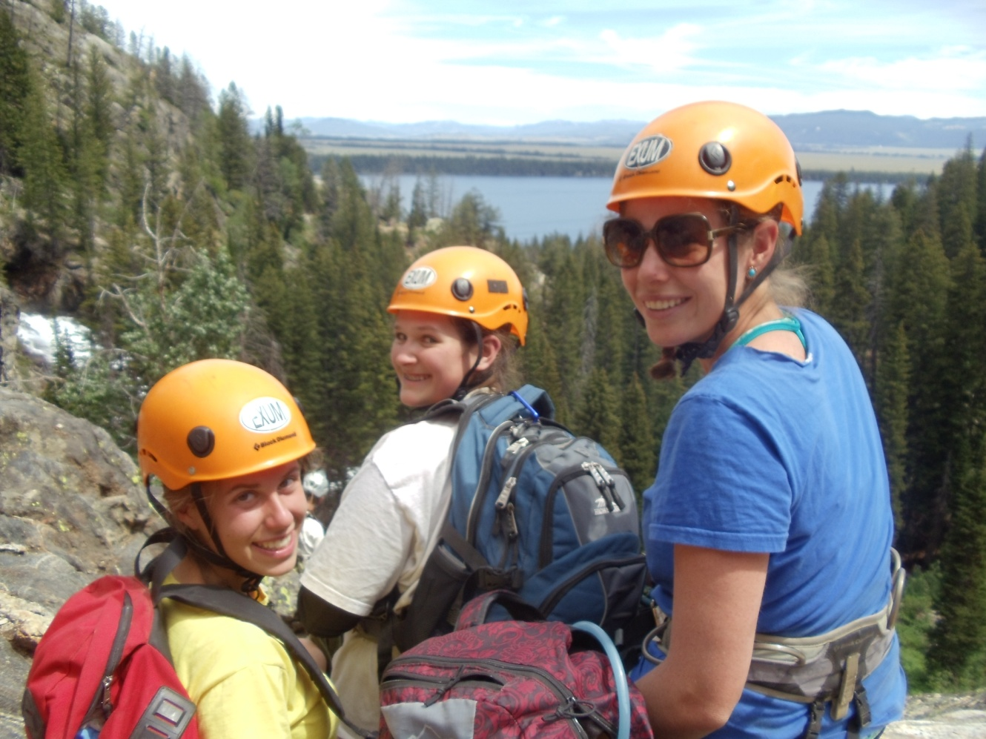
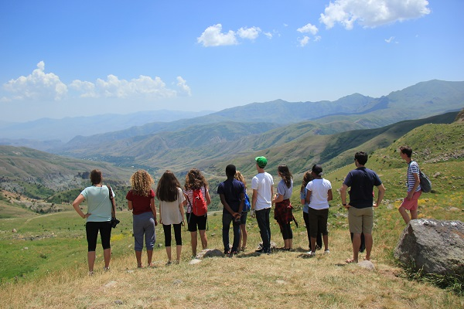
OUTCOMES OF CAMP TRAVEL AND LEADERSHIP PROGRAMS: ASSESSING INDEPENDENCE, EXPLORATION, FAMILY CITIZENSHIP AND TEAMWORK USING THE YOUTH OUTCOMES BATTERY
Colie Haahr, University of New Hampshire
RESULTS
YOB Reliability and Descriptive Results
Variable | n |  | Mean | α if Item Deleted | Std Dev/ | α
Family Citizenship Behavior (FCB) | 143
FCB Statements Overall | 143 |  | 5.52 |  | .57152 | .826
FCB Degree of Change Overall | 143 |  | 4.49 |  | .62221 | .828
Reliability for Items-Degree of Change Overall | 143 |  |  | All Items Above .786
Independence (IND) | 144
IND Statements Overall | 144 |  | 5.62 |  | .46622 | .814
IND Degree of Change Overall | 144 |  | 4.68 |  | .60144 | .847
Reliability for Items – Degree of Change Overall | 144 |  |  | All Items Above .812
Interest in Exploration (IE) | 144
IE Statements Overall | 144 |  | 5.7 |  | .39878 | .805
IE Degree of Change Overall | 144 |  | 4.90 |  | .66270 | .863
Reliability for Items- Degree of Change Overall | 144 |  |  | All Items Above .833
Teamwork (T) | 144
T Statements Overall | 144 |  | 5.66 |  | .45659 | .844
T Degree of Change Overall | 144 |  | 4.93 |  | .58368 | .845
Reliability for Items- Degree of Change Overall | 144 |  |  | All Items Above .822
*For “statements” respondents were asked to rate their current status based on the statements 1 –false, 2 – Somewhat False, 3 – A Little False, 4 – A Little True, 5- Somewhat True, 6- True. For the “degree of change” questions, respondents were asked: “Is the above statement more or less true today than before camp?” 1- A Lot Less ,2- Somewhat Less, 3- A Little Less,4- A Little More, 5- Somewhat More, 6- A Lot More
INTRODUCTION
In the summer of 2015, the ACA Youth Outcomes Battery was used to assess 144 travel program participants in the areas of family citizenship, independence, interest in exploration, and teamwork.
The travel program is a month long, off-camp counselor in training program for 14-16 year old participants. The program offers service and leadership trips to 10 international and 2 domestic locations.
Demographic data was collected, and results were analyzed using SPSS.
Years of camp attendance had a significant positive relationship with the degree of change scale for Teamwork (p = .017, r = .201). Years of camp attendance also had a significant positive relationship with exploration in ANOVA tests for the degree of change scale.
A significant, strong, and positive relationship was discovered between Family Citizenship Behavior and all of the other domains for degree of change scales. The family citizenship scale asked participants about planned behavior, whereas the other three scales asked participants to rate their current status.
The ANOVA statistics indicated that female participants rated themselves slightly higher than male participants for the degree of change in each category, but there were no significant differences for degree of change questions based on gender in any of the domains.
Demographic results: mostly white participants (87%) who were 15 years old (81%), and had spent four or more years in camp programs (79%). The sample was 57% female.
METHODS
The Youth Outcomes Battery was used to help answer the following research questions:
Are there differences between outcomes for youth in domestic programs and international programs?
Does gender, age, or language barrier have a relationship with any of the outcomes, and what is the strength and direction of the relationship?
Do years of camp attendance or leadership dosage have a relationship with any of the outcomes?
4. Are there any relationships between the outcomes, and what is the direction and strength?
Applications to Camp
Participants rated themselves high compared to ACA normed data for this age group, which shows that specialized (leadership) programs can enhance positive outcomes for teens.
With the majority of participants having been in camp programs for four or more years, a relationship was discovered between years of attendance and positive team work and exploration outcomes.
Participants rated themselves very high in Teamwork, and this suggests that the leadership curriculum leads to positive outcomes.
UNH Graduate Research Conference 2016

