Slide 1
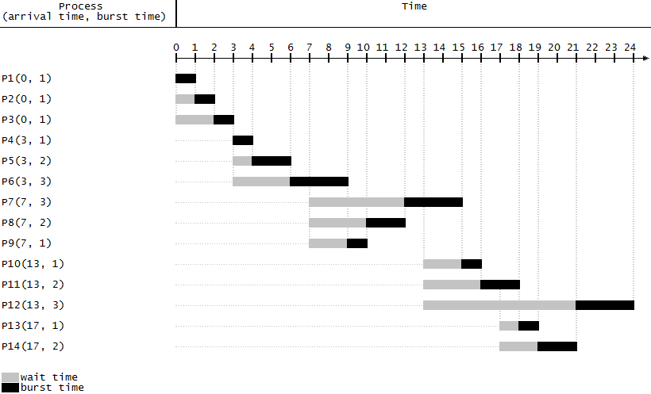
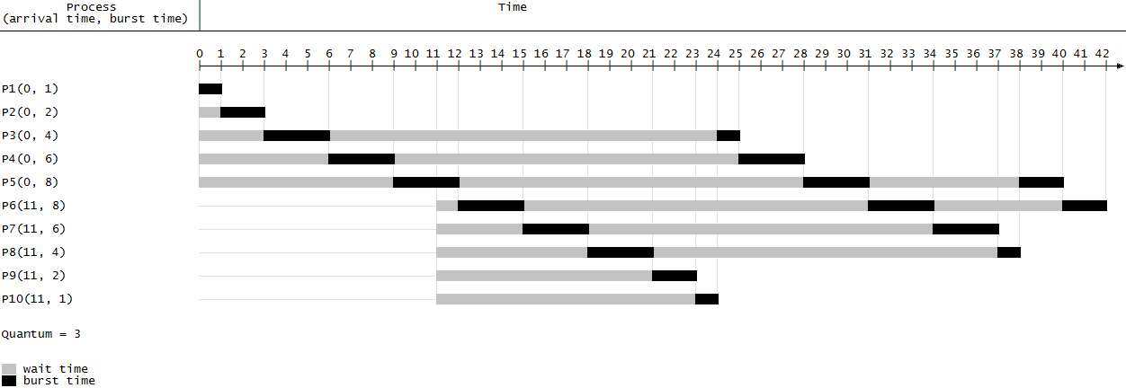
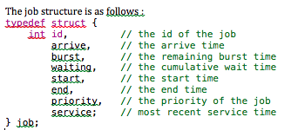
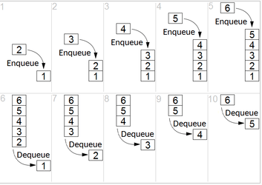
CPU SCHEDULER SIMULATOR
Advisor : Prof. Elizabeth Varki
Sanjana Seetharam
Introduction
Shortest Job First
Round Robin
CPU scheduler for computers.
A scheduler determines which computer process should be executed next.
The goal of a scheduler is to minimize response time.
CPU scheduling algorithms: First In First Out (FIFO), Shortest Job First ( SJF), Shortest Remaining Time Next ( SRTN), Round Robin ( RR), Multi-level Feedback Queue (MLFQ)
SJF is a scheduling policy that selects a waiting process with the smallest execution time to execute next.
Time quantum – T
Each job executed at most T time units. If the job does not complete execution in T time units, it rejoins the tail of the queue
Generated Queue
Completed Queue
Process Queue
Contains all the input processes
Order by burst time and arrival time. Least arrival time and least burst time in the front
Heap of jobs
Processes that have completed execution
Generated Queue
Completed Queue
Process Queue
Contains all the input processes
Heap of jobs
Processes that have completed execution
Waiting Queue
If time slice expires, if current job’s burst >0 add to waiting queue else add to completed queue
Order by arrival time and priority
Heap of jobs
Executed at the end
Contains process’ that are incomplete
First In First Out
FIFO simply queues the processes in the order that they arrive.
Multi Level Feedback Queue
Generated Queue
Completed Queue
Process Queue
Contains all the input processes
Order by burst time and arrival time.
Heap of jobs
Processes that have completed execution
Several priority queues at the CPU
Job is lower priority queues execute only when higher priority queues are empty.
Short jobs go to higher priority queues
Shortest Remaining Time Next
Generated Queue
Process Queue 2
Process Queue 1
Contains all the input processes
Heap of jobs
Heap of jobs
Process Queue 3
If time slice expires, if current job’s burst >0 add to waiting queue else add to Process Queue 2
Heap of jobs
FIFO
Completed Queue
Contains all the completed processes
RR with time slice 2 ms
Order by arrival time and priority
RR with time slice 4 ms
If time slice expires, if current job’s burst >0 add to waiting queue else add to Process Queue 3
Order by arrival time and priority
Executes process in order that they arrive
  SRTN is the best policy in terms of speed of execution
  SRTN is not practical since the job execution time is an input to the algorithm
  SRTN is unfair to long jobs and may lead to starvation.
Generated Queue
Completed Queue
Process Queue
Contains all the input processes
Heap of jobs
Processes that have completed execution
New job’s burst < max job’s burst, add to the front of the queue
Summary
FIFO is a fair policy; favors long jobs.
SJF and SRTN are theoretically the best policies for reducing response time. These policies are unfair to long jobs.
RR is a fair policy
MLF is impletemented in most computers

