Slide 1

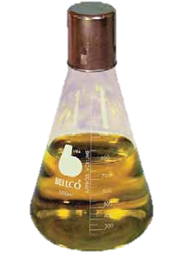
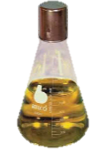

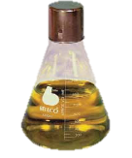

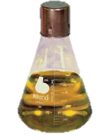
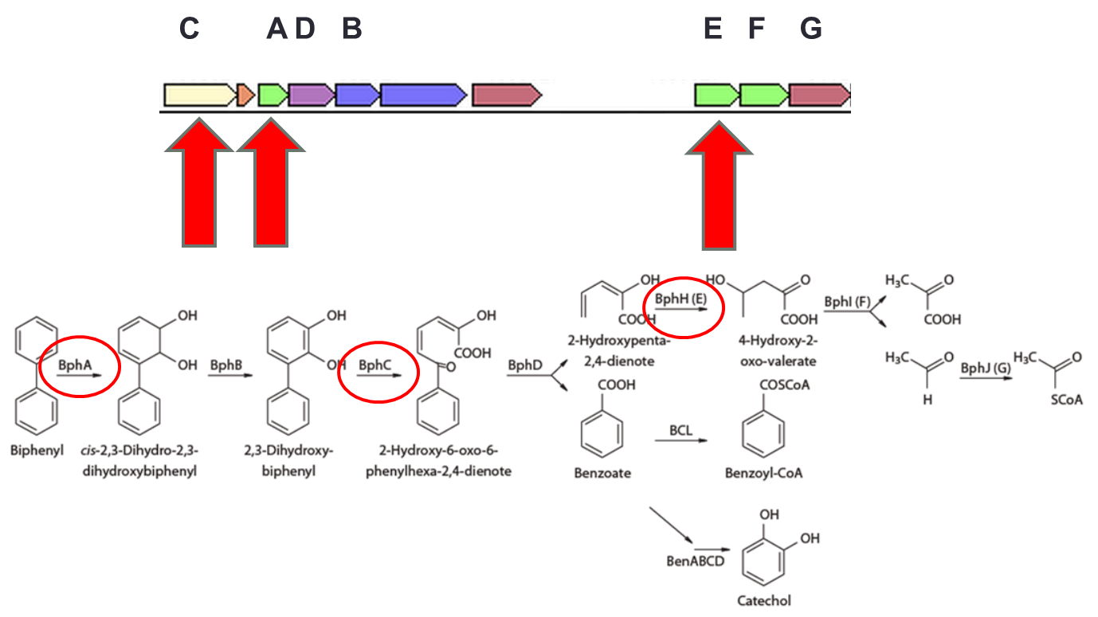
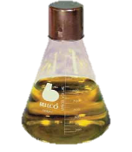
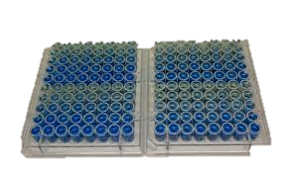
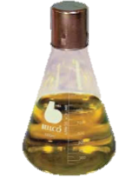
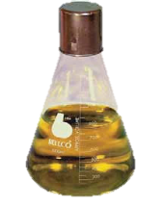
Frankia sp. Strains EuI1c and EUN1f have the Potential to Degrade Dioxins and Dioxin-like Compounds
Erik Swanson, Medhat Rehan, Louis Tisa
Abstract
Bioinformatics and RT - qPCR
Gas Chromatography – Mass Spectrometry
We tested the ability of Frankia to resist and degrade three dioxin-like compounds: biphenyl (BP), 4-chlorobiphenyl (4CBP), and dibenzofuran (DBF). A comparative genomics approach was used to detect regions in Frankia genomes homologous to a known dioxin-degrading operon (bph) in a closely related species, Rhodococcus RAH1. Only 2 of the 19 available Frankia genomes, strains EuI1c and EUN1f, contained a putative dioxin-degrading operon homologous to the ­bph operon in Rhodococcus RHA1. Growth assays demonstrated both strains EuI1c and EUN1f exhibited linear growth with BP or DBF as a sole carbon and energy source at concentrations up to 1.0mM, while CN3 does not grow with BP as a sole carbon source. However, neither strain was able to grow with 4CBP as a sole carbon and energy source. Expression of the putative bph operon in strain EuI1c in response to BP exposure was determined through RT-qPCR. This analysis revealed that ­three representative genes (bphA, bphC, and bphE) of the ­bph­ operon were upregulated in response to BP exposure. GC-MS analysis also showed that biphenyl is degraded during incubation in Frankia EuI1c cultures. These findings suggest that Frankia sp. strains EuI1c and EUN1f degrade dioxin-like compounds and could be used to remediate land contaminated by dioxin-like compounds.
3x biological replicates
3 treatments:
- control, dioxin, dioxin + alternative carbon
Sampled at 1, 3, and 7 days
Triton X-100 RNA extraction, cDNA synthesis, and SYBR green qPCR on genes identified using BLAST
Figure 2. Biphenyl concentration after 0, 3, 7, and 14 days of incubation.
Bioinformatics and RT - qPCR
Gas Chromatography – Mass Spectrometry
Three biological replicates of three conditions (Frankia only, Frankia amended with BP, and killed Frankia amended with BP) were sampled at 4 time points (0, 3, 7, and 14 days) and extracted with dichloromethane. Sample were analyzed by Millis Scientific to determine biphenyl (BP) concentration.
Introduction
Frankia sp. are soiling dwelling, nitrogen-fixing, actinobacteria that form facultative symbiotic associations with 8 families of actinorhizal plants. Frankia sp. are resistant to numerous heavy metals and toxic organic pollutants which makes the Frankia-plant symbiosis a promising candidate for bioremediation applications. Furthermore, the unique symbiosis that Frankia forms with actinorhizal plants could help establish a remediating population in contaminated environments. While Frankia is known to resist heavy metals and degrade curtain organic pollutants, its ability to degrade dioxins and dioxin-like compounds has not been previously studied.
Dioxins are common, highly recalcitrant and hydrophobic environmental contaminants. These characteristics lead to bioaccumulation and numerous associated health problems including cancer, immune suppression, birth defects, and acute toxicity. These health risks necessitate an effective remediation approach for dioxins and dioxin-like compounds.
Thus, if Frankia is able to degrade dioxin-like compounds, it could be a valuable tool in the effort to remediate dioxin contaminated sites.
Results
Growth Assays
Figure 3. The upper figure shows the putative bph operon in EuI1c as it corresponds to the bph degradation pathway in Rhodococcus RHA1. Red circles indicate genes whose expression was tested , red arrows indicated where they lie in the putative operon. The lower figure represents the results of the RT-qPCR expression assay after 7 days. Each gene tested is labeled with its protein number according to JGI. PAH = biphenyl only. PAH + C = biphenyl + glucose . Control = glucose only
Methods
Conclusions
Growth Assays
Frankia strain EuI1c and EUN1f are able to utilize biphenyl and dibenzofuran as sole carbon and energy sources, and therefore degrade them
The addition of chlorines to dioxin-like compounds may prevent metabolism by Frankia
The bph operon in Frankia is responsible for the ability to degrade dioxin-like compounds
Acknowledgements
The Tisa lab was very helpful in carrying out this research. This research was funded in part by the 2015 Summer TA Fellowship and by Hatch Grant # NH530
Figure 1. Each of the above figures represents an assay with the strain indicated grown with the compound indicated as the sole carbon source. Positive controls where supplemented with 1mM glucose (EuI1c) or 1mM fructose (EUN1f)
References
3x biological replicates of log phase Frankia cultures
Five treatments:
+ control, - control, 0.25mM, 0.50mM, and 1.0mM incubated for 28 days
Bradford Protein assay to measure growth
Roy S, et al. Journal of Canadian Botany. 2007; 85:237-51. Ridgeway K, et al. FEMS Microbial Ecology. 2004; 50:255-63. Benson D, Silvester W. Microbiology and Molecular Biology Reviews. 1993; 57(2):293-319. Lefrancois E, et al. Applied Soil Ecology. 2010; 46:183-91. Rehan M, et al. Applied Microbial Biotechnology. 2014; 98:6125-35. Fang H, et al. Bioresource Technology. 2013; 129:209-18. Baker E, et al. Can J Microbiol. 2015; 61(4):281-292

