Slide 1

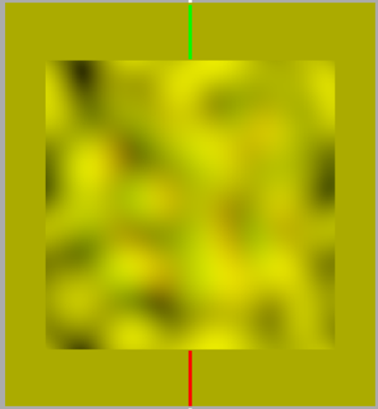
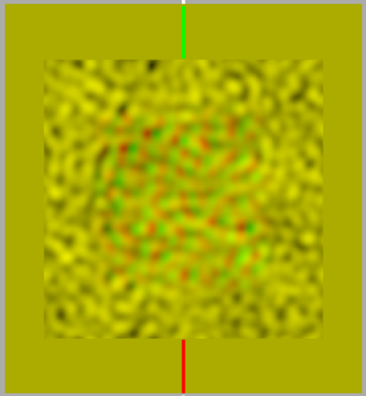
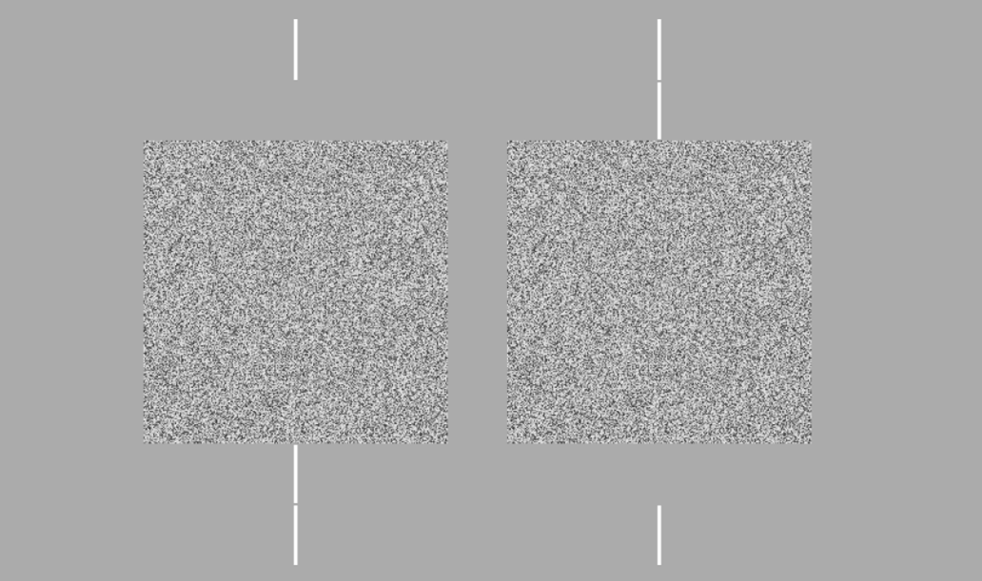
Bootstrapping Sensitivity and Bias Measures
in the Context of Stereo Acuity
Hanne K. Hansen, Alison J. Meurer, Ahlia K. Slone, Nicholas C. Duggan, Basmah El Farawami, Jaclyn H. Johnston, Amanda I. LeBel, Megan E. Lusignan, Andrew J. Kitt, and Wm Wren Stine
Psychology Department, University of New Hampshire, Durham, NH
Introduction
Previous studies indicate that spatial frequency affects stereo acuity. A study conducted by Schor and Wood in 1983 used psychometric functions to measure the effects of spatial frequency on stereo acuity using differences of Gaussians as stimuli. This experiment measures the effects of spatial frequency on stereo acuity through signal detection theory using random dot stereograms as stimuli. We bootstrapped confidence intervals for sensitivity and bias measures. Our results confirmed low acuity at low spatial frequencies, but we also found lower acuity at very high spatial frequencies for one subject.
Results
1
3
Definitions
Bootstrapping: Bootstrapping generates highly reliable estimates of confidence intervals with a relatively small amount of data by creating comparable sets of data through weighted sampling of existing data.
Random dot stereogram: Pair of images composed of an array of random dots in which part of one is shifted relative to the other, resulting in the perception of depth in that area when the images are presented to the two eyes.
Spatial Frequency: How far apart repeating patterns appear to be, expressed in terms of cycles per degree of visual angle.
Stereo Acuity: Minimum disparity that a person can identify under a given set of conditions – how much brightness changes across space.
Stereopsis: Depth perception that arises from a disparity between the images presented to the two eyes.
2
4
Methods
Random dot stereograms of five different crossed and uncrossed disparities were used to test each subjects’ stereo acuity across a range of spatial frequencies. Bootstrapping statistics were used to estimate the variability around data measured in the experiment.
Images created on Mathematica were presented on an Apple Macintosh desktop computer through a Maxwellian view system. A three-way forced choice method was utilized, with choices of near, far, and no difference.
Discussion
Schor and Wood found that acuity increased with spatial frequency until up to about 2.7 c/degree and then it plateaued up to about 19.2 c/deg. As spatial frequency increases, we expected acuity to increase until the point is reached where acuity no longer improves with increasing spatial frequency. Our results confirmed low acuity at low spatial frequencies, but we also found acuity drop off at very high spatial frequencies for one subject. Graph #2 agrees with Schor and Wood’s findings, but the other three graphs could indicate that local and global stereopsis operate under separate mechanisms in the visual system.
Anaglyphs
References
Dichoptic stimulus
for global stereopsis
Schor, C. M., & Wood, I. "Disparity Range for Local Stereopsis as a Function of Luminance Spatial Frequency.” Vision Research 23.12 (1983): 1649-654
Notes:
E15JCY15- Psychology Department
-Stereoacuity: how good you are at stereopsis
-local stereopsis: DOG
-global stereopsis: RDS
-spatial frequency: light across spatial dimension, graphing amount of light across space
-creates black and white bars
-Maxwellian view system: controls amount of light entering the pupil and also aligns the subject (using bite bar)
-Method of constant stimuli: all possible permutations are presented randomly and data is statistically analyzed after
-Define crossed and uncrossed disparity

