Slide 1

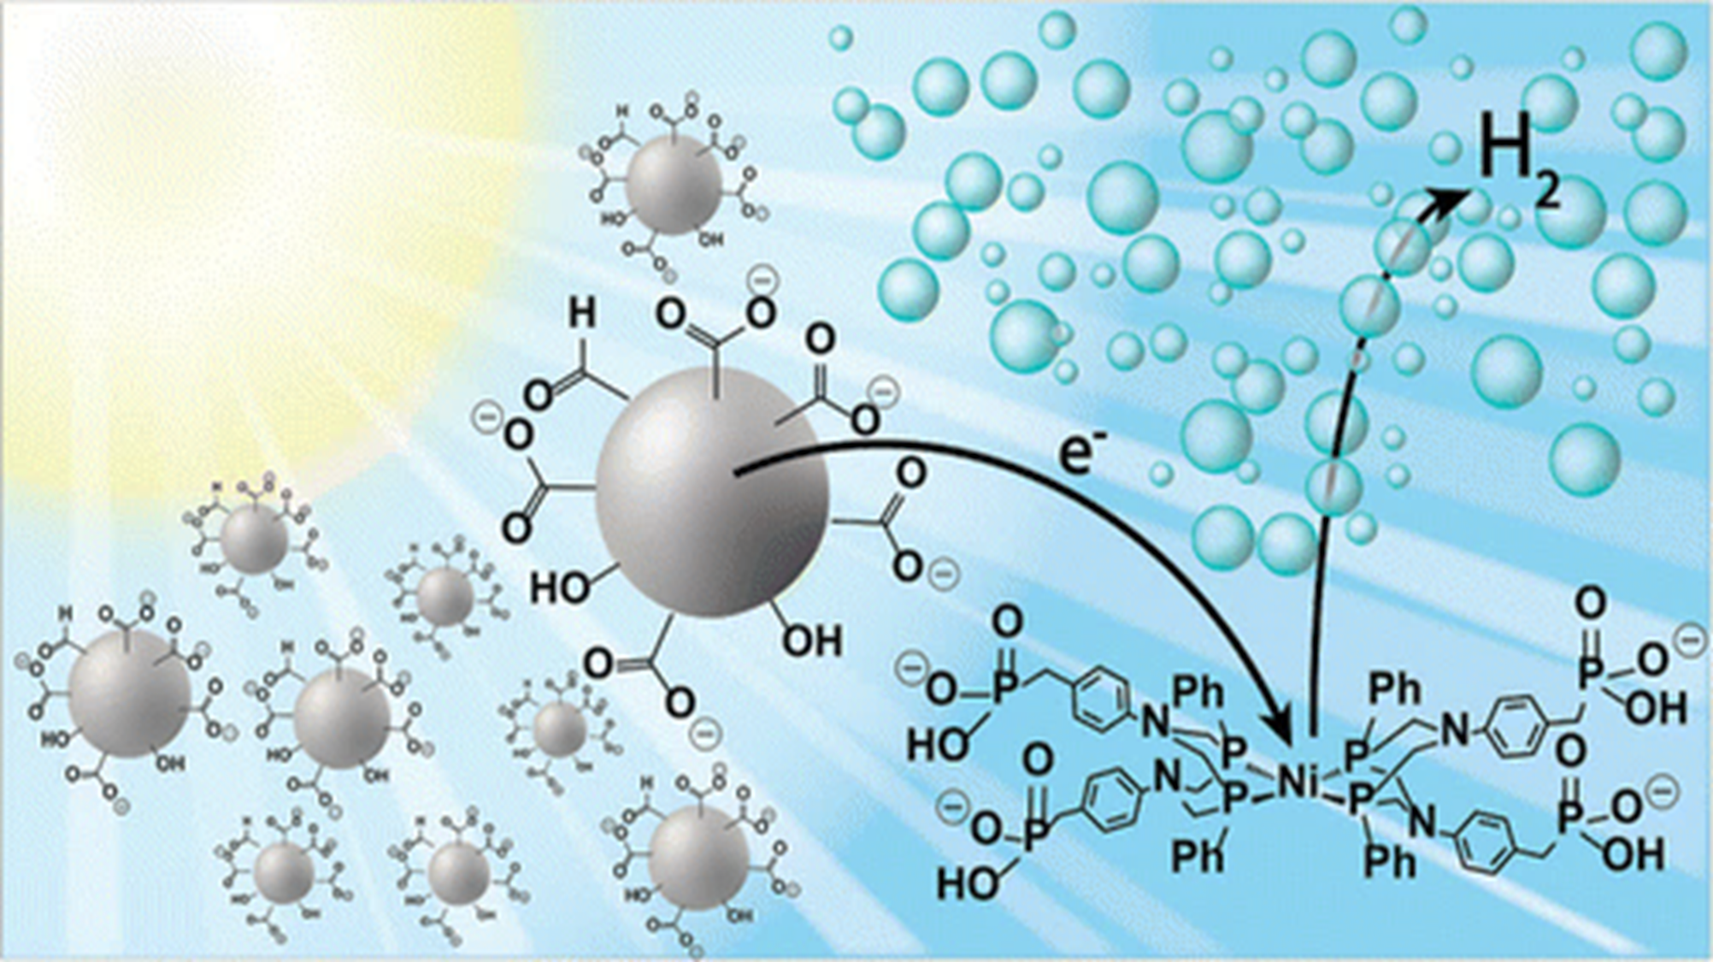
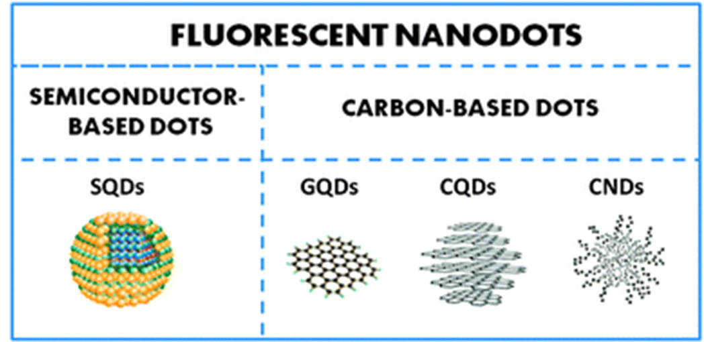
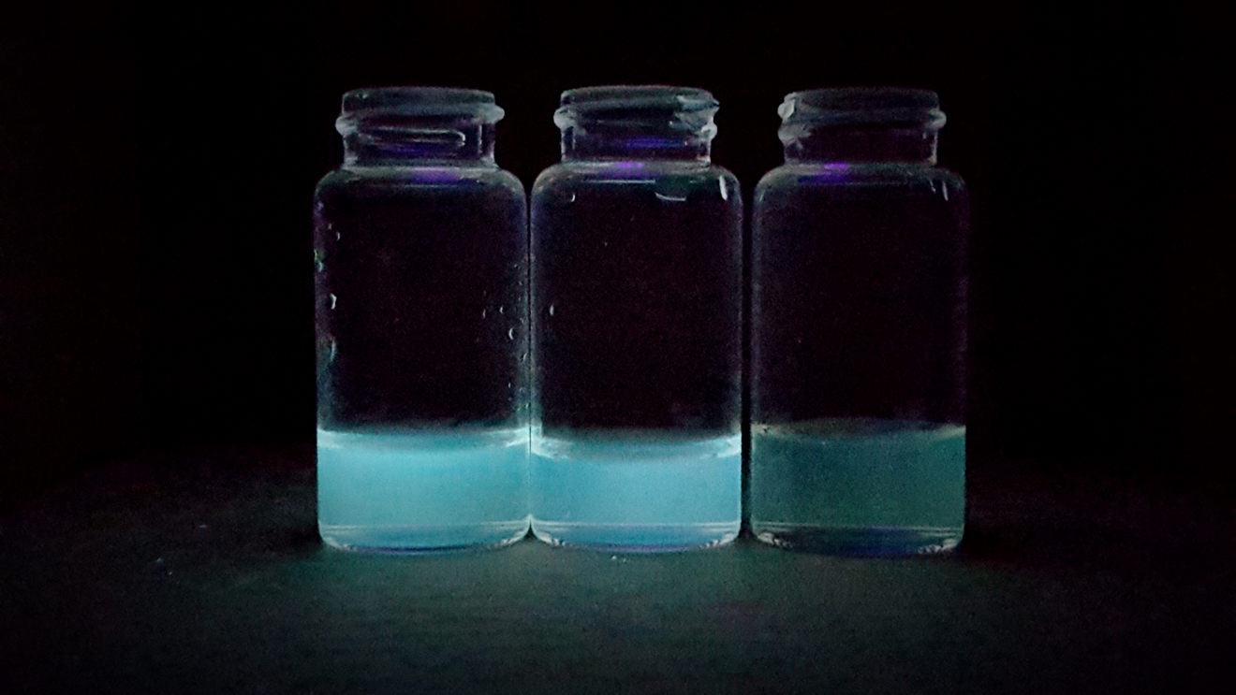
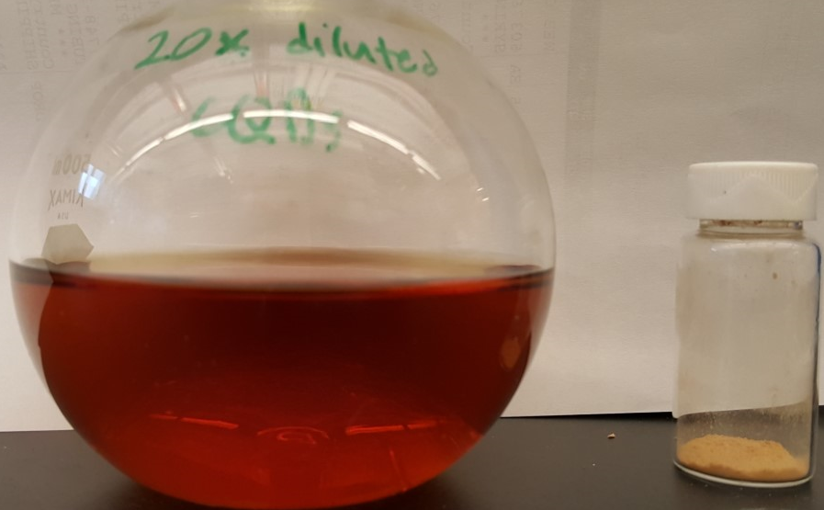
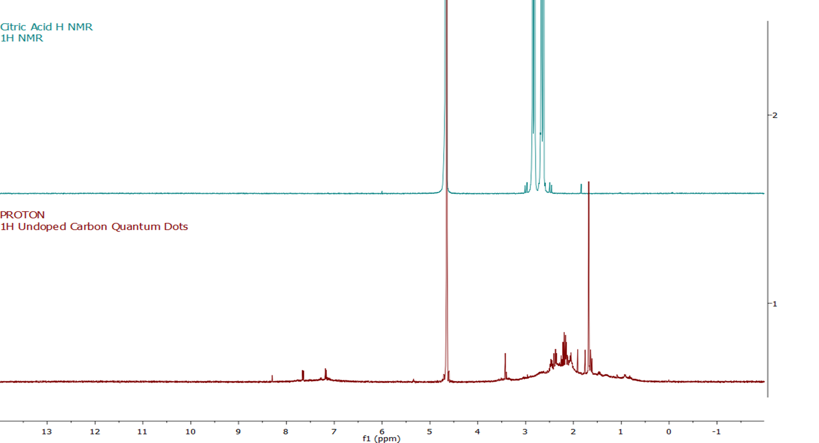
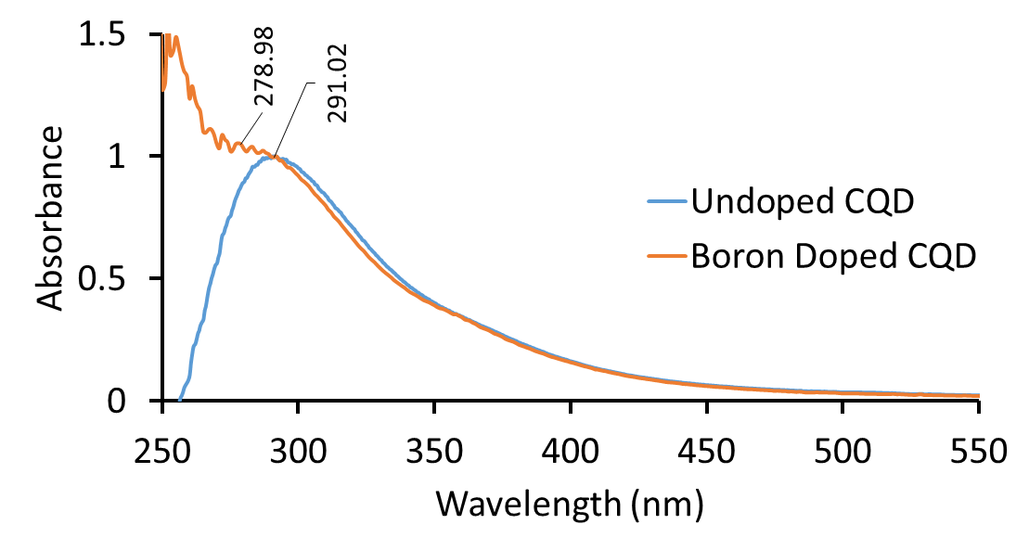
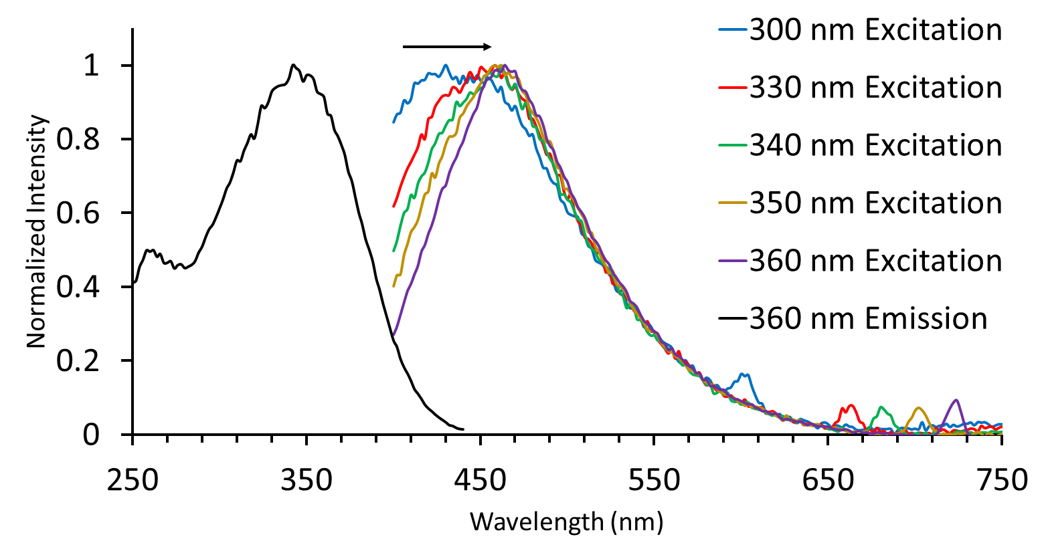
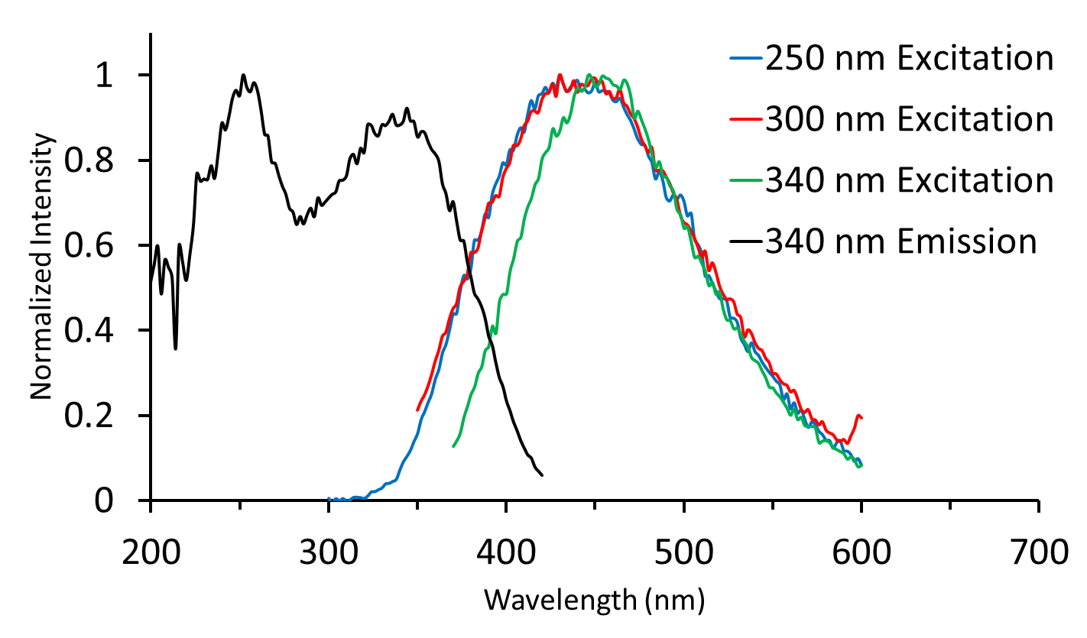
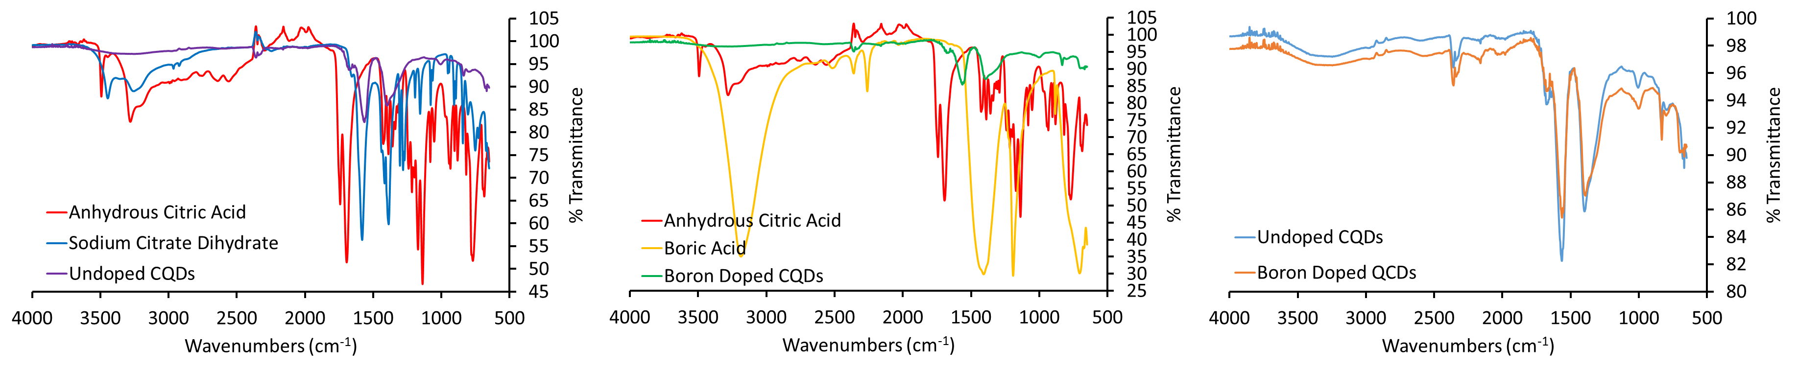
Synthesis of Carbon Quantum Dots and Their Use as Photosensitizers
Anthony J. Lemieux, Christine A. Caputo
Department of Chemistry, University of New Hampshire, Durham, NH 03824
Introduction
Figures and Data
Carbon Quantum Dots (CQDs) are fluorescent nanoparticles that consist of a graphitic carbon core with a passivated surface and are typically 2-10 nm in diameter.^{1,2} CQDs are non-toxic and can be made from inexpensive materials such as citric acid. CQDs possess unique electronic, redox, and optical properties which can be exploited for use in photocatalytic systems for energy conversion.² As such, CQDs are most often used in biochemical sensing, drug delivery, bio-imaging, and catalysis.¹
Interestingly, CQDs show great potential to replace other expensive photosensitizers, including organic and transition metal dyes, which are short-lived due to photodecomposition and are toxic.^{1,2} It is also possible to dope CQDs with group 13 and 15 elements such as boron and nitrogen to improve or further tune the CQDs luminescent properties.¹ To this end, un-doped CQDs and boron-doped CQDs (B-CQDs) have been synthesized and characterized using FTIR, NMR, UV-Vis, and Fluorescence spectroscopic methods.
Figure 1. A representation of the different structures of different types of QDs.¹
Figure 9. CQDs under normal ambient light (left) and a solid sample obtained from freeze drying (right).
Figure 2. CQDs under normal light (top left), brightly blue fluorescent CQDs (left) and fluorescent B-CQDs of increasing boron concentrations (middle and right)
Conclusions
Fluorescent doped and un-doped CQDs have been synthesized and characterized. B-CQDs exhibit a similar structure to that of their un-doped counterparts, but exhibit different optical properties.
CQDs show promise as an efficient replacement to expensive and toxic photosensitizers such as organic and transition metal dyes in photocatalytic systems.
Experimental
Figure 4. Overlaid ¹H NMR spectra for the starting material citric acid and the synthesized undoped CQDs.
A one-pot synthesis of CQDs was carried out according to a modified literature procedure using citric acid as the starting material.¹ This method includes the dehydrogenation, dehydration, and decarboxylation of the starting material to form the graphitic cores of the CQDs. B-CQDs were synthesized using a similar bottom-up synthetic approach.³ Samples of the B-CQDs and CQDs were then taken for spectroscopic analysis. CQDs were further tested as photosensitizers in a known organic reaction that uses Eosin Y, an organic dye, as a photosensitizer.⁴ The Eosin Y reaction was used as a reference for product formation. Gas chromatography (GC) was used to monitor the formation of acetophenone after given time periods of irradiation.
Future Work
Further characterization of B-CQDs is needed to confirm the presence of boron in the core and on the surface of the CQD. The effects that the concentration of dopant has on the properties of a CQD will also be investigated. Continued investigations into the efficiency of CQDs as replacement photosensitizers will be conducted.
Figure 5. The UV-Vis spectra of CQDs and B-CQDs showing a
slight shift in the absorbance λ_{max} resulting from doping.
Acknowledgements
Results and Discussion
Special thanks to the Department of Chemistry, UNH for funding. Dr. Caputo for taking me on and allowing me to pursue this project. Dr. Planalp and Dr. Pazicni for their input on Raman Spectroscopy. Dr. Berda and Dr. Boudreau for use of their instruments. As well as Ashley Hanlon, Sharon Song, and Lea Nyiranshuti for their assistance with handling instruments.
CQDs and B-CQDs were synthesized according to modified literature procedures. Characterization further suggests the successful formation and passivation of CQDs. ¹H NMR indicates that there is likely no citric acid in the CQD sample. IR analysis shows the disappearance of alcohol stretches in the 3000-3500 cm⁻¹ region and the presence of carboxylate salt stretches in the 1500-1600 cm⁻¹ region. Fluorescence studies of CQDs were shown to exhibit excitation wavelength dependent emission, while B-CQDs were shown to have wavelength independent emission.
Figure 6. The fluorescence emission spectra of CQDs showing the
excitation wavelength dependent emissions of undoped CQDs.
Figure 7. The fluorescence emission spectra of B-CQDs showing
the shift from excitation dependent emissions of doped CQDs
References
¹ Cayuela, A; Soriano, M. L.; Carrillo-Carrión, C.; Valcárcel, M. Chem. Commun. 2016, 52, 1311-1326.
² Martindale, B. C. M.; Hutton, G. A. M.; Caputo, C. A.; Reisner, E. J. Am. Chem. Soc. 2015, 137, 6018-6025.
³ Shiral Fernando, K. A.; Sahu, S.; Liu Y.; Lewis, W. K.; Guliants, E. A.; Jafariyan, A.; Wang, P.; Bunker, C. E.; Sun, Y. P. ACS Appl. Mater. Interfaces 2015, 7, 8363-8376.
⁴ Neumann, M.; Füldner, S.; König, B.; Zeitler, K. Angew. Chem. Int. Ed. 2011, 50, 951-954.
Figure 8. Overlaid IR spectra of the starting material for each type of CQD (undoped left, boron doped middle) and a comparison of
the CQDs and B-CQDs showing the similar structure of B-CQDs and CQDs (right).

