Slide 1

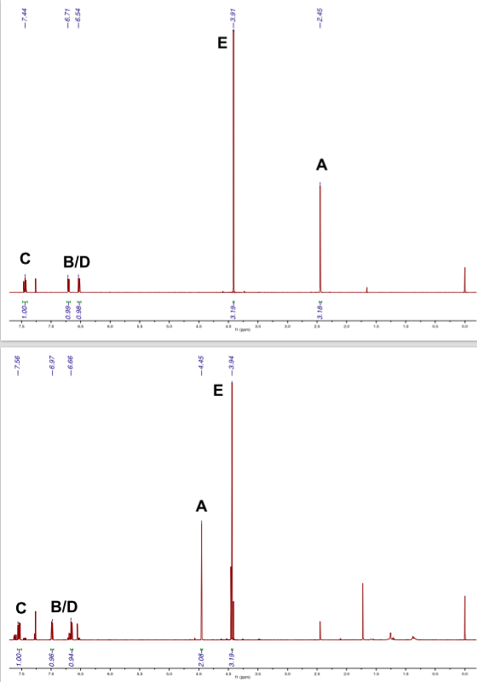
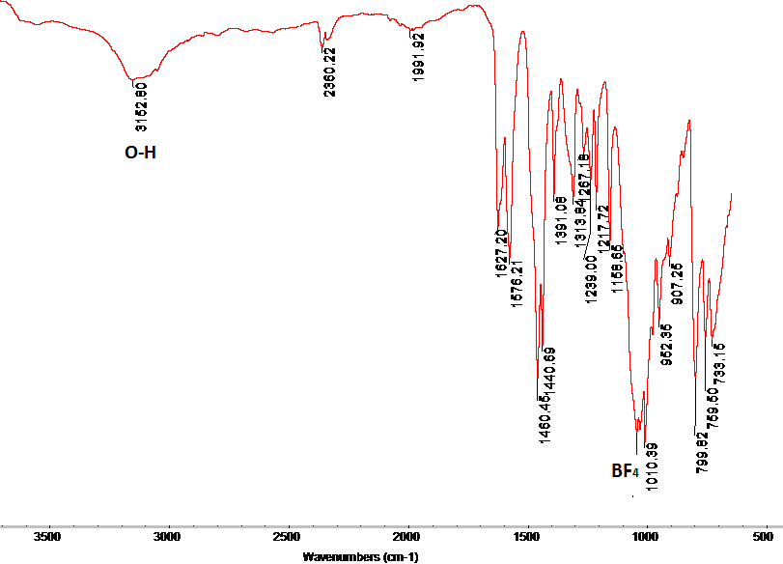
Stabilizing Transition Metal-Arylthiolate Bonds via Secondary Sphere Hydrogen Bonding
Ryan L. Hall and Samuel Pazicni. Department of Chemistry, University of New Hampshire.
Introduction
Cu (II) Arylthiolate Binding
Characterization
Metal-sulfur bonds are common motifs in the active sites of enzymes. Metalloenzyme active sites are also known to be hydrogen-bond rich, and these interactions are theorized to play a significant role in enzymatic activity. This work aims to create simple model complexes containing a metal-sulfur bond in a hydrogen-bond rich environment, so that the impact of secondary sphere hydrogen bonding can be evaluated. Various synthetic approaches were used to bind the tetradentate ligand of interest, tris(6-hydroxypyrid-2-ylmethyl)amine (H₃thpa), to copper. Thiolate binding was attempted in both copper (II) and copper (I) systems. The metal-thiolate-H₃thpa complex has remained elusive, though previously reported metal-fluoride-H₃thpa complexes were synthesized by new means. Thiolate
binding presents additional challenges, and new
experimental conditions are sought to replace
the reported synthesis of similar
copper-H₃thpa complexes^{1,2}.
During complexation with a metal, H₃thpa undergoes tautomerization to give a structure with three hydrogen bonding donors situated above an open coordination site. Attempted arylthiolate complexation in this cavity resulted in the previously reported copper fluoride complex (Fig. 5). Fluoride abstraction from BF₄⁻ has been shown to occur in protic solvents³. Aprotic conditions were used to minimize the risk of fluoride abstraction. Attempted reaction as shown in Figure 6 also yields a fluoride complex.
Figure 9: ¹H NMR spectra of starting material 1 (top) and brominated compound 2 (bottom).
5
Figure 5: Reaction of H₃thpa with copper (II) and NaSPh in NaBF₄ to give CuF(H₃thpa)BF₄ 6 instead of CuSPh(H₃thpa)BF₄ 5
4
Figure 10: FT-IR spectrum of compound 6 whose structure was verified by single crystal X-ray diffraction.
Figure 1: H₃thpa in its 2-hydroxypyridine tautomer.
6
Ligand Synthesis
Figure 6: Reaction of H₃thpa with copper (II) and NaSPh with NaPF₆ to give CuSPh(H₃thpa)PF₆ 7 instead of the desired CuSPh(H₃thpa)PF₆ 8
7
Summary
4
The previously reported CuF(H₃thpa)BF₄ was synthesized and verified via single crystal X-ray diffraction. This differs from the reported synthesis where CsF is used as the fluoride source². Aprotic conditions, employed to minimize the risk of fluoride abstraction, also yielded a fluoride complex CuF(H₃thpa)PF₆. Reactions with CuSPh and H₃thpa have yielded only starting material.
1
2
Figure 2: Wohl-Ziegler bromination of 1 to afford 2-bromomethyl-6-methoxypyridine 2.
400 MHz ¹H NMR (CDCl₃): 7.54 (1H, dd, Ar-H), 6.98 (1H, d, Ar-H), 6.65 (1H, d, Ar-H), 4.45 (2H, s, CH₂), 3.94 (3H, s, OCH₃). Percent Yield: 65%
8
Cu (I) Arylthiolate Binding
To circumvent the use of a counter-ion, CuSPh was synthesized according to established procedure as shown in Figure 7 below. CuSPh was then combined with H₃thpa and heated to reflux. Three trials were attempted with three different solvents: benzene, toluene, and acetonitrile. Only starting material was seen as shown in Figure 8.
Acknowledgements
2
3
Kyle Rodriguez (UNH)
UNH Department of Chemistry
SURF: UNH Hamel Center
University Instrumentation Center (UNH)
Norris-Richards Undergraduate
Research Scholarship: ‘’’’=Northeast Section ACS
Christian Tooley (UNH)
Jon Briggs
Figure 3: Condensation of three units of 2 to afford tpa^{OMe} 3
400 MHz ¹H NMR (CDCl₃): 7.53 (3H, t, Ar-H), 7.23 (3H, d, Ar-H), 6.59 (3H, d, Ar-H), 3.92 (9H, s, OCH₃), 3.83 (6H, s, CH₂). Percent Yield: 47%
Figure 7: Synthetic scheme to CuSPh using established procedure⁴.
(Blue)
(Colorless)
(Yellow)
References
Figure 8: Reaction of H3thpa with CuSPh to yield only starting material. Solvents* used: benzene, toluene, acetonitrile.
Moore,C.; Quist, D.; Kampf, J.; Szymczak, N. A 3-Fold-Symmetric Ligand Based on 2-hydroxypyridine. Inorg Chem., 2014, 53, 3278-3280.
Moore, C.; Szymczak, N. Chem. Commun., 2015, 51, 5490- 5492.
Kannan, S..; Moody, M.; Barnes, C.; Duval, P. Inorg. Chem., 2006, 45 (23), 9206-9212.
Nguyen, L.; Dellinger, M.; Lee, J.; Quinlan, R.; Rheingold, A.; Pike, R. Convenient synthesis of copper (I) thiolates and related compounds. Inorg. Chim. Acta, 2005. 358 (4), 1331-1336.
3
4
Figure 4: Demethylation in triplicate of 3 to afford pyridone tautomer of H₃thpa 4
400 MHz ¹H NMR (DMSO-d₆): 11.85 (3H, s, NH), 7.35 (3H, dd, Ar-H), 6.22 (3H, d, Ar-H), 6.13 (3H, d, Ar-H), 3.40 (6H, s, CH₂). Percent Yield: 28%
4

