Slide 1
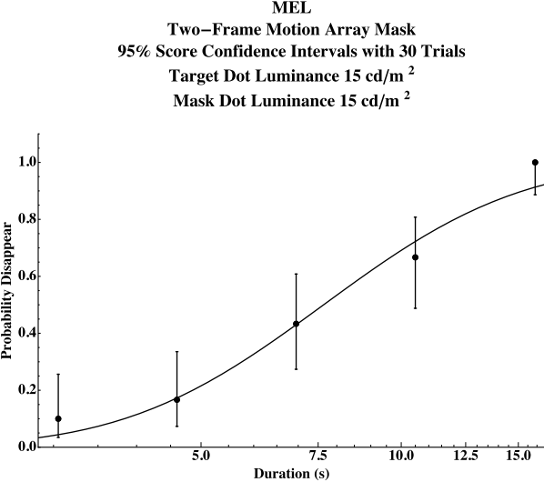
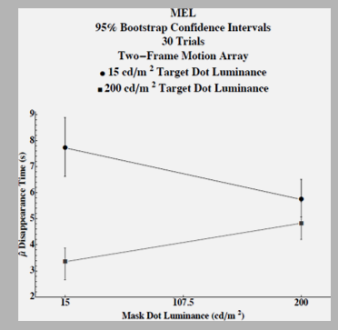
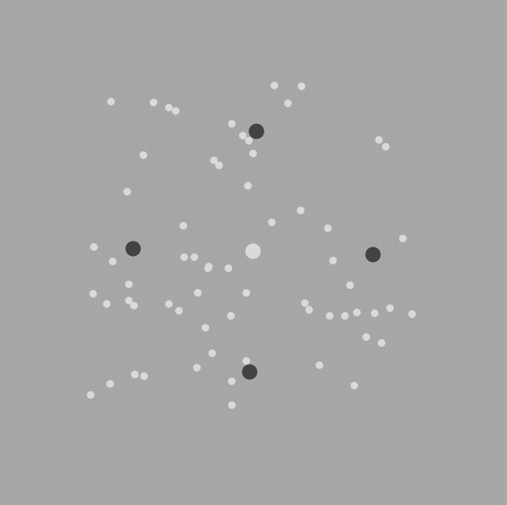

Bootstrapping Psychometric Functions in the Context of Motion-Induced Blindness
Authors: Megan E. Lusignan, Duggan, Nicholas C., Hansen, Hanne, Johnston, Jaclyn H., LeBel, Amanda, Slone, Ahlia K., Kitt, Andrew J., and Stine, Wm Wren
Psychology Department, University of New Hampshire, Durham, NH
Introduction
Results
The bootstrap method is a computer-based resampling technique that makes statistical inferences, including standard error, bias correction, and confidence intervals, using computers to simplify the intricate calculations involved in data analysis. This method is able to answer questions too complex for traditional statistical analyses, or when insufficient data is collected for reliable analysis. The bootstrap technique does not require knowledge of the population, or have a sample size greater than 30. To produce a larger data set that is able to provide more accurate statistical inferences, this method takes a finite number of weighted random samples from the original data set to produce a larger data pool. This set now includes more data that is a sound representative of the original sample.
Data were pooled across samples for one subject and the probability of perceived disappearance was determined. 95% bootstrap confidence intervals were calculated for the combinations of mask and target luminance from a psychometric curve that shows the probability of the target disappearing after several time durations. This method was able to estimate a disappearance threshold for the target and calculate its confidence interval. The top line represents the time to mask a dark target, while the bottom line represents the time to mask a light target.
Methods
Assumptions of bootstrapping:
                The sample is a valid representation of the population in question
                Sampling with replacement will occur and all subsamples will come from the original sample.
Motion-Induced Blindness Experiment
Introduction & Methods
Motion-Induced blindness is a perceptual illusion where visual stimuli disappears when masked with a moving background. Participants in the experiment ran 5 sessions, which contain 6 trials. Each trial included conditions that varied in the color of center fixation point (target), peripheral dots, and the mask.
Conclusion
The bootstrapping method was able to estimate the variability in the psychometric function and calculate a 95% confidence interval. Experiments in psychophysics often require many sessions of long and tedious series of stimulus presentations, which can sometimes result in subject fatigue or subject error. Bootstrapping allowed equivalent data sets to be drawn from substantially less stressful experiment sessions.
Participants fixated on the center dot and reported if peripheral dots disappeared in the presence of a mask. Responses were collected automatically by computer.

