Slide 1
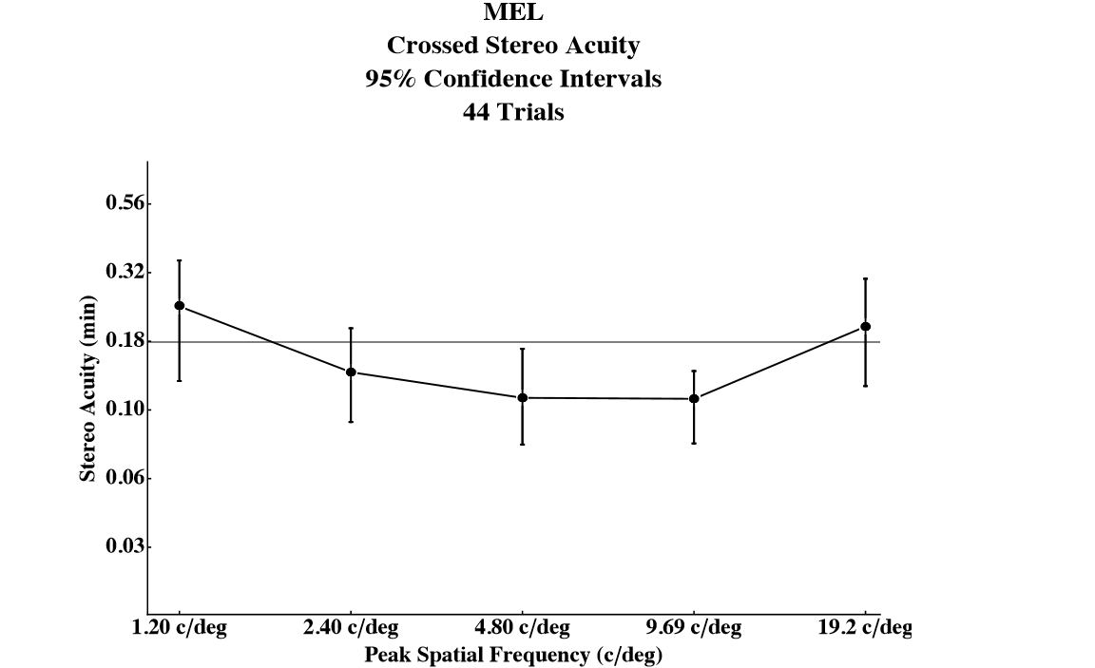
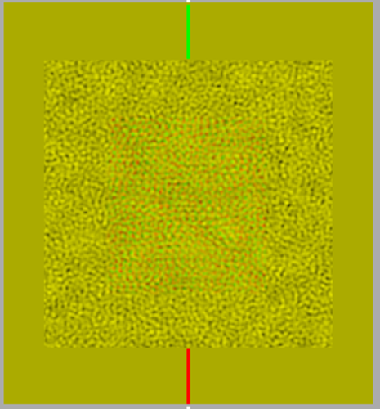
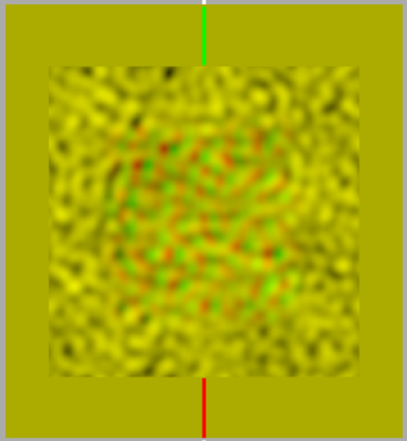
Signal Detection Analysis of a Three Alternative Forced Choice
in a Stereoacuity Context
Nicholas C. Duggan, Basmah ElFaramawi, Hanne K. Hansen, Jaclyn H. Johnston, Amanda I. LeBel, Megan E. Lusignan, Ahlia K. Slone, Andrew J. Kitt, and Wm Wren Stine
University of New Hampshire, Psychology Department, Durham, NH
Definitions
False Alarm: An outcome of a noise trial without a stimulus where the subject claims to perceive the stimulus (Tanner and Swets, 1954).
Sensitivity Threshold: The lowest level of stimulus that can be detected.
Signal Detection Theory: A system of using hit rates and false alarm rates that create separable and independent discrimination and bias values
Stereopsis: Depth perception that arises from a disparity between the images presented to the two eyes.
Results
The results are comparable to those found by Schor & Wood (1983) for all but very high spatial frequencies.
Introduction
Signal Detection theory has been an effective model for calculating bias and sensitivity thresholds for more than 60 years. A problem arises, however, with regard to three alternative forced choice scenarios because calculating the probability of a false alarm becomes ambiguous. For experiments in stereoacuity, the probability of hit rates for crossed disparities is independent of hit rates for uncrossed disparities, but there is overlap between the values normally used for false alarm rates between crossed and uncrossed disparities. Should the false alarm rate for crossed disparity noise trials include or exclude false alarm responses in which the subject was incorrect in the wrong direction? The goal of this study was to test an inclusive three way forced choice signal detection theory model for calculating false alarms by comparing sensitivity thresholds of retinal disparities across a range of spatial frequencies to pre-established data from Schor & Wood (1983).
Discussion
The similarity of results using our signal detection theory model to those found by Schor & Wood (1983) suggests that our model generates accurate data. The advantage of a reliable signal detection theory model is that it generates thresholds irrespective of bias, and therefore a more realistic representation of true thresholds. So, our results are likely more accurate. However, our high spatial frequency curves did not match at high spatial frequencies. This suggests that difference of Gaussians and random dot stereograms may be processed differently in the brain. Alternatively, variability at high spatial frequencies may be an individual difference, and Schor & Wood may not have tested enough subjects to capture it.
Methods
A set of random dot stereograms of varying spatial frequencies were generated with Mathematica to test a subject’s stereoacuity. Five different crossed, five different uncrossed disparities, and five noise trials (no disparity) were produced for each spatial frequency.
Subjects observed these random dot stereograms through a Maxwellian view system.
Subjects responded through a three alternative forced choice paradigm by choosing whether they observed the stimulus in front of the plane of the image, behind the plane of the image, or on the plane of the image.
_{Anaglyphs}
References
Schor, C. M., & Wood, I. "Disparity Range for Local Stereopsis as a Function of Luminance Spatial Frequency.” Vision Research 23.12 (1983): 1649-654
Tanner, W.P. and Swets, J. A. (1954). A decision-making theory of visual detection. Psychological Review. 61. 401-409.
Notes:
E15JCY15- Psychology Department
-Stereoacuity: how good you are at stereopsis
-local stereopsis: DOG
-global stereopsis: RDS
-spatial frequency: light across spatial dimension, graphing amount of light across space
-creates black and white bars
-Maxwellian view system: controls amount of light entering the pupil and also aligns the subject (using bite bar)
-Method of constant stimuli: all possible permutations are presented randomly and data is statistically analyzed after
-Define crossed and uncrossed disparity

