Slide 1

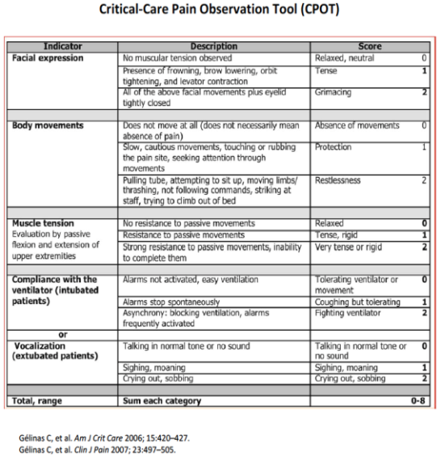
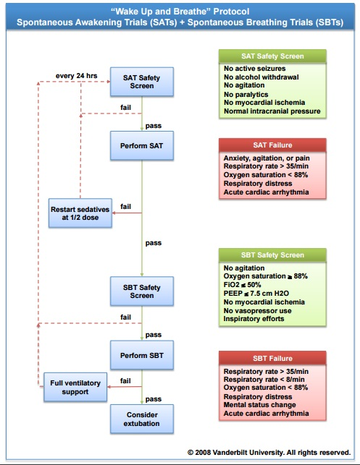
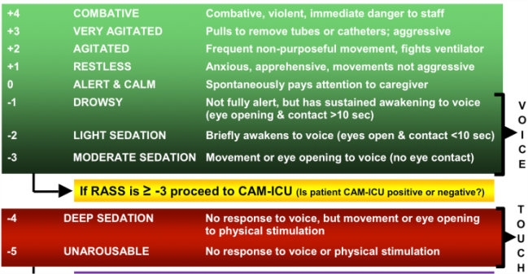
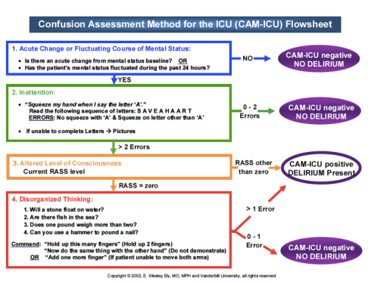
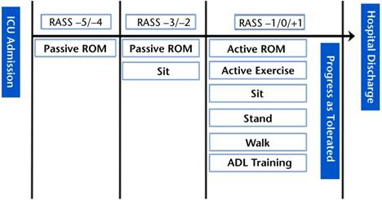
References
Barr, J., Fraser, G., Puntillo, K., Ely, E., Gelinas, C., Dasta, J., ... Jaeschke, R. (2013, January). Clinical practice guidelines for the management of pain, agitation, and delirium in adult patients in the intensive care unit. Crit Care Med, 41(1), 263-306. http://dx.doi.org/10.1097/CCM.0b013e3182783b72
Girard, T., Kress, J., Fuchs, B., Thomason, J., Schwweickert, W., Pun, B., ... Ely, E. (2008, January 12). Efficacy and safety of a paired sedation and ventilator weaning protocol for mechanically ventilated patients in intensive care (Awakening and Breathing Controlled trial): a randomised controlled trial. Lancet, 371(9607), 126-134. http://dx.doi.org/10.1016/S0140-6736(08)60105-1
Reducing Delirium in the ICU Patient:
The ABCDE Bundle
ICU Delirium and Cognitive Impairment Study Group. (2013). http://icudelirium.org/
Kanji, S., MacPhee, H., Singh, A., Johanson, C., Fairbairn, J., Lloyd, T., ... Rosenburg, E. (2016, January 16). Validation of the critical care pain observation tool in critically ill patients with delirium: A prospective cohort study. Crit Care Med. Retrieved from http://www.ncbi.nlm.nih.gov/pubmed/26783859
Klompas, M., Anderson, D., Trick, W., Babcock, H., Kerlin, M., Li, L., ... Platt, R. (2015, February 1). The preventability of ventilator-associated events. The CDC prevention epicenters wake up and breathe collaborative. Crit Care Med, 191(3), 292-301. http://dx.doi.org/10.1164/rccm.201407-1394OC
A
Assess, Prevent, and Manage Pain
B
C
Choice of Analgesia
and Sedation
Both SAT and SBT
Lack of pain treatment can result in many complications including delirium
Self-reporting of pain is the gold standard
CPOT is the most valuable and reliable behavioral pain scale for adult individuals unable to communicate the pain scale
Daily Spontaneous Awakening Trials (SAT) and Spontaneous Breathing Trials (SBT)
Coordination emphasizes narcotic and sedation titration with SBT
“Wake up and Breathe Study”
Showed pairing of SAT and SBT resulted in improved patient outcomes
Decreased time on ventilator
Reduced time spent in the ICU and the hospital
Improved one-year survival
Necessary to achieve a patient specific, appropriate balance between sedation and analgesia
Sedation scales help the medical team agree on target sedation levels
Richmond Agitation-Sedation Scale (RASS)
Duration of eye-contact as the principal means of titrating sedation
Excellent interrater reliability and validity
Levels of sedation and agitation should be monitored frequently
D
E
Early Mobility and Exercise
Delirium: Assess, Prevent, and Manage
Up to 80% of mechanically ventilated ICU patients develop delirium
Confusion Assessment Method (CAM) used in conjunction with the RASS
Leads to earlier identification and characterization of acute brain dysfunction
Early Delirium identification reduces mortality, and improves long-term cognitive and functional outcomes.
Early mobility decreases duration of delirium, days on mechanical ventilation, and ICU/Hospital length of stay.
Can be completed by multiple members of the interdisciplinary team: nurses, PT, OT, physicians
Activities range from passive ROM to ambulation, based on the patient’s RASS score

