Slide 1


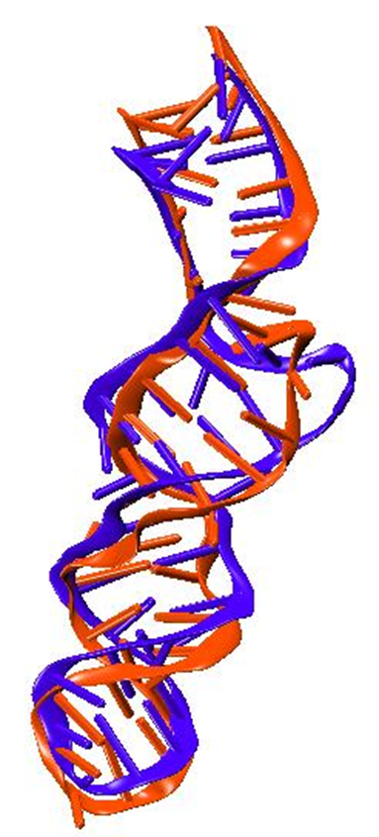
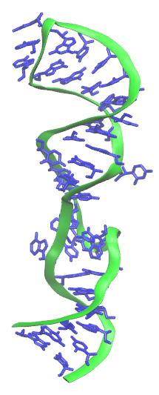
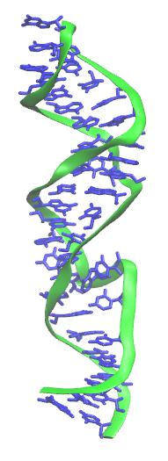
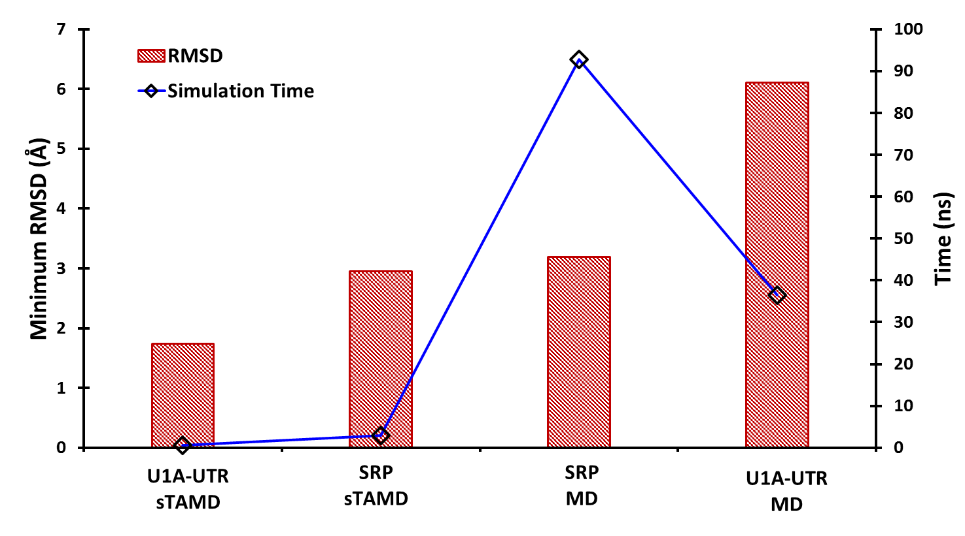
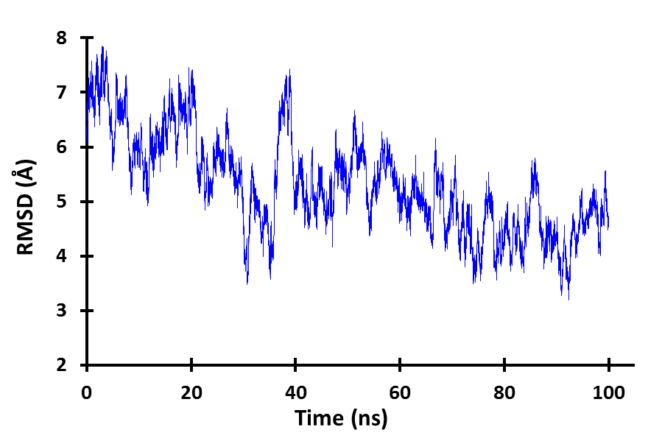
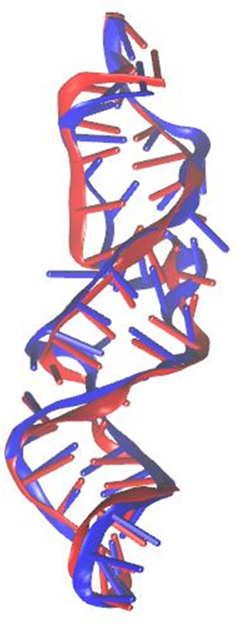
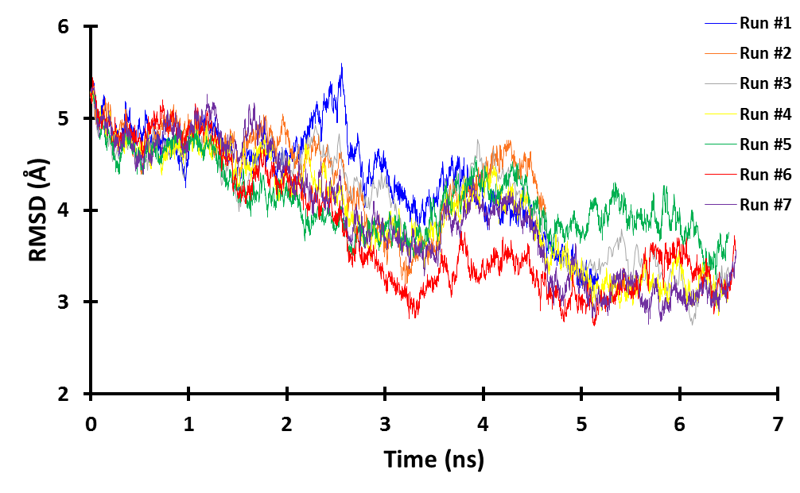
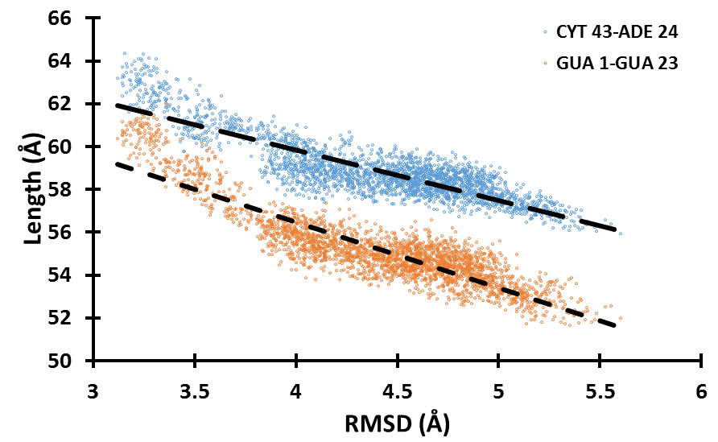
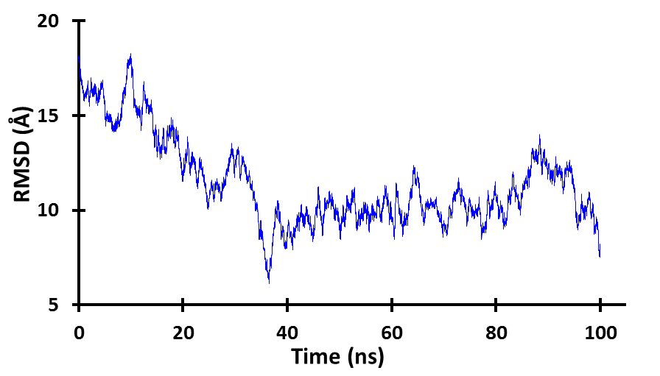
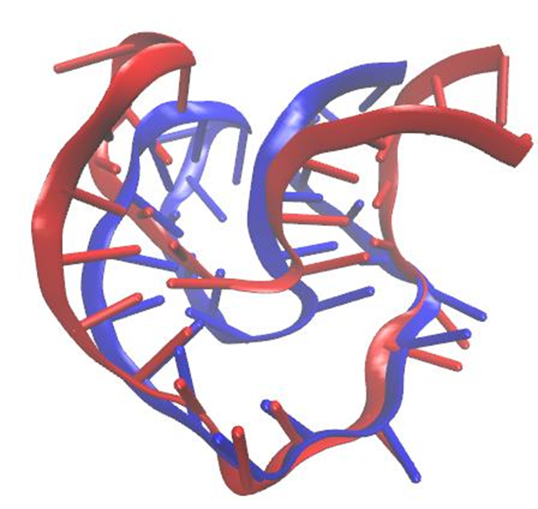
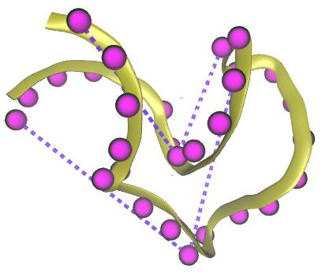
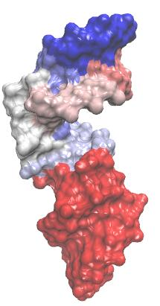
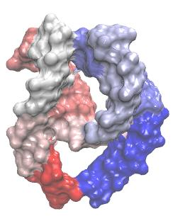
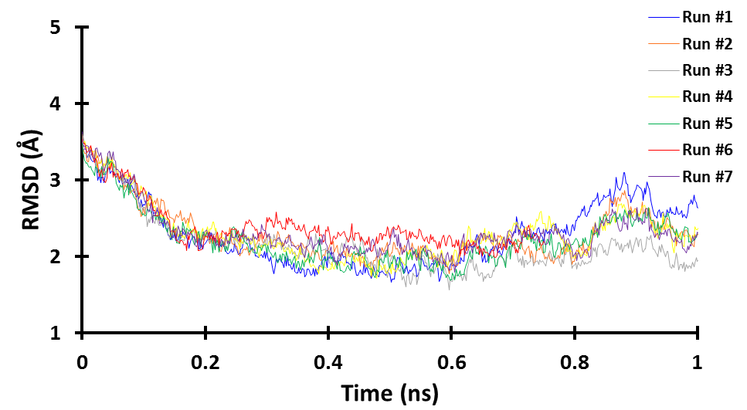
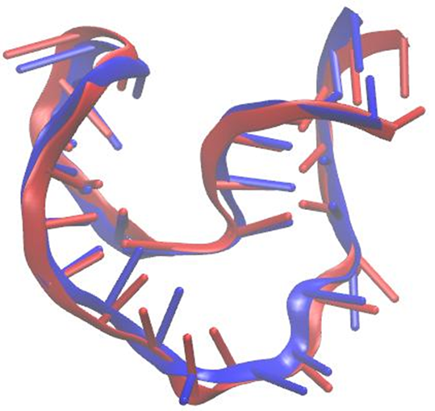
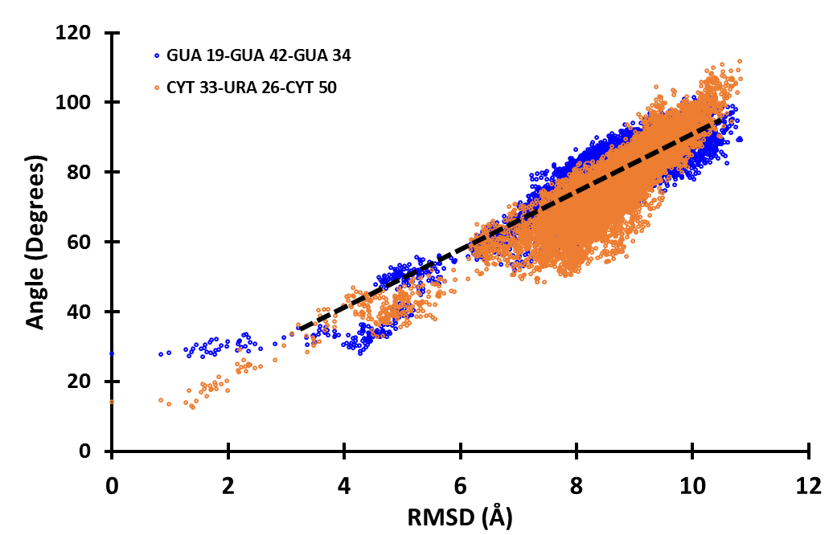

A Computational Study of RNA Structure and Dynamics
Rhiannon Jacobs and Dr. Harish Vashisth
Department of Chemical Engineering, University of New Hampshire, Durham, NH
Abstract
Results
Comparison of Simulation Techniques
Evidence from experimental characterization of structures of nucleic acids such as RNA suggests that nucleic acids are highly flexible similar to proteins, and can undergo large-scale conformational rearrangements due to motions encoded in their structure or due to binding of triggering factors such as small metabolites or proteins. These observations warrant a detailed understanding of the dynamics of RNA molecules, yet it is not possible to capture all transiently populated conformations of biomolecules using experimental methods alone. Proposed in this work is the development and application of a temperature-based enhanced sampling simulation methodology that has proven successful in the study of conformational changes in proteins. Extending this methodology for application to nucleic acids will increase its scope not only for understanding RNA dynamics, but also for understanding RNA-protein complexes. The technique will be tested on small RNA molecules that are known to undergo large-scale conformational transitions. A better understanding of variables that can be accelerated in molecular dynamics (MD) simulations will help in the development of improved simulation algorithms and methodologies to characterize structural flexibility of RNA.
SRP RNA
Ribonucleic Acid (RNA)
Figure 1: Plot displaying root-mean-squared-deviation with respect to a second state for a classical MD simulation with respect to simulation time.
Figure 4: State 1.
Figure 5: State 2.
One type of nucleic acid
Responsible tor cellular function and heredity
Experimental data has revealed that multiple types of RNA exist based upon function
Multiple conformations of the same RNA exist
Figure 12: Comparison between simulation time (ns) and the minimum root-mean-squared-deviation (Å) for classical molecular dynamics simulation (MD) technique and the enhanced sampling (sTAMD) technique for each RNA.
Applications
Methodology
Figure 2: State 2 (red) overlaid with the closest conformation from simulation data (blue) for MD simulation (top) and sTAMD simulation (bottom).
Figure 6: Plot of RMSD versus length of RNA measured from the center of mass of base pairs CYT 43—ADE24 (blue) and GUA 1—GUA23 (orange).
Understanding the conformational landscape of small biomolecules such as RNA can contribute to:
Drug design and delivery,
RNA-protein interactions,
Substrate binding.
Molecular dynamics simulation is a computer based approach to statistical mechanics which allows for an estimation of equilibrium and dynamic properties of a complex system that cannot be done analytically.
Approach to evolve positions of a system of particles in time, where particles interact with each other under a complex potential function.
Operate on the principle of classical mechanics; where F=ma.
Structural files obtained from the Nucleic Acid Database
Force Field Parameters: CHARMM 36
Solvated in a water box
Temperature Accelerated Molecular Dynamics (TAMD)
Enhanced sampling method based upon the use of collective variables (CV’s).
Collective variables: functions of atom Cartesian coordinates
Selected as center of mass of spatially continuous atoms
6 subdomains → 18 CV’s
Steered Temperature Accelerated Molecular Dynamics (sTAMD)
Enhances likelihood of largescale conformational change by adding a harmonic biasing potential
Technique has proven effective for proteins, new to nucleic acids
Software
Visual Molecular Dynamics (VMD): visualization software which displays, animates, and analyzes biomolecular systems using 3D graphics.
Nanoscale Molecular Dynamics (NAMD): simulation software which is distinctly designed for high performance simulation of biological systems
Figure 3: Plot displaying root-mean-squared-deviation with respect to a second state for a sTAMD simulation with respect to simulation time.
U1A-UTR RNA
Conclusions
Enhanced simulation techniques display that the same RNA at an initial conformation can achieve a second known conformation;
The pathway the RNA takes as it trends to a second conformation exhibit great variability;
Enhanced sampling method (sTAMD) approaches the second state in less time than with classical MD;
“Hinge-like” opening of U1A-UTR-RNA is major conformational change;
Greater analysis and on more systems is necessary before trends can be confirmed.
2
1
Figure 10: Two angles used to measure flexibility of U1A. Angle 1 defined by GUA 19-GUA 42-GUA 34 and angle 2 defined by CYT 33-URA 26-CYT 50.
Figure 7: Plot displaying root-mean-squared-deviation with respect to a second state for a MD simulation with respect to simulation time.
Acknowledgements
I would like to thank my advisor Dr. Harish Vashisth,
University of New Hampshire Department of Chemical
Engineering, and the UNH McNair Scholars Program.
We are grateful to the National Science Foundation for
support through grant No. CBET-1554558.
CV subdomains
References
Figure 9: State 2 (red) overlaid with the closest conformation from simulation data (blue) for MD simulation (top) and sTAMD simulation (bottom).
[1] Vashisth, Harish, and C. L. Brooks, III. "Conformational Sampling of Maltose-Transporter Components in Cartesian Collective Variables Is Governed by the Low-Frequency Normal Modes. "Journal of Physical Chemistry Letters 3.22 (2012): 3379-384. 01 Nov. 2012. Web. 07 Mar. 2016.
[2] Vashisth, H., Skiniotis, G., & Brooks, C. L. III (2014). Collective variable approaches for single molecule flexible fitting and enhanced sampling. Chemical Reviews, 114, 3353- 3365.
[3] Al-Hashimi, H. M.; Walter, N. G (2008). RNA dynamics: It is about time. Current Opinion in Structural Biology, 18, 321– 329
[4] Bailor et al. (2011). Topological constraints: using RNA secondary structure to model 3D conformation, folding pathways, and dynamic adaptation. Current Opinion in Structural Biology, 21, 296-305.
[5] Maragliano, L.; Vanden-Eijnden, E (2006). A temperature accelerated method for sampling free energy and determining reaction pathways in rare events simulations. Chemical Physics Letters, 426, 168– 175.
Figure 8: Plot displaying root-mean-squared-deviation with respect to a second state for a sTAMD simulation with respect to simulation time.
Figure 11: Plot of RMSD versus Angle 1 defined by GUA 19-GUA 42-GUA 34 (purple) and Angle 2 defined by CYT 33-URA 26-CYT 50 (orange) to characterize movement of the RNA.

