Slide 1
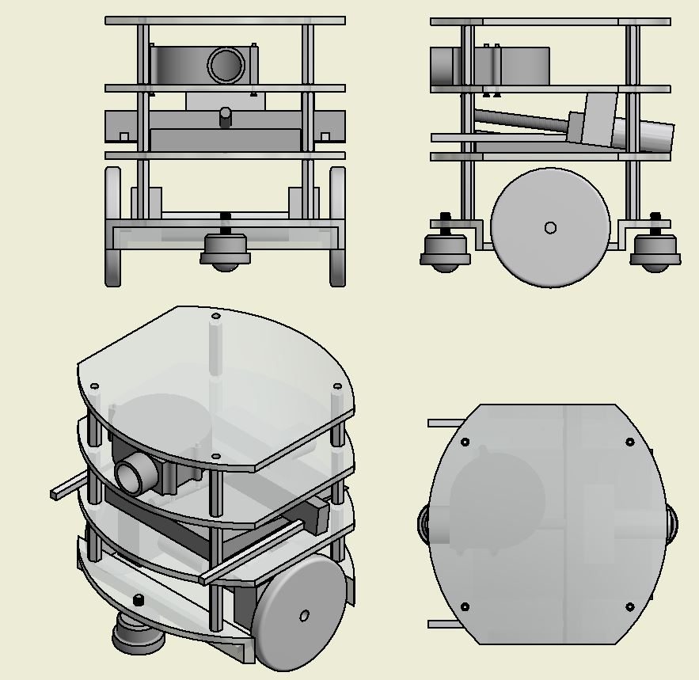
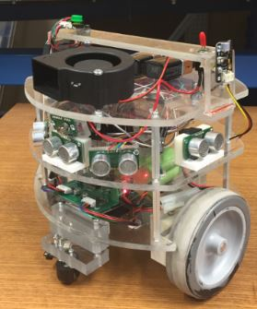
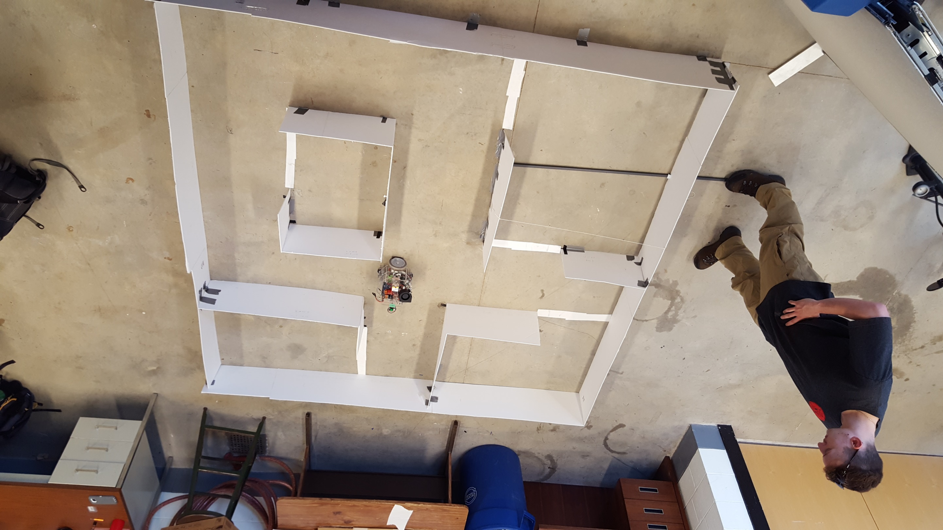
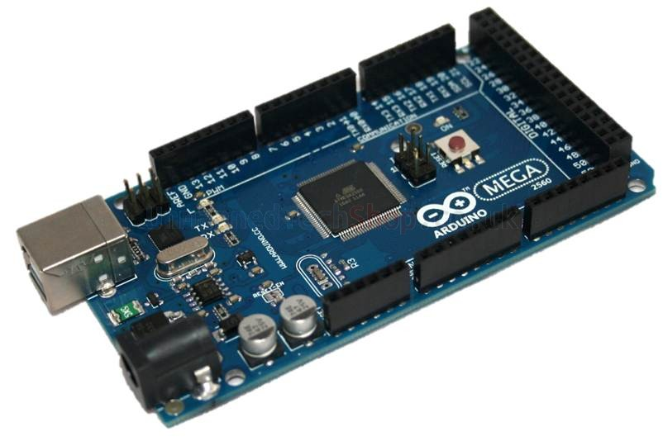
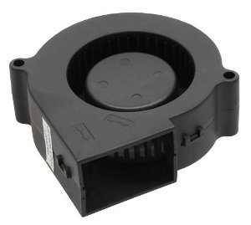
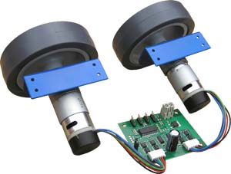
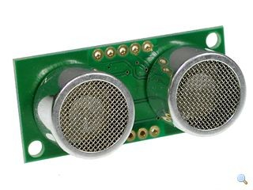
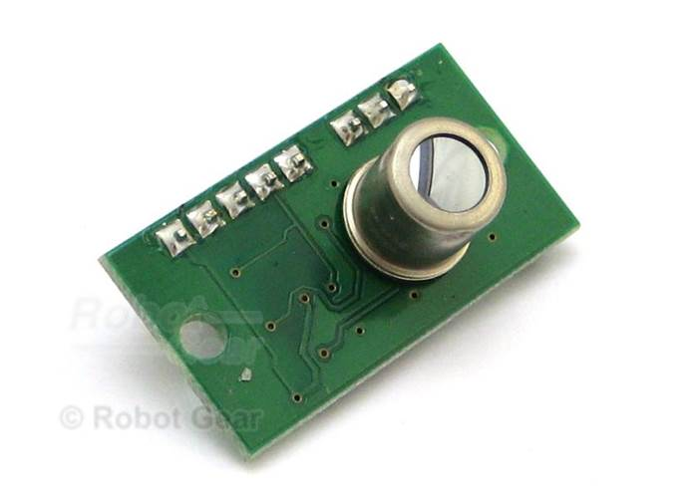
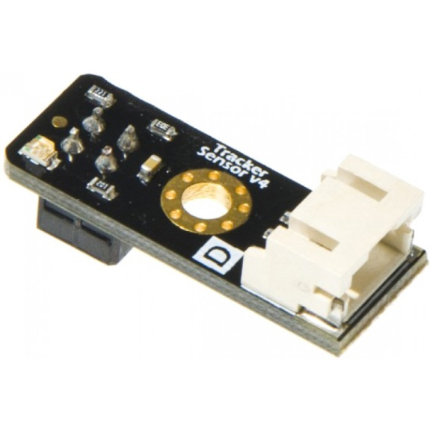
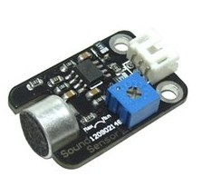


Introduction
UNH FIREFIGHTING ROBOT
Ryan Morin, Craig Shurtleff, Andrew Levenbaum, Stephen Tobin, and Liam O’Connor
University of New Hampshire: College of Engineering and Physical Sciences
Robot Capabilities
This robot was designed to compete in the Trinity College Firefighting Robot Competition.
This robot must be capable of navigating a maze with obstacles, detecting a flame, extinguishing that flame, and returning to the starting point.
Using strict design criteria laid out in the competition rulebook, the team designed and constructed the robot using both purchased and fabricated materials.
The robot is designed around the idea of center-axis rotation criteria in order to navigate and turn easily.
The navigation algorithm is a right wall follow technique which is used extensively in maze solving algorithms.
The robot uses dead reckoning with sensor integration to make its way through the maze.
The robot uses a top mounted fan as an extinguishing method.
Successfully activated through toggle switch
Identify walls and successfully adjust course to avoid collision
Confidently traverses a 1 cm rug lip and its surface
Using white line sensors, the robot can identify when it has entered a room.
Can effectively follow a lit flame by means of the thermal array sensor
Fully capable of extinguishing the flame
The robot utilizes the right wall follow navigation algorithm.
The integration of sensor information provides means of navigating through the maze and around obstacles.
Hardware
Sensors
The robot has the following three main components:
This robot needs to take in information from multiple sensors, interpret that information, and then use that information to navigate through the maze in order to find the flame and extinguish it.
The robot uses multiple sensors to gather data including: ultrasonic sensors, thermal array sensors white line sensors, and an analog sound sensor.
MD25 Motor Driver
DC Brushless Motors
Arduino MEGA microcontroller
Top Mounted 5V radial fan
Additional hardware components include:
  Bread board
  Relay switch with a 7407 non-inverting hex buffer
  Push button
  Kill Switch
  12 V rechargeable Ni-MH and 9 V batteries
  Red LED
Future Considerations
An additional task in the competition was a search and rescue mission. In order to accomplish this goal the addition of a mechanical arm was necessary.
We have designed a mechanical arm that works much like a forklift. The next step would be to implement this arm on the robot .
Although, the fan is efficient, replacing it with a CO₂ canister and valve system would yield more points and be more effective.
Given more time, we would like to be able to include a “return trip” algorithm that brings the robot back to its starting position once the task is completed.
Implementation of full sound activation
Revision and further research on Arduino coding in order to develop a more effective navigation algorithm.
SRF05 Ultrasonic Sensor
Used for range finding and wall correction
TPA81 8-pixel Thermal Array Sensor
Used for flame detection and flame alignment
Design Process
Most important criterion were size, mobility, and simplicity.
In order to navigate well within tight time and space restrictions, center-axis rotation was key (especially for corners) as opposed to a multi-axis turning radius as seen in cars.
Building off this, the robot was chosen to have a multi-tier cylindrical plexi-glass body, maintaining equidistant symmetrical sensors.
The robot navigates using an MD25 motor controller and an Arduino MEGA microcontroller connected directly to the DC brushless motors.
To ensure mobility and simplicity, the two DC brushless motors were bolted under the first tier; Furthermore the battery pack and motor driver were mounted directly above for ease of wiring.
Spherical bearings were placed in the front and back to guarantee stability.
The extinguishing method was chosen to be a top mounted radial fan.
Once fully constructed, a maze matching competition dimensions was built for testing.
Tracker Sensor V4
Used for white line detection when entering rooms
Analog Sound Sensor
Used for sound activation

