Slide 1
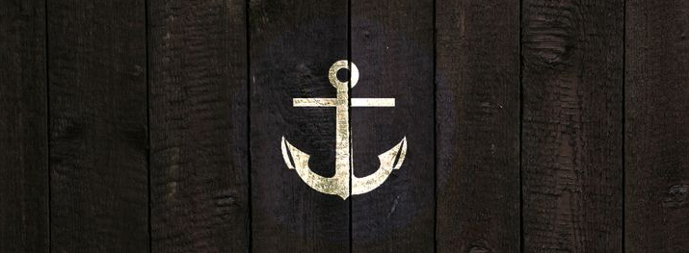

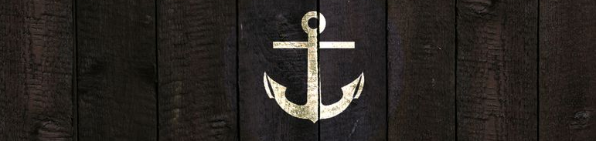

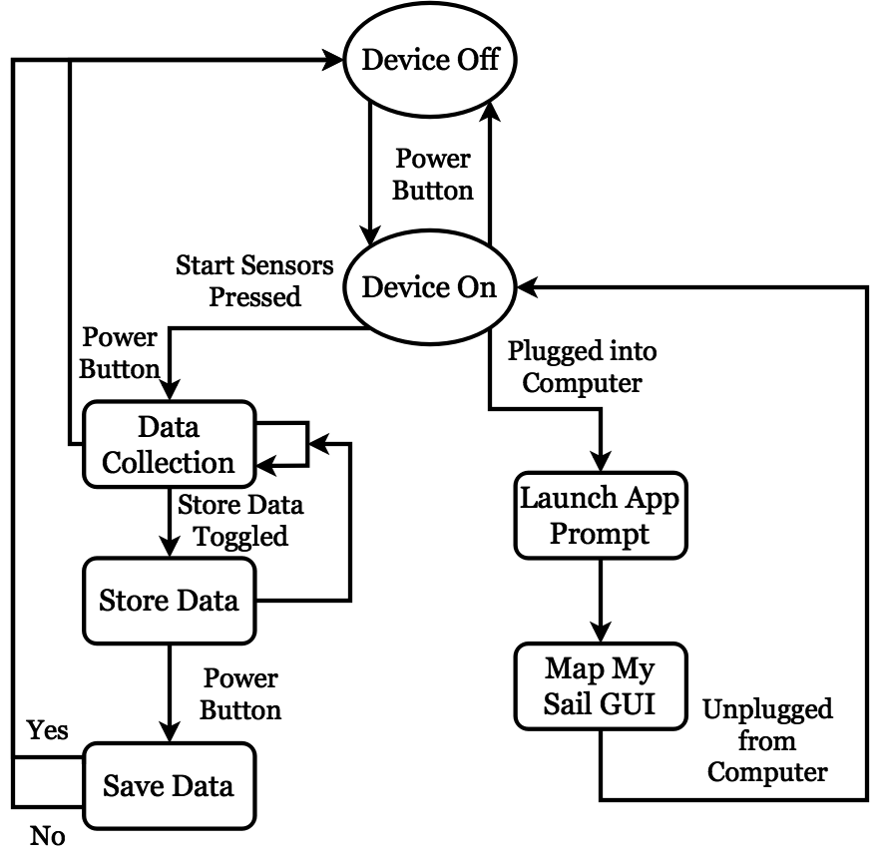
Sailing Information System
Department of Computer Science
Advisor: Radim Bartos
Alexander Clarke Eliza Hunt-Hawkins
Ian Powell Kim Xuan Tran
Background
Usage
Issues
The nautical environment is not ideal for common electronic sensory devices, and many devices that do exist are expensive or do not collect data into one utility.
For sailors of any skill level on small boats
Display screen on device shows processed data
Smartwatch can be worn by sailor to view data from anywhere on a boat
Application allows viewing of past excursions
Cannot directly access smartwatch Bluetooth properties
Display refresh rate doesn’t allow fast cycling through screens and affects the UI design
Goals
Conclusion
Combine and display data from multiple sensors into one low-cost, waterproof device
Make data viewable from anywhere on a boat using a smartwatch connected via Bluetooth
Store data so that it can be accessed later with a computer application
Multiple sensor data is processed and combined
Data is shown in real-time on the display
Data is stored into database for future use
Smartwatch is connected and has basic Bluetooth communication with the R. Pi
Fully designed user interactions
Procedure
Sensors send raw data to processor
Data is smoothed and converted
Processor sends data to displays
Components
Future Work
Raspberry Pi 2 Model B | Combines multiple sensor data and stores it
Pebble Time Round | Mobile display platform
2.7in. E-Paper Display | Onboard display
L3GD20H | 3-axis gyroscope
LSM303 | 3-axis magnetometer 3-axis accelerometer
MTK3339 | GPS module
BMP180 | Barometer, thermometer, & altimeter
Implement Bluetooth data transfer
Write a complete application to allow the user to interact with data from previous sails
Construct a waterproof case to contain all components
Add additional sensors, e.g., wind speed, water current, etc.
Create a navigational aid feature

