Slide 1

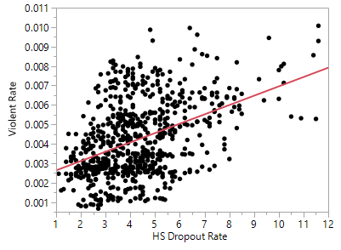
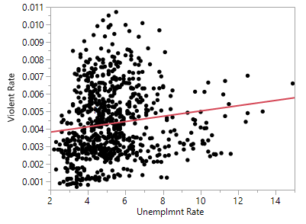
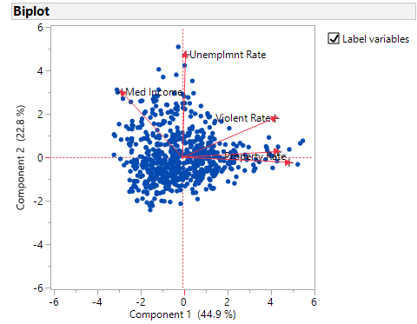
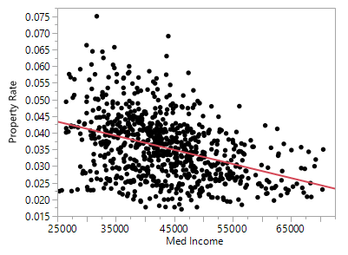
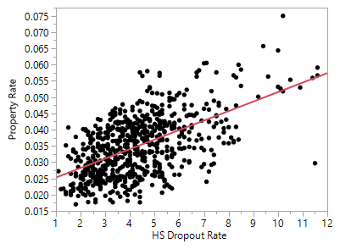
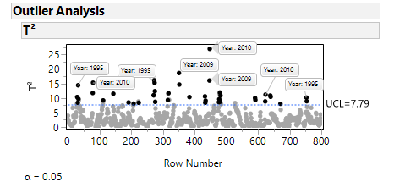
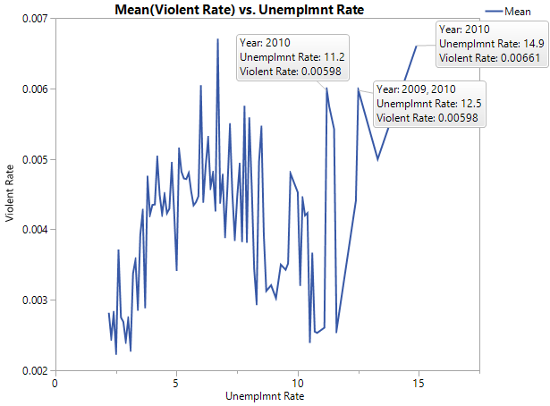
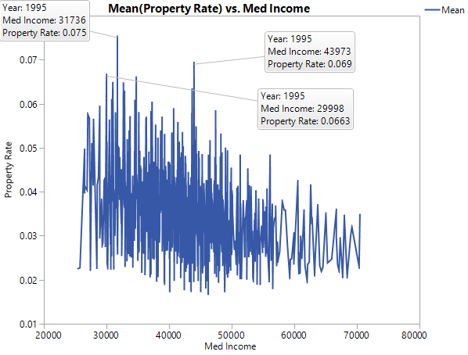
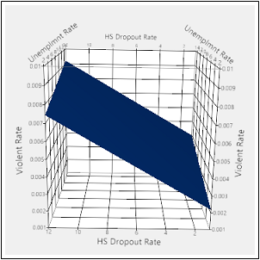
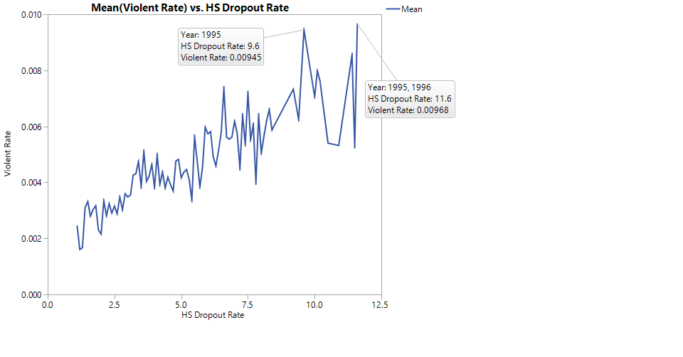
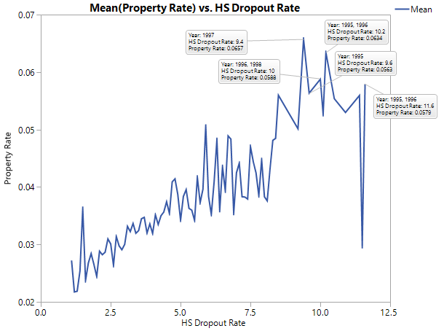
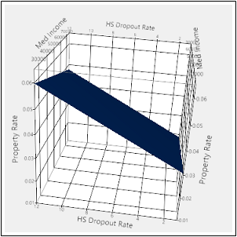
Economic Effects on Crime Rate
Erin Gallagher
Faculty Advisor: Michelle Capozzoli, Ph.D
Introduction
Violent Crime Rate= 0.0014448 + 0.0001362*UnemplmntRate + 0.0004771*HSDropoutRate
Findings
Studies have been conducted that found relationships between property crime rates and both low income and high unemployment rate due to the monetary gain of committing property crimes ^{[2] [3]}
Between 2007 and 2009, the national unemployment rate rose by 4.7%, the poverty level increased by 1.3% and an annual average of $2,700 of household income was lost in response to the 2008 Recession ^{[4]}
Studies have shown that high school dropouts are 3.5 times more likely than high school graduates to be arrested ^{[1]}
PropertyCrimeRate= 0.0341905 – 0.0000002429*MedIncome + 0.0026386*HSDropoutRate
Positive relationship found between high school dropout rate and both types of crime
Inverse relationship found between median household income and property crime
The most influential factors in the Violent Crime Rate model were unemployment rate and high school dropout rate
The most influential factors in the Property Crime Rate model were median household income and high school dropout rate
Following the recession, there was an increase in both unemployment rate and violent crime rate
Years of high property and violent crime rate also had highest high school dropout rates
Purpose
The aim of this research was to explore relationships between crime rates and unemployment rate, percent in poverty, median household income, and high school dropout rate.
Conclusion
Violent Crime Rate Surface Plot
Overall, this research provides additional evidence to support the idea that there are relationships between both violent and property crime rates and different economic factors.
Methods
References
Multiple Regression Analysis
Principal Component Analysis
Visual representations through graph building
All analyses performed through JMP Pro Statistical Software
Property Crime Rate Surface Plot
[1] Christeson, Bill, Brian Lee, Stephanie Schaefer, David Kass, and Soren Messner-Zidell. School or the Streets: Crime and America's Dropout Crisis. Rep. Fight Crime: Invest in Kids, 2008. Web. 3 Apr. 2016.
[2] Gould, Eric, Bruce Weinburg, and David Mustard. "Crime Rates and Local Labor Market Opportunities in the United States: 1979–1997." Review of Economic and Statistics 84.Feb. 2002 (2002): 45-61. MIT Press Journals. The MIT Press, Feb. 2002. Web. 3 Apr. 2016.
[3] Krivo, Lauren, and Ruth Peterson. "Extremely Disadvantaged Neighborhoods and Urban Crime." Oxford Journals 75.2 (1996): 619-48. Multilevel Study Finds No Link Between Minimum Wage and Crime Rates. Oxford University Press, Dec. 1996. Web. 03 Apr. 2016.
[4] Mishel, Lawrence, Josh Bivens, Elise Gould, and Heidi Shierholz. "The Great Recession: Causes and Consequences." State of Working America. 12th ed. N.p.: Cornell UP, 2012. 12-22. State of Working America. Economic Policy Institute, Nov. 201212. Web. 03 Apr. 2016.

