Slide 1

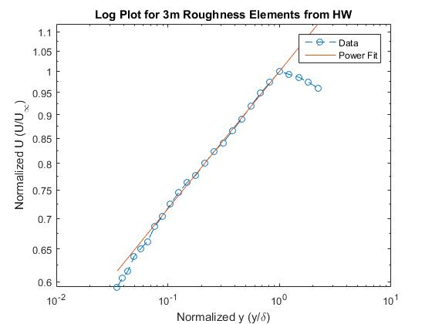
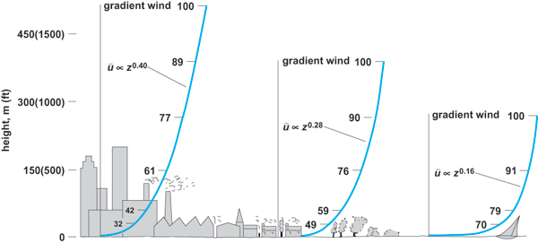
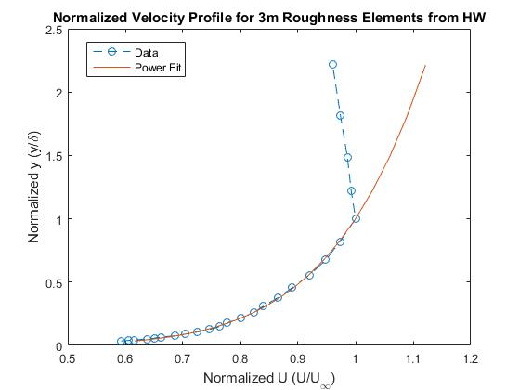
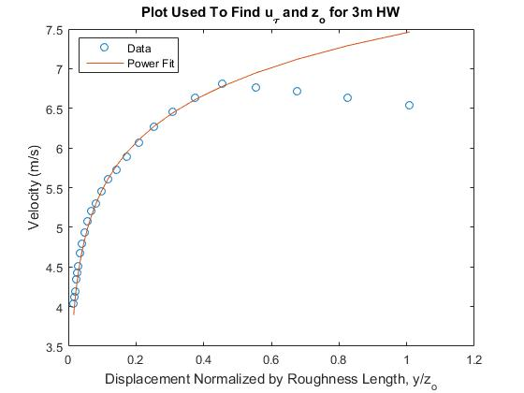
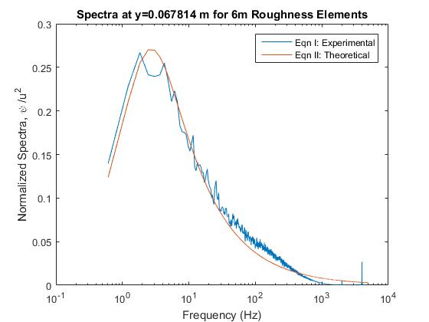
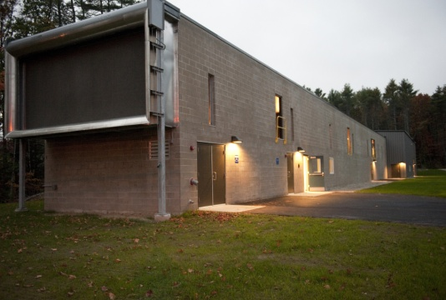
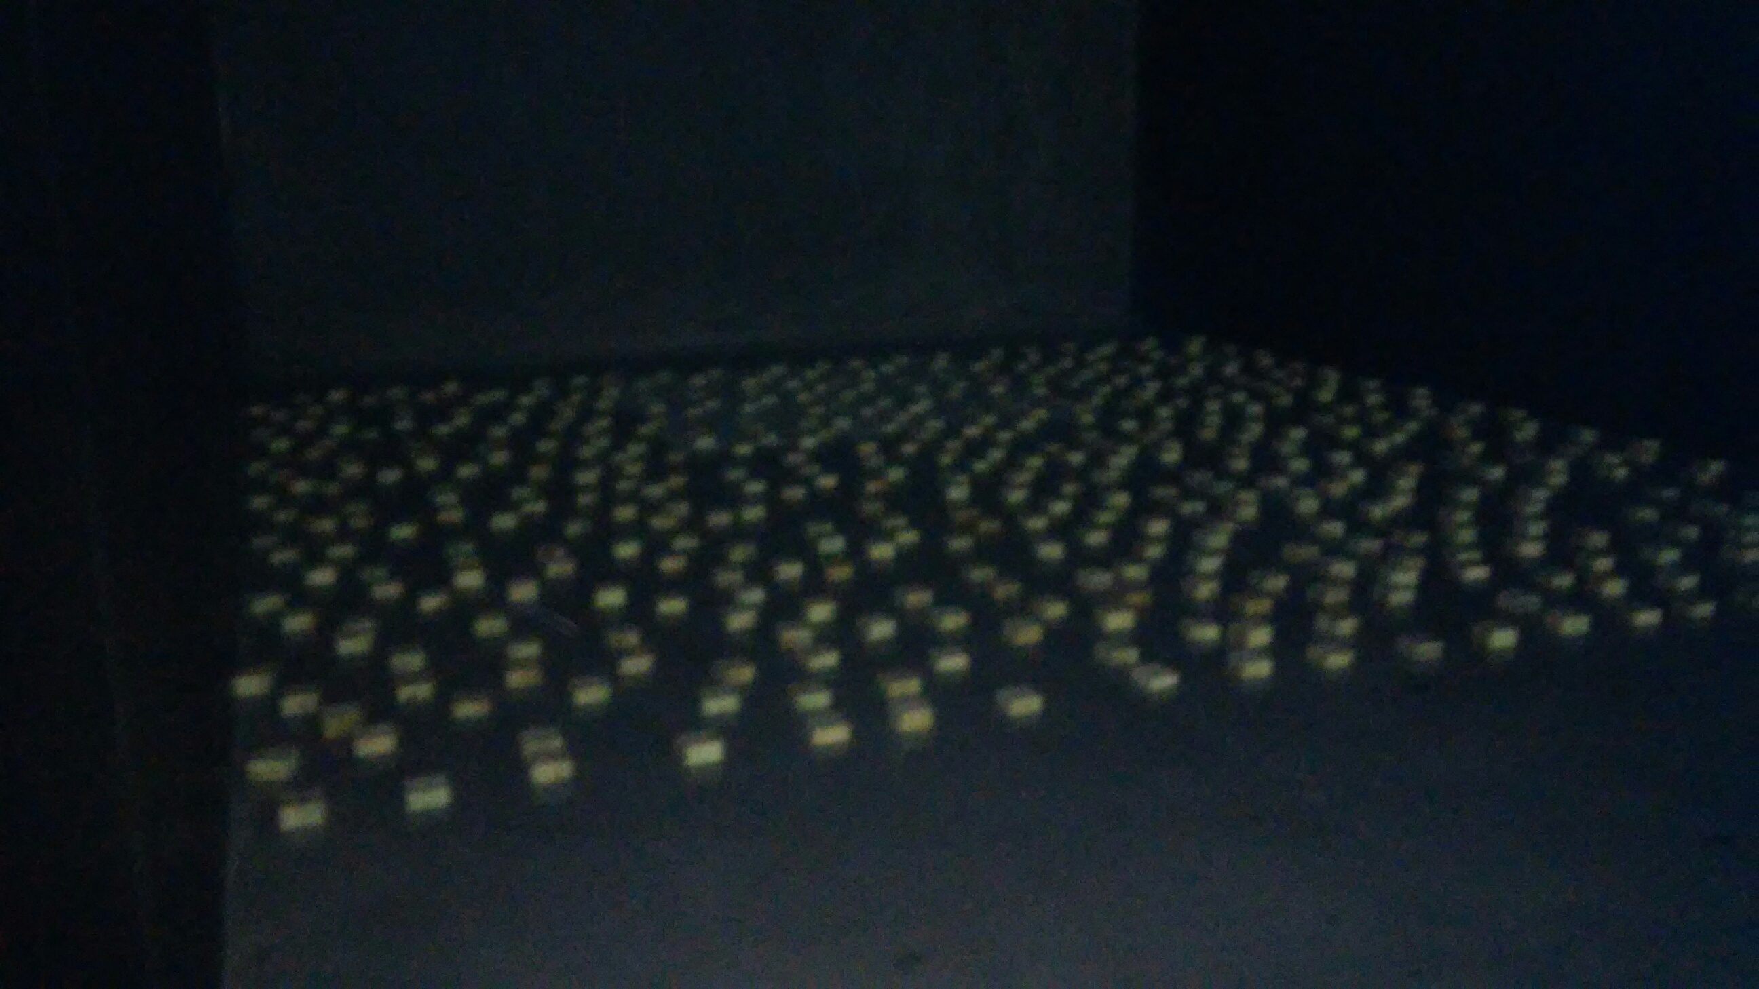
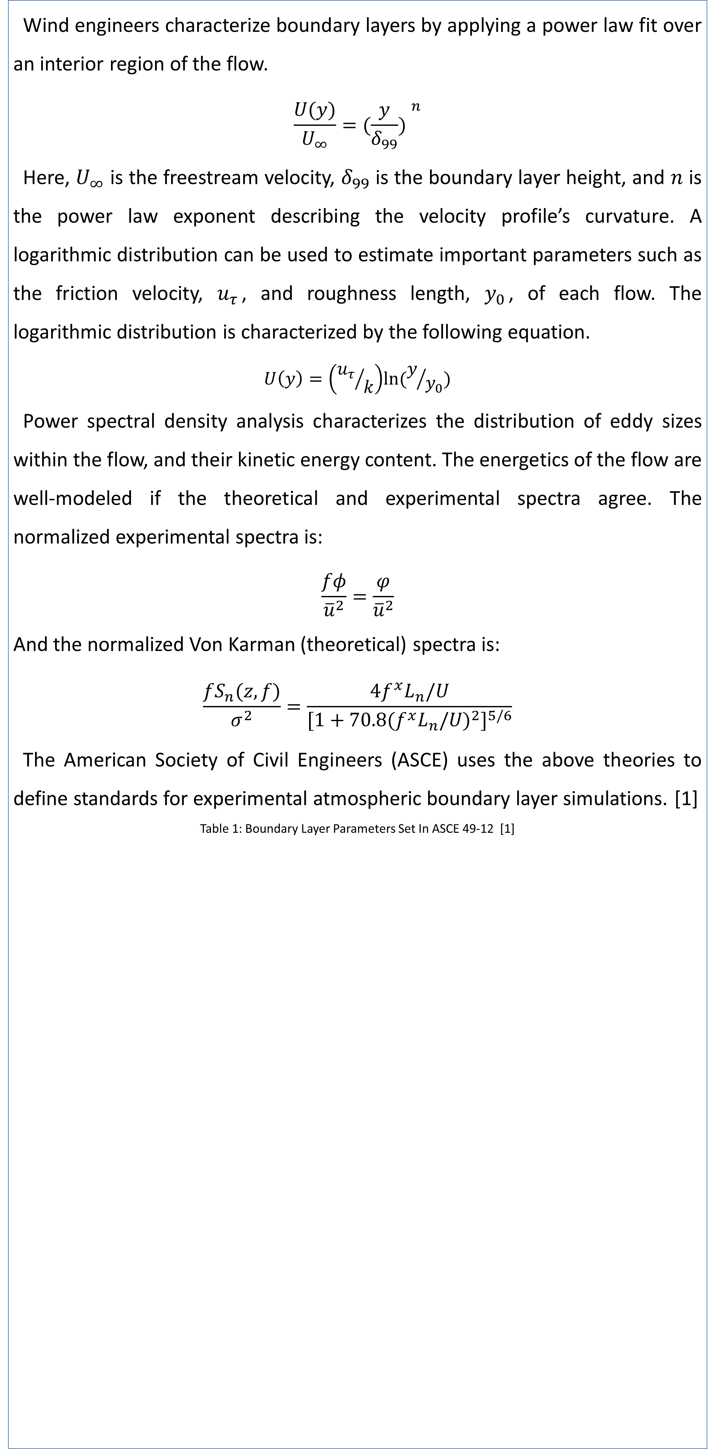
Physical Modeling of the Atmospheric Boundary Layer in the UNH Flow Physics Facility
Stephanie Gilooly and Gregory Taylor-Power
Advisors: Dr. Joseph Klewicki, Dr. Martin Wosnik, John Turner V
Background
Methods
Results
The Atmospheric Boundary Layer (ABL) is the lowest part of the atmosphere, and it is formed when air flows over the earth’s surface. The ABL wind profile is the reason that wind speeds are faster at higher altitudes.
Obstacles like cities, forests, and hills affect the shape of the ABL, and these different shapes can be modeled in a wind tunnel. When using scale models to design tall structures or predict local wind speeds, it is necessary to ensure the approaching flow has the same characteristics as the ABL.
Wind engineers characterize boundary layers by applying a power law fit over an interior region of the flow.
$$\frac{U(y)}{U_{∞}}={(\frac{y}{δ_{99}}) }^{n}$$
Here, $U_{∞}$ is the freestream velocity, $δ_{99}$ is the boundary layer height, and $n$ is the power law exponent describing the velocity profile’s curvature. A logarithmic distribution can be used to estimate important parameters such as the friction velocity, $u_{τ}$, and roughness length, $y_{0}$, of each flow. The logarithmic distribution is characterized by the following equation.
$$U\left(y\right)=\left({u_{τ}}/k\right)ln⁡(y/{y_{0}})$$
Power spectral density analysis characterizes the distribution of eddy sizes within the flow, and their kinetic energy content. The energetics of the flow are well-modeled if the theoretical and experimental spectra agree. The normalized experimental spectra is:
$$\frac{fφ}{{\overline{u}}^{2}}=\frac{φ}{{\overline{u}}^{2}}$$
And the normalized Von Karman (theoretical) spectra is:
$$\frac{fS_{n}(z,f)}{σ^{2}}=\frac{4f^{x}L_{n}/U}{{[1+70.8{(f^{x}L_{n}/U)}^{2}]}^{5/6}}$$
The American Society of Civil Engineers (ASCE) uses the above theories to define standards for experimental atmospheric boundary layer simulations. [1]
Table 1: Boundary Layer Parameters Set In ASCE 49-12 [1]
The figures show examples of a power law fit, a logarithmic law fit, and a comparison of the measured and theoretical power spectra. They fit the data very well for the entire boundary layer. The flow outside of the boundary layer is the freestream velocity and no longer increases exponentially. The regions in which the experimental spectra were comparable to the theoretical were determined using root mean square difference (RMSD) criteria. The table below lists the calculated parameters, including the regions where the power law and power density spectral density methods are applicable.
Table 2: Experimental Results from March 2016 Data
Figure 1: Atmospheric Boundary Layers on Varying Terrain [3]
Research Objectives
The overall objectives of this study are to:
Generate different types of scale models of the ABL for testing in the UNH Flow Physics Facility. These models are developed through the design and construction of various roughness elements.
Measure the resulting boundary layer properties and compare these to existing wind engineering standards.
 | Fetch Length | Power Law Exponent | u_{τ} (m/s) | δ₉₉ (m) | y₀ (m) | Power Law Region (m) | Spectral Region (m)
Hot Wire | 0 m | 0.174 | 0.36 | 0.24 | 3.44E-04 | 0-0.24 | 0.021-0.087
 | 1 m | 0.124 | 0.32 | 0.37 | 4.55E-05 | 0-0.37 | 0.018-0.19
 | 3 m | 0.145 | 0.25 | 0.46 | 1.74E-04 | 0-0.46 | 0.020-0.21
 | 6 m | 0.158 | 0.24 | 0.46 | 3.16E-04 | 0-0.46 | 0.022-0.31
Pitot Tube | 0 m | 0.158 | 0.32 | 0.20 | 2.22E-04 | 0-0.20 | -
 | 1 m | 0.131 | 0.31 | 0.29 | 6.31E-05 | 0-0.29 | -
 | 3 m | 0.145 | 0.33 | 0.39 | 3.79E-05 | 0-0.39 | -
 | 6 m | 0.132 | 0.32 | 0.47 | 9.94E-05 | 0-0.47 | -
The UNH Flow Physics Facility
Class | Terrain Description | (z_{o})_{r}^{n} (m) | n^{b} | Exposure^{f}
1 | Open Sea, fetch at least 3 miles | ~0.0002 | 0.10 | D
2 | Mud flats, snow; no obstacles | 0.005 | 0.13 | ----
3 | Open flat terrain; grass | 0.03 | 0.14 | C
4 | Low crops; occasional large obstacles | 0.10 | 0.18 | ----
5 | High crops; scattered obstacles | 0.25 | 0.22 | B
6 | Parkland, bushes: numerous obstacles | 0.5 | 0.29 | ----
7 | Suburb/Forest | 1.0-2.0 | 0.33 | A
8 | City - high- and low-rise buildings | >2 | 0.40-0.67 | ----
Conclusions and Future Work
Figure 2: Flow Physics Facility in Durham, NH [4]
The Flow Physics Facility (FPF) at UNH has test section dimensions W=6.0 m, H=2.7 m and L=72 m. The FPF was designed to study high Reynolds number turbulent boundary layers and, for smooth surfaces, produces boundary layers on the order of 1 meter. [4] The large test section of the FPF offers considerable potential for wind energy and wind engineering studies.
Power Laws fit the mean profile data in the rough-wall FPF boundary layer.
The experimental power density spectra showed excellent agreement with the Von Karman spectra (theoretical spectra).
Consistent with known ABL behaviors, the regions where the power law and spectra agree increases with additional roughness elements.
From our experiments, we conclude that the FPF wind tunnel can be configured to generate an accurate model of the ABL for wind engineering purposes. We recommend that future studies explore a broader range of roughness conditions.
The most commonly used method for ABL simulation is to create a roughness array upstream of the test area. In this project, an array of roughness elements with an average height of 0.38mm was placed in a regular array from the start of the FPF test section. Methods following Counihan can be used to calculate the density of the
elements. [2] Velocity profiles were measured at 16m downstream of the inlet for roughness fetch lengths of 1m, 3m, 6m, and for a smooth surface.
References
[1] American Society of Civil Engineers (2012) Wind Tunnel Testing for Buildings and Other Structures: ASCE/SEI 49-12
[2] Counihan J (1971) Wind tunnel determination of the roughness length as a function of the fetch and the roughness density of three-dimensional roughness elements
[3] Plate, E.J. (1971) Aerodynamic Characteristics of Atmospheric Boundary Layers. AEC Crit. Rev. Ser. TID-15465, Technical Information Center, US Department of Energy.
[4] Potier, Beth. "Media Relations." Slow Flow: New Wind Tunnel Is Largest of Its Type. UNH Media Relations, 15 Nov. 2010. Web
[5] Vincenti P; Klewicki J; Morrill-Winter C; White C; Wosnik M (2013) Streamwise Velocity Statistics in Turbulent Boundary Layers that Spatially Develop to High Reynolds Number
Figure 3: Roughness Elements in the FPF (Fetch of 6m)

