Slide 1
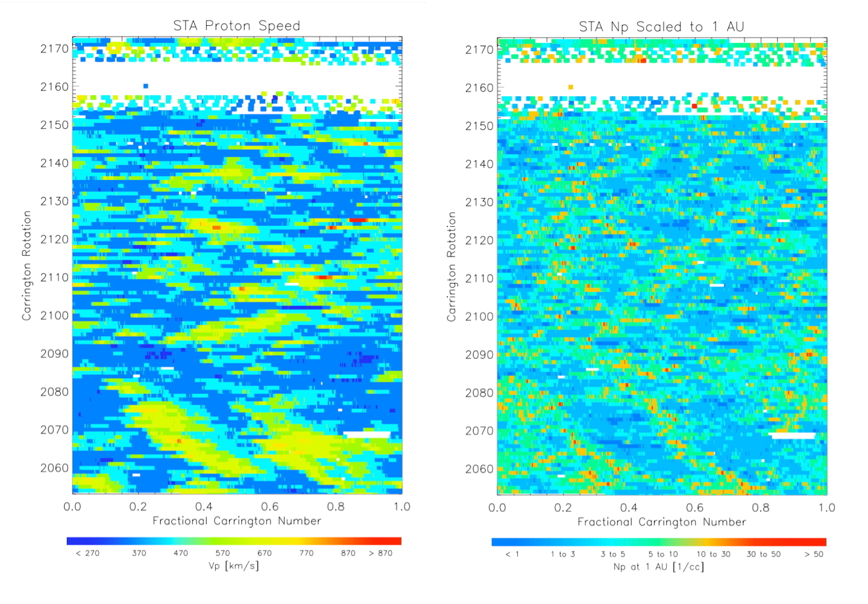
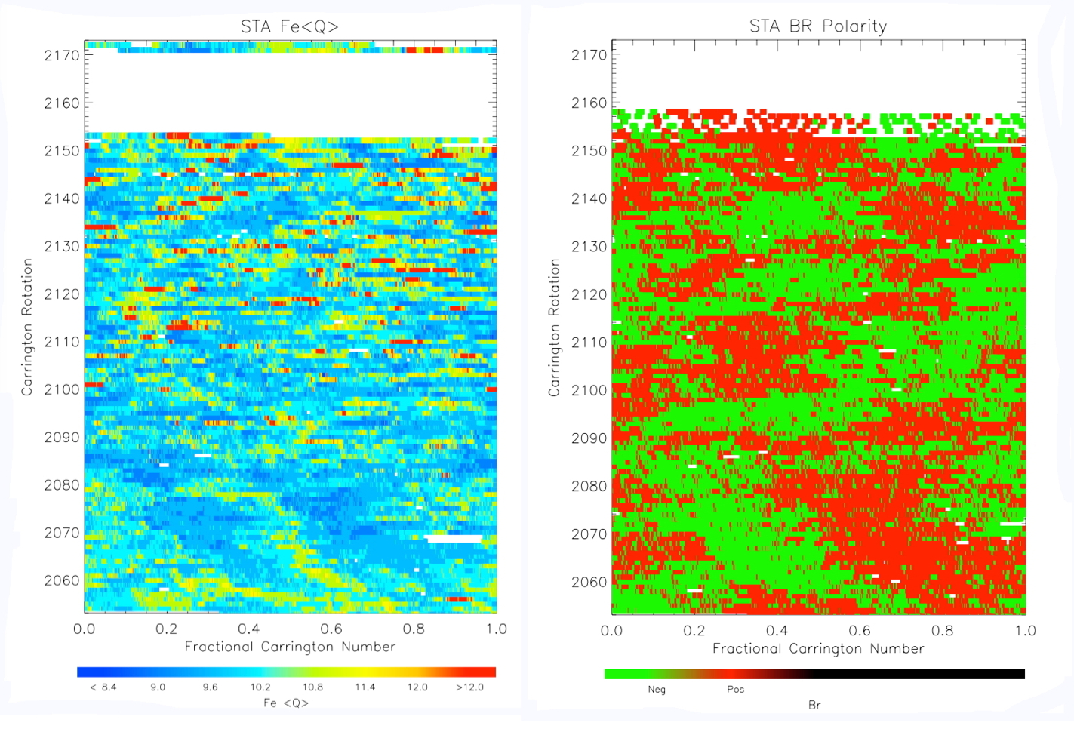
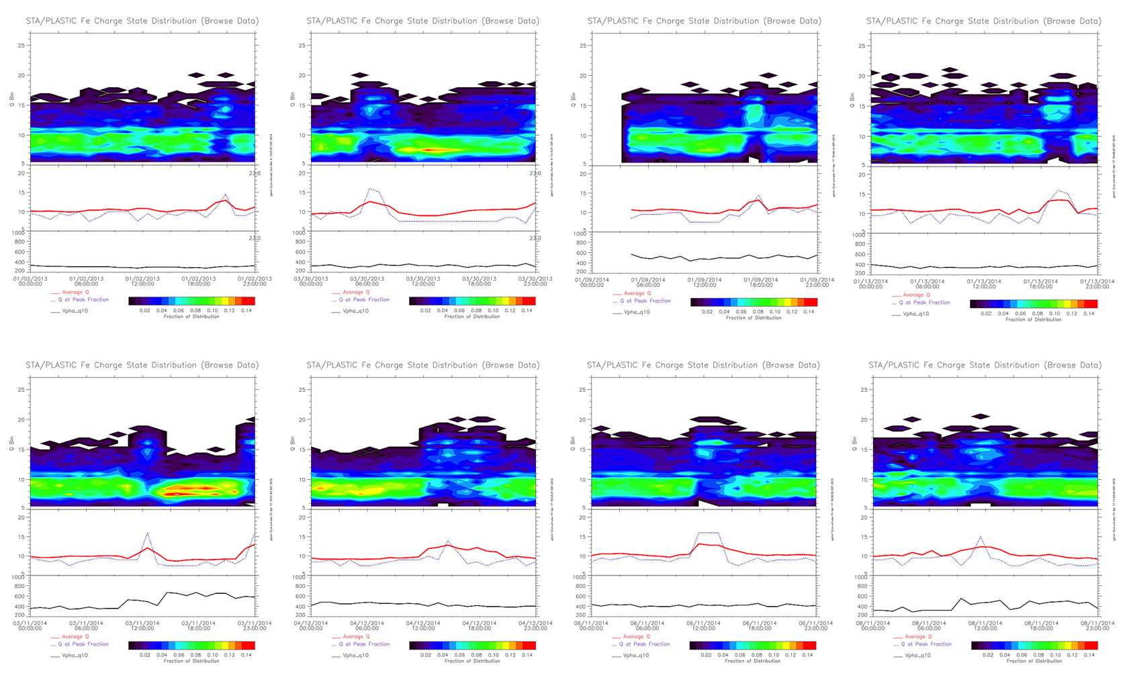
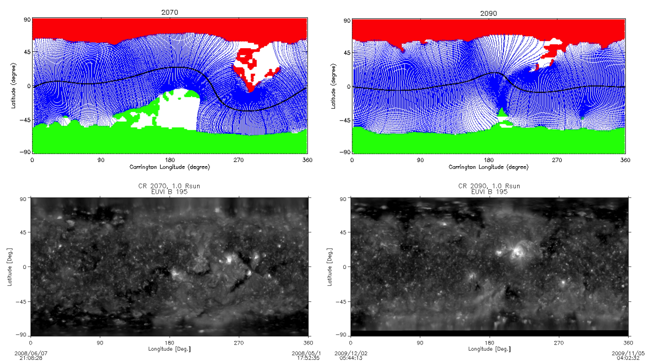
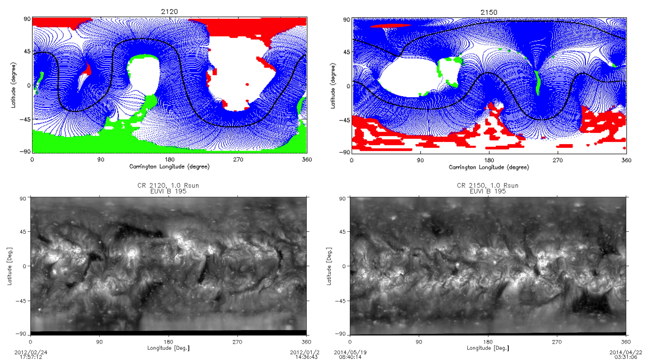
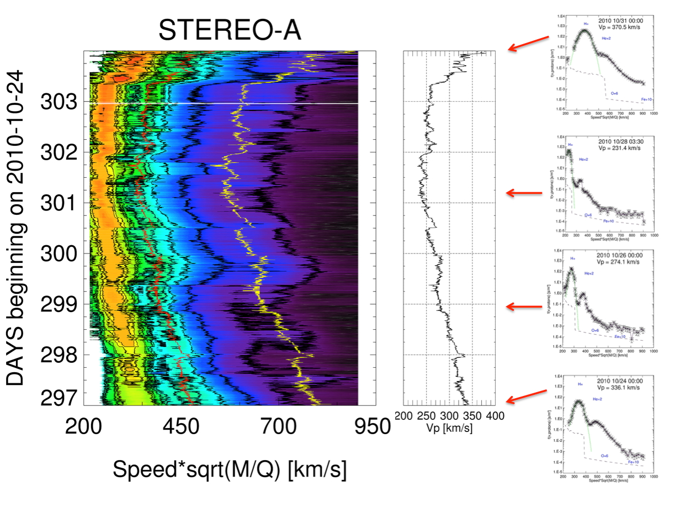
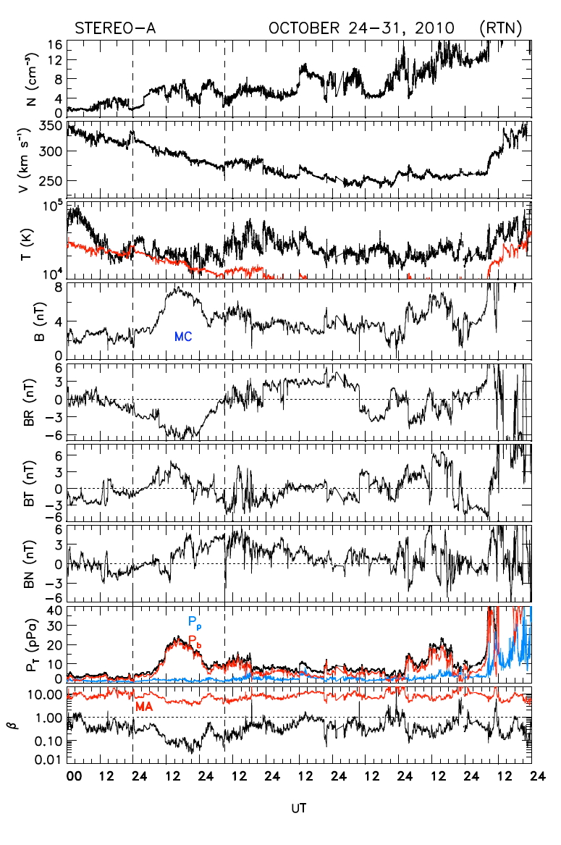
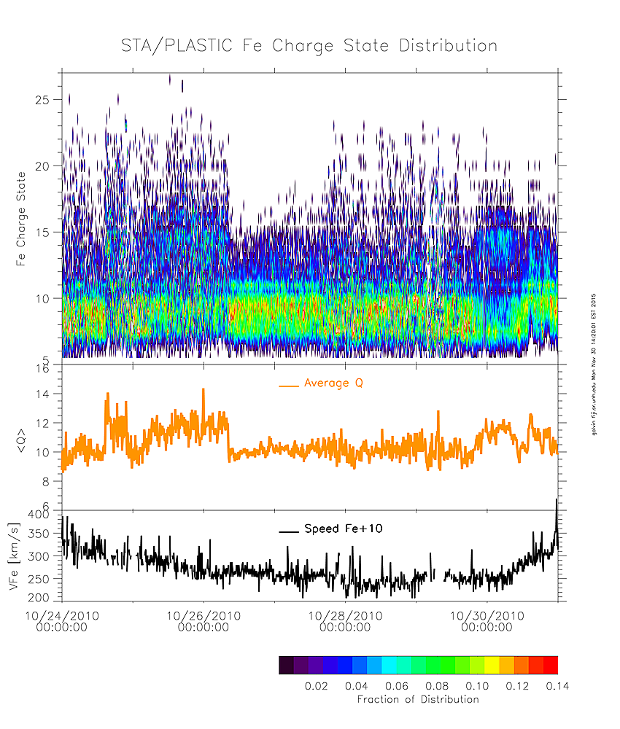
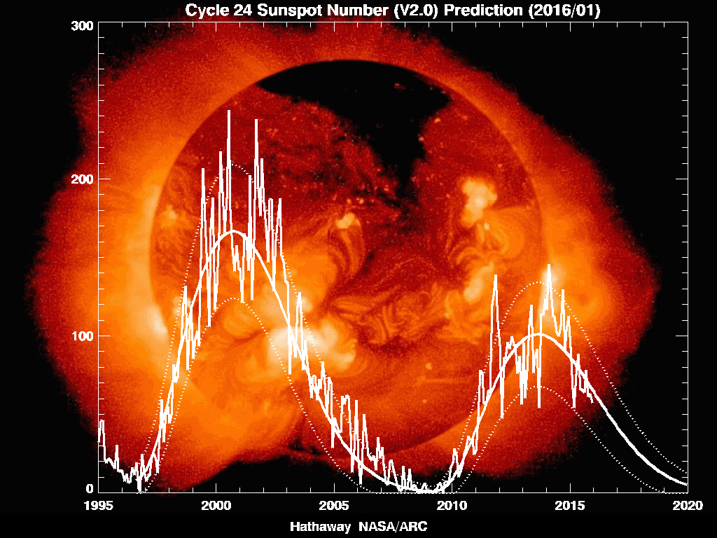
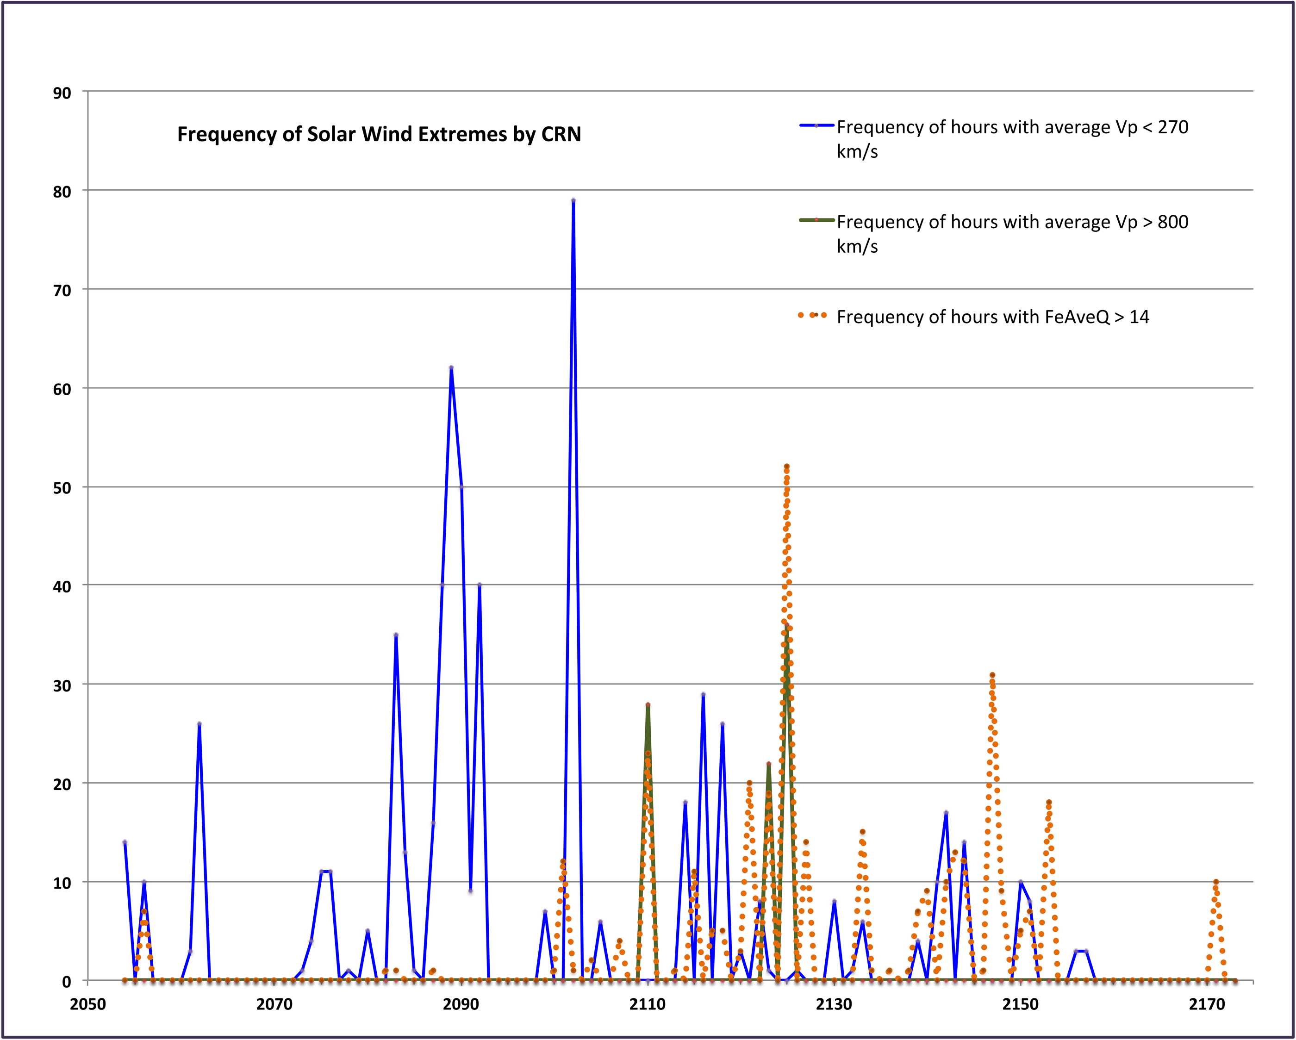
Poster X4.137 Solar Wind Trends in the Current Solar Cycle (STEREO Observations)
A.B. Galvin*¹, K.D.C. Simunac² , C. Farrugia¹
1.Space Science Center, Institute for the Study of Earth, Oceans and Space and the Department of Physics, University of New Hampshire, USA 2. St. Petersburg College, Tarpon Springs, FL, USA
Abstract We examine solar wind ion characteristics during the solar cycle using STEREO PLASTIC, IMPACT/MAG, and SECCHI data. Sources of the solar wind are known to be linked to the phase of the solar cycle and include coronal holes, coronal mass ejections, and multiple cycle-dependent sources for the so-called “slow” solar wind. This past solar minimum was characterized by weak transients and sustained periods of slow solar wind, and included cases of “slow” and “slower” solar wind stream interactions. In contrast, intervals around solar maximum have included extremely fast interplanetary coronal mass ejections, with one such ICME observed in situ by STEREO A exceeding 2000 km/s at 1 AU. We will examine specific cases of solar wind observed in situ by STEREO, particularly for solar wind proton and iron ions during slow speeds.
Solar Wind Overview The STEREO Observatories were commissioned in early 2007, near the end of solar cycle 23, and have continued making observations into the current solar. Synoptic data for the solar wind as seen at STEREO A for the mission to date are shown in Figure 1 (most instruments were off for the Solar Conjunction period, showing as blank periods). In the vicinity of CRN 2060-2080, during approach to solar minimum, there are two well-delineated regions of higher speed solar wind (> 500 km/s) correlated with lower densities, lower iron ionic charge states, and uniform magnetic polarity. Preceding these regions are higher density ridges. The SECCHI STB/EUV1 data and the NSO/GONG integrated Coronal Hole Plots (Figure 2 CRN 2070), indicate that the high speed regions are associated with the central meridian passage of the polar coronal holes (the density ridges are the stream interface regions, or SIRs). Note in the Vp map that there are significant intervals of slow speeds in 2009 during the sustained recent solar minimum (Figure 2 CRN 2090). Active regions (Figure 2 CRN 2120, 2150) and interplanetary coronal mass ejections (higher speeds and higher Fe Q) become more prevalent as the cycle progressed toward solar maximum. The sunspot cycle is shown in Figure 3. The occurrence frequency of very slow (< 270 km/s) and very fast solar wind (>800 km/s) is shown against CRN in Figure 4.
Figure 1. Left to Right: Solar wind proton bulk speed, proton density, average ionic charge state of solar wind iron (Fe) from PLASTIC, and the interplanetary magnetic field polarity from IMPACT/MAG. Hourly averages.
Each horizontal strip represents one Carrington Rotation, corresponding to solar longitude for the Sun-probe line (i.e., solar wind data are not translated to account for transit time).
Small Transients at Solar Minimum and Solar Max Using STEREO and near Earth assets, this recent solar minimum revealed a number of small transients (ST), as first reported by Kilpua et al. (2009, 2012), and later by Yu et al. (2013, 2016 in preparation). In some cases, the origins have been tracked. Foullon et al. (2011) detected a detached plasmoid in the heliospheric plasma sheet (HPS) associated with the heliospheric current sheet (HCS). Rouillard et al. (2011) linked plasmoid release observed remotely to in-situ observations. Year 2009, dominated by slow speed solar wind, contains the bumper crop of small transients (Yu et al., 2013). The solar minimum ST’s showed ambient charge states in iron, however small events toward solar maximum have been seen with higher charge states (Figure 5).
Figure 5. Small duration events observed in 2013-2014 during solar maximum conditions, using only ionic charge state distributions of Iron for identification. These events occur during slow or moderate solar wind speeds. Some events are isolated, while others precede larger events by a few hours.
Figure 2 (left four panels). Selected Carrington Rotation Synoptic maps showing the solar cycle evolution. CRN 2070 had both northern and southern polar hole excursions toward the ecliptic, that were seen as well-ordered high speed streams in the proton data at STEREO.
CRN 2090 was during a period of solar speed minimum.
CRN 2120, 2150 show the dominance of active regions during solar maximum.
Ultra Slow Solar Wind This solar cycle has exhibited some of the slowest and fastest solar wind recorded in-situ at 1 AU. In one event, STA (but not assets at L1) observed a sustained period of slow speeds at/near the “floor” value (259±12 km/s if He/H He/H → 0, derived by Kasper et al. 2007, from solar wind data in the previous solar cycle).
Figure 6. Solar wind speed contour plot during extended slow wind period in October 2010. Protons are the orange-red contour. The red line indicates the predicted location of He+2, yellow line indicates the predicted location of Fe+10. Middle panel is the Vp derived from a Maxwellian fit to the speed distribution function, as shown in the snapshots in the rightmost panel. Proton speeds are measured down to 215 km/sec.
Figure 3 (left). Sunspot Numbers of the previous and current solar cycle (NASA MSFC).
Figure 4 (right). Occurrence frequency of periods of sustained slow (<270 km/s), fast (>800 km/s), and high charge state solar wind, based on 1-hr averages from STEREO A. Note that starting near CRN 2153, STEREO data retrieval is impacted by solar conjunction activities. STA has only recently returned to full data coverage.
Figure 7 (right). The solar wind plasma (PLASTIC) and magnetic field data (IMPACT/MAG) indicate that the beginning of this slow wind period is in fact a magnetic cloud.
Figure 8 (far right). Higher Fe charge states are seen during this MC interval. The source of the transient MC event was traced to small, slow coronal mass ejections near an active region on the sun.
  Acknowledgement. NASA STEREO Grant NNX13AP52G at UNH for PLASTIC. J. Luhmann for IMPACT/MAG and R. Howard for SECCHI images.

