Slide 1

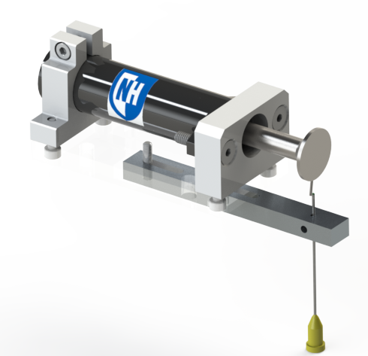
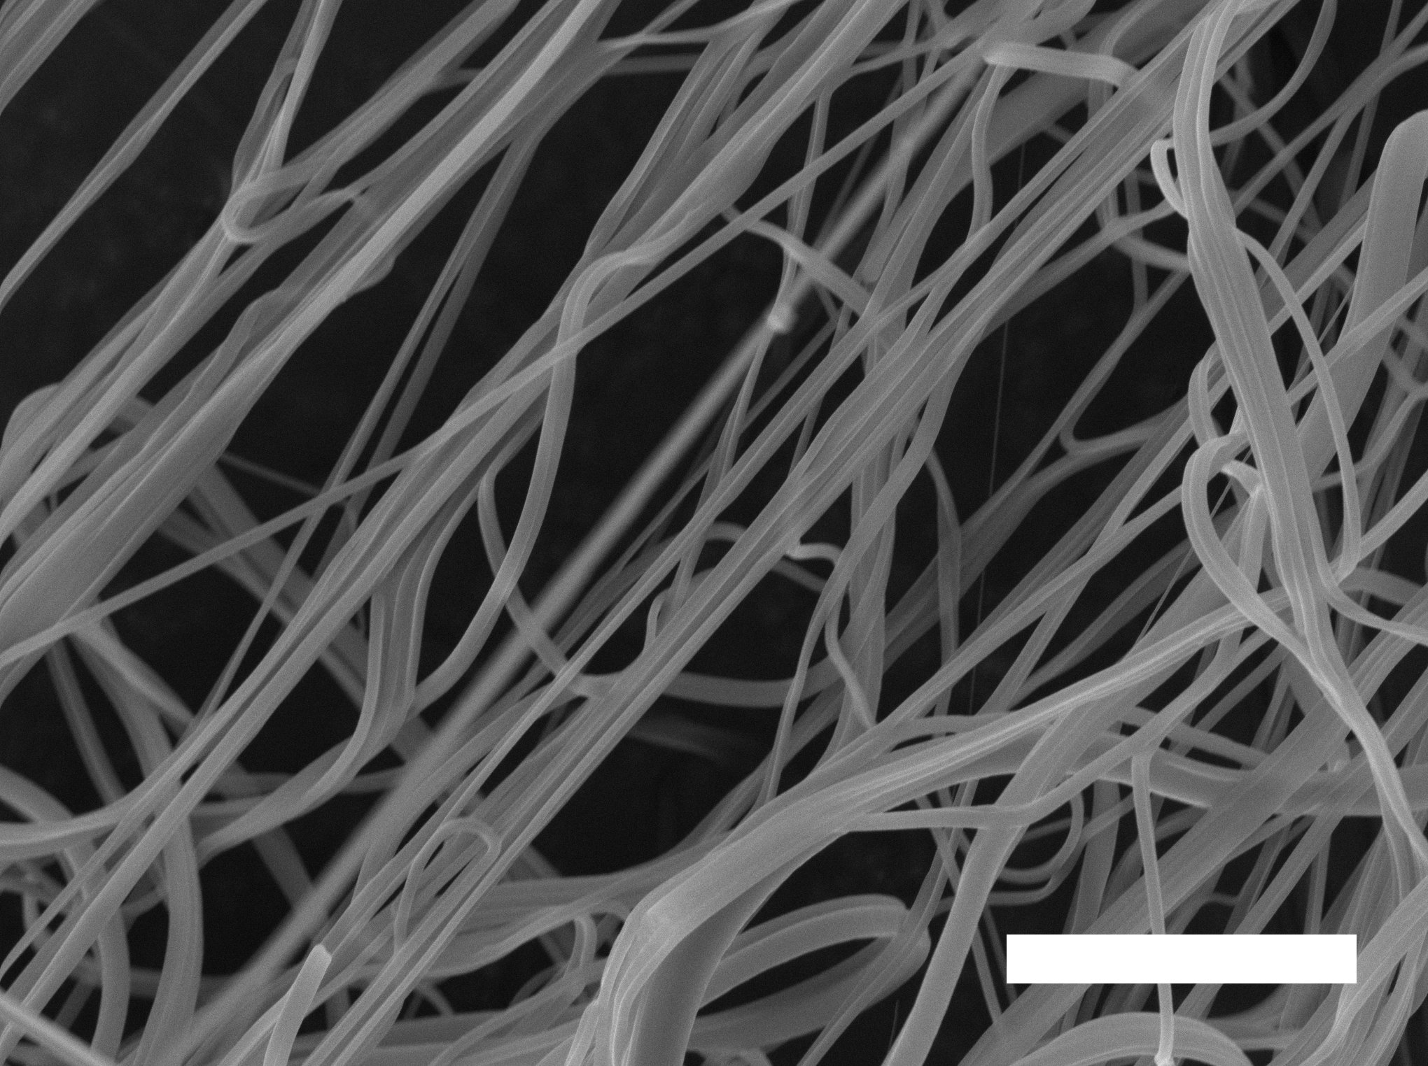
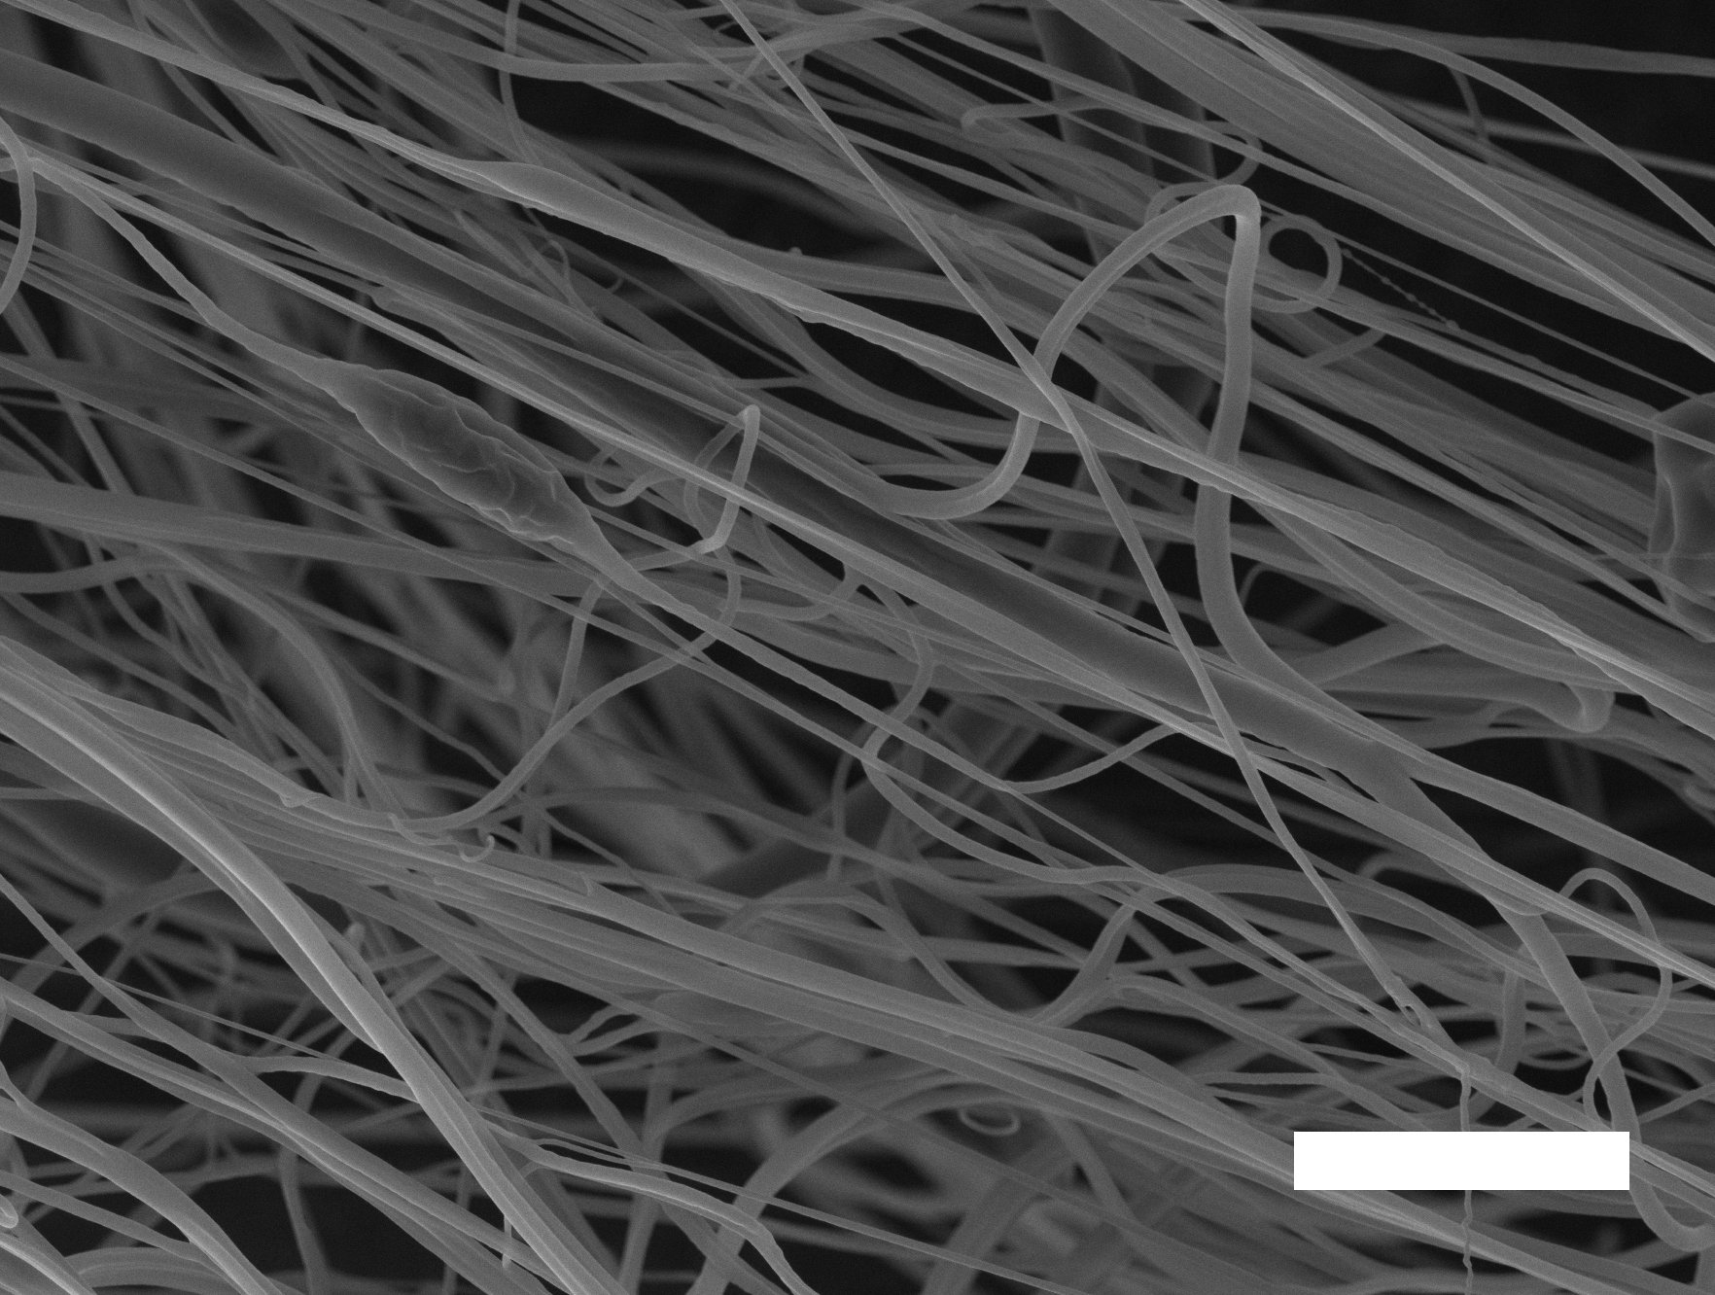
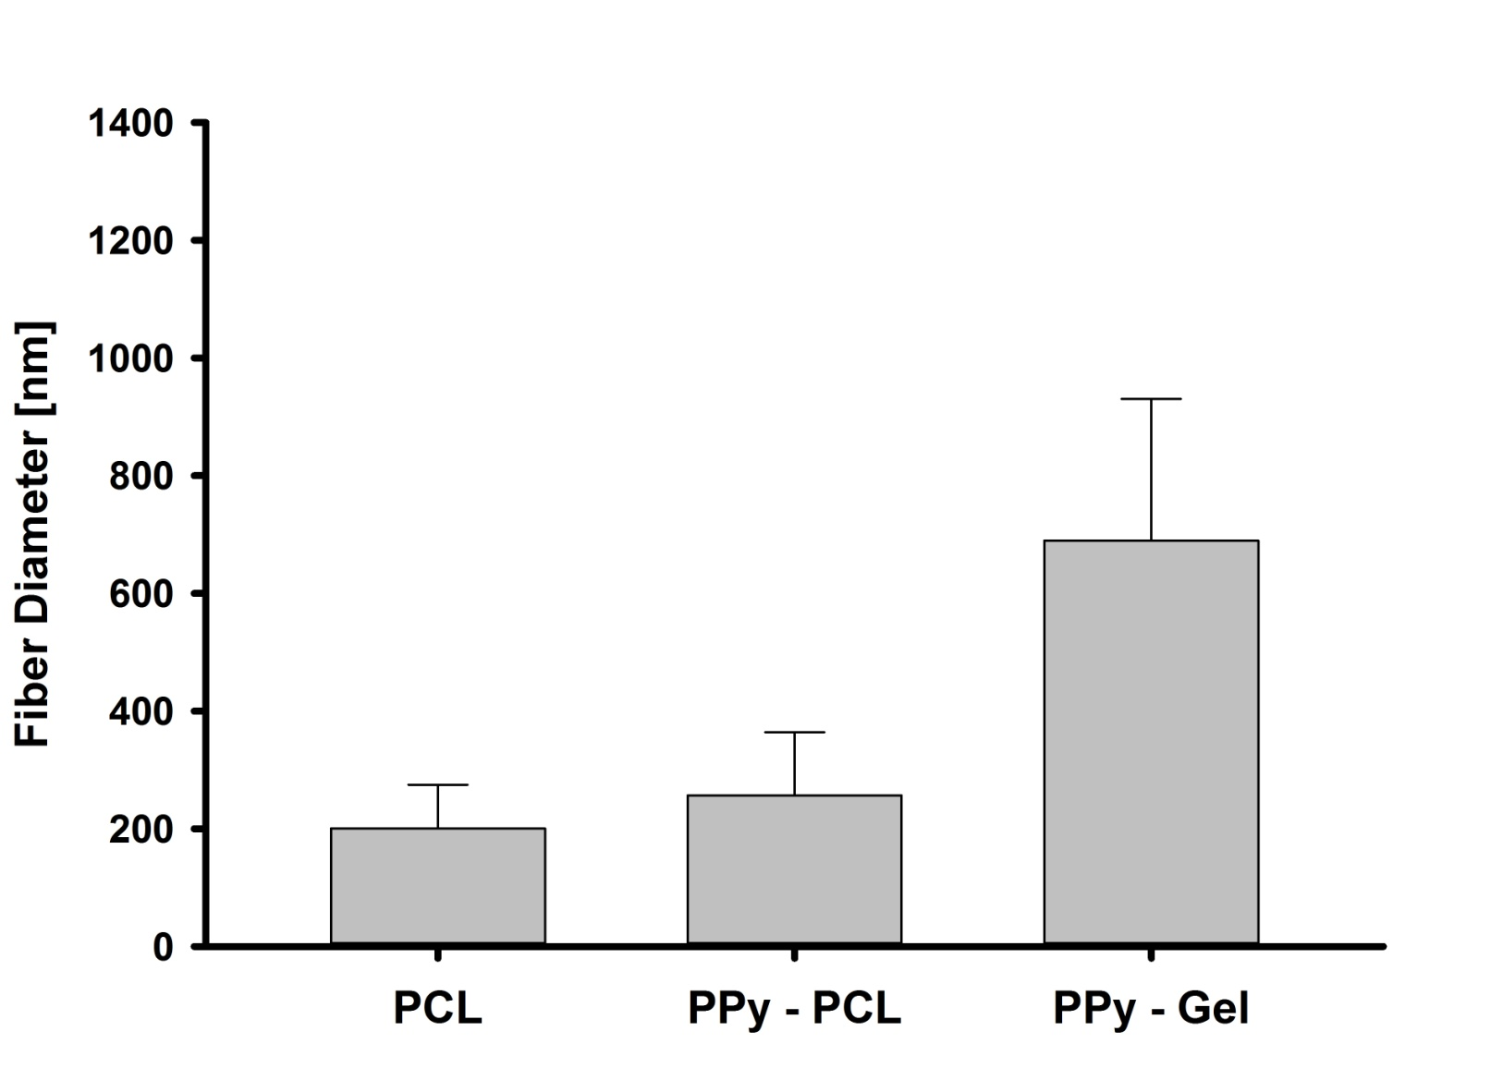
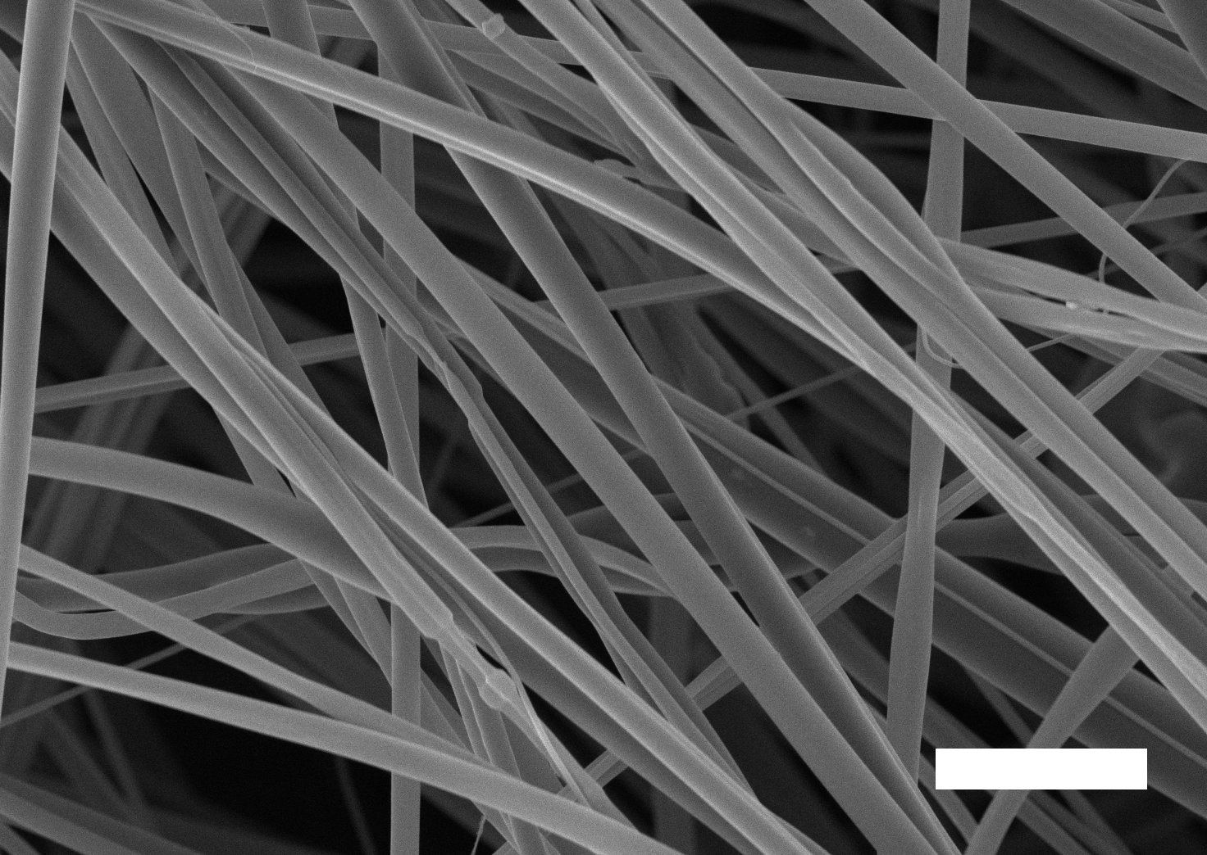
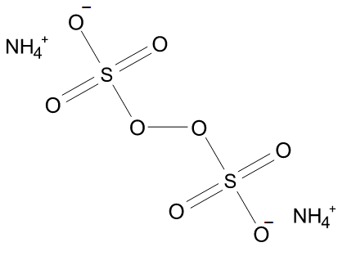
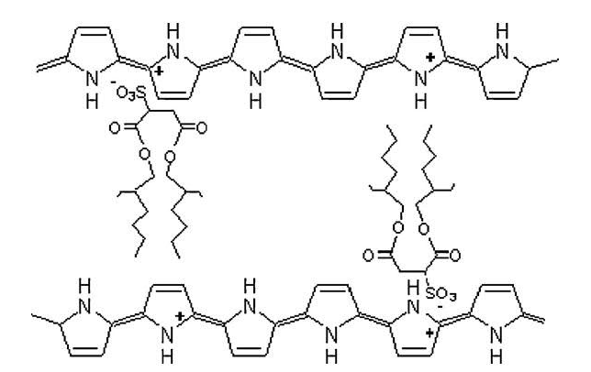
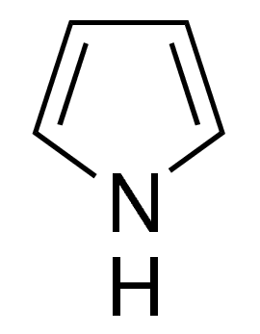
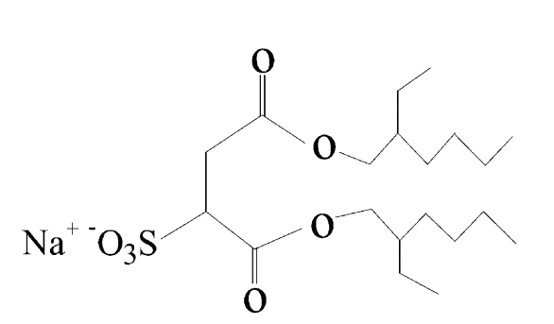
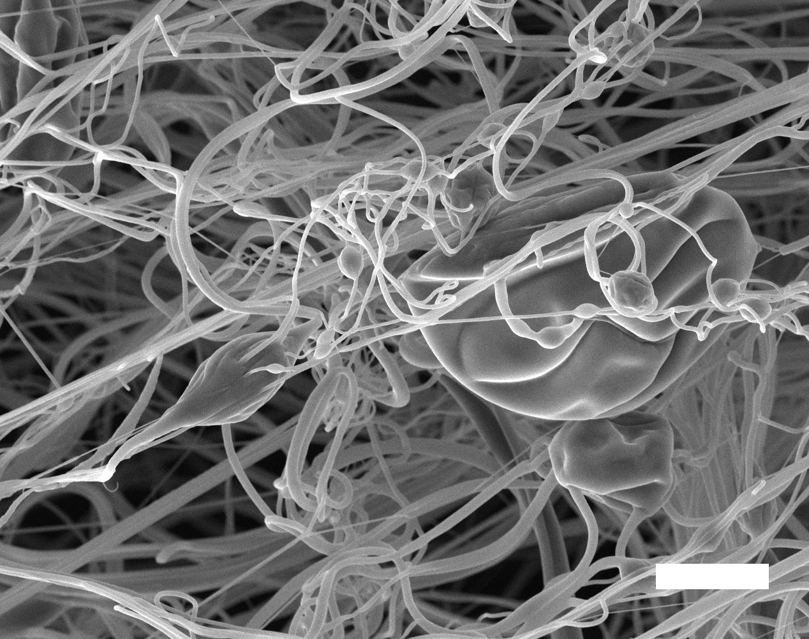
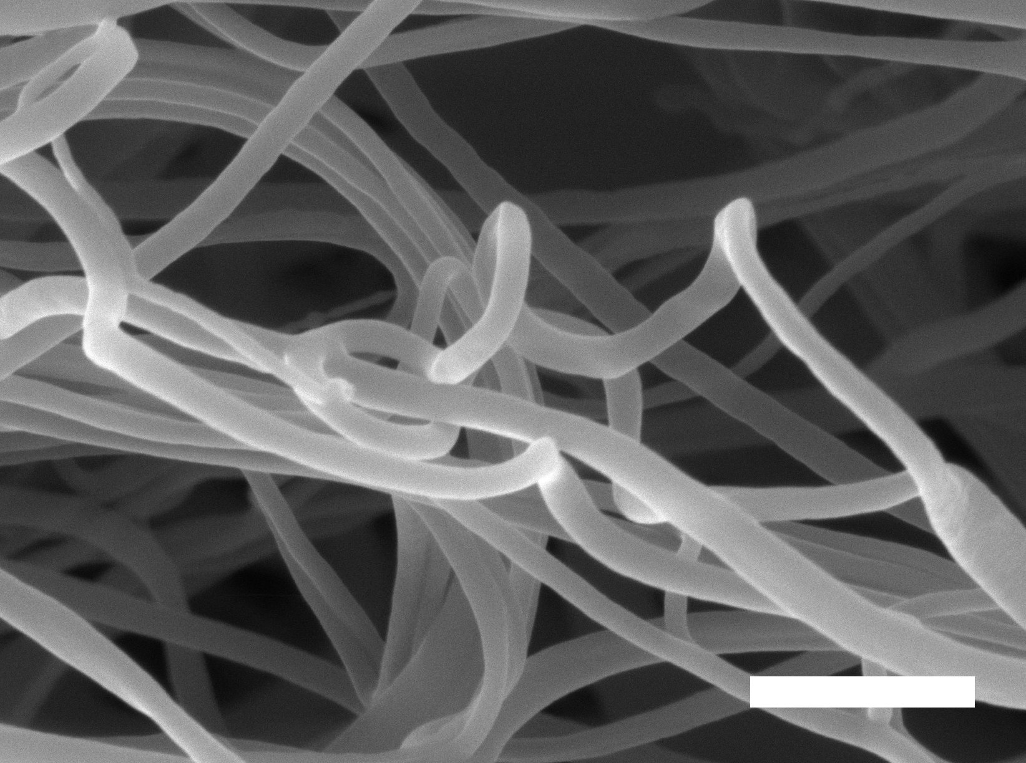
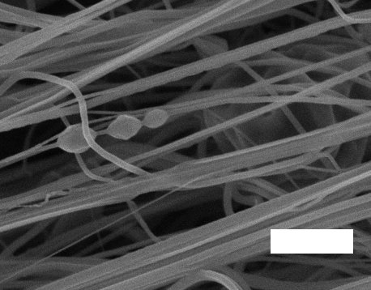
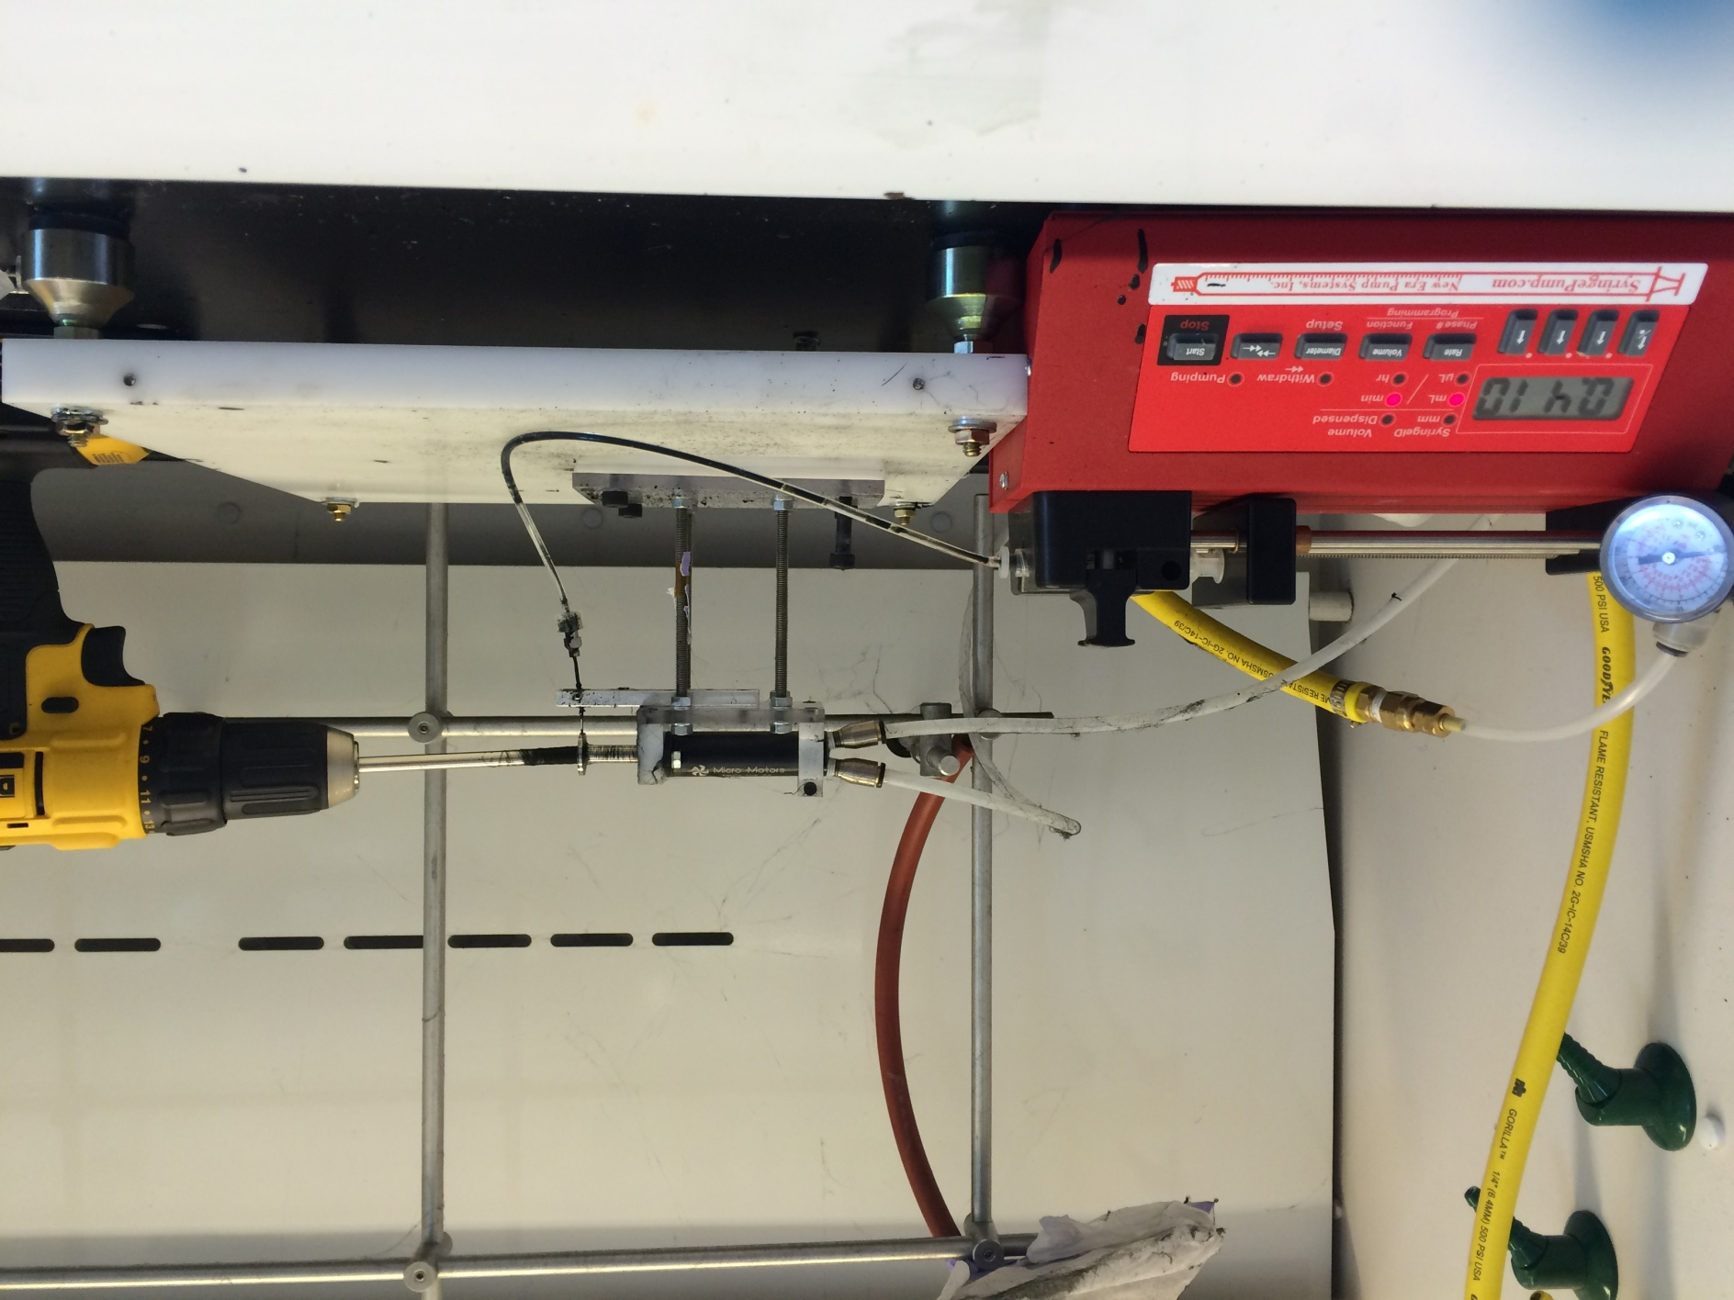
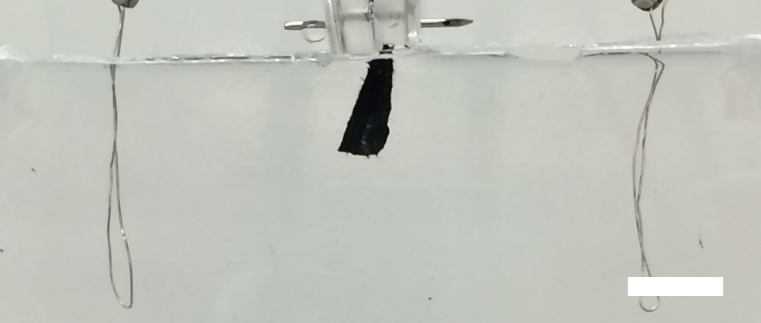
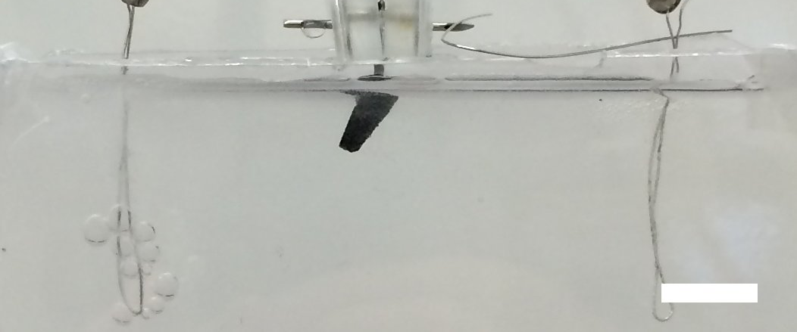
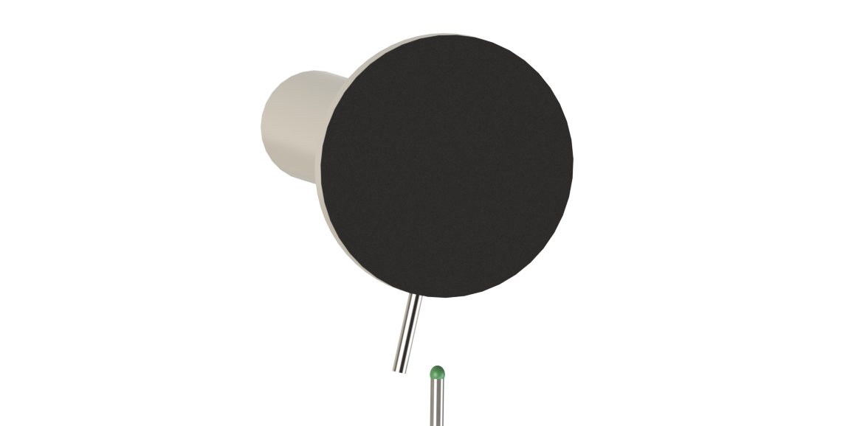
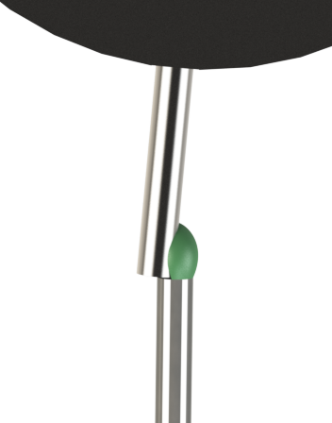
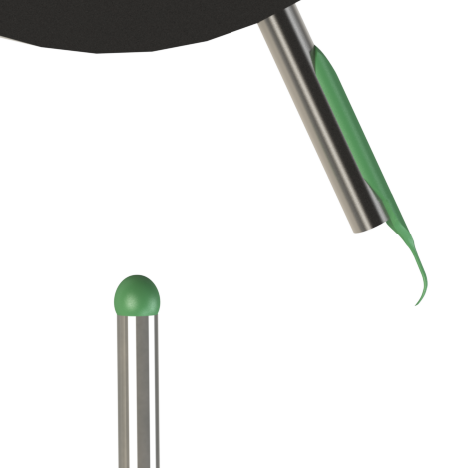
Translating High-Throughput Nanofiber Fabrication Techniques for
Electroactive Polymer-Protein Hybrid Textile Based Materials
Matthew A. Griswold, and Leila F. Deravi
Biomaterials Design Group, Department of Chemistry and Materials Science
University of New Hampshire
Introduction
Results
Pull spinning is a recently developed technique for rapidly fabricating nanofibrous materials from polymers, proteins, and composites thereof
It works using a high-speed rotating bristle that wicks a polymer solution from a nozzle and pulls it into a nanofiber
Pull spinning offers significant productivity gains when compared to traditional methods, such as electrospinning, operates at ambient temperatures, in air, and without the need for electric fields
In this work, we report how electroactive nanofibers can be manufactured using a custom-built pull spinning apparatus
Nano-Scale Morphology of fibers
PCL fibers
PCL - PPy fibers
High speed pneumatic turbine
Rotating “bristle”
50 µm
50 µm
Nozzle
Illustration of pull spinning apparatus
5 µm
5 µm
Methods
Composition of Electroactive Polymer Solutions used in Pull Spinning
PPy - Gelatin fibers
Polypyrrole (Ppy) with dopant di(ethylhexyl) sulfosuccinate (DEHS) was synthesized
+
+
5 µm
Pyrole
DEHS
Ppy-DEHS
Polymers used in Pull Spinning
Control polymer: A 8 wt/v % Polycapralactone (PCL) in Hexaflouroisopropanol (HFIP) served as a model fluid due to it’s low cost and high degree of confidence in fiber formation
Electroactive polymers: Two hybrid polymers were tested as Ppy alone could not make fibers. These are:
8 wt/v % DEHS-doped PPy in HFIP was then mixed 1:1 with 8% wt/v PCL in HFIP;
8% wt/v DEHS-doped PPy in HFIP was then mixed 1:1 with 8%wt/v Gelatin protein in HFIP
10 µm
1 µm
3 µm
Common irregularities / “bugs”: beading, curling fibers
It is suspected that the smooth beads form as a result of Raleigh instability during solvent evaporation, and others the result of fiber curling while enough solvent remains to allow fusing
Electroactive actuation
Set-up for pull-spinning system
Collected Ppy-Gelatin hybrid fibers submersed in Phosphate Buffer Solution (PBS); 20 Volt potential difference applied; Scale bars 1 cm
Mandrel
Pt electrode
-
+
+
-
+
+
Polymer nozzle
y
z
Nanofiber network
Syringe pump
x
Time = 0
Time = 10 minutes
Time = 20 minutes
Future Work:
Nanofiber Production and collection – Pull Spinning
Determine relationship between elasticity and applied electrical potential difference, and/or relationship between applied potential difference and contractile forces
Characterize polymer solution fluid mechanical properties; conduct series of optimization experiments to determine relationship between viscosity, surface tension, and fiber formation and characteristics
Conduct optimization experiments to determine relationships between spinning parameters, angular velocity of rotating bristle and collection mandrel, fluid extrusion rate, bristle diameter, distance from fiber formation to collection, etcetera.
Integrate controlled laminar air flow, fabricate mini-wind tunnel to direct fibers and reduce Raleigh instability; integrate coulomb forces into collection schemes
Develop novel nanofibrous materials from various polymer – protein combinations
Bristle rotation initiated at approximately 55,000 RPMs
Polymer/Protein solution extruded from nozzle by positive displacement (syringe) pump at 0.4ml per minute
Fibers collected by rotating mandrel
Rotating Mandrel
Formed fibers
Collected fibers
Rotating “bristle”
Acknowledgments
Mechanism for fiber formation (left) and collection (top) using rotating mandrel
The authors acknowledge all members of the Biomaterials Design Group, the University Instrumentation Center, and the CEPS machine shop. Special acknowledgment is also given to Patrick Curley for the synthesis of a tractable doped polypyrrole.
Marshall KE & Serpell LC (2009) Biochemical Society Transactions 37:671-676
Erickson HP (2002) Journal of Muscle Research and Cell Motility 23(5-6):575-580
Feinberg AW & Parker KK (2010) Nano Letters 10(6):2184-2191

