Slide 1

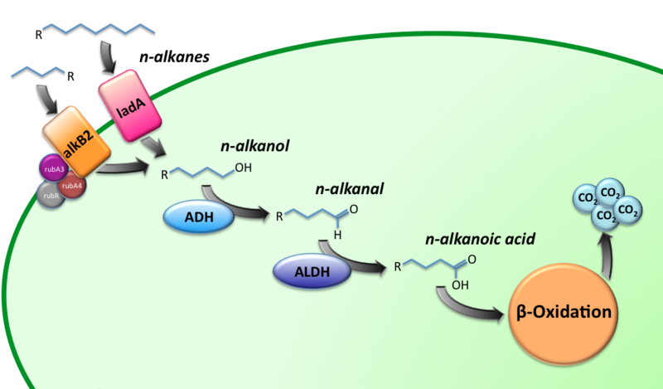
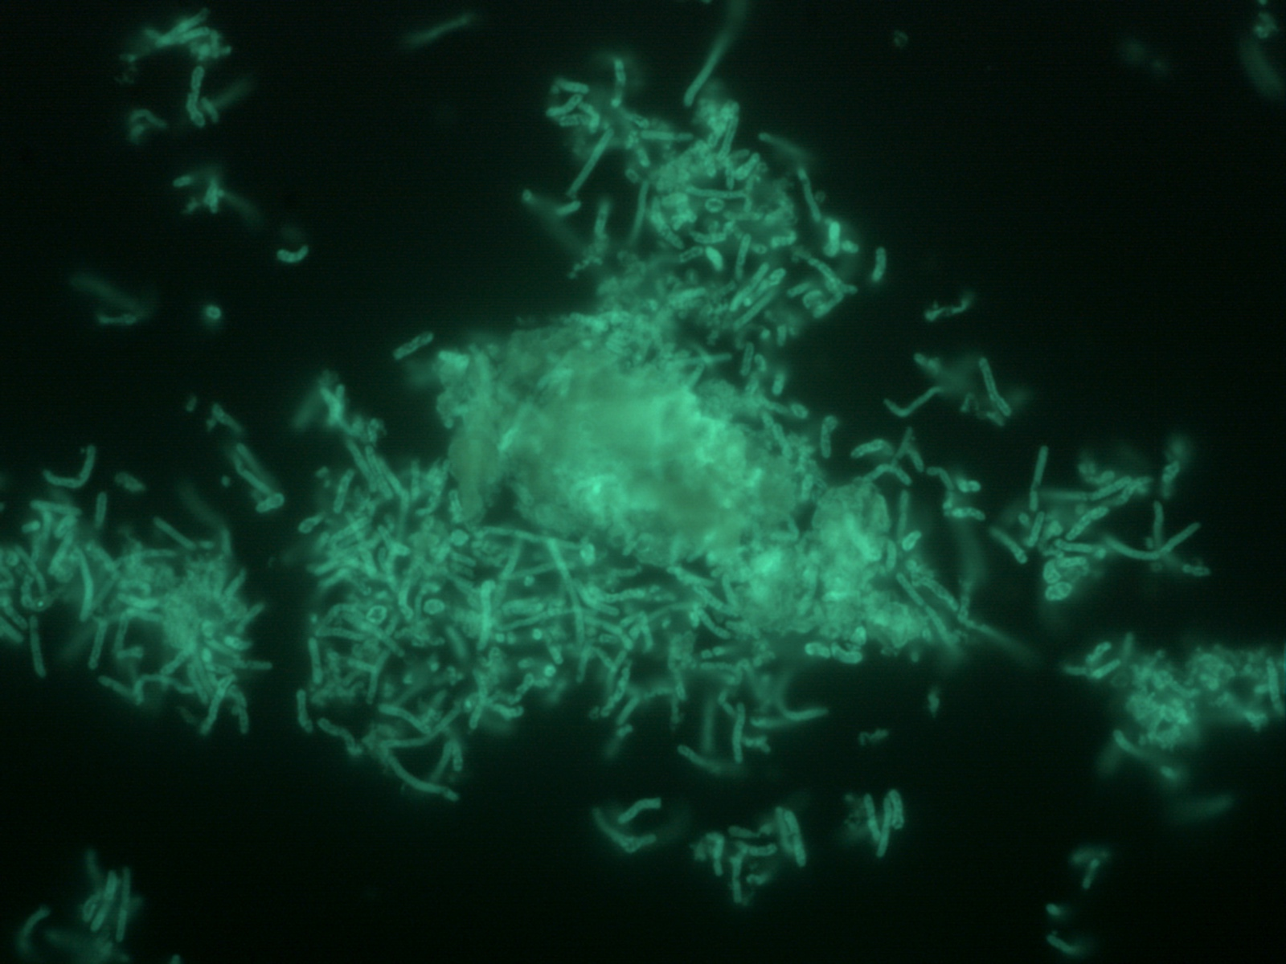
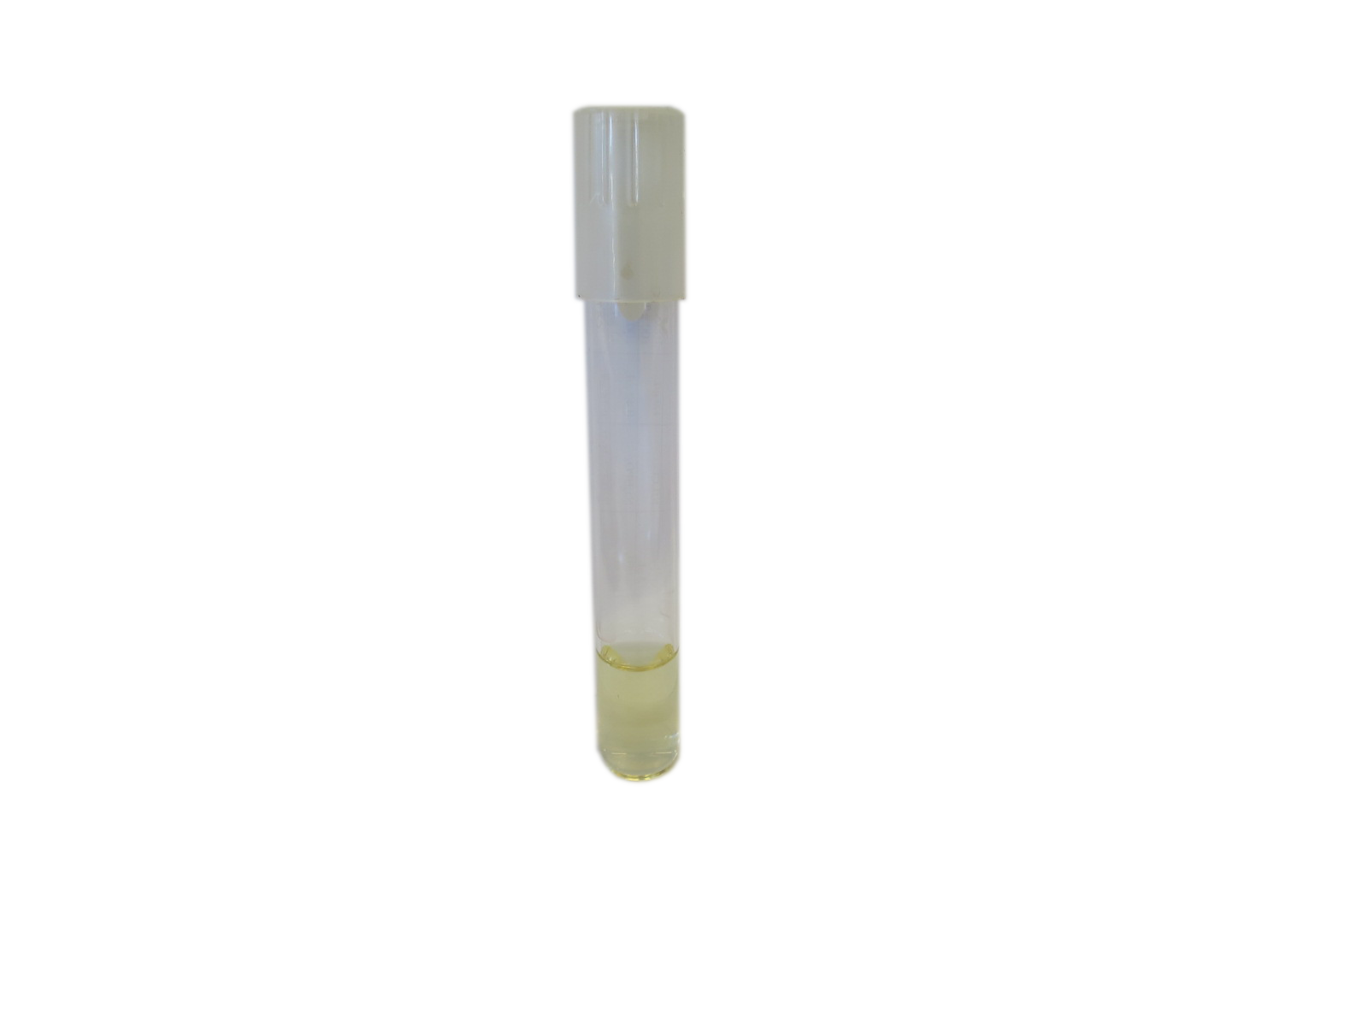
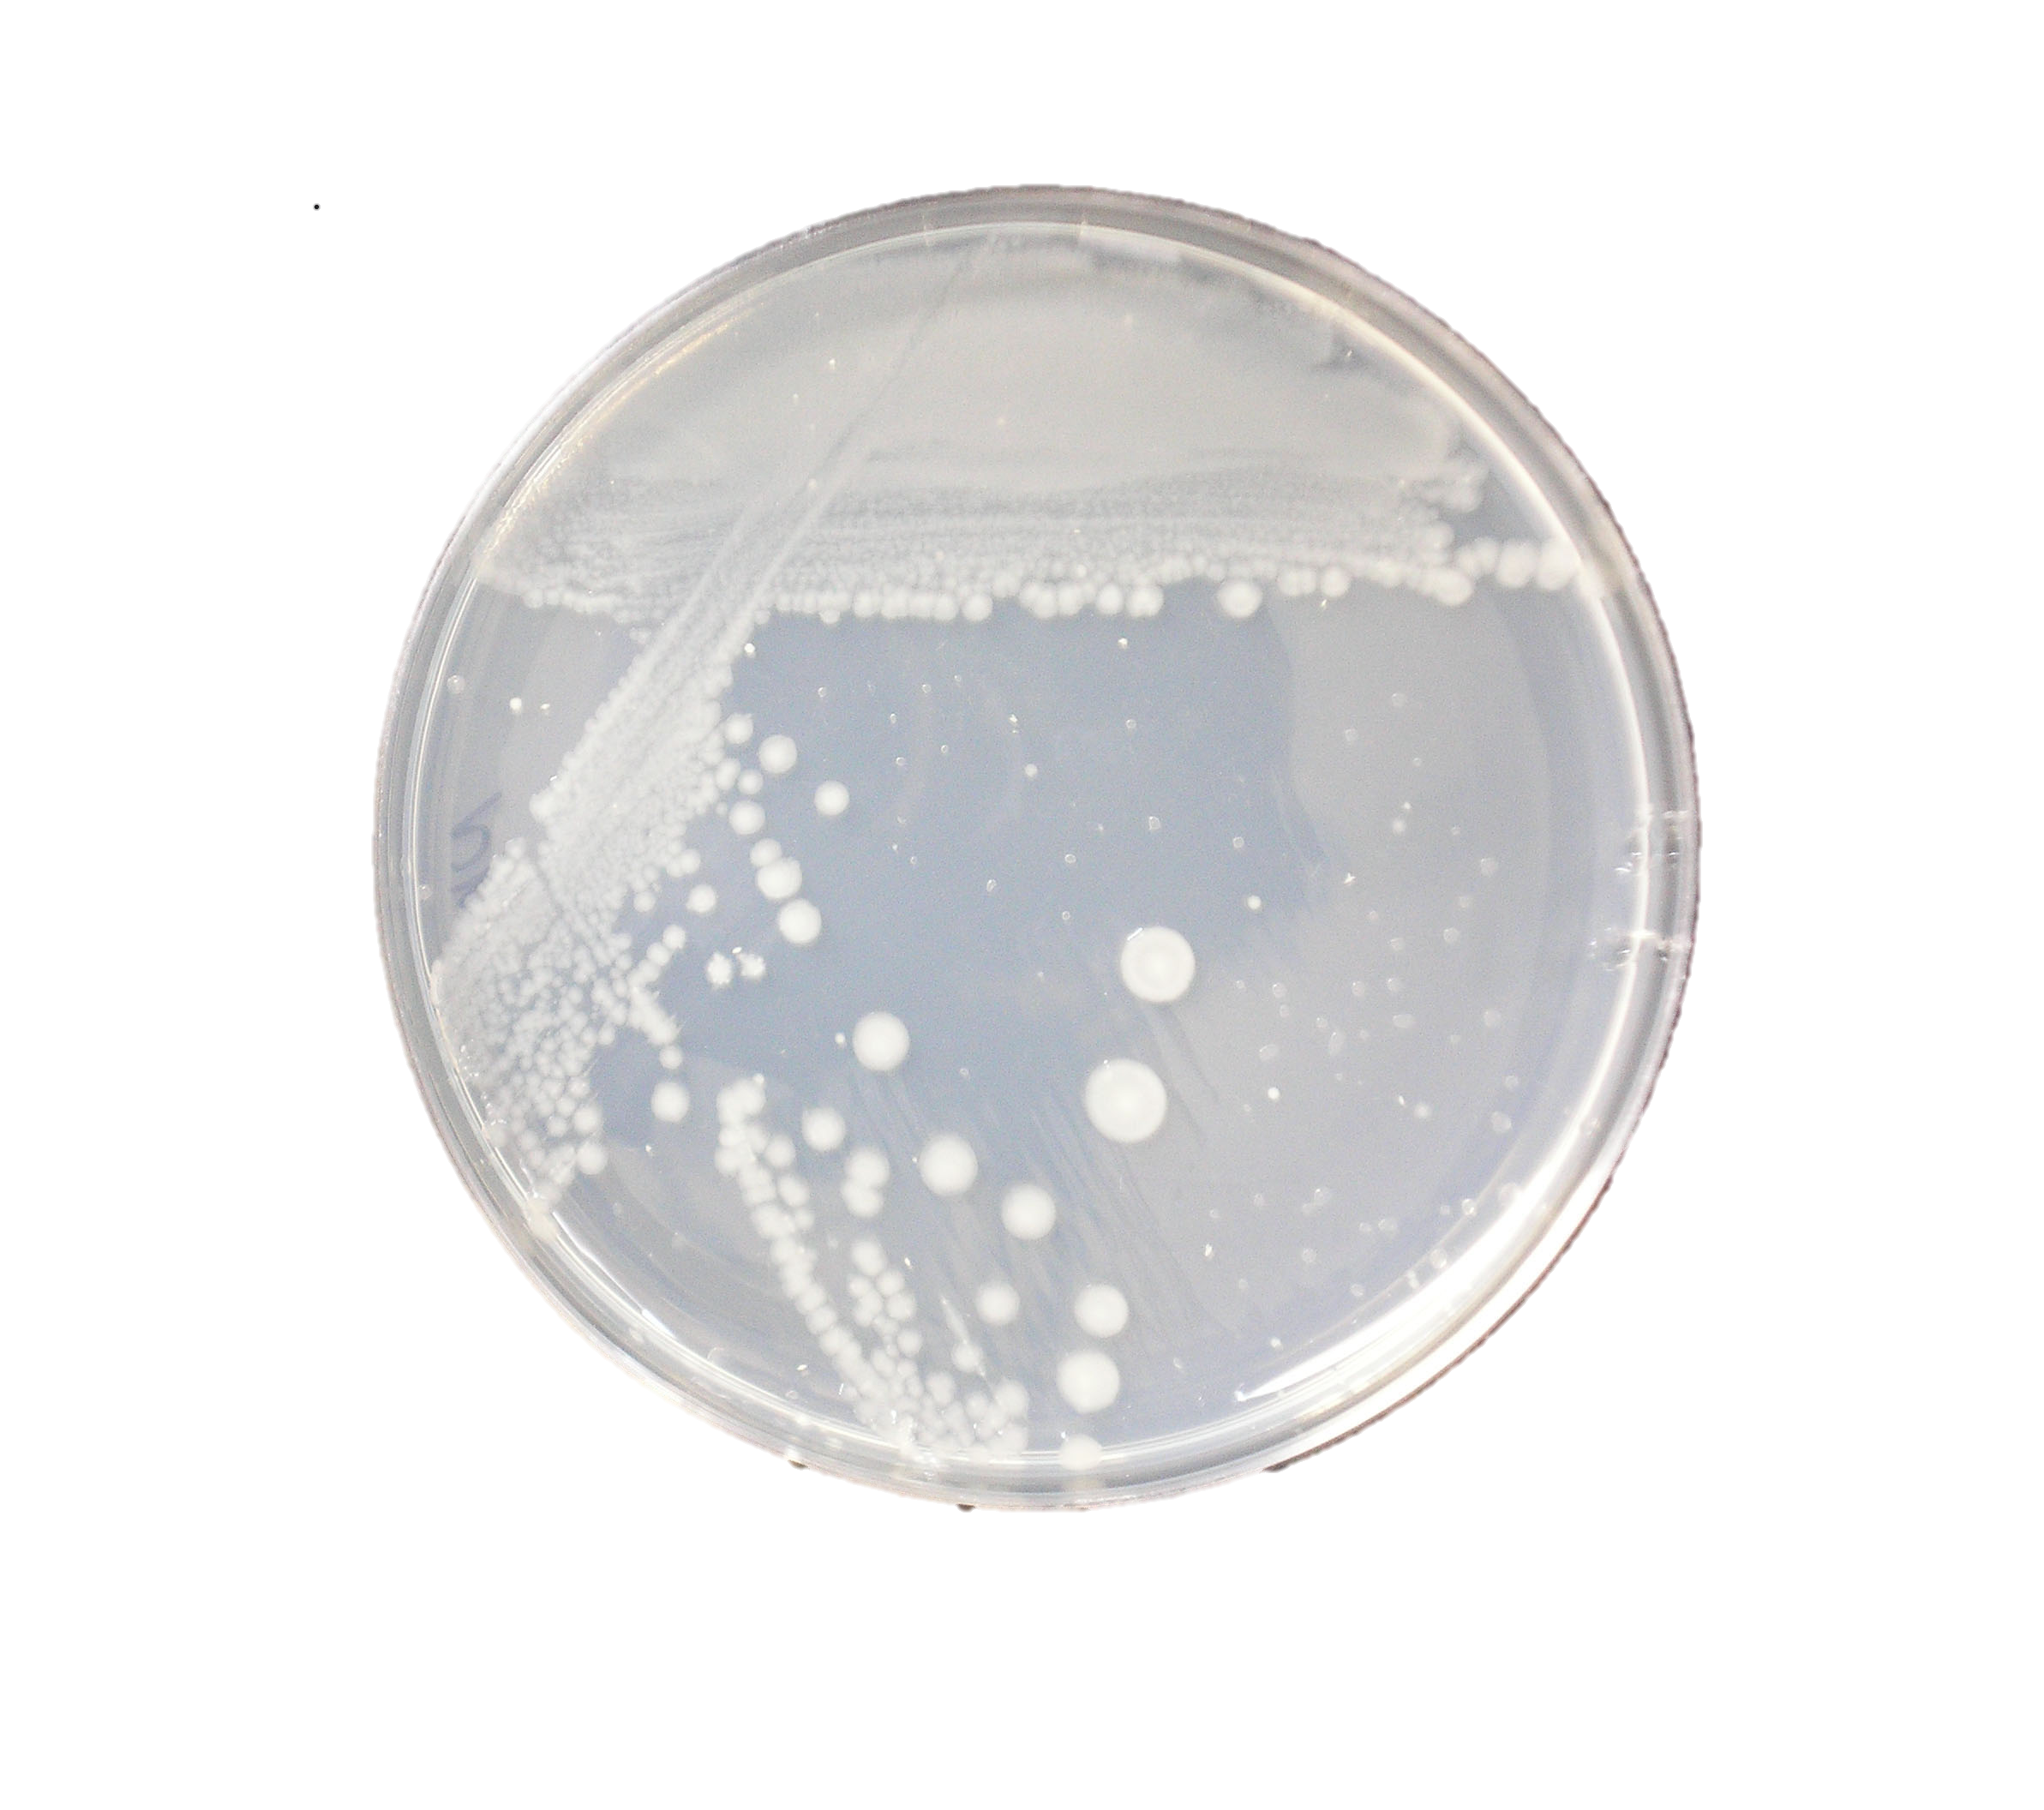
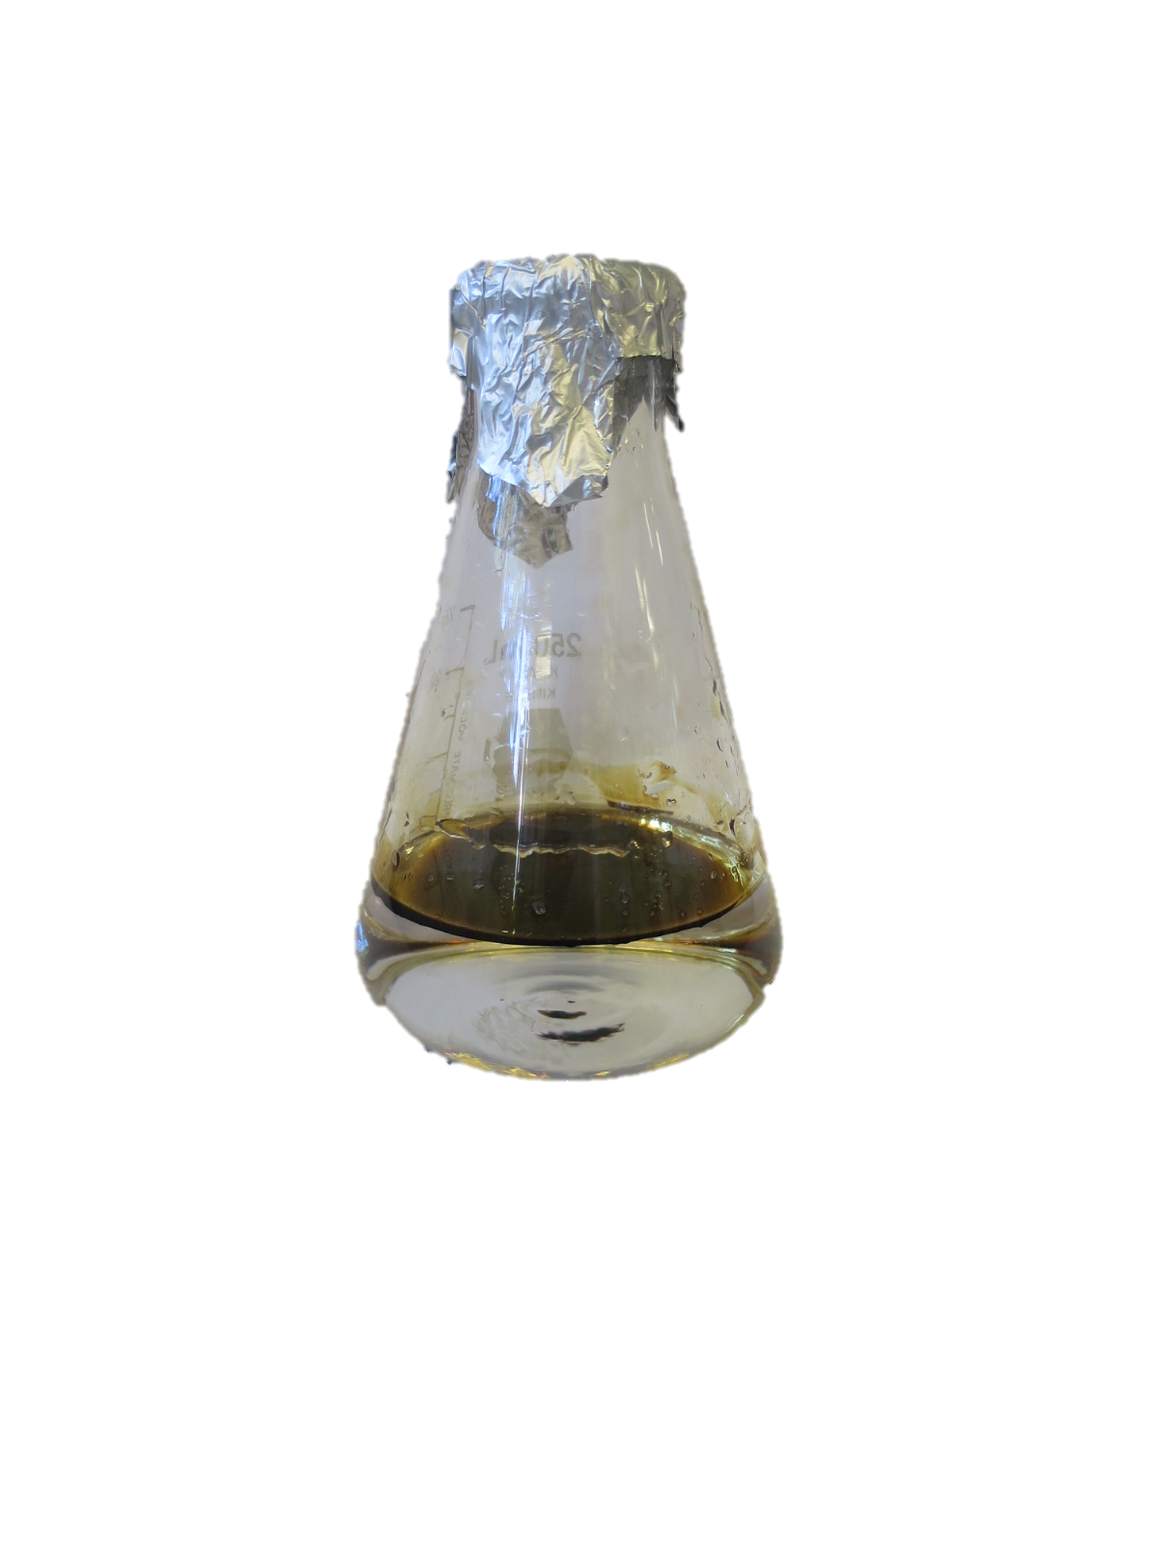
Characterization of Hydrocarbon Degradation by Thermophilic Geobacillus Strains
Michael Pappas and Kang Wu
Chemical Engineering Department, University of New Hampshire
Background
Results
Discussion
Geobacillus is a genus of thermophilic bacteria that grow at 45-75 °C. They are isolated from various geothermal environments, such as hot springs, soil, wastewater, and compost, and due to these harsh conditions of their habitats, many of them have shown great potential for bioremediation. In this study, we characterized the ability of five Geobacillus strains isolated from oil contaminated soils and oilfields to degrade crude oil and selected one strain that is able to degrade n-alkanes with a wide spectrum of carbon numbers.
Figure 1. Growth of strains W9A95 (Black square), W9A101 (Green diamond), W9A104 (Red square), W9A111 (Purple circle) and 92A2 (Blue triangle) in minimal media with 1% (w/v) of crude oil as sole carbon source. Cells were shaken and grown at 60°C.
Figure 2. Predicted pathways for alkane degradation via alkB and ladA genes.^{[4]}
Future Work
-GC-MS and GC-FID tests to quantify the degradation of n-alkanes
-Directed evolution of the strain W9A104 to enhance its abilities to degrade hydrocarbons
-Sequence both wildtype W9A104 and evolved W9A104 to elucidate the pathway of n-alkanes metabolism and identify novel enzymes involved in hydrocarbon degradation.
Methods
-Strains W9A95, W9A101, W9A104, W9A111 and 92A2 were grown overnight on TBAB plates at 60°C
-A single colony was selected from each plate and grown in overnight TGP media and shaken at 60°C
-Cells are then washed with minimal media and added to 100 mL of minimal media until the OD of the media was 0.05. 1% (w/v) of either crude oil or hydrocarbons are then added to the flask. For hydrocarbons greater than C22, 0.001% (w/v) PLYsurf was added as a dispersant. The innoculated media is then shaken at 60°C for six days with OD readings taken every day.
Table 1. Displays + positive or – negative growth for strains W9A95, W9A101, W9A104, W9A111 and 92A2 in minimal media with 1% (w/v) of hydrocarbons as the sole carbon source. Cells were grown in a flask at 60°C with vigorous shaking.
References
Strain | C8-C16 | C18-C24 | C28-C44 | Cyclic Compounds
W9A95 | - | - | - | -
W9A101 | - | + | - | -
W9A104 | ++ | ++ | + | -
W9A111 | ++ | ++ | - | -
92A2 | + | ++ | - | -
[1] Feng, L., et. al. “Isolation and characterization of a novel thermophilic Bacilus strain degrading long-chain n-alkanes” Extremophiles 2006 Aug; 10(4): 347-56
[2] Shen, B., et. Al. “ Molecular characterization of the alkB gene in thermophilic Geobacillus sp, strain MH-1” Research in Microbiology 160 (2009) 560-566
[3]Geobacillus Thermoglucosidasius Y41MC1. Digital Image. Geobacillus Enzymes. C56 Technologies, 2016. Web.
[4]S, Kira, and Mathais V. Digital image. N.p., 10 July 2010. Web.
[5] Feng, L., et. al. “Proteomics analysis of aromatic catabolic pathways in thermophilic Geobacillus thermodenitrificans NG80-2” Journal of Proteomics 75 (2012) 1201-1210
Contact
Acknowledgements
Michael Pappas
University of New Hampshire
Chemical Engineering
Email: mcq92@wildcats.unh.edu
Chemical Engineering Dept, UNH
Dr. Kang Wu
Erin Drufva

