Slide 1

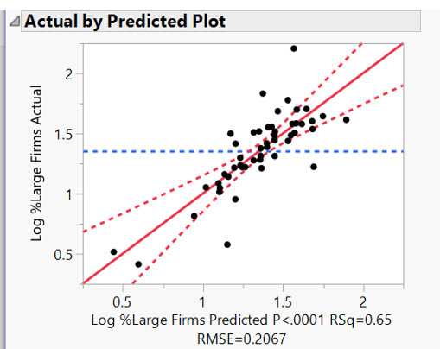
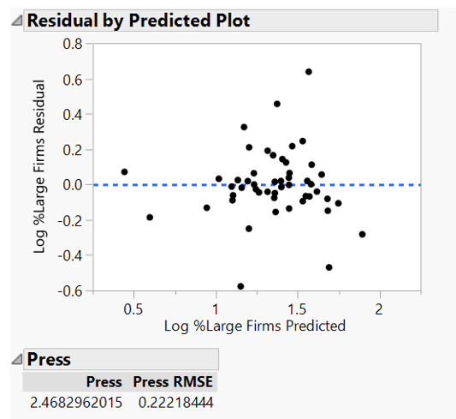
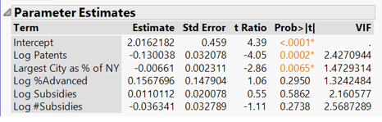
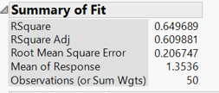

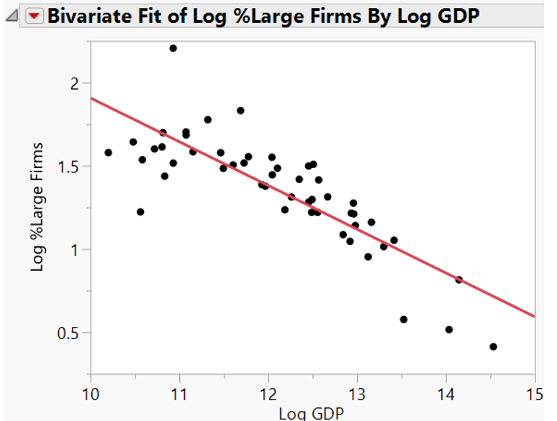
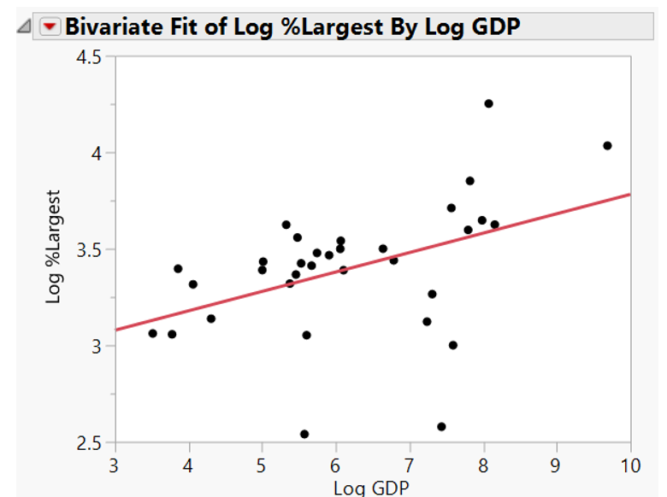
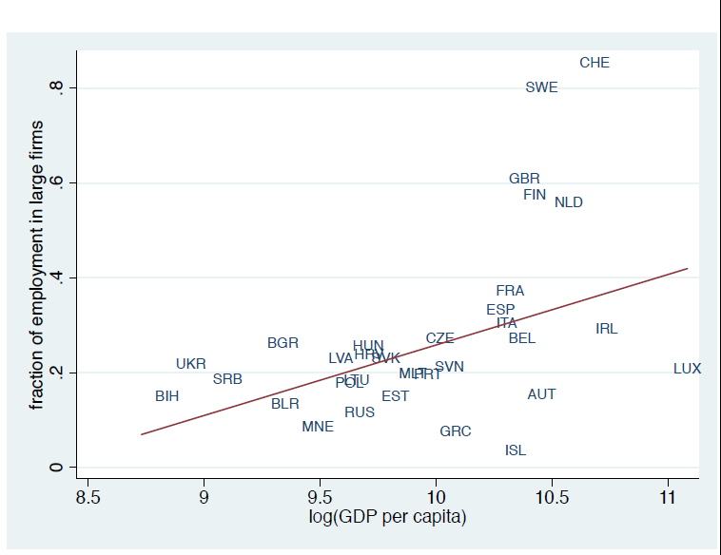

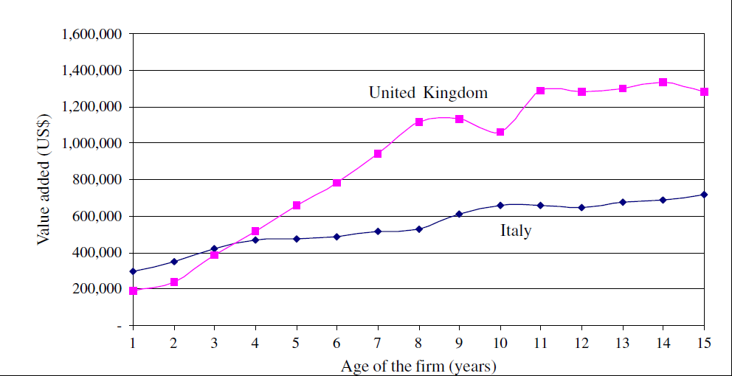
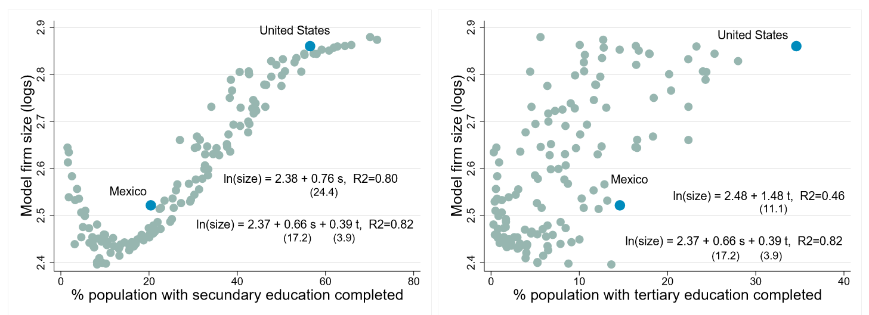
Adventures in Industrial Organization: Predicting Firm Size Distribution
Sean Hogan
Advisor: Dr. Aziz Saglam
The Model and Variables
$$Log \%Large Firms=β1∗Log Patents∗+ β2∗Log \%With Advanced Degree+ β3∗ Urbanization+ β4∗Log Subsidies+ β5∗Log Number of Subsidies$$
In the early stages of development there are many entrepreneurs. The ecosystem is dynamic but productivity is low..
Main Model Elements And Their Proxies
Entrepreneurial Ability
  Percent of Working Population With A Masters or Higher
Technology Progress
  Patents Granted
Government Intervention
  Dollar Value of Subsidies
  Number of Subsidy Programs
Urbanization
  Size of Largest City in State as a percentage of NYC
Data & Methodology
Multiple Linear Regression
2013 Census Data of Firm Size
2013 USPTO Patents Issued By State
2013 or Most Recent Educational Attainment by State
Subsidy Data as Compiled by Good Job First
Results
Entrepreneurs vary in skill and the benefits of technology are not uniform. The most skilled and tech savvy entrepreneurs expand, firms grow markets consolidate, and productivity rises.
Literature Review
The Firm Size Distribution across Countries and Skill-Biased Change in Entrepreneurial Technology, (Poschke, 2014, Forschungsinstitut zur Zukunft der Arbeit)
As GDP rises, small firms importance declines
Explanation
  Wages rise as more firms push boundaries encouraging employment over entrepreneurship
  Tech change benefits entrepreneurs unequally
  Entry regulation as a barrier to entrepreneurship
  (Klapper et al, 2006, Journal of Financial Economics, 591–629)
  High entry costs reduce startups and increase their size
Human Capital and the Size Distribution of Firms
(Pedro Gomes & Zoë Kuehn, 2014, IZA Discussion Paper No. 8268)
Secondary education more important than tertiary for increasing firm size
Some Interesting Relationships
For US States
OECD International Data
In later stages of development regulations and incumbent advantages can cause large industries to grow complacent under diminished competition.
Conclusions
An increase in patents and urbanization reduced the percentage of large firms.
Firm size and GDP had a negative relationship in the US for 2013.
It is possible that the positive relationship supported by the literature does not always hold after a certain level of development has been reached. Increasing consolidation and profit margins in the US may signal that gains from large firms have reached a high water mark and that further growth requires more competition from the bottom.
(Based on Poschke, 2014)

