Slide 1
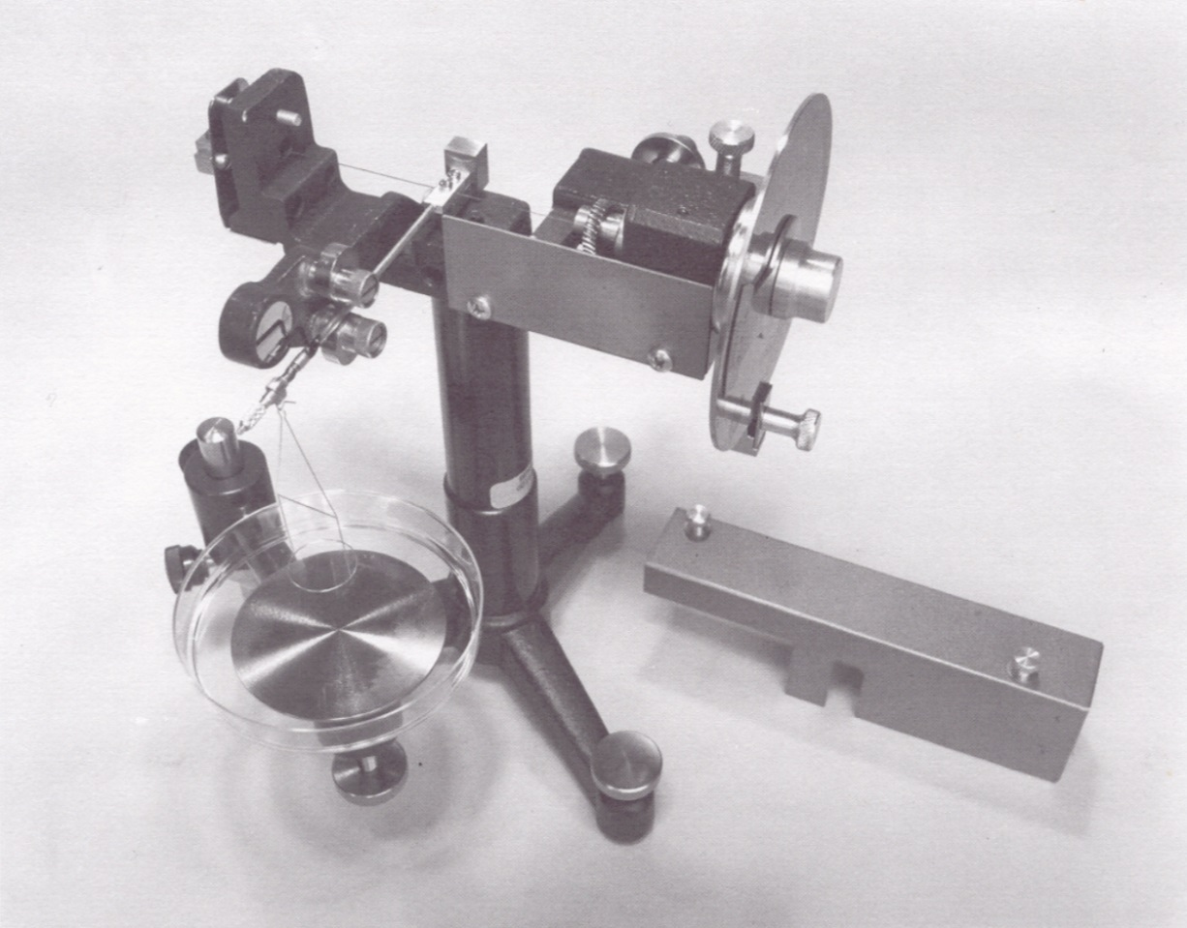
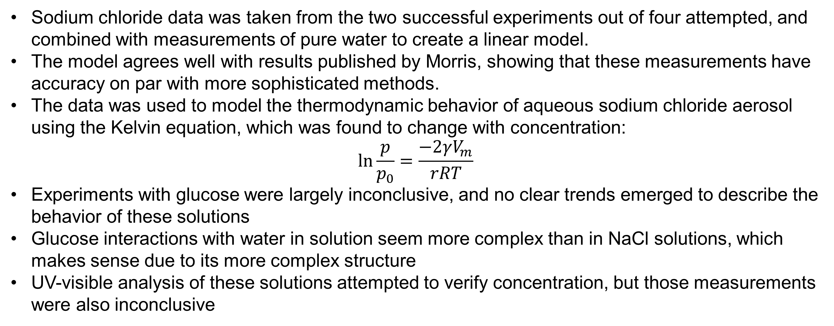
Surface Tension Measurements of Organic, Inorganic and Mixed Aqueous Solutions
Anthony Jennings, Dr. Margaret Greenslade
asu54@wildcats.unh.edu; Parsons Hall, 23 Academic Way, Durham NH 03824
Introduction
A common process by which solid aerosol particles are formed is known as wet generation. The solid in question must be dissolved in water, and this solution is atomized, forming droplets suspended in the air. The water then evaporates, leaving behind the solid aerosol. The surface tension of the solution is one of several factors that control the size of aerosol droplets. When a solid is dissolved in water, the resulting solution can have a significantly higher or lower surface tension than the pure liquid, often having a clear relationship with concentration. Therefore, it may be possible to use the surface tension of a solution to predict the properties of aerosols formed from it. The purpose of this work was to determine the relationship between surface tension and concentration in aqueous solutions of sodium chloride and D-glucose, both commonly found in atmospheric aerosol. This data would be used to show how changes in surface tension affect wet generation of aerosols.
Results and Discussion
Figure 3. Surface tension of aqueous NaCl versus concentration. Points represent average of three measurements and error bars represent standard deviation. Weighted linear regression equation: y = (2.1±0.2)x + (73.3±0.5).
Figure 4. Kelvin equation plot comparing droplet size and the ratio of vapor pressure to saturated vapor pressure for aqueous NaCl. From top to bottom, the lines represent concentrations of 0M, 1.5M and 6M.
Sodium chloride data was taken from the two successful experiments out of four attempted, and combined with measurements of pure water to create a linear model.
The model agrees well with results published by Morris, showing that these measurements have accuracy on par with more sophisticated methods.
The data was used to model the thermodynamic behavior of aqueous sodium chloride aerosol using the Kelvin equation, which was found to change with concentration:
$$\ln{\frac{p}{p_{0}}}=\frac{−2γV_{m}}{rRT}$$
Experiments with glucose were largely inconclusive, and no clear trends emerged to describe the behavior of these solutions
Glucose interactions with water in solution seem more complex than in NaCl solutions, which makes sense due to its more complex structure
UV-visible analysis of these solutions attempted to verify concentration, but those measurements were also inconclusive
Figure 1. CSC Scientific Precision Tensiometer model used in this study.
Figure 2. Surface tension of aqueous glucose versus concentration from three different experiments. Points represent average of three measurements and error bars represent standard deviation.
Experimental
Surface tension measurements taken manually using a DuNouy ring tensiometer
Uses a platinum-iridium wire ring attached to a lever arm to pull upwards on the liquid surface, and the force required to break the surface is recorded
The instrument was calibrated using the known downward force provided by a 0.5g weight attached to the ring
50 mL solutions of sodium chloride and D-glucose were made using reverse osmosis water and allowed to equilibrate to room temperature before study
Future Work
Experiments on glucose solutions will be continued in order to produce reproducible results and form a model for their surface tension behavior. If models can be made for both solution systems, they will be used to predict the behavior of mixed solutions of both compounds
References
Morris, H. S., V. H. Grassian, A. V. Tivanski. Humidity-dependent surface tension measurements of individual inorganic and organic submicrometre liquid particles. Chemical Science. 2015. 6. 3242-3247.
Seinfeld, J. H. and S. N. Pandis. Atmospheric Chemistry and Physics: From air pollution to climate change. Wiley. 2nd Edition. 2006.
CSC Scientific Company. Manual for tensiometers, CSC – DuNouy
Ming, Y. and L. M. Russell. Predicted hygroscopic growth of sea salt aerosol. Journal of Geophysical Research.2001. 106. 28,259-28,274.
Zamora, I. R. et al. Hygroscopic Growth of Common Organic Aerosol Solutes, Including Humic Substances, as Derived from Water Activity Measurements. Journal of Geophysical Research: Atmospheres. 2011. 116. D23207.
Pöschl, U. Atmospheric Aerosols: Composition, Transformation, Climate and Health Effects. Angewandte Chemie Int. Ed. 2005. 44. 7520-7540.
Conclusions
It is possible to predict properties of aerosolized solution droplets based on the surface tension of bulk solutions, if a clear relationship between surface tension and concentration can be established. This is fairly easily done for ionic solutes, but more complex organic solutes present additional challenges.
Acknowledgments
Thanks to the UNH Chemistry Department and Dr. Greenslade’s research group for support and funding for this study.

