Slide 1


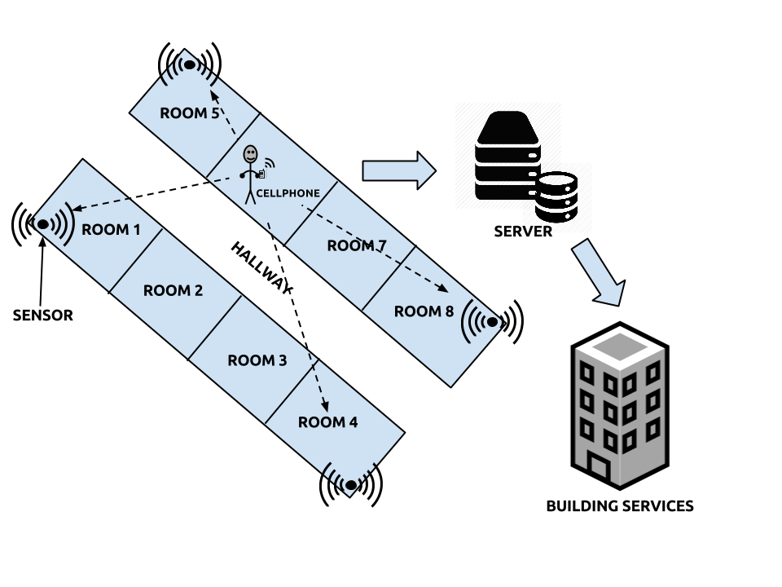
Wireless Occupancy Detection Infrastructure
Caleb Frantz ● Joseph LeBlanc ● Cody Pitman Dr. Nicholas Kirsch ● Jonathan Tefft
Supported by the NSF Grant No.: 13-36824
Project Motive
The climate control inside of the buildings at the University of New Hampshire use a lot of energy
CO2 sensors can be used to effectively regulate the fresh air in rooms but are expensive
Other options include video or key cards, but these can be invasive and detrimental to usability
A cheaper and less invasive alternative is to count the occupants in a room by detecting cellphones
Based on room occupancy fresh air in a room can be regulated
Our Contribution
Server setup to receive and store data being sent from sensors
Cellphone signal location calculated into X,Y positioning
X,Y coordinates mapped to relative position within the building
Occupancy of room sent to building services to regulate room climate
Technical
Sensors are Ettus B200s
  Frequency coverage: 70MHz to 6GHz
  Captures cell phone signals
Signals transferred to NUC
  Running GNU Radio
GNU Radio
  Deciphers the signal
  Power, frequency, and time
  String sent to server via TCP
TCP script: Python 3
  Opens a port and listens for connection
  Data sent to port will be captured and stored into the database
Database: MariaDB (MySQL)
  Hits table contains Sensor Number, Frequency, Power, and Time
  Coordinates table contains X and Y coordinates of signal
  Room table contains room IDs
Grouping Script: Python 3
  Groups SQL data by similar frequencies and times.
  Phone signal has unique time and frequency across four sensors
Localization Algorithm
  Takes distances and positions of the sensors
  Creates X,Y coordinates of the phone
  X,Y coordinates mapped to position to determine room
SERVER
TCP Connection
Hits
Localization
Report Occupancy

