Slide 1

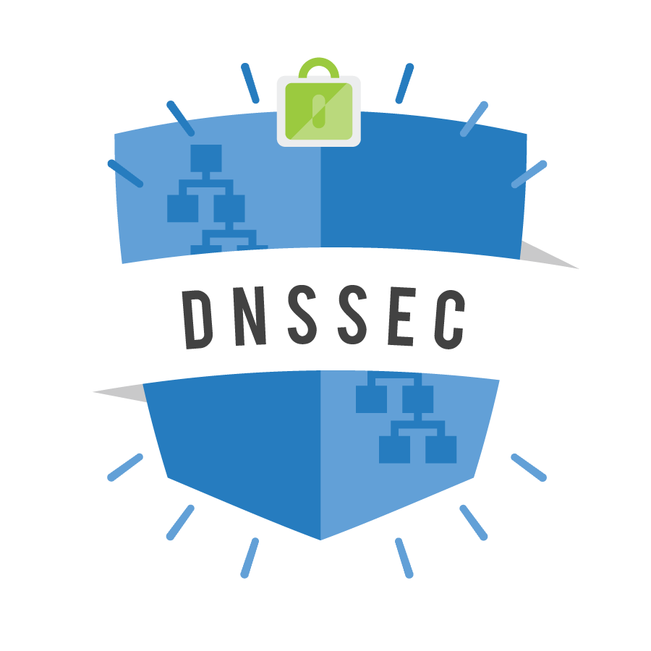
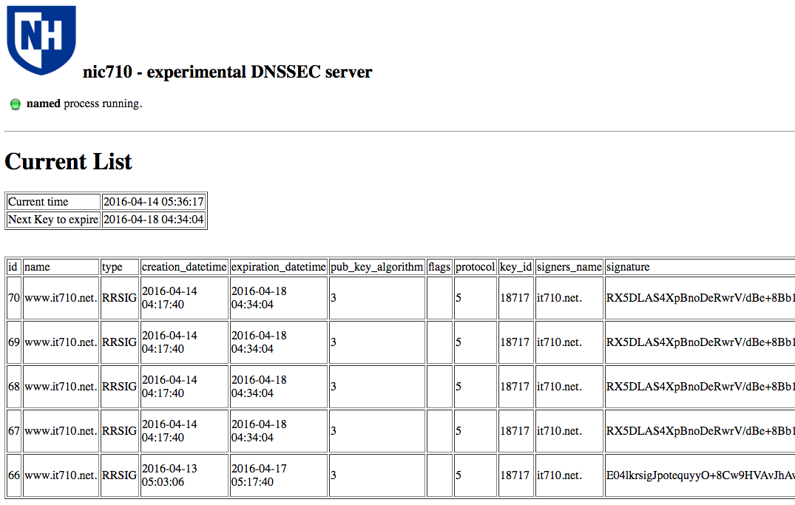
DNS Security Extensions
Researchers: Nick Calderan, Taylor Puksta, Craig Kost, Scott Kitterman, and Marcus Del Greco
ttd9@wildcats.unh.edu | nan53@wildcats.unh.edu
cax236@wildcats.unh.edu | stk@unh.edu | marcus.delgreco@unh.edu
Project Goals
  Build a knowledge and skill level to operate and implement DNSSEC
  Implement DNSSEC on the RedHat test server.
  Create a procedural document to implement DNSSEC on the UNH Infoblox server.
  Construct a web interface for managing and monitoring the health of the DNSSEC system.
Summary of Results
Duplicated the UNH zone on a mirror zone and with full DNSSEC functionality, serving over 20,000 records
Gained understanding of DNSSEC implementation and operation, behind the scenes and through a GUI
Created tools to monitor operation and provide useful information
Abstract
The purpose of this project is to implement Domain Name System Security Extension (DNSSEC) on the University of New Hampshire Domain Name Server(DNS). DNSSEC extends standard DNS to provide a measure of security; it proves that the DNS information comes from the official source and has not been modified in transit.
Domain Name System is a top down naming service which translates domain names which can be easily memorized by humans, to numerical IP addresses which are needed for computer and internet services worldwide.
The original Domain Name System protocol provides no protection against malicious or forged responses. DNSSEC addresses this need by adding digital signatures into DNS data, so each DNS response can be verified for integrity and authenticity. This ensures that the message did not change during transit, and the sender is not an imposter.
Lessons Learned
DNSSEC is not widely deployed and although it takes effort to implement, it is mature and production ready for service on the internet
DNSSEC management includes, key management, updating Delegation Signer (DS) records, and managing expiration and rollover
DNSSEC uses more human and computer resources to add an extra level of security to support secure domain name service
Future Work
Develop web interface to enhance monitoring the health of DNSSEC, to prepare for implementation on production
DNSSEC deployment on all of UNH's live server environment
Ability to identify problems and remedy them quickly
Plan for identifying and mitigation against Denial of Service (DDOS) attacks
Notes:
Key-signing and Zone-signing keys must be directly related to the zone the are to be attached to.​
Delegation Signer (DS) resource records must be added to Domain host(GoDaddy.com), to indicate key is valid​
Must add keys into main server configuration file.

