Slide 1



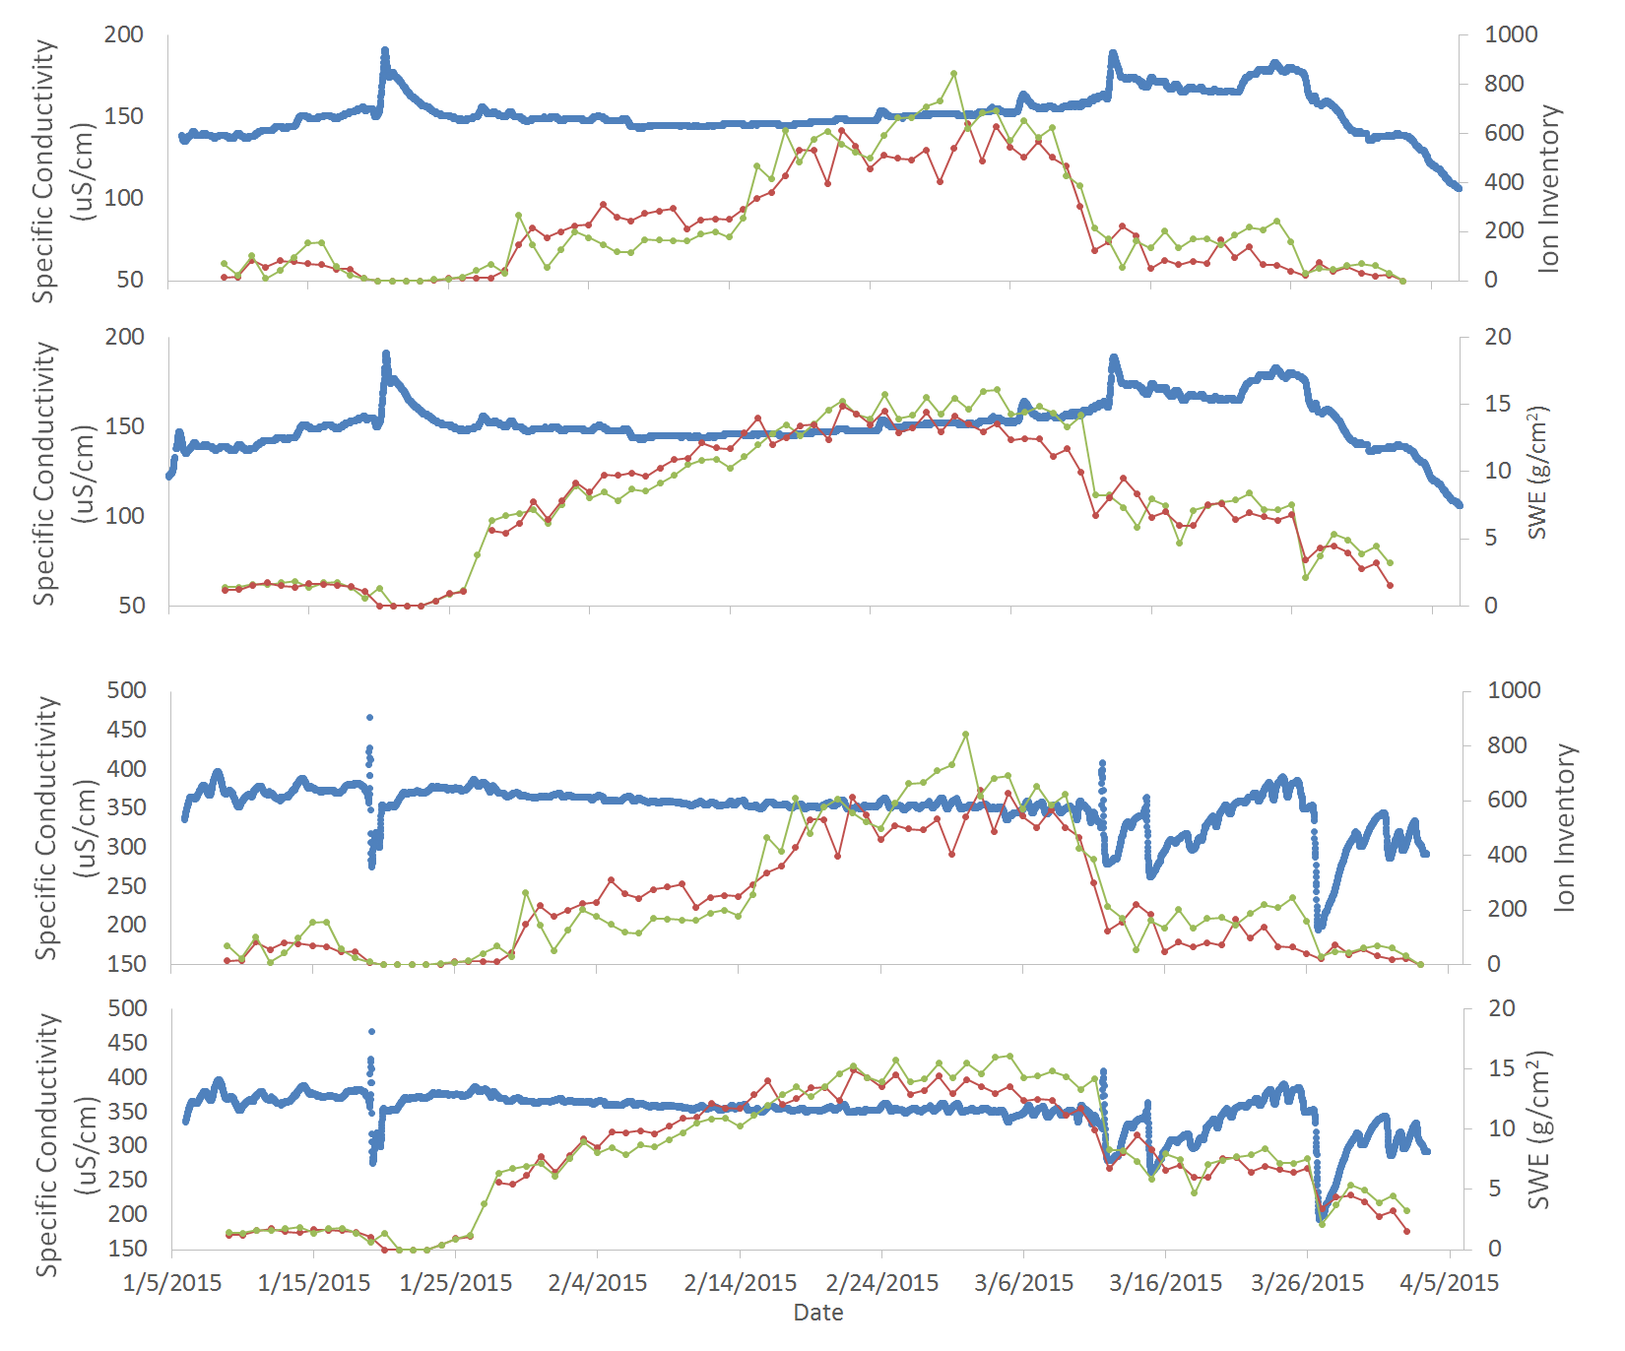
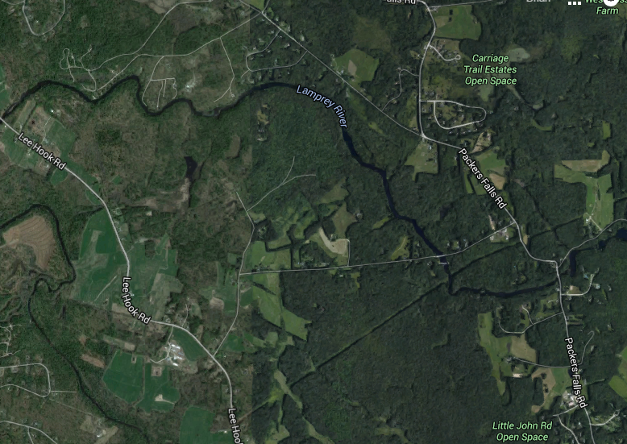

The Impact of Melting Snow on Rivers in New Hampshire
Brian Taetzsch ¹, James Lazarcik ^{2, 3}, Jack Dibb ^{2, 3}
¹College of Life Sciences and Agriculture, University of New Hampshire, Durham NH
² Department of Earth Science , University of New Hampshire, Durham, NH, USA
³Institute for the Study of Earth, Oceans and Space, University of New Hampshire, Durham, NH, USA
Introduction:
High conductivity in streams can lead to osmotic shock for aquatic life as well as temporary acidification of the water (Johannessen and Henriksen 1978). At the onset of the melt, an ionic pulse occurs. These ions may not immediately reach streams, rather, they linger on the surface soil until sufficient melt water is available to drive overland flow (Colbeck 1981). Our goal for this investigation was to determine if the pulse could be detected in the Lamprey River watershed using ion and snow water equivalence as well as stream stage and conductivity data.
Results:
a
Lamprey River
b
c
Table 2: The timing of the drop dates and the conductivity spike. The drop dates are referring to the day we observed the change. The order of the lag times are the same each time and the gap is larger for the larger river system
1a.
Lamprey River
Site (event) | Ion Drop Start | SWE Drop | Conductivity Spike
BDO (a) | 17-Jan | 18-Jan | 20-Jan
TFO(a) | 16-Jan | 18-Jan | 20-Jan
BDO (b) | 8-Mar | 10-Mar | 13-Mar
TFO (b) | 9-Mar | 11-Mar | 13-Mar
BDO (c) | 23-Mar | 25-Mar | Dilution
TFO (c) | 25-Mar | 27-Mar | Dilution
1b.
Wednesday Hill Brook
Site (event) | Ion Drop Start | SWE Drop | Conductivity Spike
BDO (a) | 17-Jan | 18-Jan | 19-Jan
TFO (a) | 16-Jan | 18-Jan | 19-Jan
BDO (b) | 8-Mar | 10-Mar | 11-Mar
TFO (b) | 9-Mar | 11-Mar | 11-Mar
BDO (c) | 23-Mar | 25-Mar | 28-Mar
TFO (c) | 25-Mar | 27-Mar | 28-Mar
Key Terms/Concepts:
Ion Pulse: The term used to describe the rapid delivery of a large fraction of ions stored in a temperate snowpack to the ecosystem at the beginning of snow melt.
Snow water equivalent (SWE): How much mass of water there is in an area, here in grams per square centimeter.
Stage: A measure of how much water is moving through a stream.
1c.
Wednesday Hill Brook
1d.
Conclusions:
We did find a relationship with snowmelt and stream conductivity.
Initial snow melt leads to a temporary increase in the conductivity of a stream.
Later in the melt, large volumes of water released dilutes the ions and lowers stream conductivity.
Methods:
Specific conductivity data from the Lamprey River and Wednesday Hill Brook were taken from the High Intensity Aquatic Network. Snow ion inventory and SWE data were collected at Burley-Demeritt Organic Dairy Farm (BDO) and Thompson Farm (TFO). These data sets were compared to each other in order to find trends.
Figure 1 (above): The measured ion inventory (1a. and 1c.) and SWE (1b. and 1d.) compared to conductivity in Wednesday Hill Brook and the Lamprey River. The shaded areas highlight small decreases in SWE accompanied by large drops in ion inventory which are followed by an increase in conductivity. Each event has been designated a letter.
Implications:
Some of the ions that are sampled from the snow are nutrients for many aquatic organisms such as nitrates. Nitrates, although beneficial in low levels for many types of aquatic plant life, can create problems further downstream such large algal blooms in estuaries (Townbridge et. al 2014; Williams and Seibold 2008). These ions also lead to high acidity which may lead to fish kills that can impact a number of different aspects of life (Tranter et. al 1985).
a
b
c
Sample Sites:
Figure 2 (above): The loss of SWE from the snow pack is accompanied by a rise in the stage height in Wednesday Hill Brook shortly after. This pattern extends to the Lamprey River as well (not shown). Stage can also increase with out a drop in SWE through intense precipitation events such as on January 27th.
WHB
References:
Colbeck, S.C. 1981. A Simulation of the Enrichment of Atmospheric Pollutants in Snow Cover Runoff. Water Recources Research 17:(5). pp 1383-1388.
Johannessen, M. and A. Henriksen. 1978. Chemistry of Snow Meltwater: Changes in Concentration During Melting. Water Rescources Research. 14:(4). pp 615-619.
Townbridge, P., M.A. Wood, J.T. Underhill, and D.S Healy. 2014. Great Bay nitrogen non-point source study. New Hampshire Department of Environmental Services.
Tranter, M., P. Brimblecombe, T.D. Davies, C.E. Vincent, P.W. Abrahams and I. Blackwood. 1987. The composition of snowfall, snowpack, and meltwater in the Scottish highlands- evidence for preferential elution. Atmospheric Environment. 20:(3). pp 517-525.
Williams, M. W. and C. Seibold. 2008. Storage and release of solutes from a subalpine seasonal snowpack: soil and stream water response, Niwot Ridge, Colorado. Biogeochemistry. 95. pp 77-94.
TFO
Measurement | Error (%)
SWE | 8.696
Ions | 38.67
Table 1: The spatial variability error for the snow measurements. Error bars were excluded for clarity purposes.
BDO
Acknowledgements: Thank you to Jody Potter for providing the data for Wednesday Hill Brook.
Support for the New Hampshire EPSCoR Program is provided by the National Science Foundation’s Research Infrastructure Improvement Award # EPS 1101-245

