Slide 1


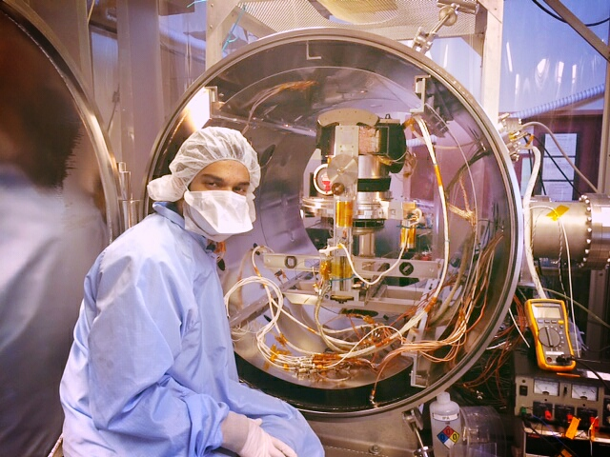
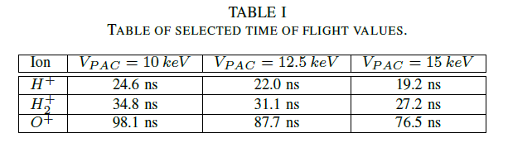
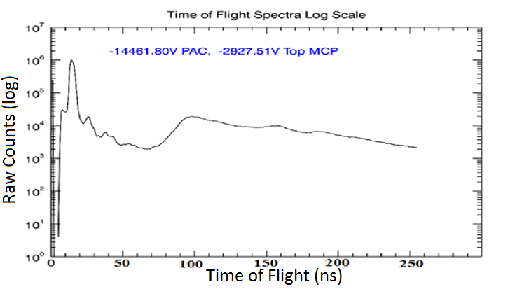
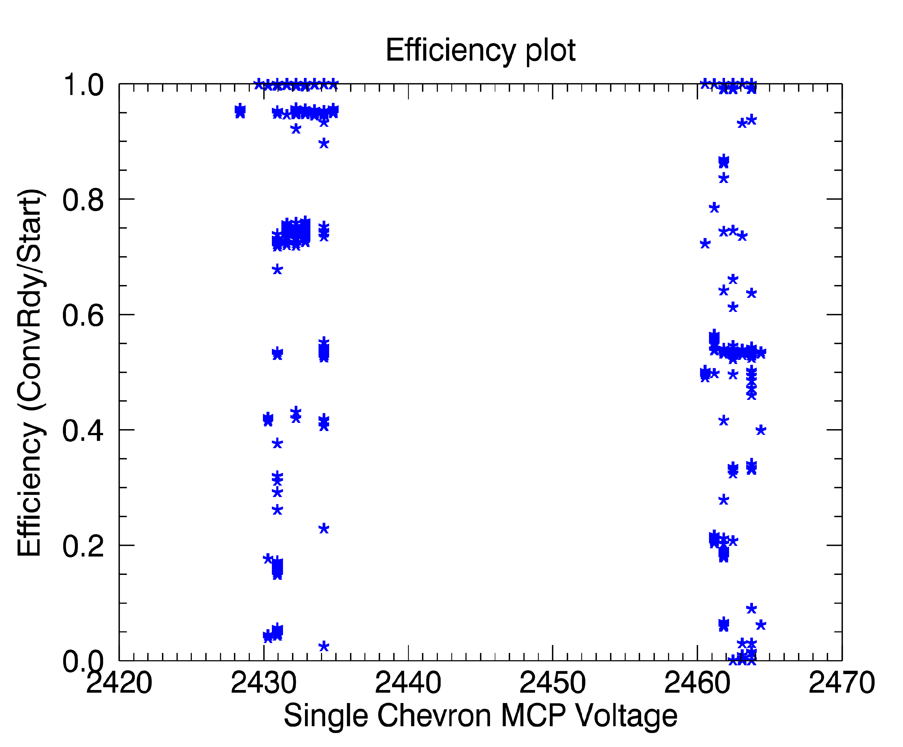
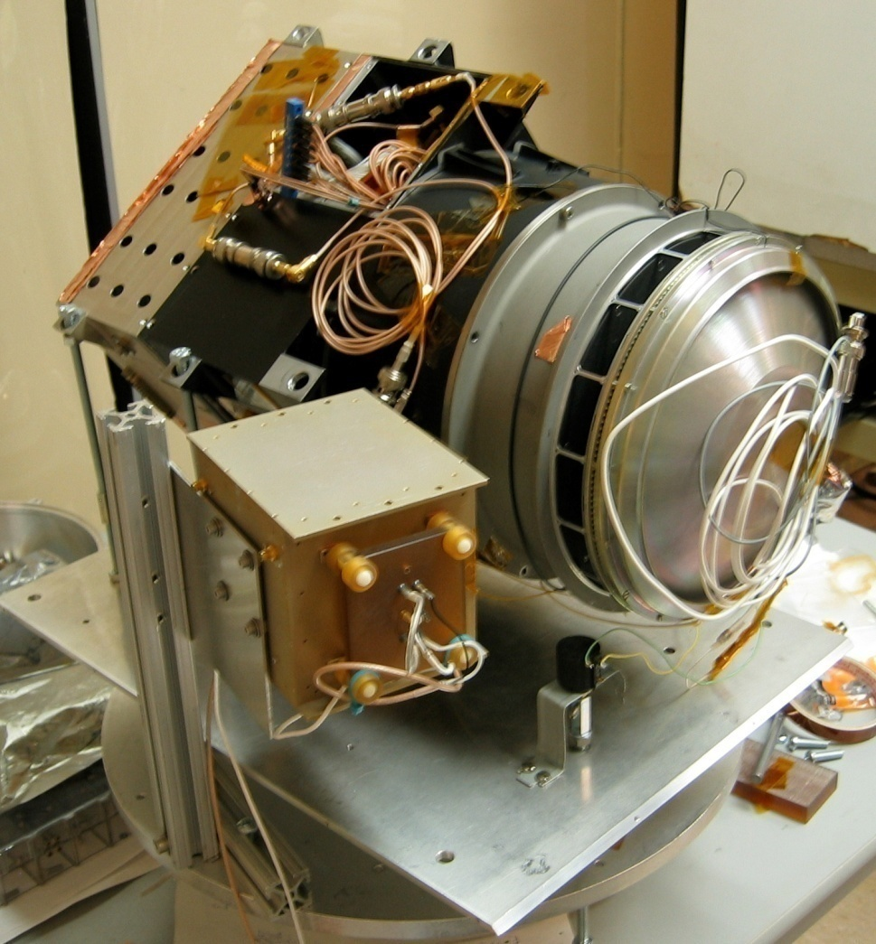
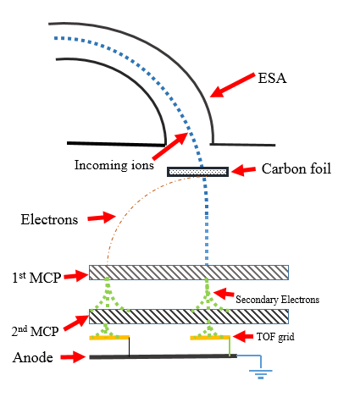
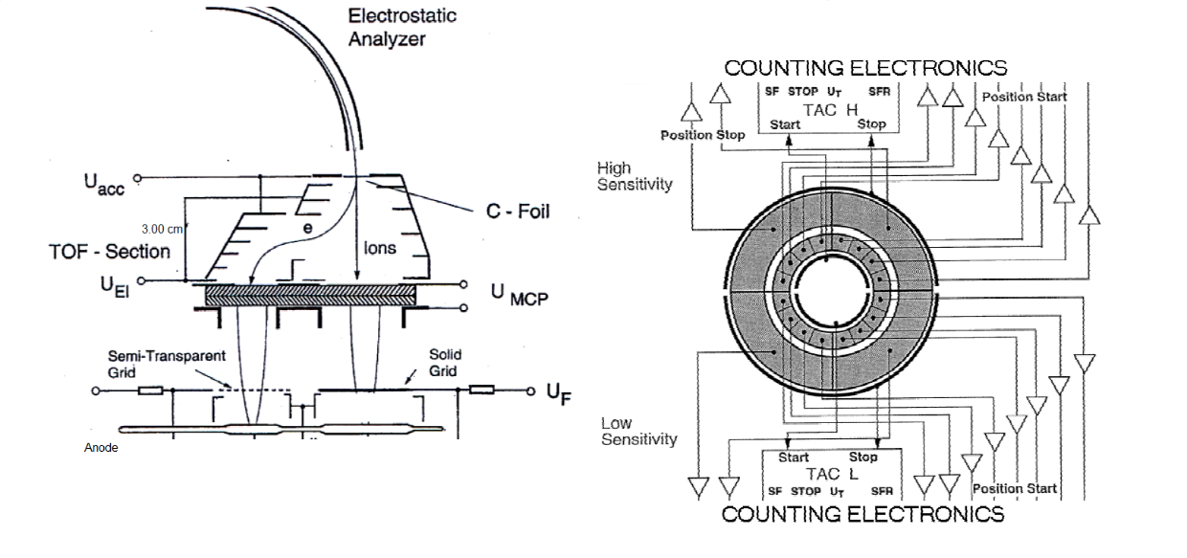
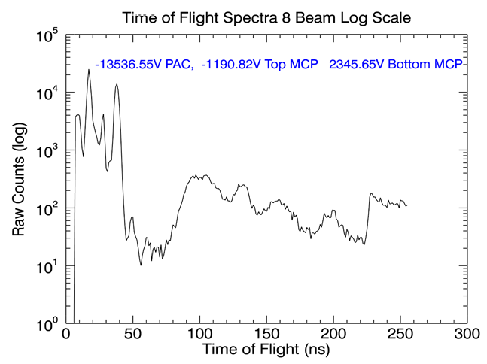
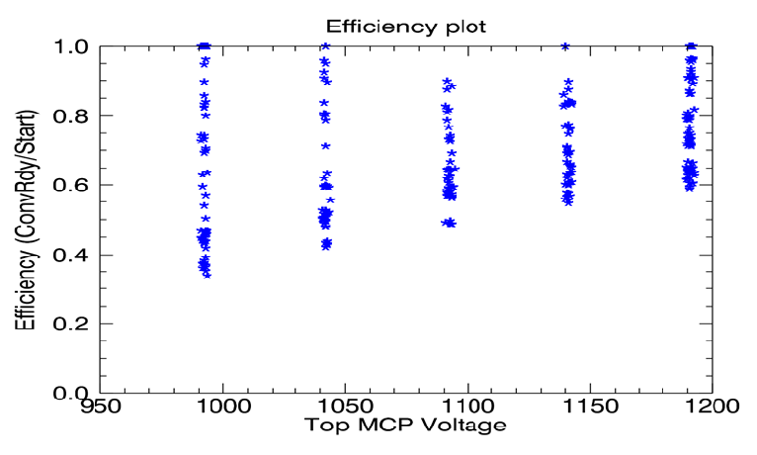
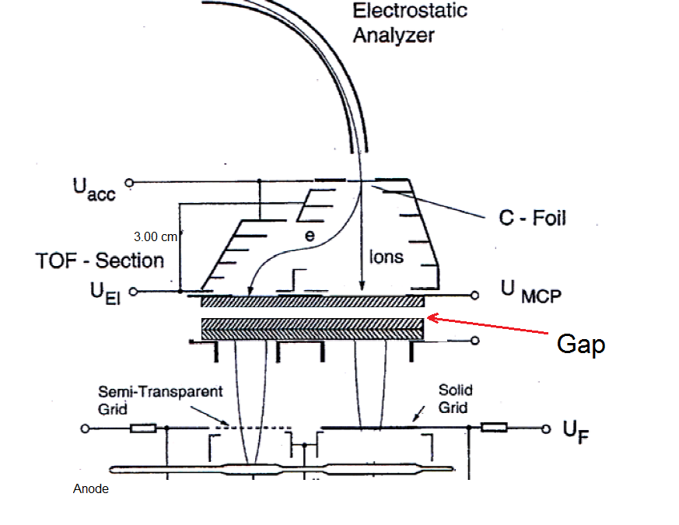
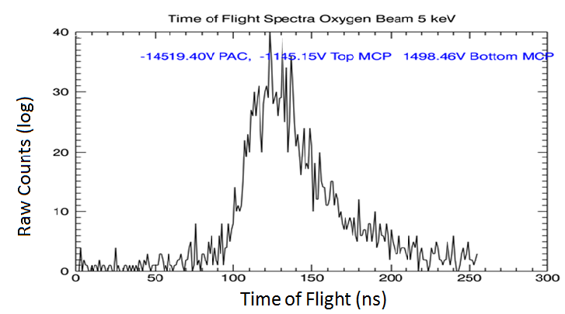
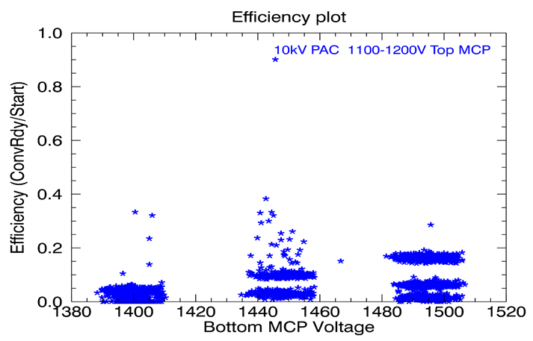
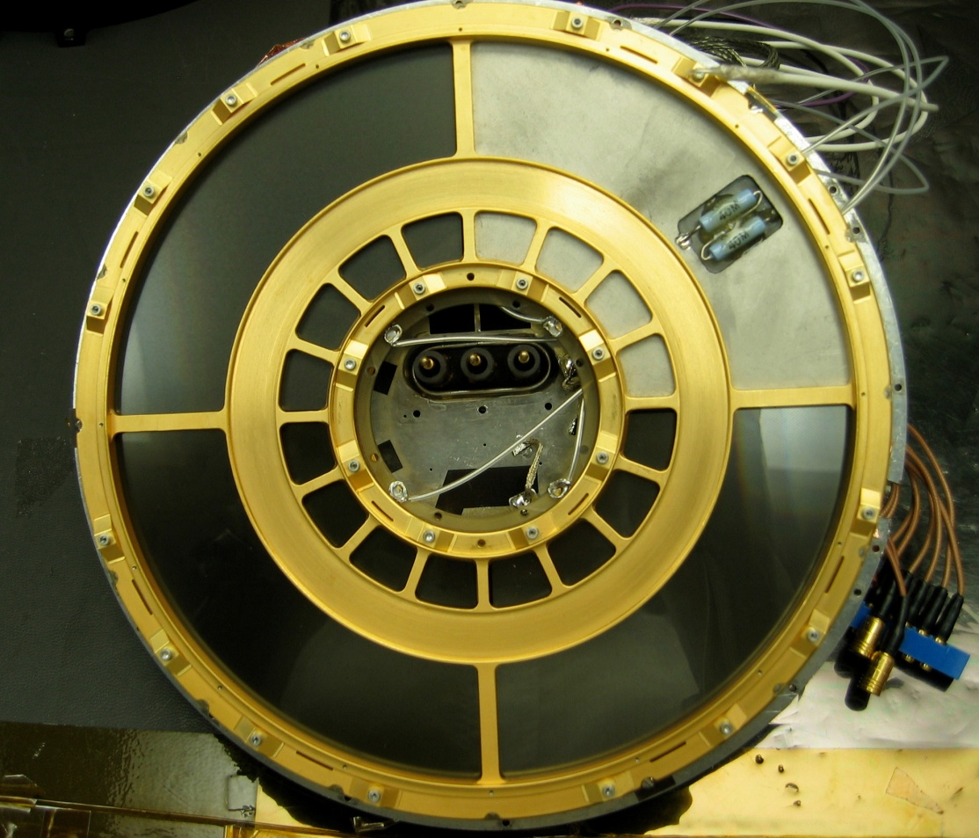
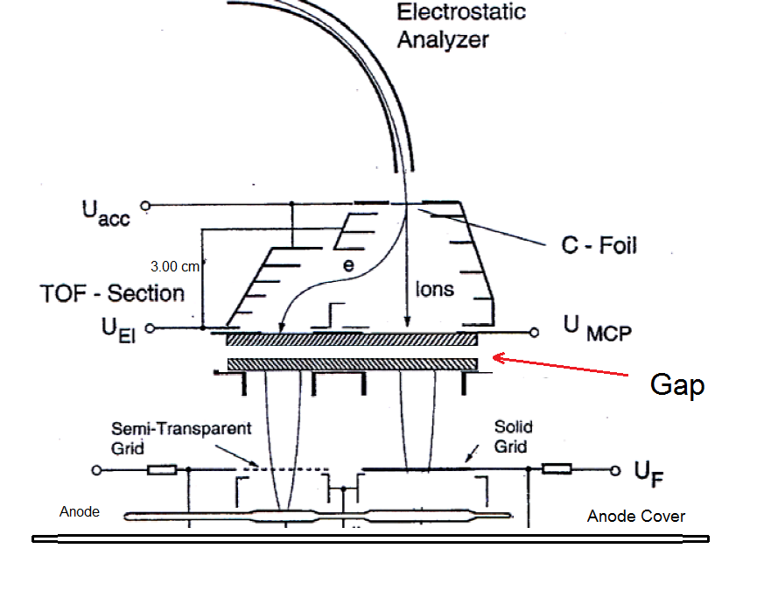
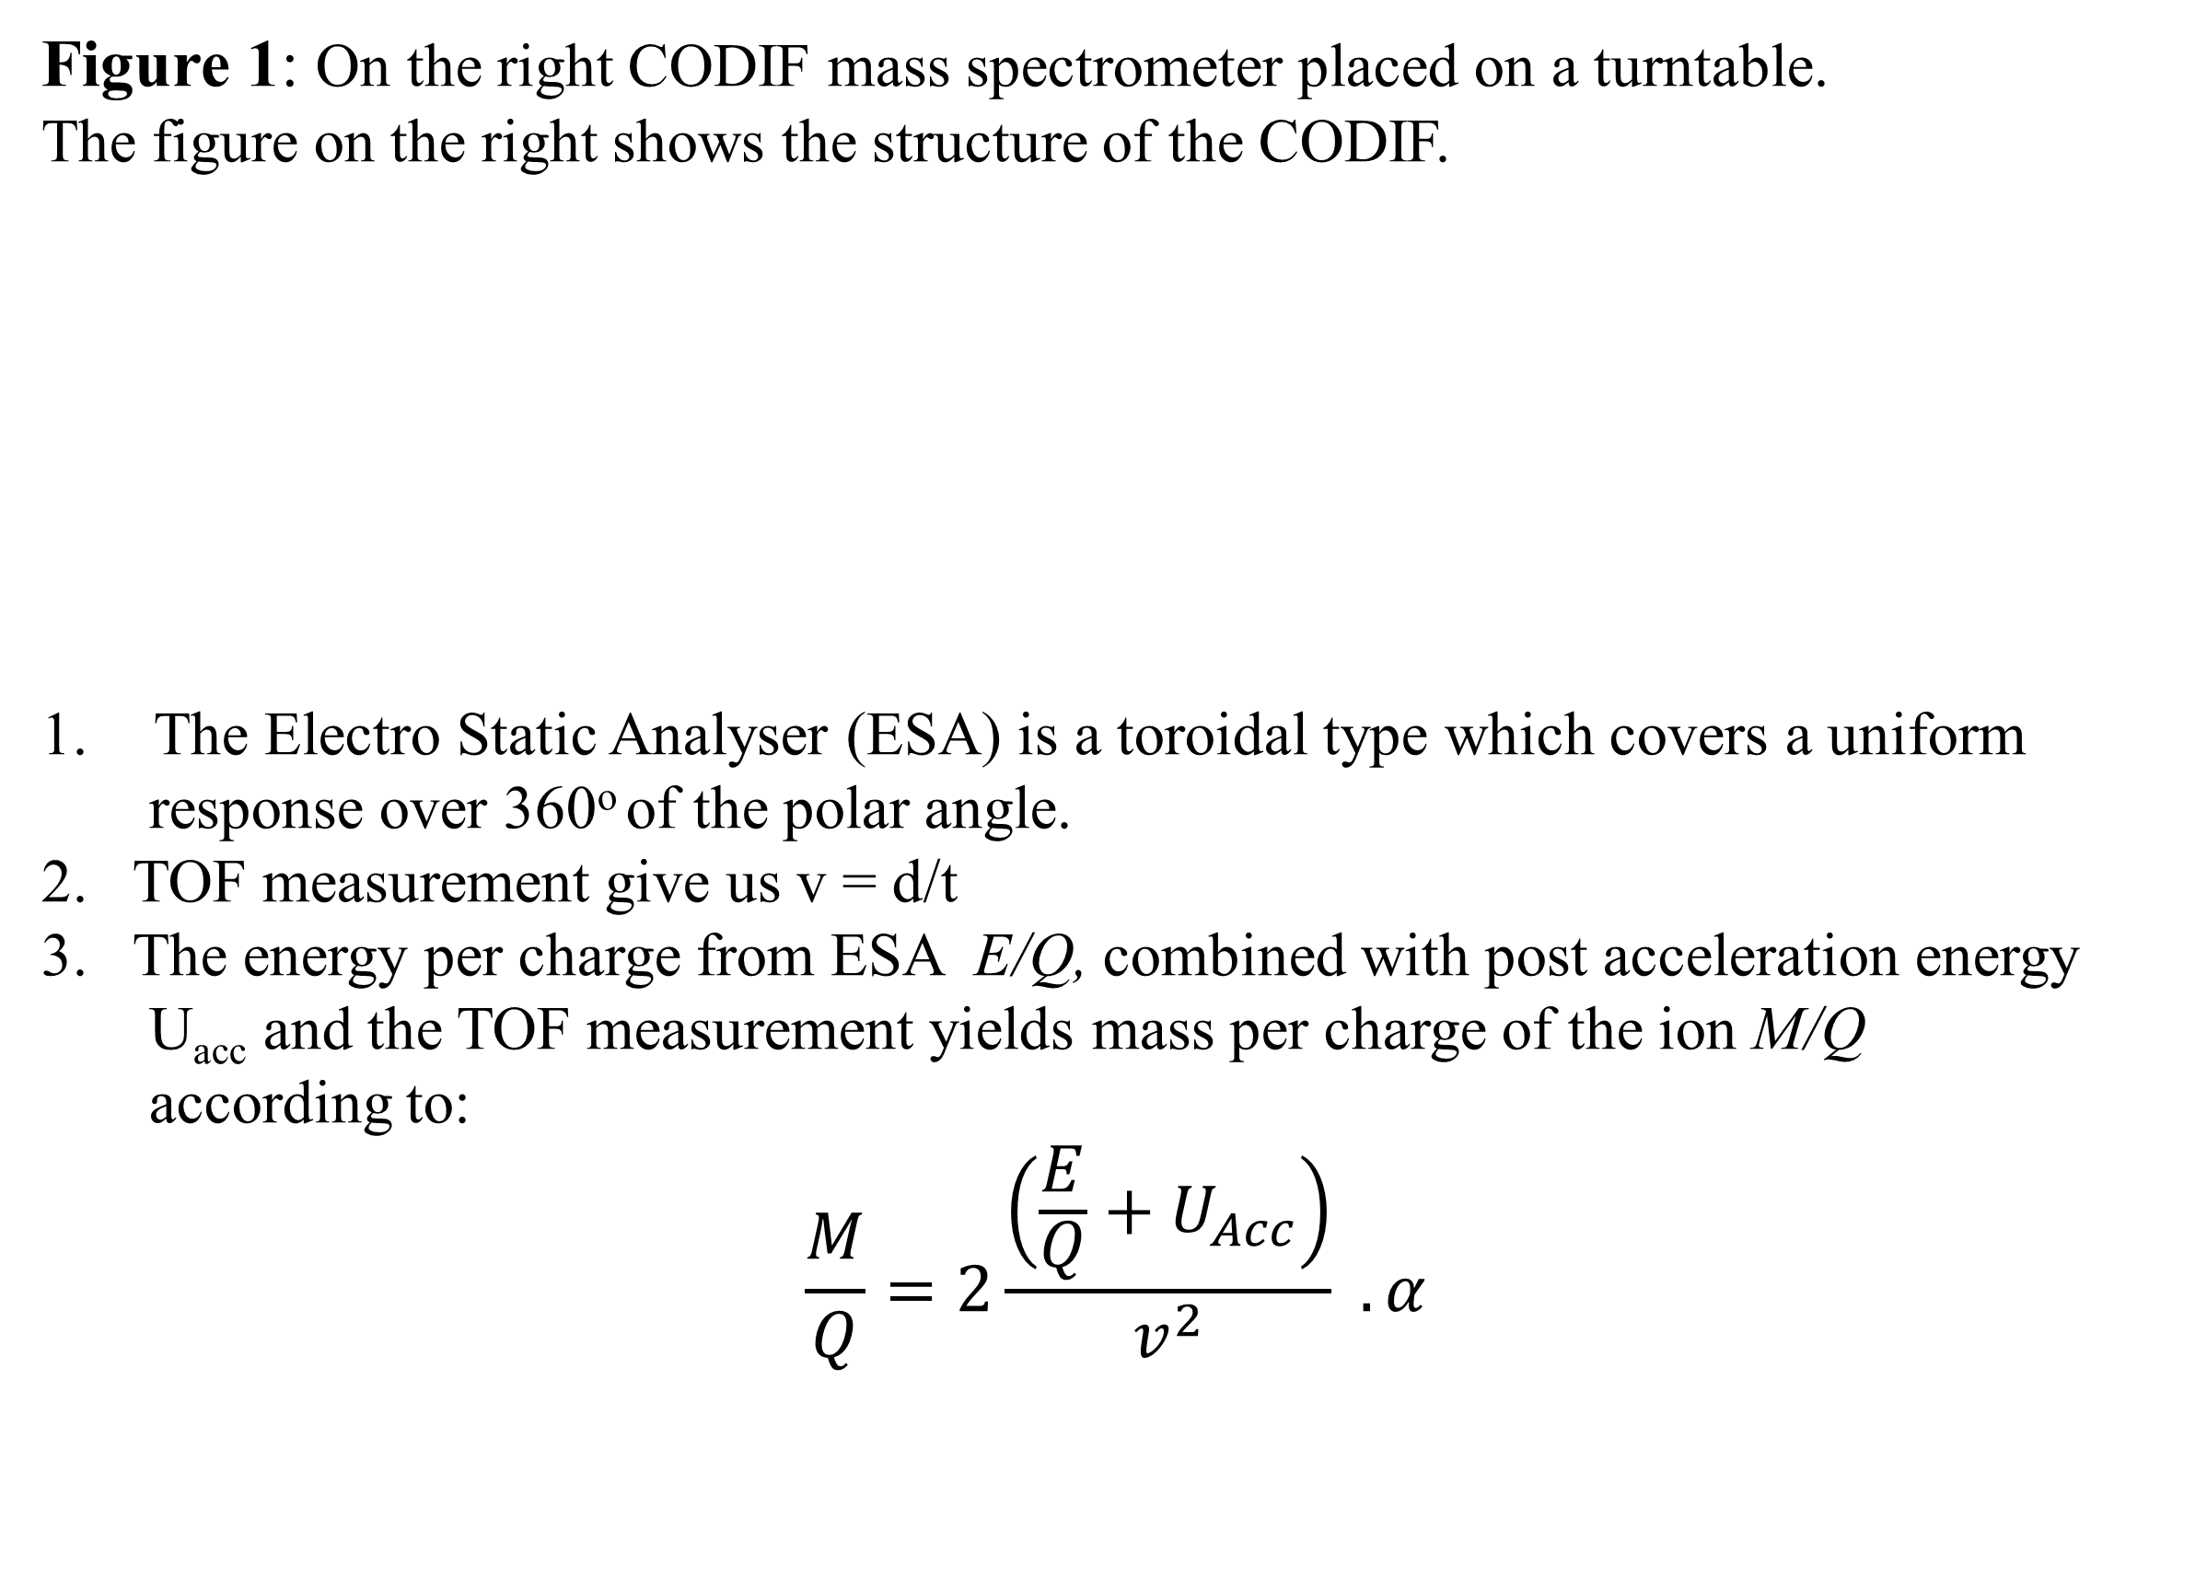
Improving the Efficiency and Resolution of Time of Flight (TOF)
Mass Spectrometer for Magnetospheric Applications.
Zain Abbas
Ph.D candidate Nick Lubinsky
Advisor Prof. Harald Kucharek, Co-advisor Prof. Lynn Kistler
Department of Physics, University of New Hampshire
Abstract
The interaction of Solar wind particles with Earths magnetic field creates various plasmas and currents inside the magnetosphere.
In order to study the dynamics of ions we have improved the CLUSTER/CODIF Ion spectrometer which provides composition and the 3D ion distributions for hydrogen, helium and oxygen using MicroChannel Plates (MCP).
Tested three different configurations of the MCP’s in the instrument. For each configuration, we have determined both the Time Of Flight (TOF) from the MCP and the efficiency of the overall instrument.
Modification and Testing
Currently, the instrument is
located in a pressure chamber.
Compared their TOF and efficiency
spectrum.
Tested three different
configurations of the MCP’s
at various voltages.
Original CODIF (Chevron stack):
The original CODIF contains a single chevron MCP placed after carbon foil.
The grids are divided into 22.5º sections, allowing us to measure the position signal.
The position signals indicate the direction from which the ions entered the instrument.
Single & Chevron Stack:
A single MCP and chevron is placed with a gap in between.
The top MCP is operated at 1190 V and the bottom chevron at 2300V
Two single MCP’s:
Two single MCP’s are placed with approximately 3 cm gap in between.
The anode cover reduced the RF noise signal from ground to MCP.
Results
Time Of Flight (TOF) measurement:
We calculated the theoretical values of the TOF by solving the eq (2) with respect to time.
t = L_{TOF} (M / 2E)^{1/2}
The the above equation with certain U_{acc} (PAC) voltage yields to table I.
Original CODIF (Chevron stack):
Figure 6: For TOF spectrum, we obtained max counts at 20ns with efficiency ranging from 0 to 1.
Single and Chevron stack:
Figure 7: In TOF spectrum, H⁺ have the max counts at 20ns with efficiency ranging from 0.3 to 1. The TOF spectra also shows noise from the electronics and MCP configuration.
Two Single MCP’s:
Figure 8: With a 5 keV oxygen beam, we obtained 40 counts with efficiency ranging from 0 to 0.4. The TOF increased due to geometric factor of the instrument. Also, the efficiency decreased because we operated top MCP at low voltages.
Conclusion:
We successfully determined the TOF and efficiency of each configuration.
Improved the experimental method by introducing an ion gun, which allows to shoot different ion species to the CODIF instrument.
The TOF resolution is fairly stable as the MCP voltage increases.
Future Work: In future, we would use the MCP instead of carbon foil to improve the efficiency of TOF and mass of the instrument. We would analyze different ion species to better understand the composition of plasma in our magnetosphere coming from the Sun.
Background
The CODIF/CLUSTER mass spectrometer was designed to study the dynamics of ions in and outside our magnetosphere. These ions can get their energy from the Sun through the solar wind and they may exchange energy with Earths magnetic field. The Time of Flight (TOF) detector provides the composition and 3D ion distribution for H+, He++, He+ and O+. It can measure the mass per charge ratio for all the ions and gives the direction from which the ions entered the instrument. It covers the ion composition energy range from 40 eV to 40keV e⁻¹ .
Figure 3: The original CODIF configuration has a single stack of MCPs which could be operated at 3000 V. It can distinguish He⁺ , O⁺, and H⁺ .
Figure 4: In the above configuration we placed a single MCP which has a coating of Lead Silicate (PbSiO₃)
Figure 1: On the right CODIF mass spectrometer placed on a turntable.
The figure on the right shows the structure of the CODIF.
The Electro Static Analyser (ESA) is a toroidal type which covers a uniform
response over 360º of the polar angle.
2. TOF measurement give us v = d/t
3. The energy per charge from ESA E/Q, combined with post acceleration energy
U_{acc} and the TOF measurement yields mass per charge of the ion M/Q
according to:
$$\frac{M}{Q}=2\frac{\left(\frac{E}{Q}+U_{Acc}\right)}{v^{2}} . α$$
Figure 2: Top down view of MCP on CODIF/CLUSTER instrument.
Figure 5: This configuration includes a solid aluminum anode cover as opposed to a spare anode board with disconnected, floating grounds.

