Slide 1


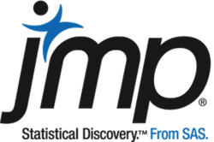
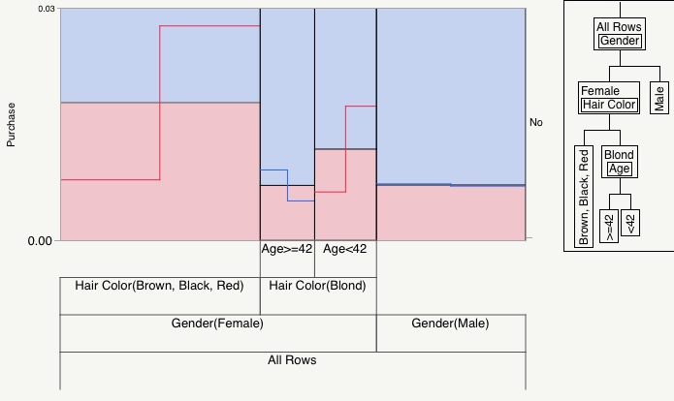
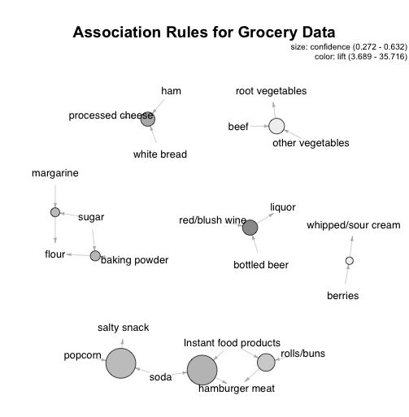
Predictive Analytics Applied to Consumer Behavior
Joe Loftus, Adviser: Phil Ramsey PhD
Department of Mathematics and Statistics, University of New Hampshire
Introduction:
We live in a time of unprecedented data collection and storage across many industries. Every day businesses are collecting information about customers, their purchases, and their habits. The end goal in collecting all this data is to turn it into valuable insights to be applied in the business setting. But how exactly is raw data translated into applicable knowledge?
This project is an investigation of two advanced analytical techniques used by businesses to accomplish exactly that. Each technique, in it’s own way, is able to extract knowledge from data that can in turn be applied to enhance business operations. In using these techniques a business can gain extra insight to make better decisions with regard to marketing campaigns, promotion structures, or retail layout. These insights can result in a significant advantage over rival competitors.
Uplift Modeling
Overview and Methodology:
Traditional response modeling seeks to identify characteristics of individuals who are likely to purchase given a treatment, such as:
While the traditional method is very effective at identifying the likely responders, it falls short in that there is no control group. The fact that many individuals may have responded regardless of treatment is ignored, so we cannot measure the true incremental impact of an action. In actuality we want to maximize the difference in response rate between those who are treated and those who are not, which we define as uplift. Instead we model:
Market Basket Analysis
Overview:
Analyzes transaction level data and seeks to establish rules that will predict the occurrence of a product based on the occurrence of other products in the transaction. For example: if a customer buys product A, are they likely to buy product B?
Methodology:
We define several objective measures of interestingness to evaluate the quality of our rules.
Analysis:
Data set is comprised of 30 days of point-of-sale transactions from a real-world grocery store database.
Analysis:
Uplift Model for Purchase
We fit a decision tree that maximizes the difference in purchase rate between the treatment and control groups at each split.
Our model finds there is uplift from treatment for female customers without blond hair. This means that the treatment (i.e. a promotion) had a positive incremental effect on the purchase rate for those customers. The opposite is true for blond females over the age of 42 and for males.
We use statistical software to generate rules of the form:
With our defined statistics we can evaluate the interestingness and usefulness of the rules. Several of the rules we find are:
{A} => {B}
The bottom figure shows the sorted uplift values for each individual. The model predicts at most uplift of .02. So for the “best” individuals there is a 2% difference in purchase rate between the treatment and control groups. These are the customers on which to focus marketing campaigns.
{berries} => {whipped/sour cream}
{popcorn, soda} => {salty snack}
We interpret these rules as customers who purchased popcorn and soda were more likely to purchase salty snacks as well.
Thorough analysis and visualization reveal patterns and structure from the raw data. With the help of subject matter experts a grocer could use these insights to more effectively structure the store layout or promotions on certain products to encourage cross-selling.
Conclusion:
The modern business must explore all avenues in order to remain competitive in today’s market. By using data mining and predictive analytics techniques a business can gain insight into their customer’s habits and behavior. Analysis of transactional data allows a business to organize effectively a store layout or structure promotional deals. Through uplift modeling a business can identify their most easily influenced customers, and therefore can more efficiently allocate resources in marketing campaigns to encourage upselling and cross selling while avoiding churn. These techniques among many others can give a business a very valuable competitive advantage.
Notes:
Aq =

