Slide 1
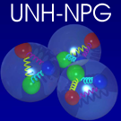

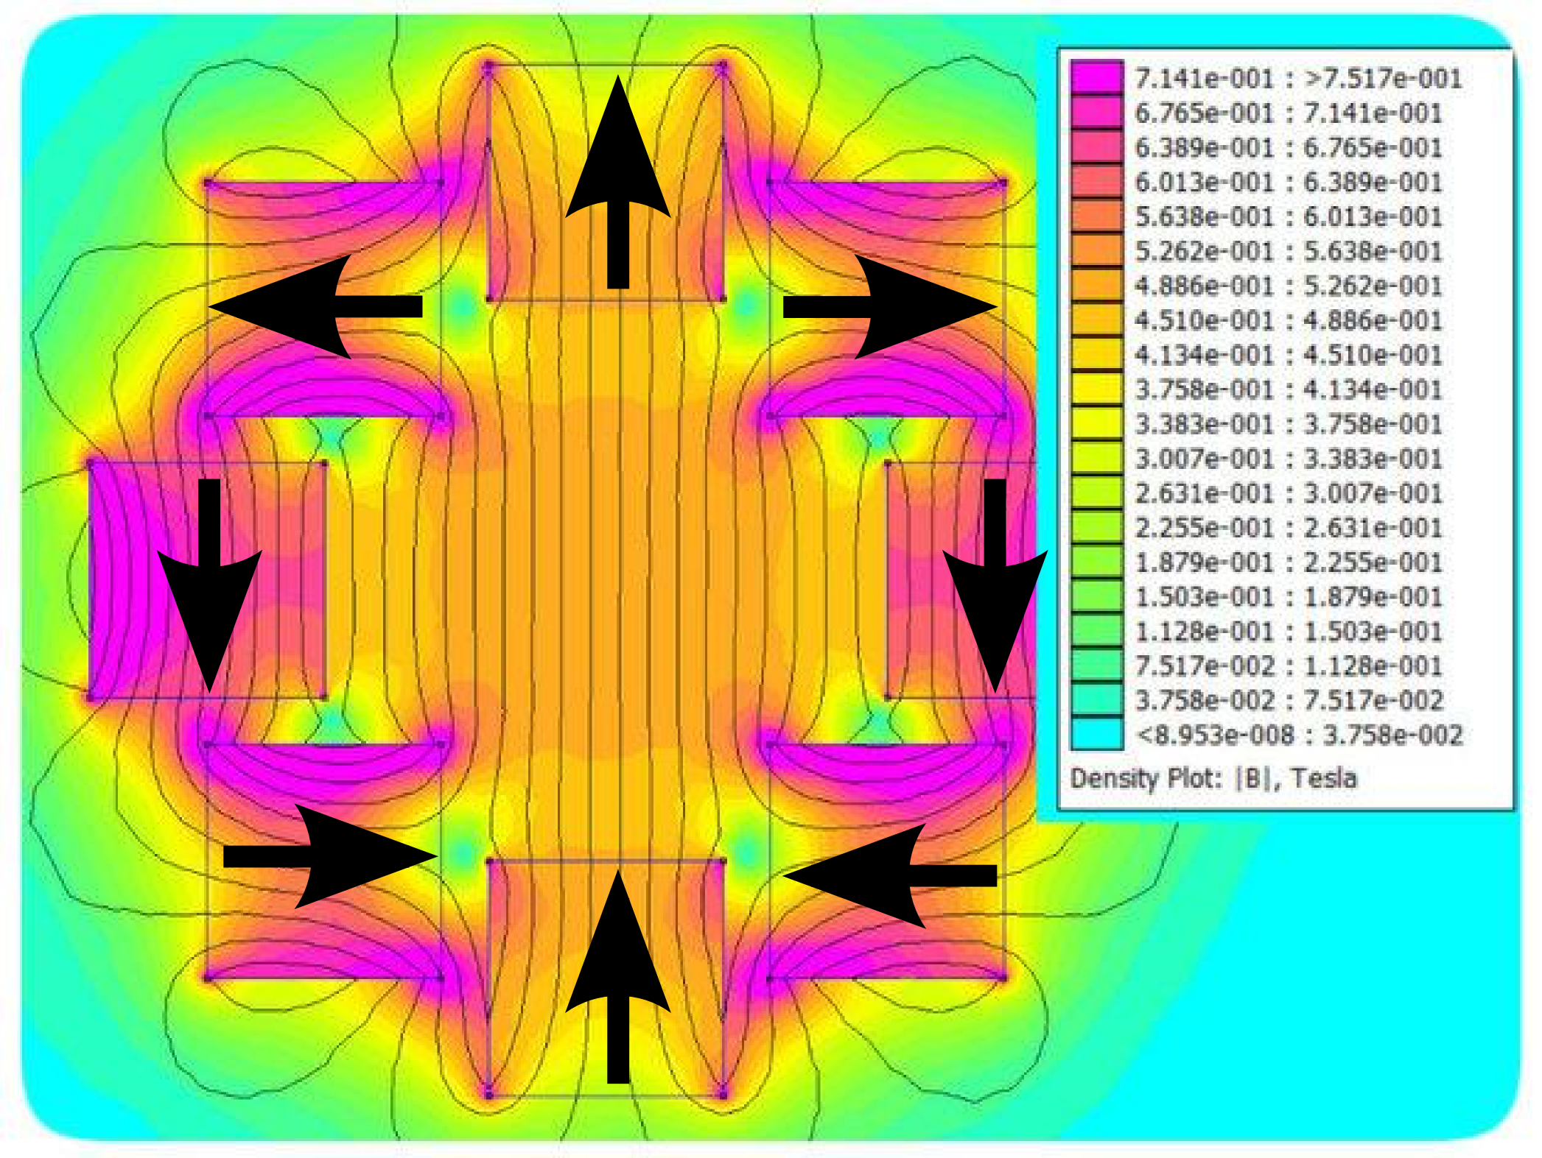
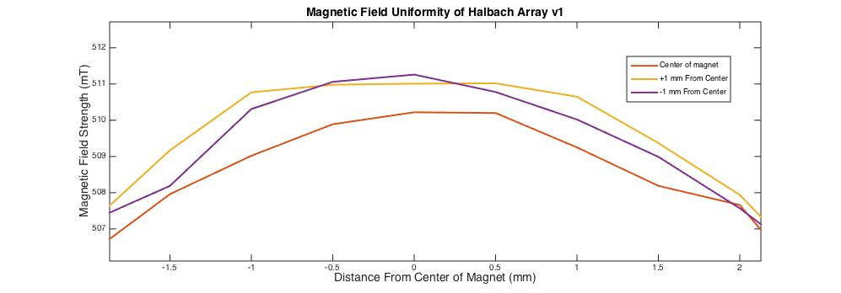
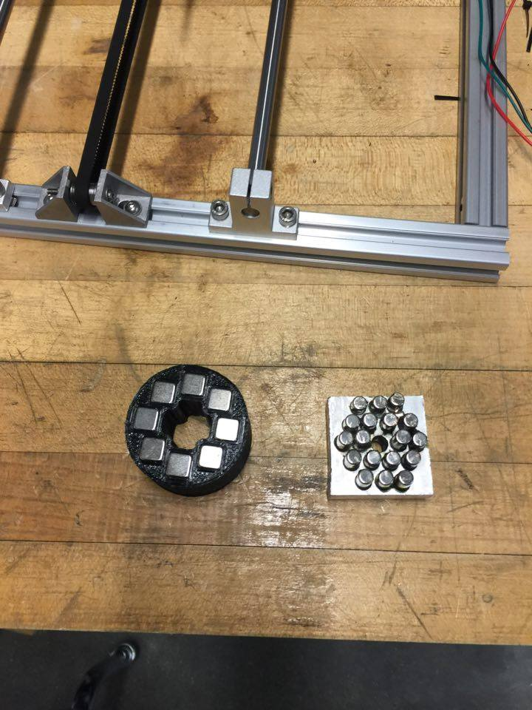
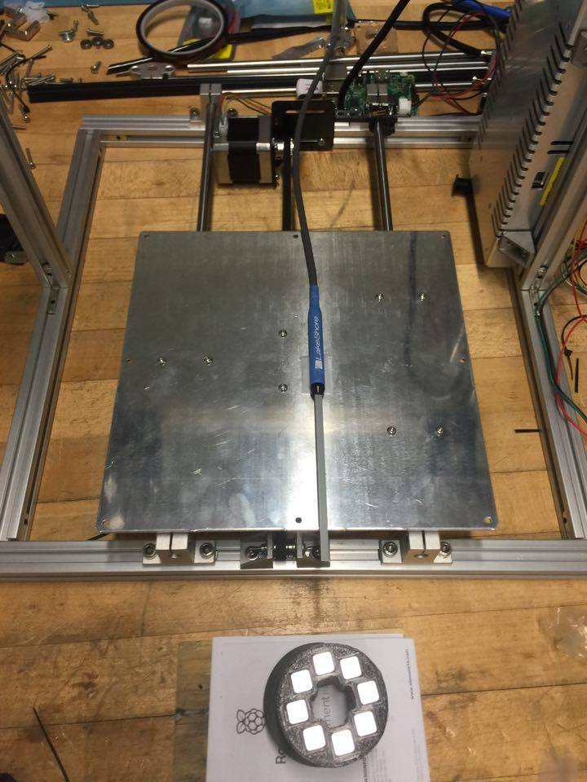
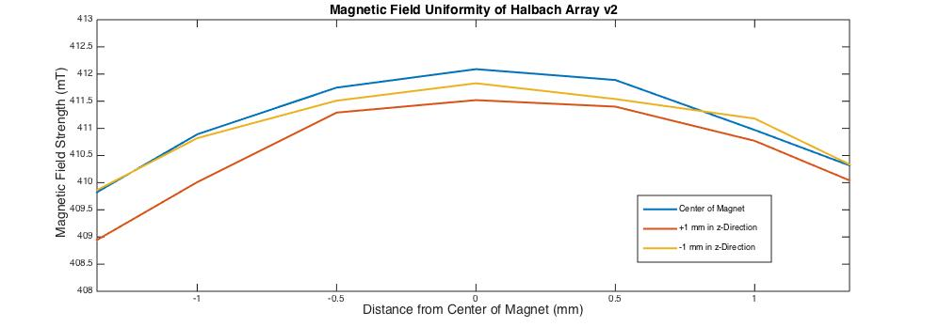
NMR Using a Halbach Array
Michael Dillman, on behalf of the Nuclear and Particle Physics Group. Advisor K. Slifer, E. Long
Motivation: Nuclear Magnetic Resonance (NMR) is the natural phenomena whereby nuclei inside of a magnetic field absorb and re-emit electromagnetic radiation at a certain frequency. NMR can be achieved by placing a polarized material in a highly uniform magnetic field. By orienting magnets in a specific pattern called a Halbach array, the magnetic field strength will double, with a highly uniform field. In this way, smaller, more cost-effective magnets can be used to produce a field suitable for performing NMR testing.
My Contribution: It has been my task to characterize the magnetic field uniformity of several different Halbach arrays. Using crystal oscillators, I have worked to mimic an NMR signal at the resonant frequency(~25 MHz) to be used as a reference when tuning into the resonant frequency of the polarized material.
The above picture is a schematic diagram of expected magnetic field strength.
Considerations: Longer rectangle magnets with a higher field strength will be used in future testing in hopes of achieving a higher field, and uniformity. Wrapping magnetic wire around the target with high proton density will help to detect an NMR signal..
Conclusion and Future Work: Halbach v1 achieved a magnetic field strength of .511 T with a uniformity of 10⁻³ over 1.5 mm. Halbach v2 had a weaker field, which peaked at .411 T with a uniformity of 10⁻³ over 2 mm. This will not be sufficient to produce a suitable field for NMR. The long rectangular magnets are stronger, and at liquid nitrogen temperatures will produce a strong enough field. If I do detect an NMR signal, the data that I collect will be analyzed and applied to the full-scale DNP system.
The v2 and v1 arrays (left to right) left picture, and translation stage, which has gauss meter probe fixed to the sliding platform.
The graphs above depict the field uniformity of the Halbach Arrays v1 and v2 (top to bottom). The field strength is in mT and distance is in mm.
Magnetic Field Uniformity: The uniformity of the magnetic field is a key factor in achieving NMR. The magnets that we are using have the capability to achieve 10⁻⁴ uniformity over a range of approximately 1 mm. This indicates where the polarized sample should be placed in order to observe NMR.
Results: Version one (v1) of the Halbach was constructed using cylindrical neodymium magnets. Orienting the magnets properly was difficult as they had a tendency to rotate. Version two (v2) was constructed using rectangular magnets. This made it much easier to orient the magnets since they did not rotate. A gauss meter probe was used to measure the magnetic field strength of each array. The translation stage is used to move the probe with precision down to 0.1 mm.

Slide 3
The lock-in amplifier (LIA) is used to detect and measure AC signals ranging from volts, all the way down to nanovolts. We will be using an SR844 lock in amplifier in order to determine the frequency at which the thermal equilibrium signal is located. There is a reference coil that is plugged into the LIA via a BNC cable. This coil reads out a peak that mimics a proton sample in a 5 T magnetic field at 1 K. This will be used to compare to the signal coming out of the sample that we are examining using the Halbach magnet.

Slide 4
Before the magnetic field is applied, the NMR graph shows a curved background wave which peaks or reaches a minimum at the value in MHz where we would expect to find the proton. When the magnetic field is applied, we see the NMR curve, which is displayed below in the graph in the upper right hand corner. This graphic is a screenshot of our program's output. The curve points upwards or downwards depending on the direction of the polarization, and the higher the spike the greater the polarization. On either side of the spike we can see the “wings” of background information.

