Slide 1

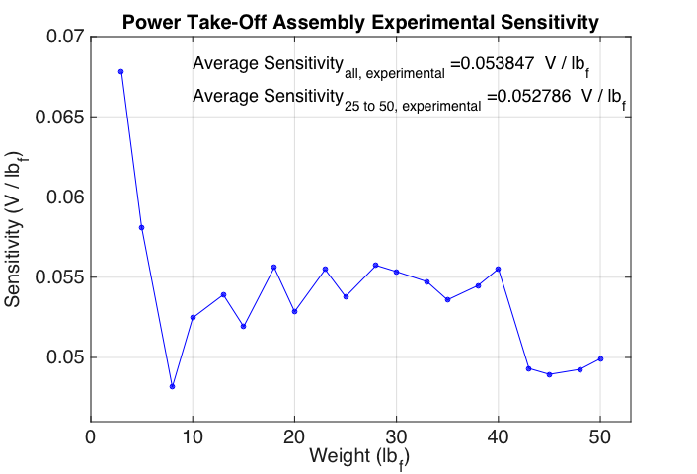
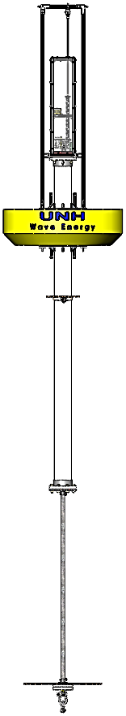
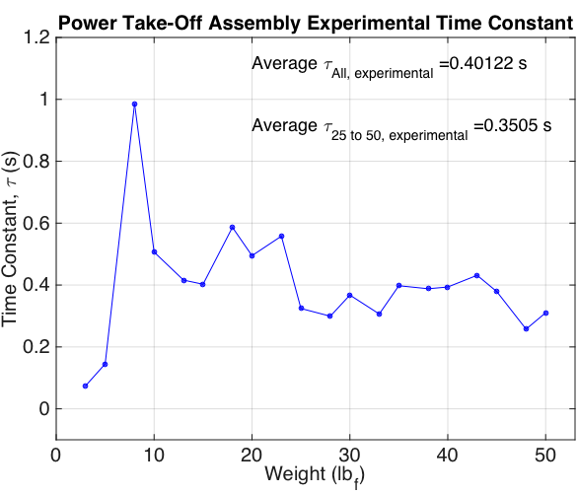
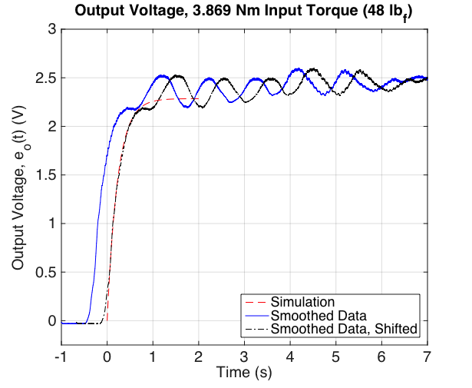
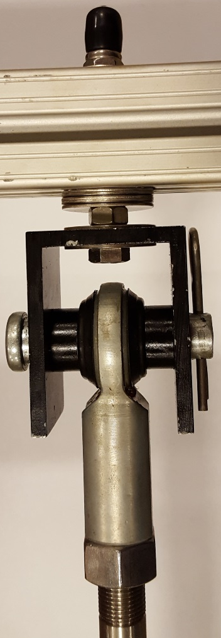
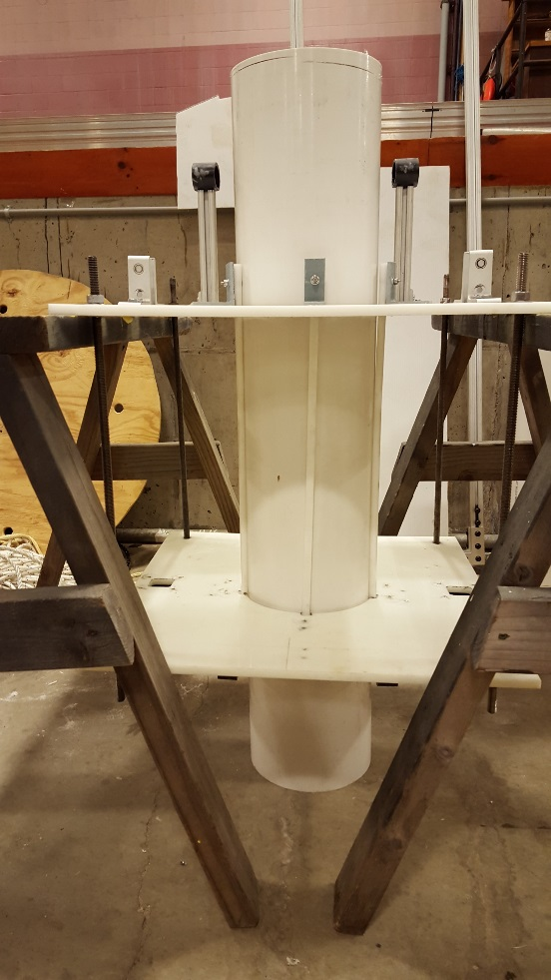
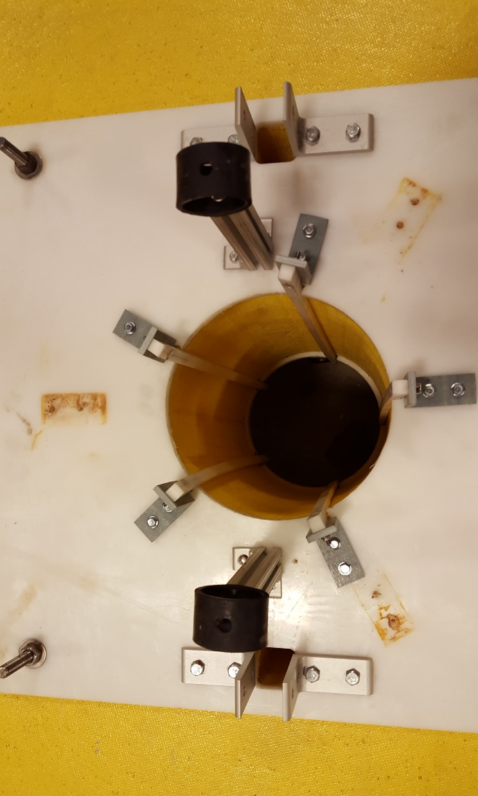
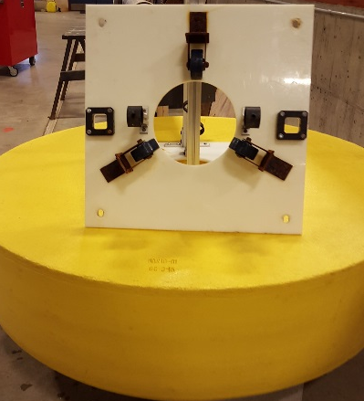
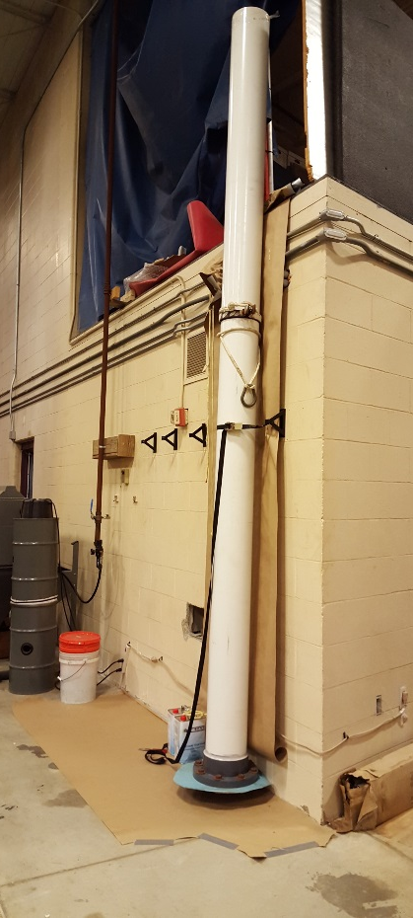
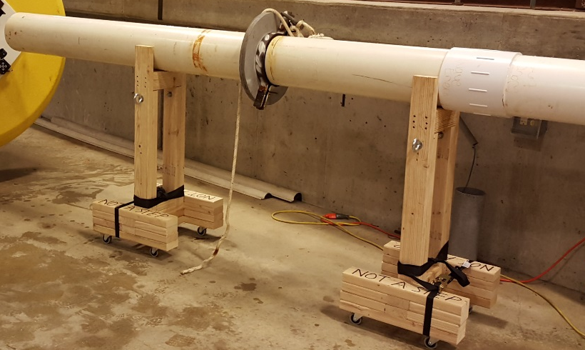
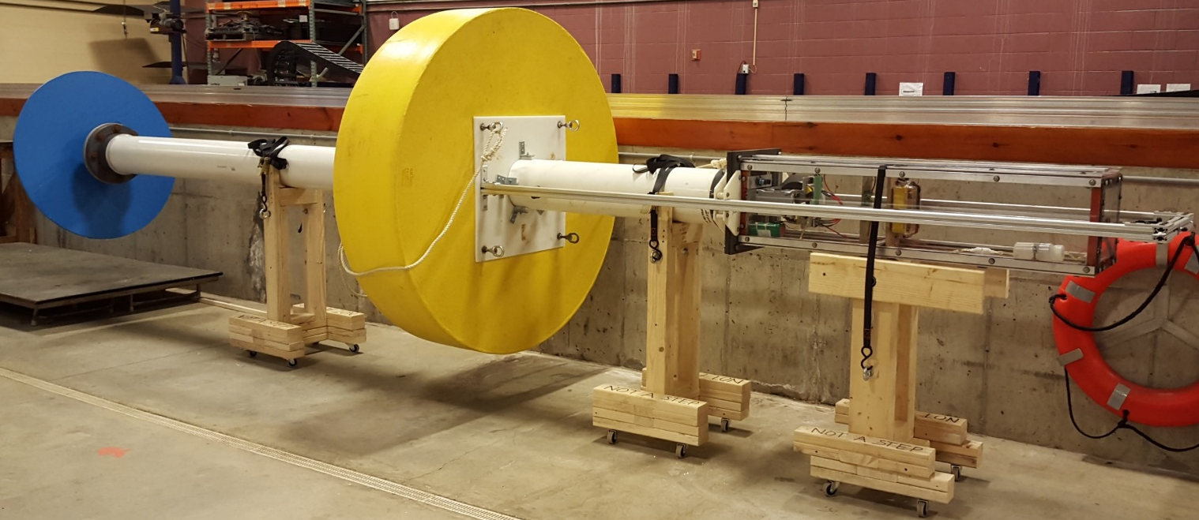
Wave Energy Conversion Buoy
Todd Michaud and Nate Denoncourt
Introduction
Design Modifications
PTO Modeling
The Wave Energy Conversion Buoy (WECB) is an ongoing project which has undergone multiple iterations since its inception. The project initially began with a feasibility study to determine if ocean waves near the Shoals Marine Laboratory, Appledore Island at the Isle of Shoals, were suitable for a wave energy device. Today, the WECB project is in its fourth year, and the second prototype is under development. The project incorporates elements from nearly every aspect of mechanical and ocean engineering, ranging from buoy dynamics and mechanics to electrical and control systems. The long-term goal of the WECB project is to help the Shoals Marine Laboratory reduce its dependence on non-renewable electrical energy sources/converters, primarily diesel generators.
This year’s WECB team has been focusing on increasing the reliability and robustness of the buoy, as well as incorporating a data acquisition system to allow for overall performance data to be collected, analyzed and compared during ocean field tests.
A mathematical model of the PTO was created to help aid further development of the PTO assembly. This was done by making a lumped parameter model containing the generator, voltage dividing circuit and gearbox. The time constant
and sensitivity of the PTO was determined by applying known forces to the PTO gearbox and measuring system voltage output.
Mathematical/Lumped Parameter Model
Data Acquisition
R₁
i
+
T_{g}
B₁
Goals:
Reliable and functional
Measure generator voltage and float displacement
Extended energy capacity
SD Shield Connection
to Arduino
SD Card
Lidar Range Sensor
J₁
T₁
ω_{g}
Arduino Uno
SD
Shield
670μF
e_{o}
R₂
J₂
T₂
B₂
T_{i}
ω_{i}
On/Off Switch
8 Ω
92 Ω
The output from the mathematical model matched the actual output of the PTO quite well aside from some steady state oscillation which occurred during experimental tests.
Overview
7.2V NiMH
Battery
Generator
Rectifier
The WECB is a point absorber buoy that harnesses heave energy from the rise and fall of ocean waves and converts it into electricity by spinning a 300 watt, 3-phase, alternating current generator.
Coupling
Goals:
Increase strength/reliability
Maintain original geometry
Quick connect/disconnect without the need for tools
The design configuration consists of a spar, a float that slides axially on the spar, and a power take-off (PTO) driven by the relative movement between the spar and float.
Power Take-off
Before
After
Spar Slides
Goals:
Properly align spar in float
Minimal friction losses
Corrosion resistance
Future Work
Linear motion between the spar and float is transmitted through a 5:1 ratio, speed increasing gear creating rotational motion which turns the generator.
Float
Deployment Platform
Specialized deployment platform to facilitate ocean testing
Heave Plate Extension
Sturdier extension that is capable of supporting the ballast weights when buoy is horizontal
PTO Configuration
PTO relocation/reconfiguration to lower the center of gravity and increase stability of the spar
A heave plate is incorporated to provide additional damping to the spar which limits its response to incoming waves. The heave plate is extended deeper in the water column where it encounters less wave energy. Mass is attached below the heave plate to provide ballasting for the buoy as well as producing the greatest potential righting moment.
Spar
Before
After
Acknowledgements
Spar
Goals:
Leak-free construction
Foam-filled to displace water
Minimal joints exposed to sea pressure
Special thanks to all who helped make this project possible including but not limited to our faculty advisors, Rob Swift and Ken Baldwin; graduate assistants, Toby Dewhurst and Corey Sullivan; UNH R/V Gulf Challenger captain and crew, Bryan Soares and Debra Brewitt; technical experts, Jim Irish, Michael Carter, John Ahern, Andy McLeod and Mike Tuttle as well as many other faculty and staff in the UNH Mechanical and Ocean Engineering departments. Additionally, this work is the result of research sponsored in part by the New Hampshire Sea Grant College Program through NOAA grant # NA10OAR4170082, and the UNH Marine Program.
Overall, the float is 5 feet in diameter, and the entire system is over 30 feet long when fully extended.
Heave Plate
Before
After

