Slide 1

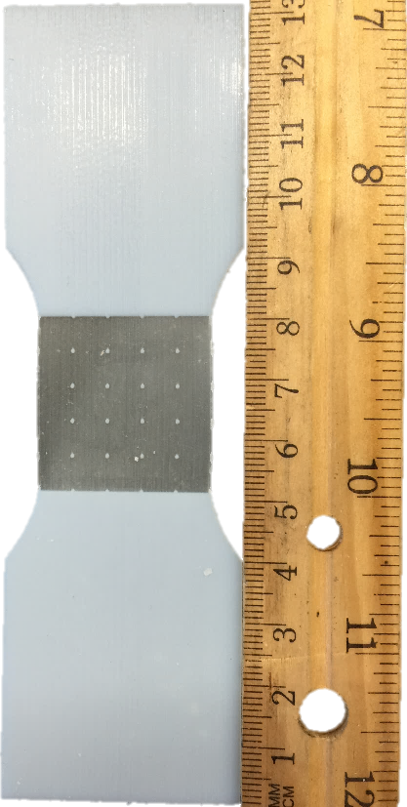
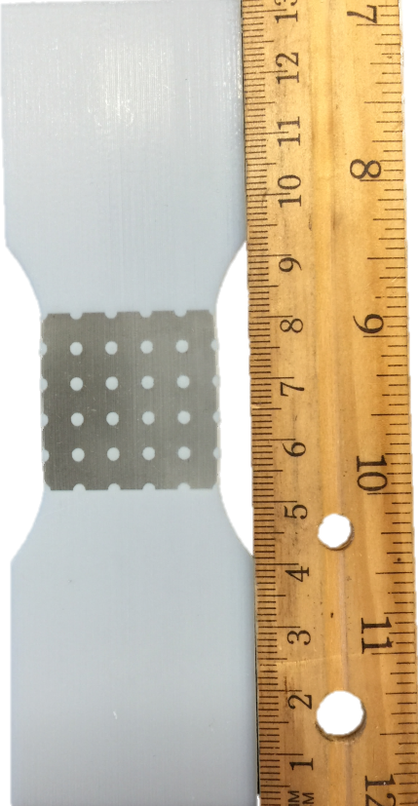
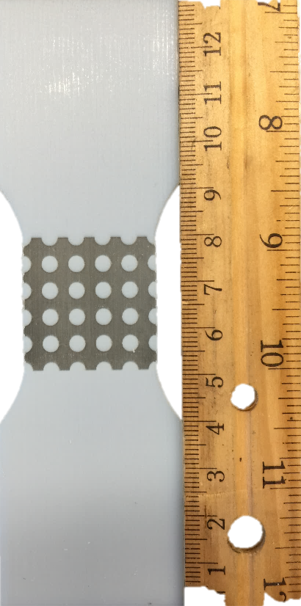
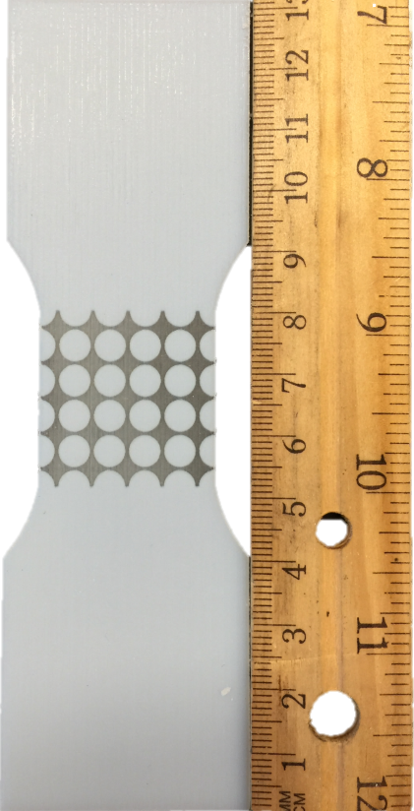
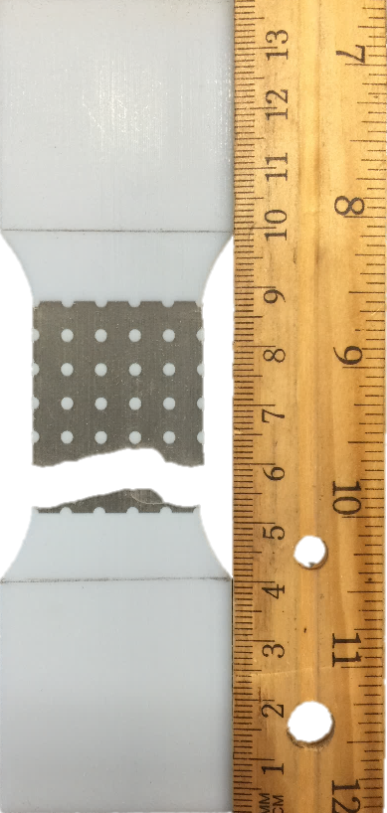
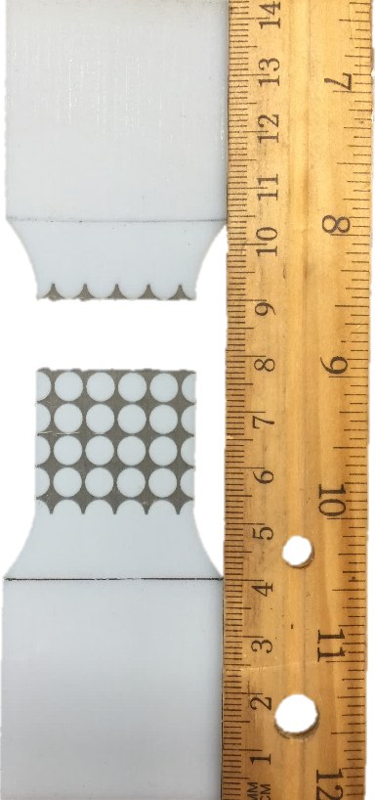
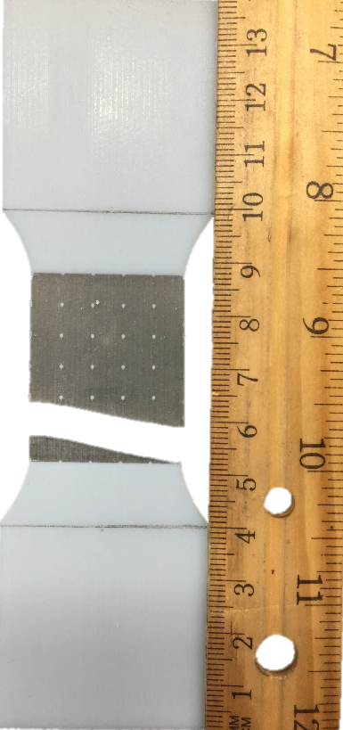
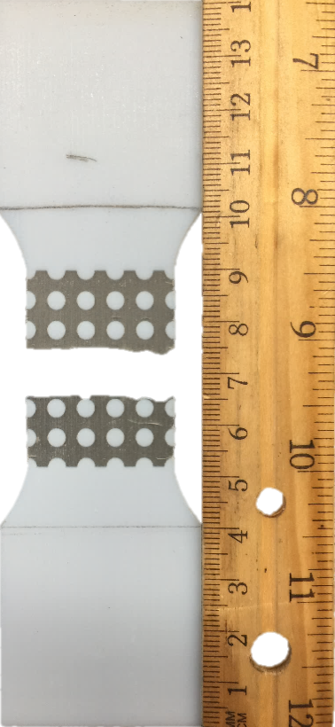
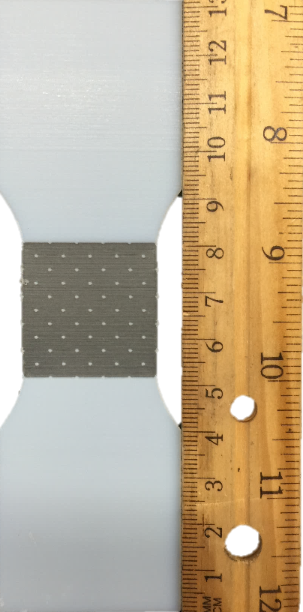
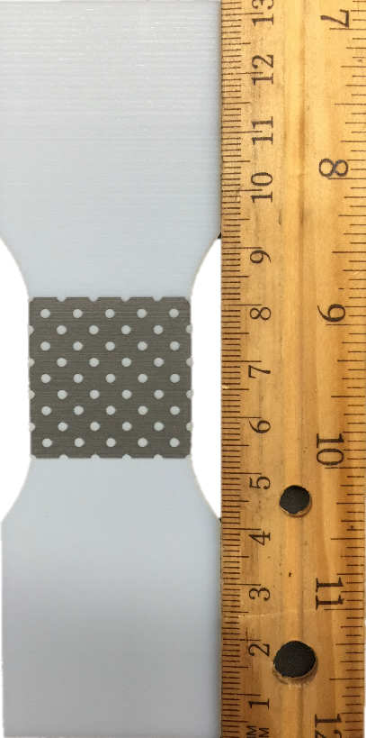
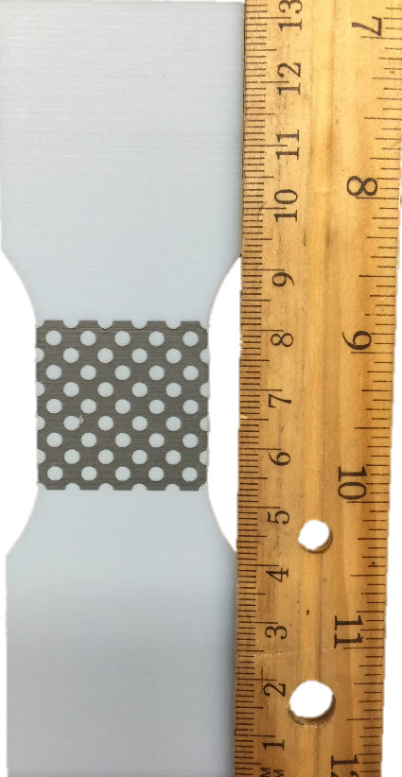
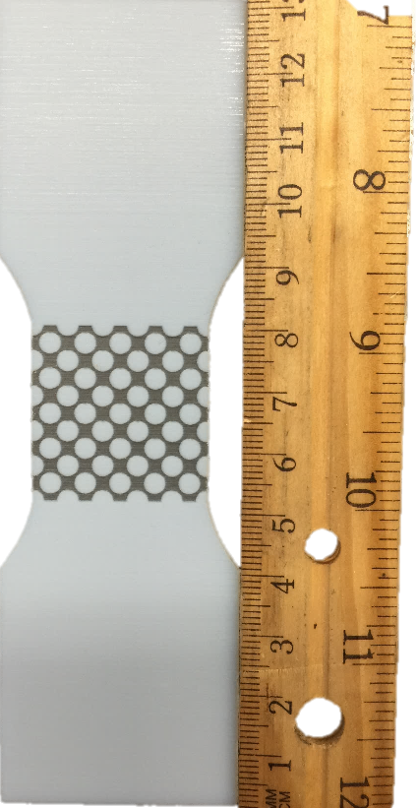
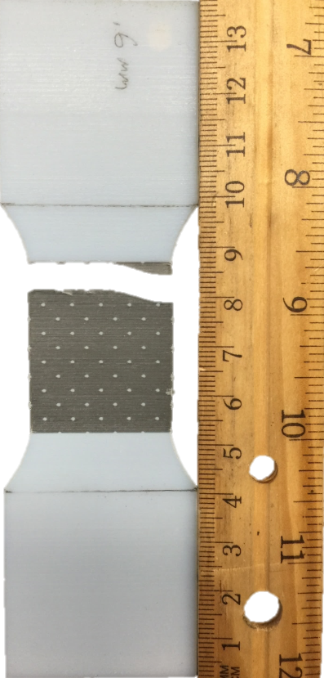
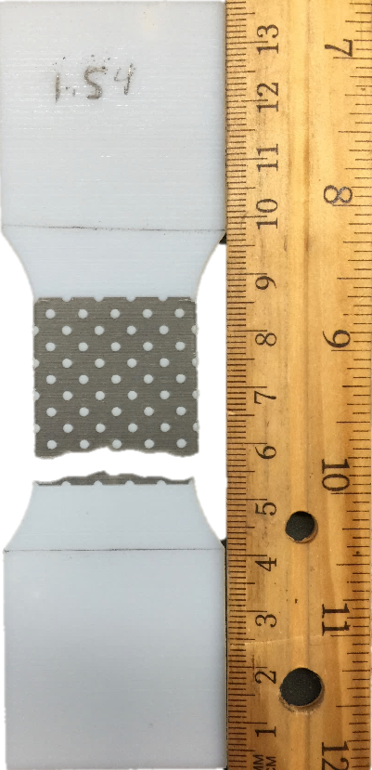
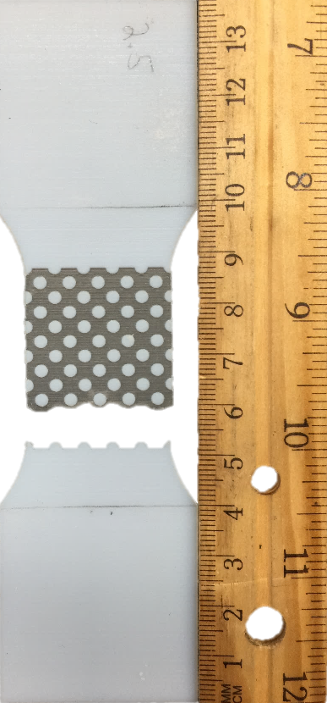
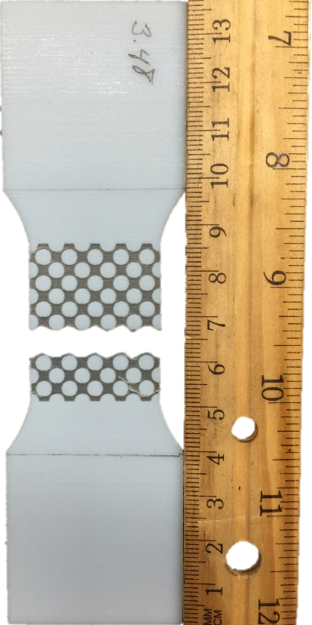

Mechanical Experiments on 3D Printed Composite Plates
Gavin Kearns, Paul School
Advisor: Prof. Yaning Li, Department of Mechanical Engineering, University of New Hampshire
Abstract
With the advent of additive manufacturing (3D printing), complex designs on micro-structured composites are able to be quickly manufactured and tested using multiple types of materials with different properties in mind. In this investigation, we focused on 3D printed thin plates with hard circular inclusions embedded in softer rubbery matrix. By changing the volume fraction and the pattern of arrangement of the inclusions, it was found that as the volume fraction of the inclusions increased, the force the dogbone sample could withstand increased. Also, comparing the square lattice to the hexagonal lattice, at higher volume fractions, the hexagonal lattice was able to withstand a greater percent elongation with a greater force.
Background and Motivation
Materials made of multiple phases has been known to be a benefit for centuries.
Materials like wood, steel, and bricks are all materials that combine properties of several types of materials.
It wasn’t until the mid-20th century that manufacturing started using deliberately designed composites such as fiberglass reinforced polymers.
While it already exists in nature for multiple materials to combine to form new materials with a combination of properties, composites refer specifically to those artificially created whose components are chemically dissimilar and separated by a distinct interface [1-4].
Composite materials are generally composed of two phases, one termed the matrix, which surrounds the other phase, and the other called the inclusion.
The properties of the composite is a function of the constituent phases and is dependent upon the relative amounts and the geometry of the inclusions [5].
There is a trend in the automotive industry to replace heavy metal parts with polymer composites in order to improve fuel economy and reduce the weight of the vehicles.
Composite polymers however tend to be more brittle rather than ductile in response to a load. [6] There is great need in the industry to identify how different composite materials react under load and how changing parameters of those composites can result in different effects.
In the research involved here, two materials were used as a composite to test how changing the volume fraction of the inclusion and changing the geometry of the inclusion. In doing so, it can show how a particular shape or volume fraction of material can change the properties.
Methods
A composite material was designed in Solidworks and fabricated via a multi-material additive manufacturing machine. VeroWhite, an acrylic-based photo-polymer, was utilized as the inclusion, and TangoPlus, a rubber-like compliant material, was used for the matrix material.
Two geometries of circles were designed. One specimen with circles in a square lattice pattern and then a geometry with a hexagonal lattice pattern. The smallest circle had a diameter of .600 mm due to the limits of additive manufacturing. The largest circles were 5.17 mm and 3.48 mm for the square lattice and hexagonal lattice pattern respectively. This was due to keeping .6 mm of space between circles in the material again due to the limits of additive manufacturing.
Results
Conclusions
In the square lattice sample, the highest force was recorded with when the volume fraction was highest at 60.9%.
In the other samples tested, the highest force was consistent in the smaller volume fractions.
This was most likely due to the material of the TangoPlus being the majority of the matrix.
This means that in these samples, until there was a small enough interface between the inclusions of VeroWhite, it did not have that big of an effect on the force required to elongate the specimen.
In the hexagonal lattice, the highest volume fraction tested was 55.2%.
When compared to the other lattice specimen, the hexagonal lattice specimen showed a similar amount of force to breaking point but did so at with a higher % elongation.
This is useful because it did so with a smaller amount of the interface material. Therefore, by changing the pattern from a square lattice to a hexagonal lattice, the amount of intrusion material can be decreased but the total force it holds will remain.
With the hexagonal lattice, the specimens behaved similarly to the square lattice in that the specimen with the highest volume fraction had the highest force.
The other samples behaved similarly in that they had similar amounts of force even as the volume fraction decreased, however as the volume fraction decreased, they were not as stiff
For relatively small volume fractions, the stiffness and strength are linearly related to the volume fraction.
Finally, at lower volume fractions in both the square and hexagonal lattice, there was not a large difference in the amount of strength or stiffness. Stiffness and strength did not significantly increase until the highest volume fraction of 60.9% for the square lattice and 55.2% for the hexagonal lattice.
References
[1] Y.N. Li, C. Ortiz, M.C. Boyce, 2011, Stiffness and strength of a suture joint model, Physical Review E, 84
[2] Y.N.Li, C.Ortiz and M.C.Boyce, 2012, Bioinspired, mechanical, deterministic fractal model for hierarchical suture joints, Physical Review E 85, 031901
[3] Y.N.Li, C. Ortiz and M.C. Boyce, A generalized mechanical model for suture interfaces of arbitrary geometry, Journal of Mechanics and Physics of Solids, (2013) 1144-1167;
[4] Lin, Er., et al. 2014, “3D printed, bio-inspired prototypes and analytical models for structured suture interfaces with geometrically-tuned deformation and failure behavior,” Journal of the Mechanics and Physics of Solids 73(2014), 166-182
[5] Callister, W. D., 2007, Materials science and engineering: an introduction, John Wiley & Sons, New York.
[6] Ghassemieh, E., and Chiaberge, M., 2011, “Materials in Automotive Application, State of the Art and Prospects, New Trends and Developments in Automotive Industry.”
Figure 1: square lattice, pre mechanical experiment
Figure 2: square lattice, post mechanical experiment
1.1
0.600 mm
specimen
1.2
2.07 mm
specimen
1.3
3.53 mm
specimen
1.4
5.17 mm
specimen
2.1
0.600 mm
specimen
2.2
2.07 mm
specimen
2.3
3.53 mm
specimen
2.4
5.17 mm
specimen
Figure 3: hexagonal lattice, pre mechanical experiment
Figure 4: hexagonal lattice, post mechanical experiment
3.1
0.600 mm
specimen
3.2
1.52 mm
specimen
3.3
2.52 mm
specimen
3.4
3.48 mm
specimen
4.1
0.600 mm
specimen
4.2
1.52 mm
specimen
4.3
2.52 mm
specimen
4.4
3.48 mm
specimen
 | Square Lattice |  |  |  | Hexagonal Lattice
Figure Number | 1.1 | 1.2 | 1.3 | 1.4 | 3.1 | 3.2 | 3.3 | 3.4
Circle Diameter (mm) | 0.600 | 2.07 | 3.53 | 5.17 | 0.600 | 1.52 | 2.52 | 3.48
Volume Fraction | 0.821% | 9.74% | 28.5% | 60.9% | 1.64% | 10.5% | 29.0% | 55.2%
Table 1: The volume fraction of the VeroWhite in each specimen.
Acknowledgements
This research was supported with funding from the National Science Foundation’s grant to NH EPSCoR (ENG)1132468.
The supports from NSF through grants CMMI-1362893, and from DoD/AFOSR through grant FA9550-16-1-0011 are greatly appreciated
Department of Mechanical Engineering for access to the multiple material Stratasys Objet260 Connex3 3D printer

