Slide 1

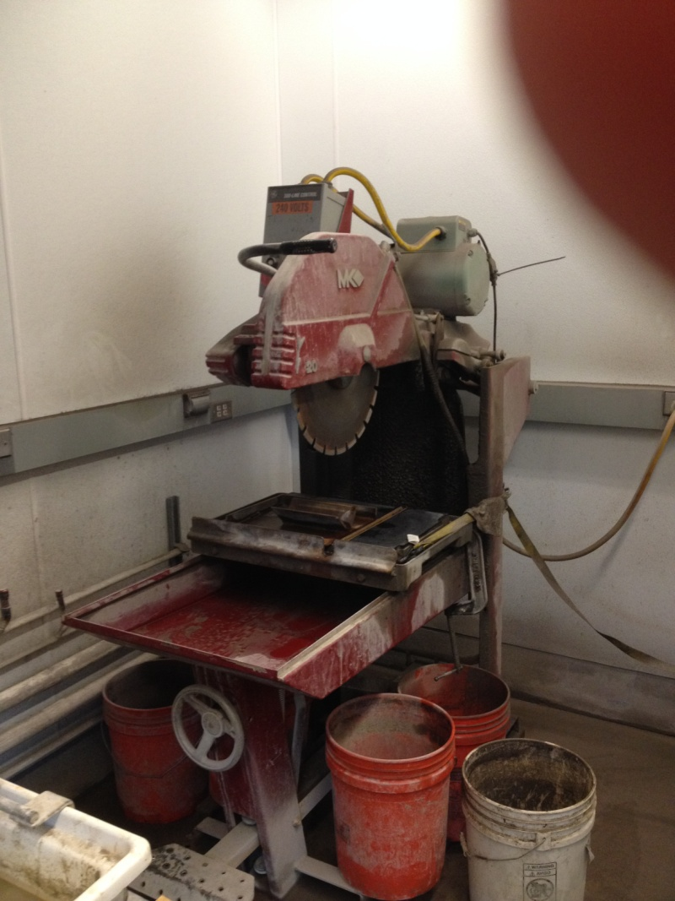
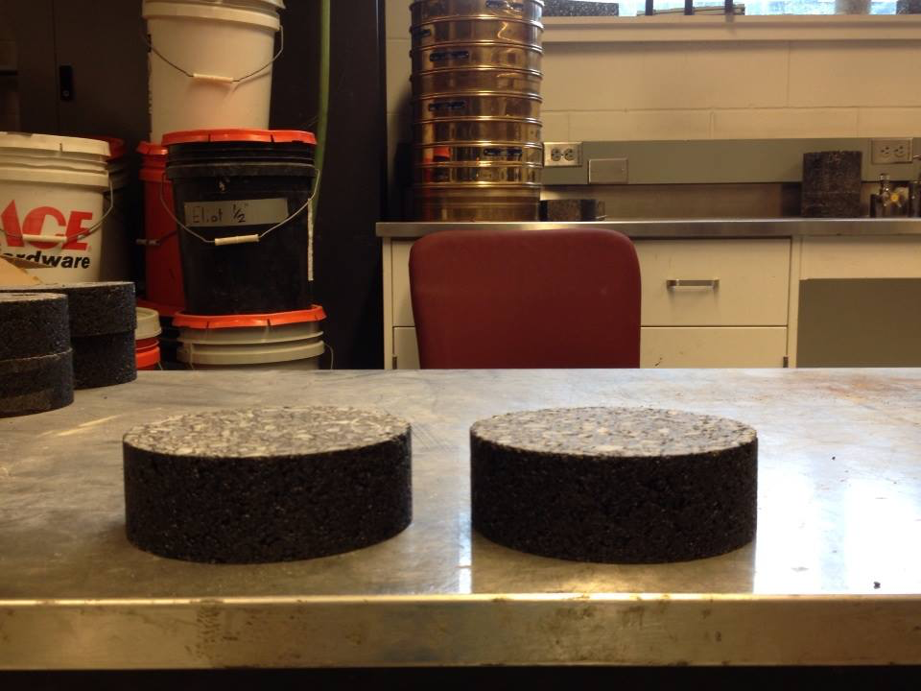
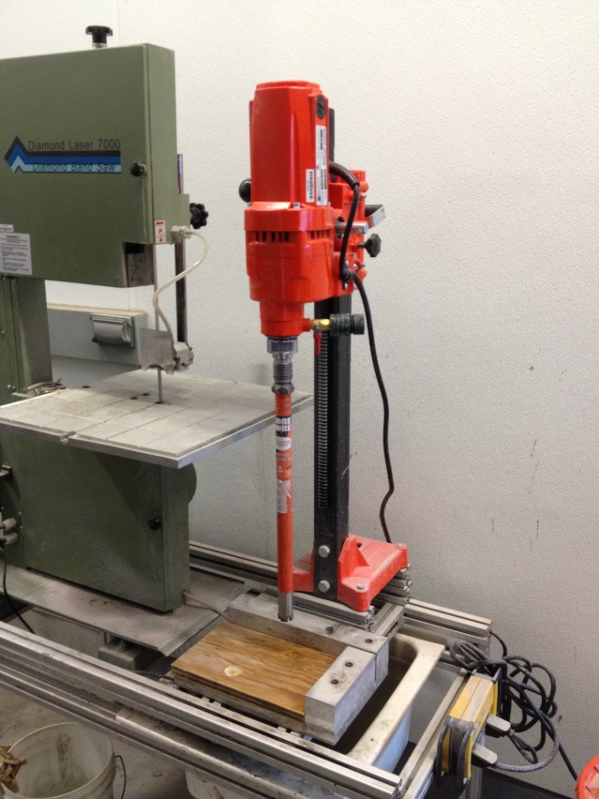

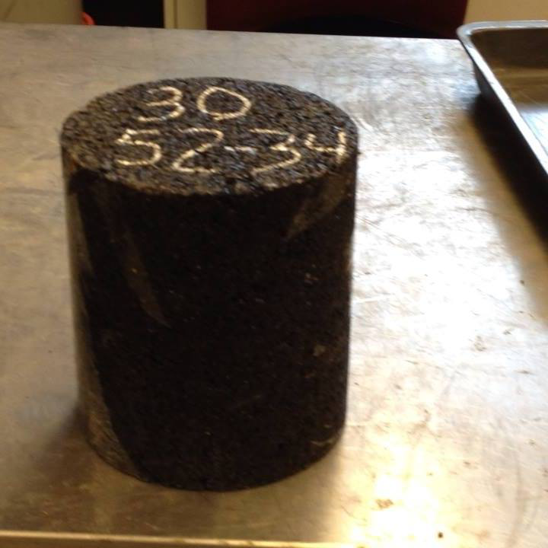
Disk-Shape Compact Tension (DCT) of HMA Samples
with 0% and 30% Recycled Asphalt Pavement (RAP)
with Freeze-Thaw conditioning
Bob Moore¹, Chris DeCarlo², Saeid Ashani², Dr. Eshan Dave², Dr. Jo Daniel²
¹Pelham High School, ²Dept. of Civil Engineering
Preparation of Sample (cont.):
The 50 mm sample is then cut to include two bore holes and a 62.5 mm notch that runs between the boreholes along the disc’s diameter.
In this study, eight HMA samples underwent freeze-thaw
conditioning (5-day cycle, 11 hours freezing, 13 hours
thawing), and then tested for Fracture Energy (J/m²).
Eight HMA samples are prepared as outlined above and then conditioned (8 hours or more) at a temperature about 10 ºC above the asphalt binder grade low temperature.
Testing Method (after sample preparation):
Samples are conditioned at a temperature about 10 ºC above the asphalt binder grade low temperature.
The sample is tested by applying a load with ¾ in. pins pulling in opposite directions at a predetermined crack mouth open displacement (CMOD) rate.
The following measurements and results are calculated and recorded for each sample: diameter (mm), thickness (mm), initial ligament length (mm), Fracture Energy (J/m²), peak load (kN), time at peak load (sec.), and test temperature (ºC).
Introduction/Background:
Asphalt pavement is susceptible to changes in temperature and moisture especially during winter conditions.
Asphalt binder has a tendency to contract and crack at low temperatures, this often leads to loss of pavement integrity and water infiltration.
ASTM D7313 − 13 has been developed to measure the fracture energy necessary to cause cracking where a load is placed on a 50 mm disc-compacted (DCT) asphalt sample under low temperature conditions.
Preparation of Sample:
A 168 mm hot-mix asphalt (HMA) sample is cut into 50 mm height discs:
Conclusion/Summary:
Samples were tested for fracture energy as virgin mixes (100% HMA) with 64-28 asphalt binder and 52-34 asphalt binder. Samples containing 30% RAP were also tested for fracture energy.
Samples labeled V 64-28 and V 52-34 were 100 % virgin hot-mix asphalt. Samples labeled 30% 64-28 and 30% 52-34 were 30% recycled asphalt pavement (RAP) blended with 70% virgin hot-mix asphalt.
The performance grade (XX-XX) of binder is the specified maximum and minimum temperature range in ºC the binder is recommended for in the field.
In the virgin mixes, the data suggest the 64-28 binder samples perform slightly better compared to the 52-34 grade, although the differences in results may not be statistically significant.
In the HMA samples containing 30% RAP, the sample containing the lower temperature grade 30% 52-34 appears to perform better with a higher fracture energy and a higher peak load.
Further testing to study the strength of 30% RAP samples with low temperature binders is recommended.
Literature Cited:
“Cracking Performance of Asphalt Mixtures Containing Taconite Tailings using Traditional and Multiple Freeze-Thaw Moisture Conditioning Methods”, Justin Joel Baker, master thesis submitted September 2012, advisor Dr. Eshan V. Dave
“Standard Test Method for Determining Fracture Energy of Asphalt-Aggregate Mixtures Using the Disk-Shaped Compact Tension (DCT) Geometry”, ASTM D7313 − 13
“Hot Mix Asphalt Materials, Mixture Design and Construction”, Third Edition, Brown, Kandhal, Roberts, Kim, Lee, and Kennedy, 1991, NAPA Research and Education Foundation
“Implementation of the Disk-Shaped Compact Tension Test”, MnRoad, Safer, Smarter, Sustainable Pavements through Innovative Research, Sept. 2014
Acknowledgements – This research was supported with funding from the National Science Foundation’s grant (ENG-1132648).

