Slide 1
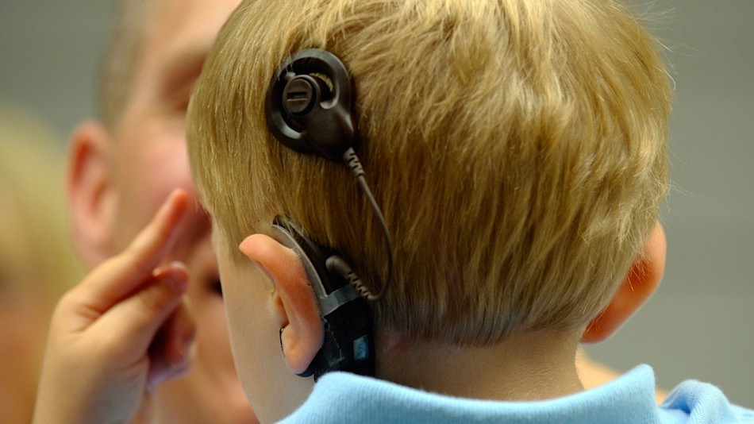

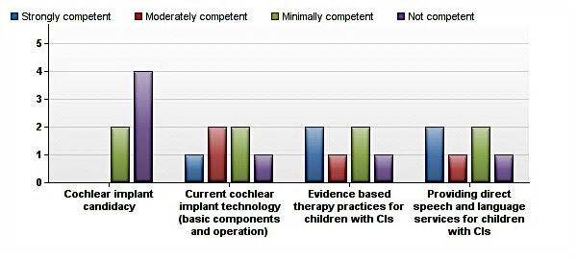
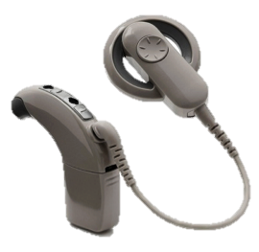
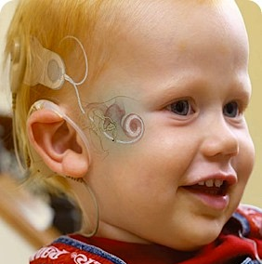

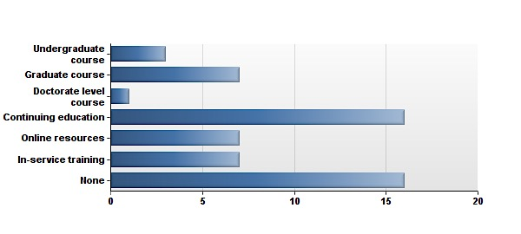








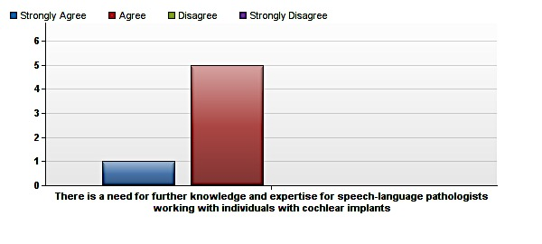


Preparation of Speech-Language Pathologists to Provide Services for Children with Cochlear Implants
Carolyn Babeu
Department of Communication Sciences and Disorders
University of New Hampshire, Durham, NH
Research Question:
INTRODUCTION
How prepared are speech-language pathologists to provide
effective services and meet educational challenges of children with cochlear implants in New Hampshire public schools?
RESULTS
Since the 1980s, cochlear implants have been used to provide hearing to children with severe-profound hearing loss.
Percentages of children receiving cochlear implants today is increasing steadily and 90% of children with hearing loss are educated in public school settings (2).
Implanted children are given the opportunity to learn alongside typically hearing peers, but require intensive listening and spoken language facilitation to maximize their potentials to succeed academically and socially (2).
As children with CIs reach school age, speech-language pathologists will need to have competency and skills to address these educational challenges and provide effective services to a growing implanted population (1).
Competency
Levels
SLPs were least competent in cochlear implant candidacy
Most of the SLPs were moderately competent in addressing educational challenges for children with CIs
Of all 5 educational challenges, SLPs were least competent in addressing attention challenges
What is a cochlear implant (CI)?
What does a speech-language pathologist (SLP) do?
Who is eligible to receive a cochlear implant?
Speech therapists evaluate, diagnose, and treat individuals with communicative and/or swallowing disorders
They create and carry out individualized treatment plans to address patients’ functional needs
SLPs work in a variety of settings with people from ages across the lifespan
12 months of age
Severe to profound sensorineural hearing loss
Receive no benefit from traditional amplification
No medical contraindications
Normal cognition and normal vision
Appropriate expectations of client and/or family
Access to appropriate therapy services and education
8% (n=3) had formal training on CIs through undergraduate education and 19% (n=7) had graduate education on CIs
80% (n=4) indicated their primary level of competency in CIs to come from workshops/professional development; 0% indicated formal education
A cross tab showed that out of 9 SLPs that graduated from UNH, only 1 had formal training on CIs during graduate school
Preparation and Education
A sensory device that bypasses damaged portions of the ear and electrically stimulates the auditory nerve to provide a sense of sound
Consists of an external portion that sits behind the ear and a second portion that is surgically placed under the skin
An implant does NOT result in “restored” hearing
Please indicate if you have had formal training on CIs through any of the following:
Roughly 40 percent of children who are born profoundly deaf now receive a cochlear implant, which is a 25 percent increase from five years ago (3).
Number of SLPs
METHODS
Five Main Educational Challenges of Children with Cochlear Implants
CONCLUSIONS
Subjects
Limitations of this study:
37 members of the New Hampshire Speech Language Hearing Association (NHSLHA) completed an online survey
76% of participants were 46-60 years old
Academic
Acoustic
Attention
Sample size: survey was distributed to 114 members of NHSLHA and only included SLPs working in the state of New Hampshire
SLPs that chose to participate in this survey may have had heightened interest in CIs and previous experience working with clients with CIs
More than half of participants indicated over 21 years of experience
24% of participants attended SLP graduate school at UNH
Procedure
English language development and literacy achievement
Opportunities for functional language use at home and school are important
Need quality input across all settings to accelerate language growth and aid in comprehension
“Reading to learn” is the ultimate goal for all children with implants
Degree of hearing loss and its effect on speech perception
Physical parameters of classroom: size of room, level of ambient noise, distance from teacher
Short-term memory deficits affect child’s ability to process and learn language concepts
100% (n=6) of SLPs who have worked with clients with CIs in the past 3 years strongly agree/agree there is a need for further knowledge for SLPs working with individuals with CIs
There is a lack of CI training in undergraduate and graduate programs
Participants completed a 5-10 minute Qualtrics survey consisting of 2 sections, each with 10 questions
First section (answered by all 37 participants):
  Demographic information
  Extent of formal training (if any) received on CIs
  How often resources are used to treat children with CIs
Second section (answered only by 6 school-based SLPs who have worked with a child with a CI in the past 3 years):
  Current caseload profile including ages of clients, total clients, clients with CIs
  Professionals with whom SLP keeps in contact with regarding child with CI’s success in school
  Level of competency in general knowledge of CIs and providing direct/indirect services for child with CI
  Opinion of whether more knowledge and expertise is needed for SLPs working with children with CIs
Adjustment
More resources and training is necessary for speech-language pathologists to feel competent in effectively treating individuals with a cochlear implants.
There is a need for the inclusion of cochlear implant coursework and education in SLP undergraduate and graduate preparation programs.
Associative
Children with CIs exist in three worlds: hearing, deaf, and implant recipient worlds
Transitions in curriculum and environments
References:
Self-esteem; social maturity
Establishing relationships
Learning subtleties of social behavior
Chute, P. M., & Nevins, M. E. (2003). Educational Challenges for Children with Cochlear Implants. Topics in Language Disorders, 23(1), 57-67.
Compton, M., Tucker, D., & Flynn, P. (2008). Preparation and Perceptions of Speech-Language Pathologists Working With Children With Cochlear Implants. Communication Disorders Quarterly, 30(3), 142-154.
Science Capsule - Cochlear Implants. Retrieved April 18, 2016, from https://www.nidcd.nih.gov/about/strategic-plan/2012-2016/science-capsule-cochlear-implants
Winter, M., & Phillips, B. (2009). Clinical Management of Cochlear Implants in Children: An Overview. In Clinical Management of Children with Cochlear Implants (pp. 17-33). San Diego: Plural Publishing.
Contact Information:
Carolyn Babeu
cat233@unh.edu
Dr. Stephen Calculator
stephen.calculator@unh.edu

