Slide 1


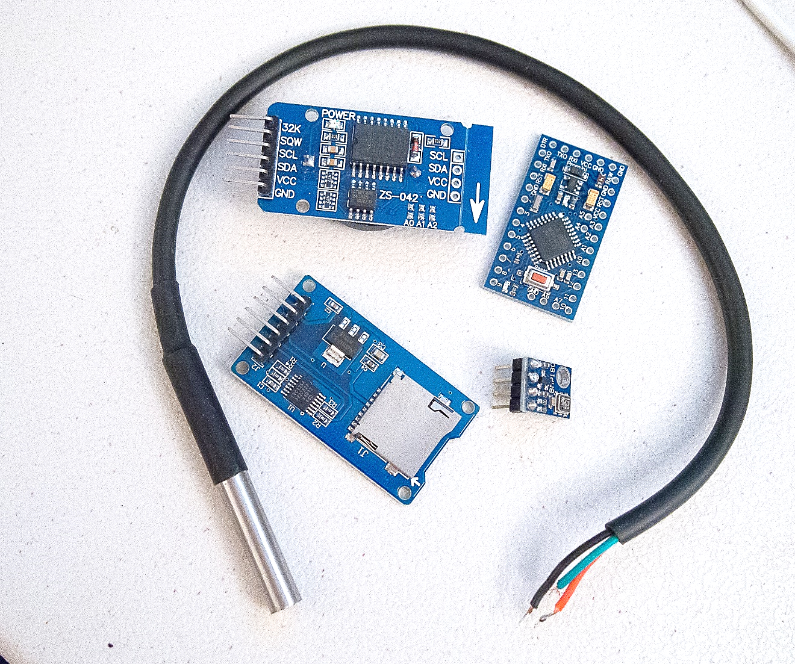
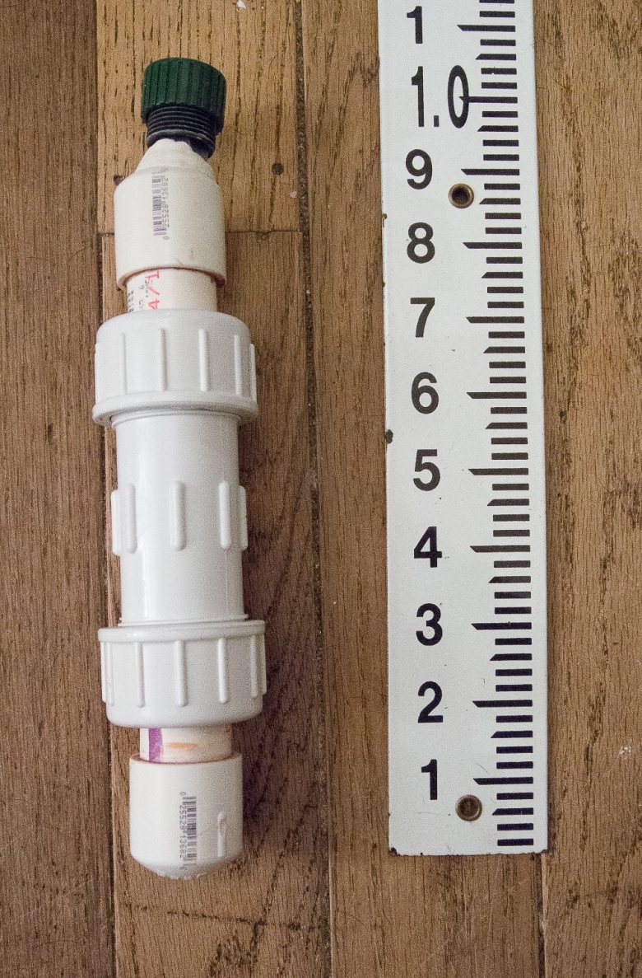
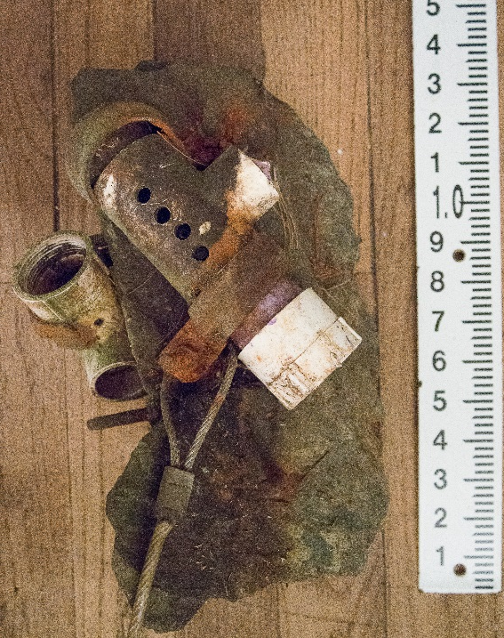
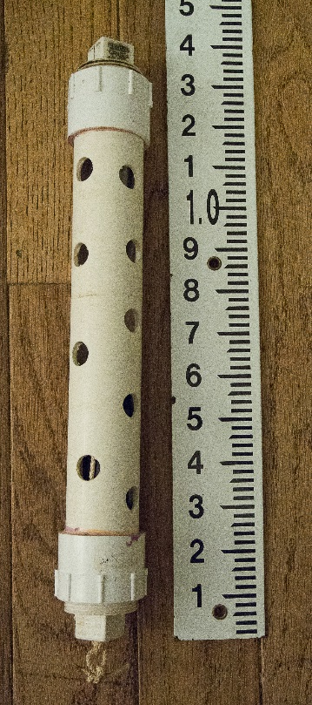

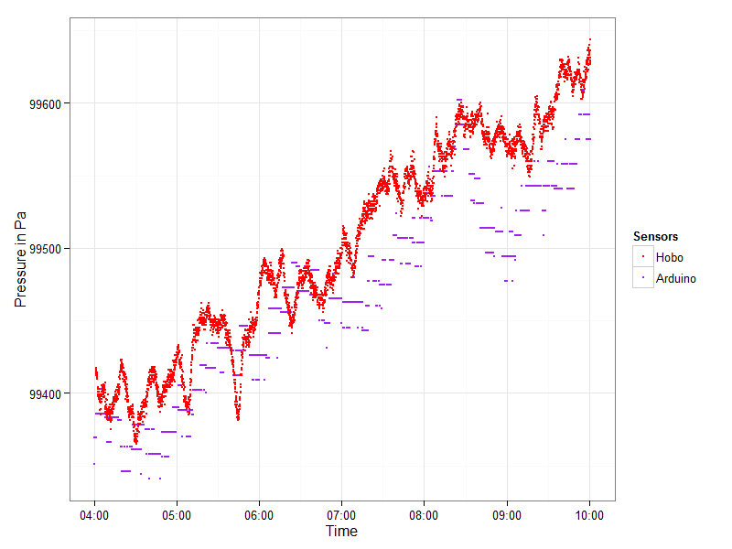
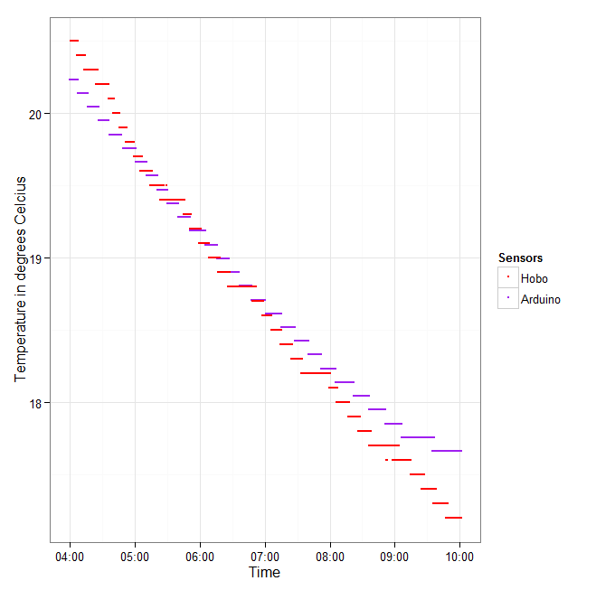
Use of Arduino Sensors in Hydrologic Research
Bethany Poulin & Mark Green
Plymouth State University – Center for the Environment
Background:
Materials & Methods:
Conclusion:
Water from storms enters rivers, streams and groundwater carrying with it particulates including agricultural runoff and road salts.
Rivers, streams and residential wells are affected, both physically and chemically, by the infusion of precipitation.
Infiltration of particulates, carried in stormflow, pose possible water quality risks to residential drinking water.
Continuous interval testing of temperature, pressure and specific conductance across a watershed help elucidate the flow of stormflow, and movement of its physical and chemical constituents.
Contemporary local research includes 18+ months of measurements taken from a number of local rivers and streams, but little data on the movement of stormflow into and out of wells and public water supplies.
The sensors and Arduino microcontroller were permanently soldered together using appropriate resistors (4.7 k & 10k, to condition signals for accurate readings using I2C and SPI standards.
The array was programmed, using standard open-source
Finished Sonde Approx 1.0 ft. long
Although there is some difference between the Arduino and the HOBO ® sensors’ readings in this initial test, particularly in the pressure sensors, it is not immediately clear the if the difference is one of sensor precision or programming.
In particular, the temperature readings showed a slight offset in readings that varied with the temperature (possibly due to the isolated airspace surrounding the sensors under the membrane) but the Arduino temperature measurements were very close, within 10% of the control . Pressure was more difficult to discern.
Despite some disparity in our tests there is enough of a pattern to suggest that further exploration of these units is worth the investment, due to the extreme cost savings and the compact foot print of the arrays.
Real time
clock
Arduino Mini Pro 5V
Card
adapter
Pressure sensor
Waterproof
Temperature Probe
Arduino libraries in C++ for the two sensors, the microSD adapter as well as the real time clock. The array was set up to make temperature and pressure readings every 15 seconds saving them in comma separated file.
A custom housing for the array was constructed from PVC pipes and fittings; a pressure housing was assembled from a hose cap, O-ring, marine putty and thin silicone membrane.
Arduino board and constituent sensors
Arduino Pro Mini 5V microcontroller
Catalex MicroSD adapter
Bosch BMP180 Pressure sensor (with temperature)
Maxim Integrated DS18B20 temperature probe
Maxim Integrated DS3231 Real-time clock
Research Obstacles :
Current research is carried out using a sonde of Onset HOBO® sensors including a temperature adjusted pressure sensor, temperature and conductivity sensors and field operable data shuttles to collect data and reset sensors.
Each field unit costs $1300 or more limiting our ability to implement them as broadly as needed to create a clear picture of stormflow across time and space.
Future Work:
Adjust the pressure readings to take the averages of 25, 50 and 100 readings to see if an averaged measurement is more in line with the HOBO® sensor.
Create more sophisticated program to manage power better; disabling all LED board illumination, use the real time clock to wake the Arduino and manage sleep cycles, use Arduino EEPROM as temporary memory, writing to the CSV only once per day
Develop a non-electroplating cost effective, easy to calibrate, conductivity sensor for co-deployment, experiment with carbon fiber rods
Optimize the housings internal bracket with 3D printed parts to facilitate more compact arrangement of components and in-place soldering to reduce wire management.
Procedure & Analysis:
The Arduino array was assembled and programmed to read and record temperature and absolute pressure every 15 seconds, as was a HOBO ® U20l-01 pressure sensor. The two arrays were submerged in the same water bath for a three day period of time to record changes in temperature and pressure.
The Arduino array survived initial deployment, recording for the entire three days with no apparent leaking and plenty of reserve battery power.
Both sets of recordings were explored using R statistical scripts to evaluate the performance of the DIY Arduino sensor array against the current research standard HOBO® using simple time-series plots.
HOBO ® Conductivity Sensor
Stream Sensor Assembly
HOBO ® Pressure Sensor
Well Sensor Assembly
Both the HOBO® and Arduino arrays show clear pattern similarity between units in both temperature and pressure readings**
There is a disparity in the response time between the two systems.
In addition to the cost associated with the sensor units, sensors assembled into an array are cumbersome, which is not a problem in most installations, in shallow streambeds and narrow wells, the size of the housing can make installation difficult or impossible.
References:
Brooks, K. N., Ffolliott, P. F., & Magner, J. A. (2012). Hydrology and the Management of Watersheds, 4th Edition. John Wiley & Sons.
Meas. Tech., 2012.
Project Goals:
Acknowledgments:
To design, build and test an Arduino-based sensor array, with a modest footprint, which can be easily assembled for under $100 by students, teachers and citizens with modest skills to facilitate wide deployment.
Mark Green
University of New Hampshire Leitzel Center
Plymouth State University - Center for the Environment
This research was supported with funding from the National Science Foundation’s grant to NH EPSCoR (#1101245).
**Using the HOBO ®as the control, the assumptions is made that the unit is both accurate and precise to the extent stated in the documentation from Onset.

