Slide 1


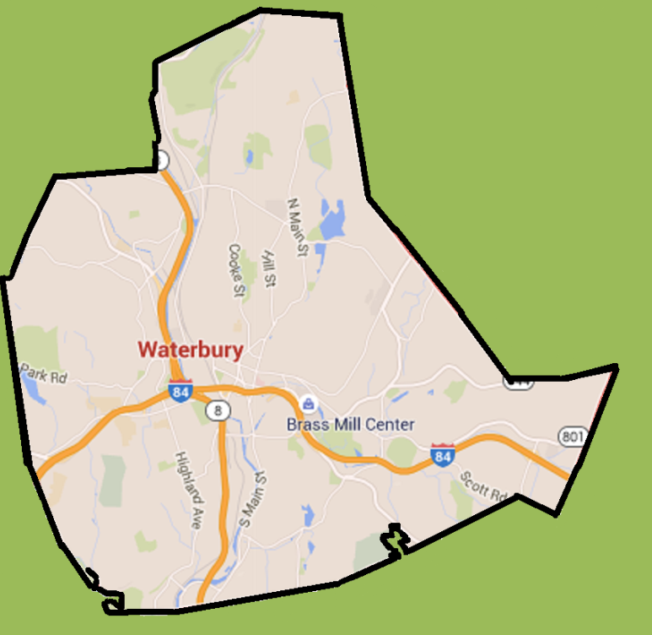
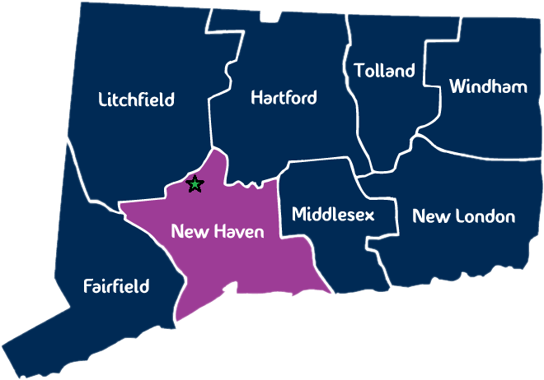
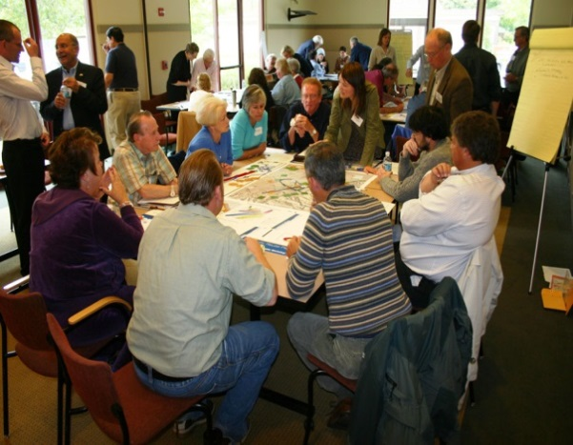
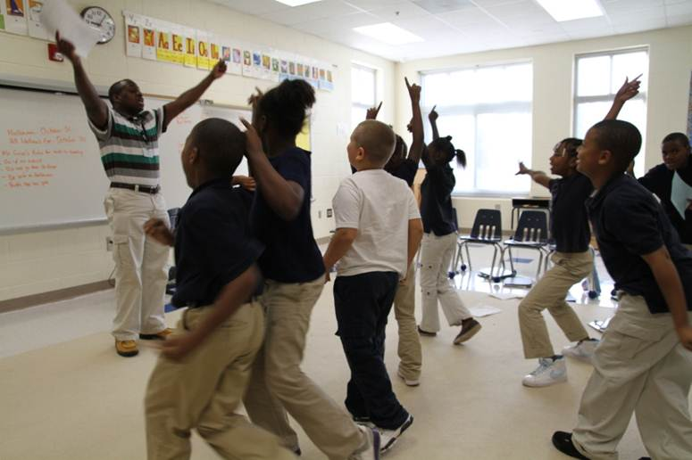
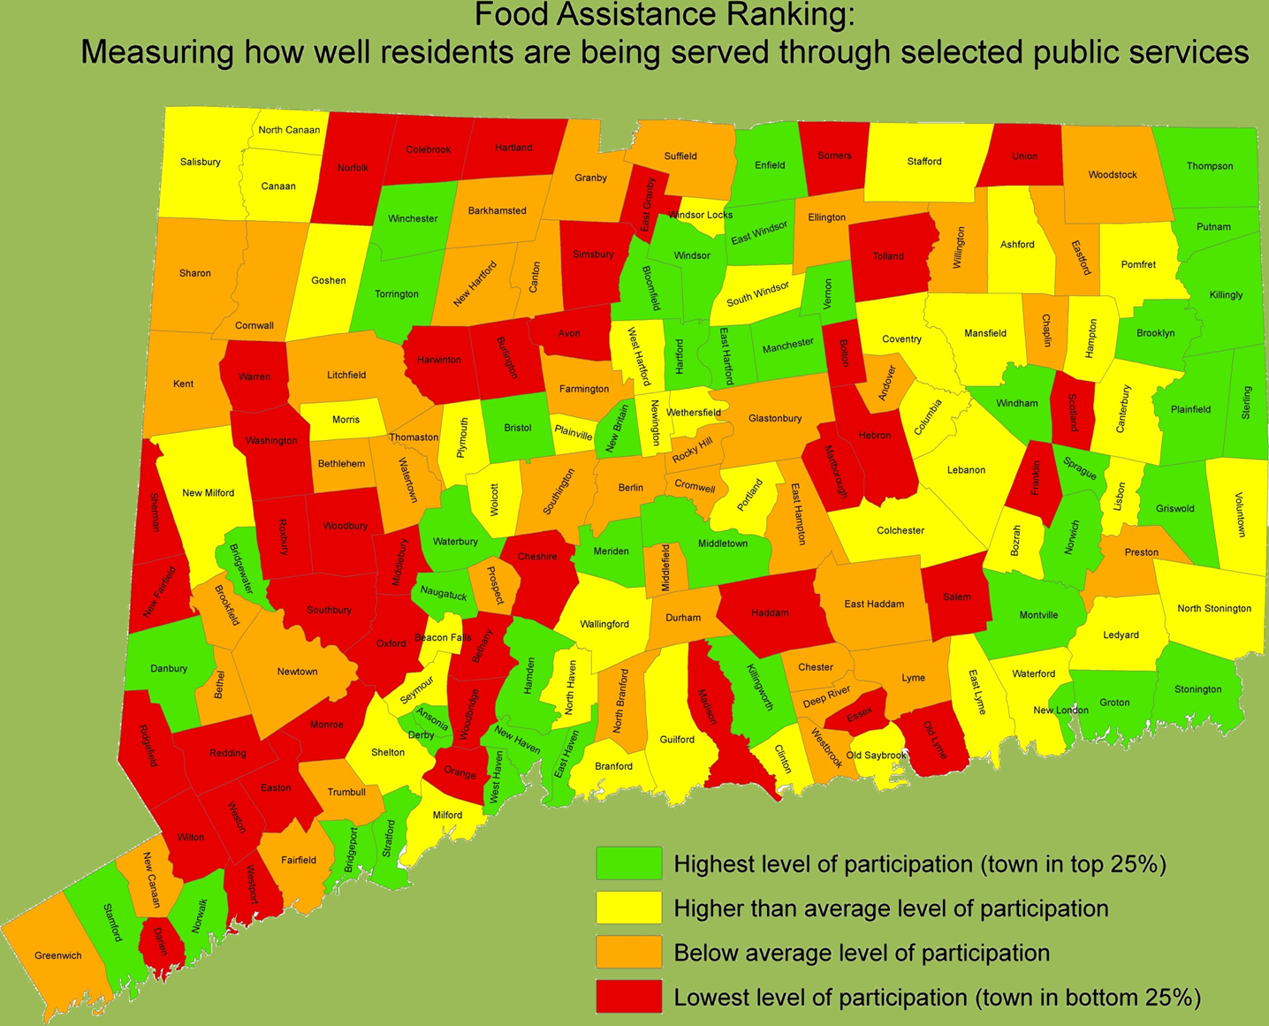
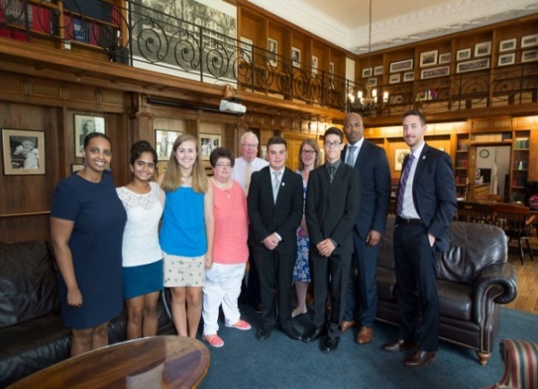
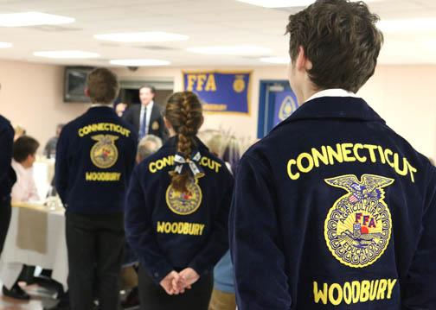
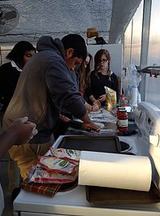

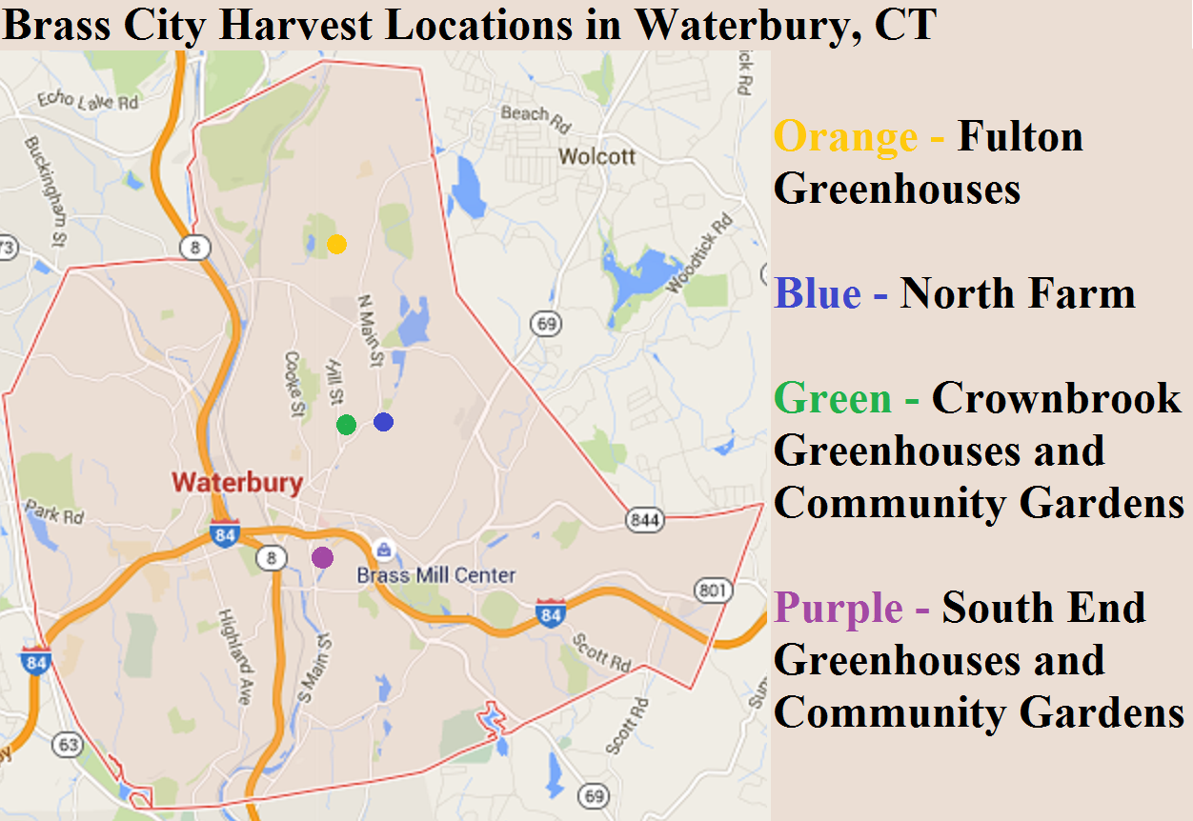
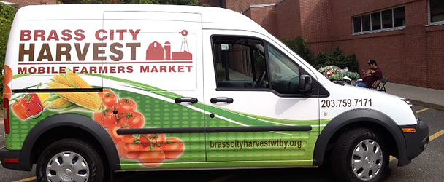
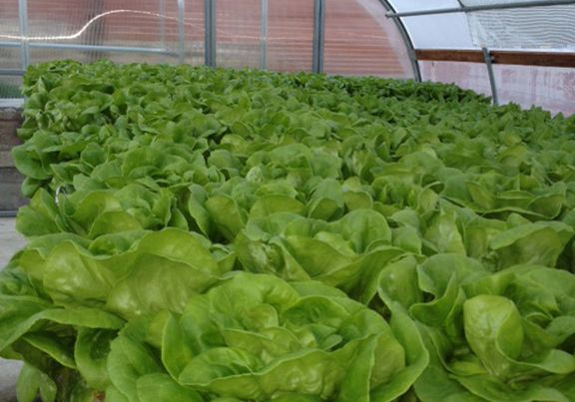
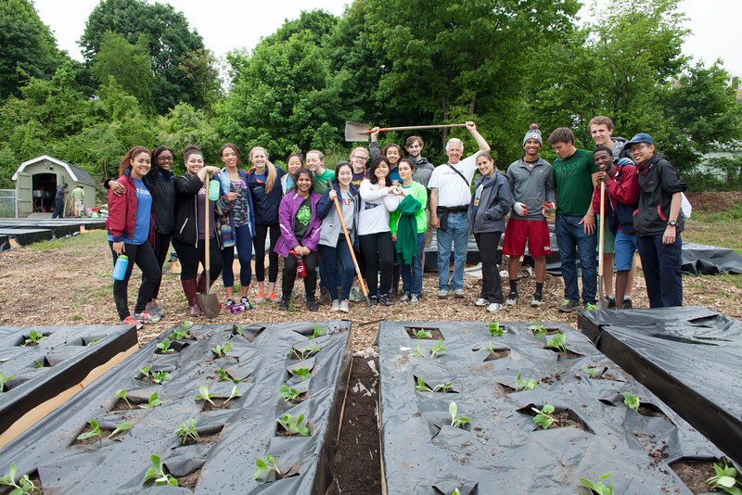
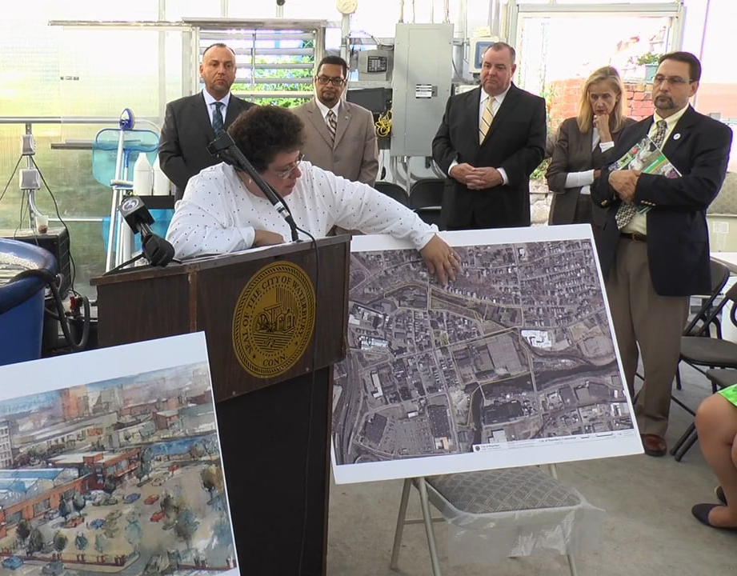
OASIS: Optimal Agriculture Skills Initiative for Students
Waterbury, Connecticut
Quid Aere Perennius
What is so lasting as Brass?
Kathleen Gorman and Dr. Joanne Curran-Celentano, Faculty Advisor
Abstract
Waterbury is one of the oldest urban communities in Connecticut. Over the years the city has seen a significant collapse in their economy and food security. A local Community Supported Agriculture (CSA) Non-Profit Organization, Brass City Harvest, was founded to support the city’s food security through organizing year-long farmer’s markets and producing products at their own facilities for food pantries in the city.
Since its formation Brass City Harvest has grown and within the next year (summer and fall school year of 2016) will be expanding to offer more outreach experiences to Waterbury citizens and the surrounding communities. The goal of this project is to design an outreach program to support, sustain and grow the Greater Waterbury area’s agriculture future. With the support of the Brass City Harvest Team and Waterbury Public School administrators the OASIS handbook and curriculum was developed. This handbook provides information on geographic target areas and populations within the city, lesson plans and evaluation tools. The curriculum was designed to be administered by the Brass City Harvest Outreach Team to provide innovative nutritional guidance and generate meaningful community service opportunities to: 1) the general public, 2) Waterbury Public School students, 3) participating Global Leadership Initiative summer service interns from Taft School in Watertown, CT, and 4) state-wide National FFA Organization chapters.
Following initial field testing, OASIS is designed to be modified based assessments by the instructor and third party evaluators connected with the Waterbury Public School System and Taft Global Leadership Initiative counselors.
The result of this project is to provide Brass City Harvest a plan to follow and implement at Farmer’s Markets, presentation in Waterbury Public School Health Classes and summer programs provided by Brass City Harvest to the general public and school students. The ultimate goal is to provide an avenue for Waterbury citizens to partake in their food system and strive to build an “oasis” in their “food desert.”
Lesson Planning
In collaboration with four target groups, sixteen lesson topics were chose; for organization purposes, they were categorized by the groups.
 | General Public Farmer’s Market Presentations and Workshops; targeting adult learners.
 | Waterbury Public Schools Health and Physical education classroom presentation and a Cooperative pilot program to provide participating students with fresh produce.
 | Global Leadership Initiative (GLI) Summer Internship Program students from the Taft School, in Watertown, CT, will complete classroom activities to correspond with their volunteer work.
 | National FFA Organization Fulfilling student’s Supervised Agriculture Experience (SAE) requirements.
Population Estimate: 109,307
There are approximately 3,800 people living in 1 mi²
The lesson plans presented below have been chosen based on the needs and requests of the groups mentioned above.
1. Food Exploration
9. Eating In vs. Eating Out
The city houses the majority of the minority population in the state of Connecticut.
Approximately 25% of the population in the city is currently living in poverty based on the United States Census definition.
2. Growing Seasons
10. Nutrition Worksheets
3. Local Foods
11. Home Gardening
4. Milk
12. International Cuisine
5. Food Deserts
13. Food Policy
Lesson Development
Lesson plans are made of four sections to describe and provide instructions about the lesson plan.
6. Personalized Food Mapping
14. Soil Exploration
7. Nutrition Labeling
15. Holiday Workshops
Introduction: Basic information about the lesson: Name, Target Group, Prerequisite Knowledge and the Common Core Standards Addressed.
Tools and Resources: Any materials used in the lesson plan: URLs, Software, Printed Materials, PowerPoint Presentations, Foods, etc.
Procedures: Detailed description of the activities of the lesson; structured as a guide to allow for replication.
Closure: Comprised of recommended modifications and evaluation methods.
8. Food Distribution Programs
16. Supervised Agriculture Experience
Acknowledgements
Thank you to Susan Pronovost and Joseph Gorman for their continued support and technical expertise
Program Evaluation
This program is intended to be nurtured over time to be adapted to the changing needs of the Waterbury community. The program instructors will be subject to summative evaluations:
Self - Brass City Harvest instructors will be required to evaluate their performance
Peer - Brass City Harvest outreach workers will be assigned to evaluate their colleagues.
Third Party -The groups that the program caters to will also evaluate the program’s effectiveness in their organization. These evaluators will be at the discretion of the group and are not associated with Brass City Harvest personnel.
References
(2014). About brass city harvest. Retrieved from http://www.brasscityharvestwtby.org/
Rabinowitz, A. N., & Martin, J. (2016). University of Connecticut College of agriculture and natural resources community food security. Retrieved from http://zwickcenter.uconn.edu/CFS.iiind.php
Reynolds, E., & Murray, J. (2009). A brief history of Waterbury. Charleston, SC: The History Press.
United States Census Bureau. (2014). State & county quickfacts: Waterbury, CT. Retrieved from http://www.census.gov/quickfacts/table/PPS045215/00

