Slide 1


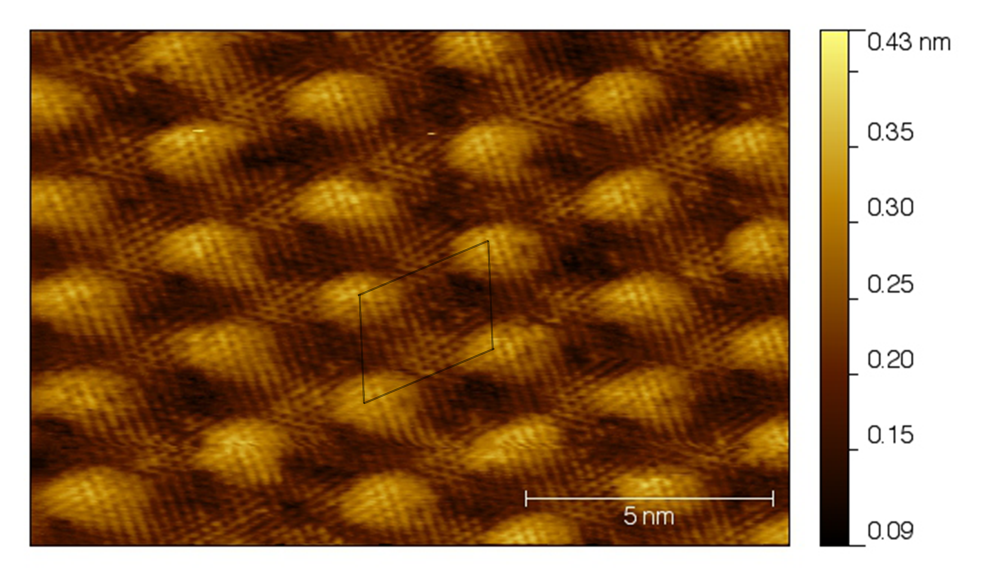
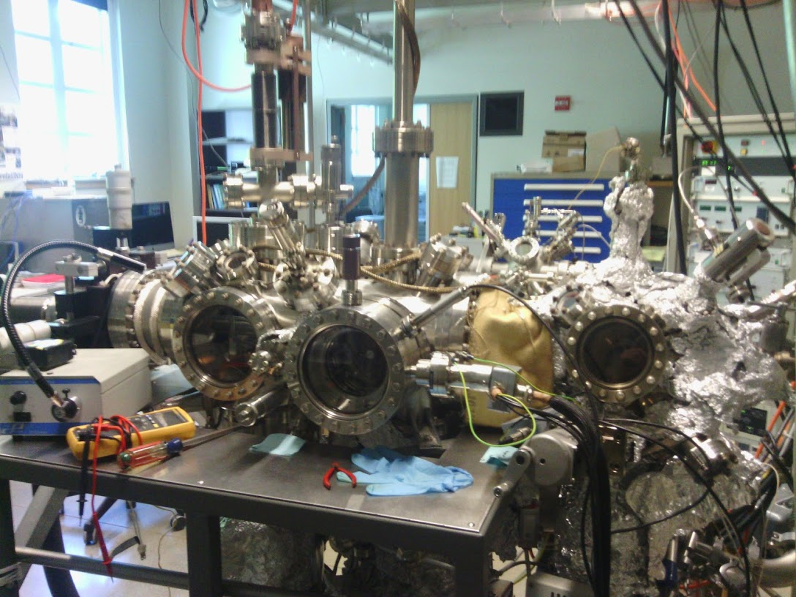
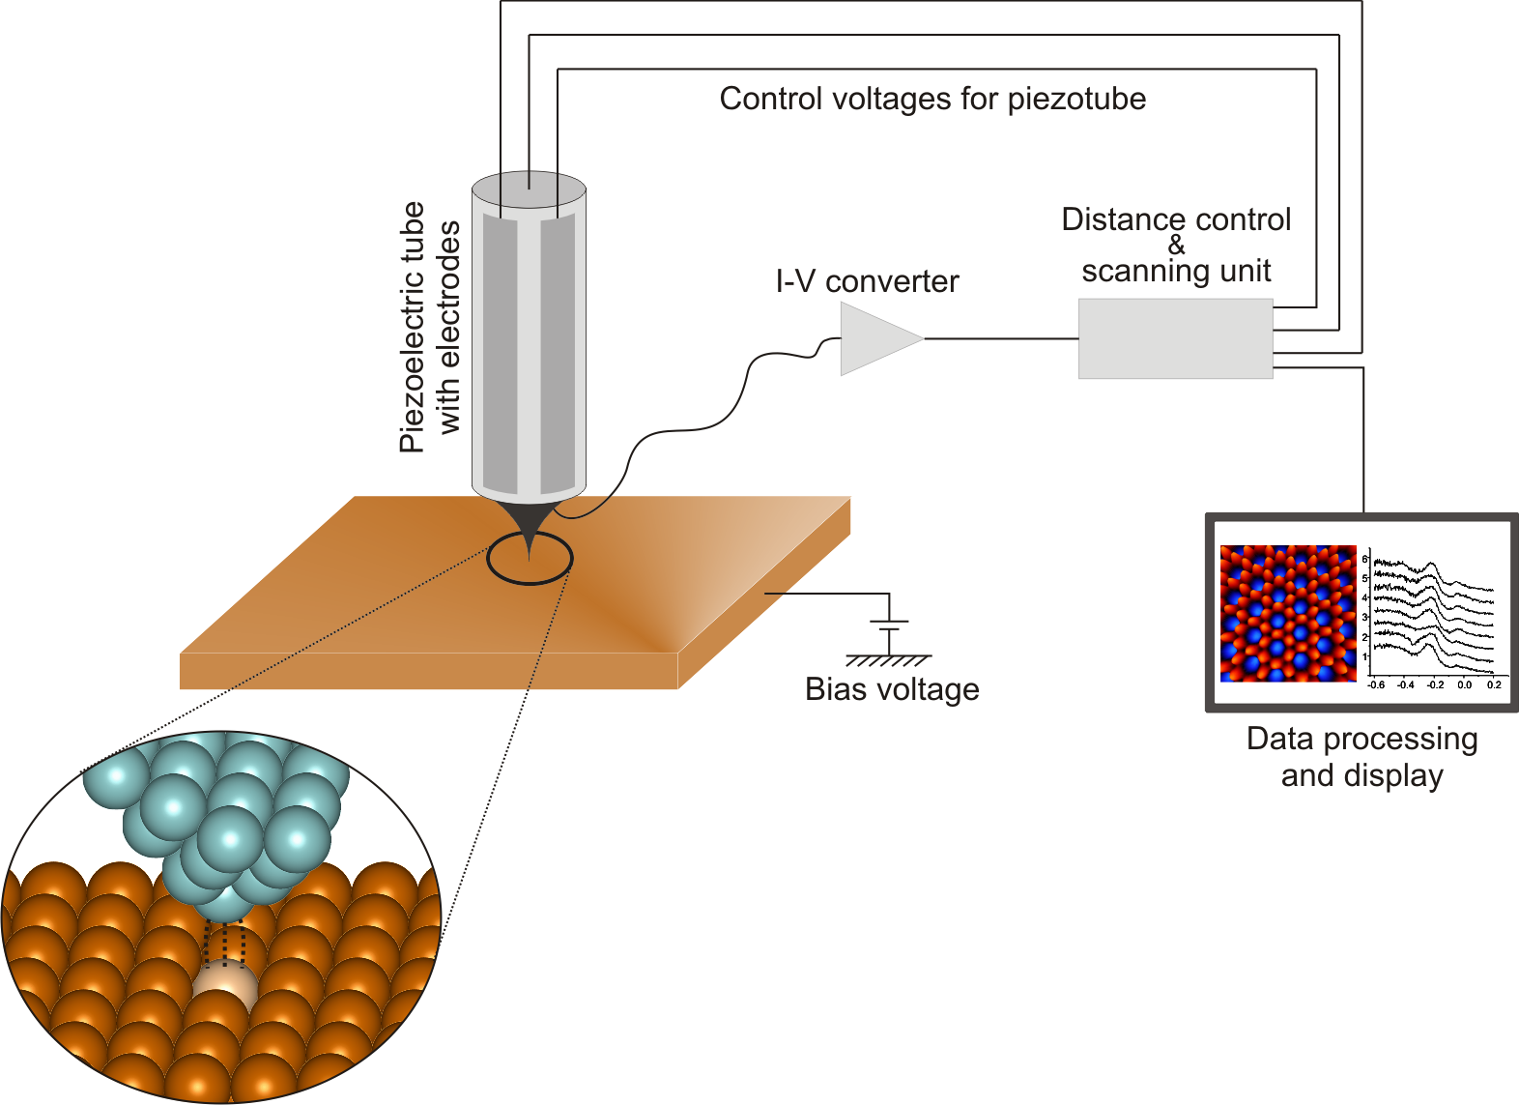
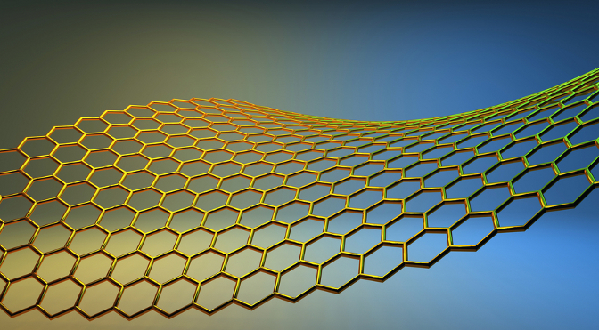
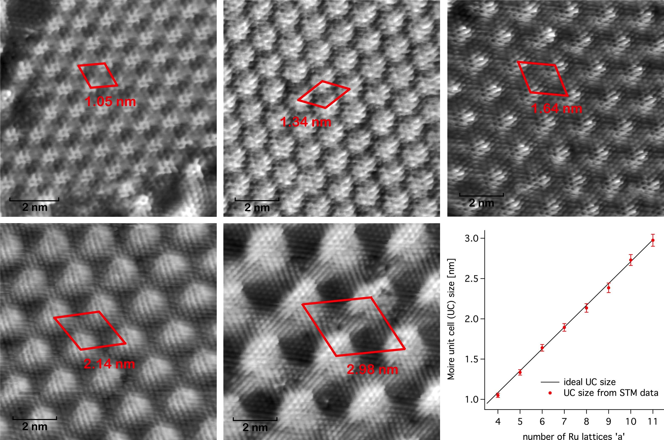
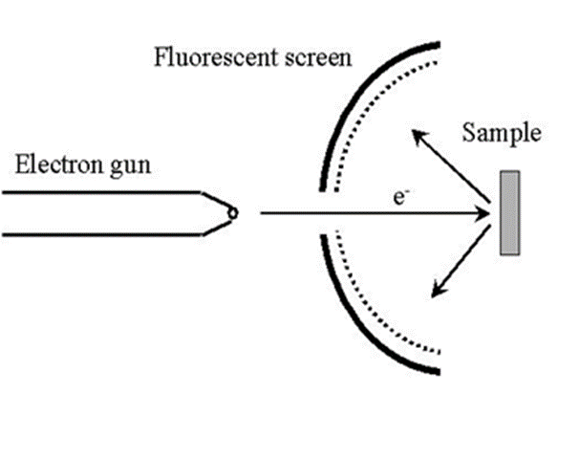
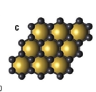
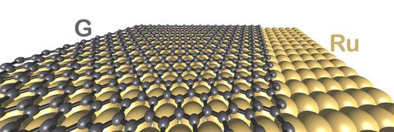
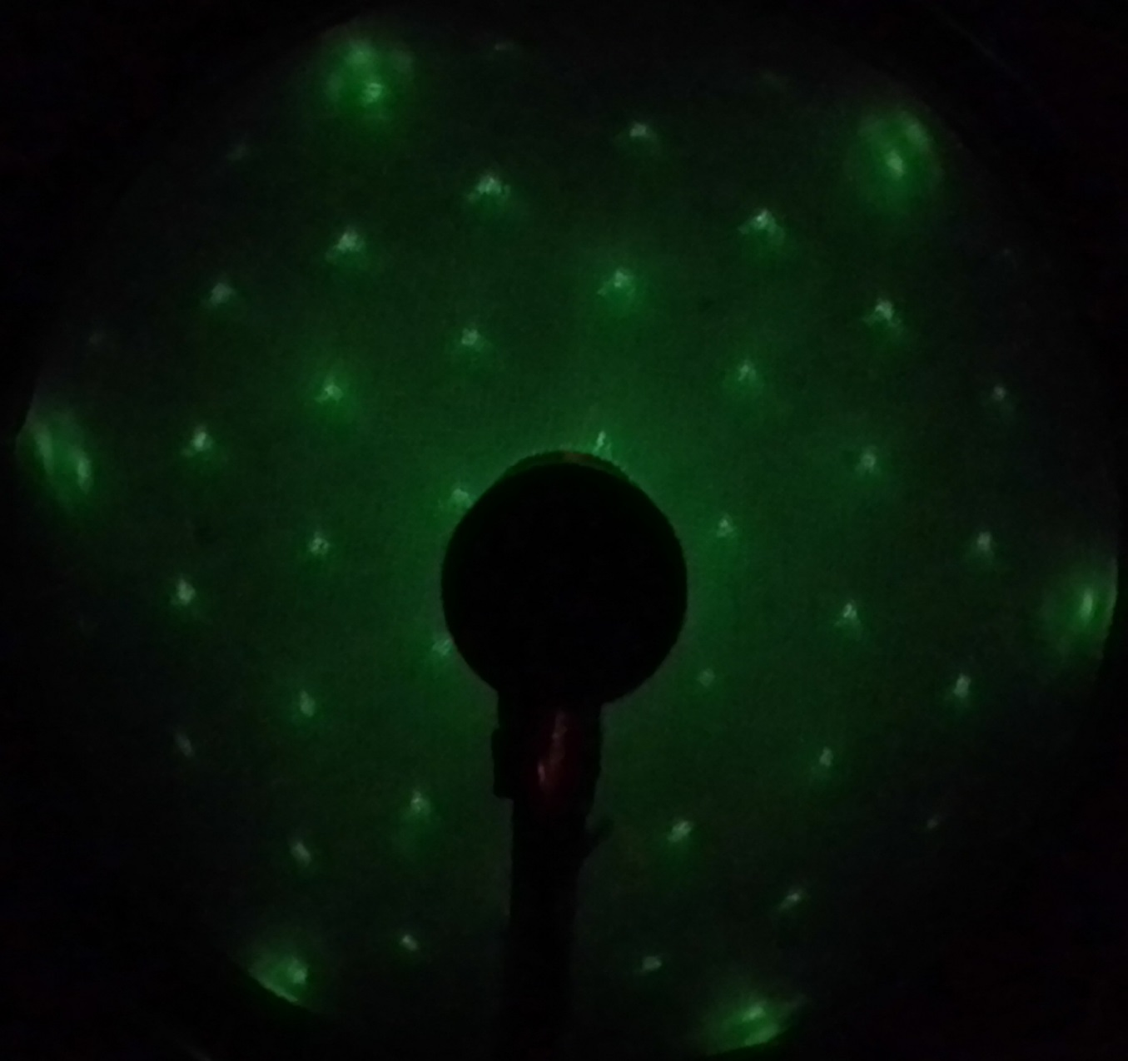
Novel Method for Synthesizing Graphene on a Metal
Electrode for Photovoltaic Applications
Steven Arias, University of New Hampshire
Faculty Mentor : Karsten Pohl, UNH
Maxwell Grady, UNH
Acknowledgments
This work was funded by the:
McNair Scholars Program.
UNH Surface Science Group
Introduction
Materials And Methods In Ultra-High Vacuum
Results and Conclusions
Two-dimensional (2D) materials have attracted the attention of many researchers.
The first created 2D material was graphene, it was discovered in the early 2000’s.
Graphene is a single layer of carbon atoms with amazing properties:
  One of the strongest materials
  One of the lightest materials
  The thinnest material possible.
  Very flexible and transparent.
  Excellent electrical and heat conductor.
Graphene can improve the performance of current technological devices
We grow graphene in an ultra-high vacuum chamber and characterize the structure of this 2D material by scanning tunneling microscopy and low energy electron diffraction.
Homebuilt STM
Omicron SPECTALEED Leed/Auger Optics
Thermal evaporators for organic deposition
Top: Solid carbon source for PVD graphene in presence of hydrogen.
Bottom: Ru(0001) substrate
PVD growth proceeds by positioning the substrate near a solid rod of high purity carbon.
The rod is heated to high temperatures (~2000K) which ejects carbon atoms that are deposited on the surface of the substrate
After the deposition the substrate is covered with unstructured carbon, but as you heat the sample at 800-900 K the disordered carbon slowly transitions into graphene.
Scanning Tunneling Microscopy
Used to image surfaces at an atomic level thanks to a principle called quantum tunneling.
Physical Vapor Deposition (PVD)
Is accomplished by positioning the substrate near a solid rod of high purity carbon.
The rod is heated to high temperatures (~2000K) which ejects carbon atoms that are deposited on the surface of the substrate
After the deposition the substrate is covered with unstructured carbon, but as you heat the sample at 800-900 K the disordered carbon slowly transitions into graphene.
Low Energy Electron Diffraction
GRAPHENE!
THIN
^{d}
Provides an image of the surface crystal structure of the target.
Method for analyzing at a large scale the surface of our sample.
STRONG
FLEXIBLE
LIGHT WEIGHT
I_{t} ∼ e^{-2κd}
EXCELLENT HEAT CONDUCTOR
^{d}
EXCELLENTELECTRICAL CONDUCTOR
Top: Schematic of the STM setup.
Bottom: Schematic of a layer of Graphene on Ruthenium. [1]
Significance And Applications
STM Images of PVD Grown Graphene (UNH):
Top: Atomically Resolved Graphene. Center: Moiré Structures of Graphene.
Bottom: Atomically Resolved Moiré Structures of Graphene.
Top: Schematic of the LEED setup.
Bottom: LEED showing Ru(1x1), Carbon satellites and Hydrogen atoms.[2]
Creation of nanoscale templates based on graphene geometry.
Large scale uniform single layer graphene film.
Graphene has a huge potential in organic electronics.
Modern devices are switching to ‘organic electronics’
Mobile screens and displays are starting to be created with organic light emitting diodes
Organic electronics can lower the cost and power consumption of our devices in this way improving our Green Technologies.
References
[1] Peter Sutter, Jan-Ingo Flege, Eli Sutter. “Epitaxial Graphene on Ruthenium,” Nature Materials, 2008.
[2] Valovcin, D. (2013), A study on the Growth of Graphene on Hydrogenated Ruthenium(001),Senior thesis, University Of New Hampshire
[3] Bogdan Diaconscu, Teng Yang, Savas Berber, Mikael Jazdzyk, Glen P. Miller, Karsten Pohl. “Molecular Self-Assembly of Functionalized Fullrenes on a Metal Surface,” Physical Review Letters, 2009.
[4] Yi Pan, Min Gao, Li Huang, Feng Liu, H.-J. Gao. “Directed self-assembly of monodispersed platinum nanoclusters on graphene Moiré template,” Applied Physics Letters, 2009.

