Slide 1


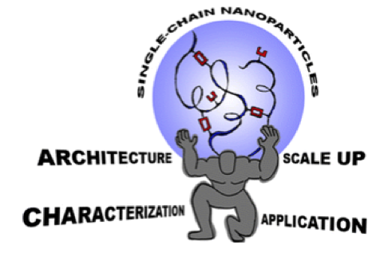
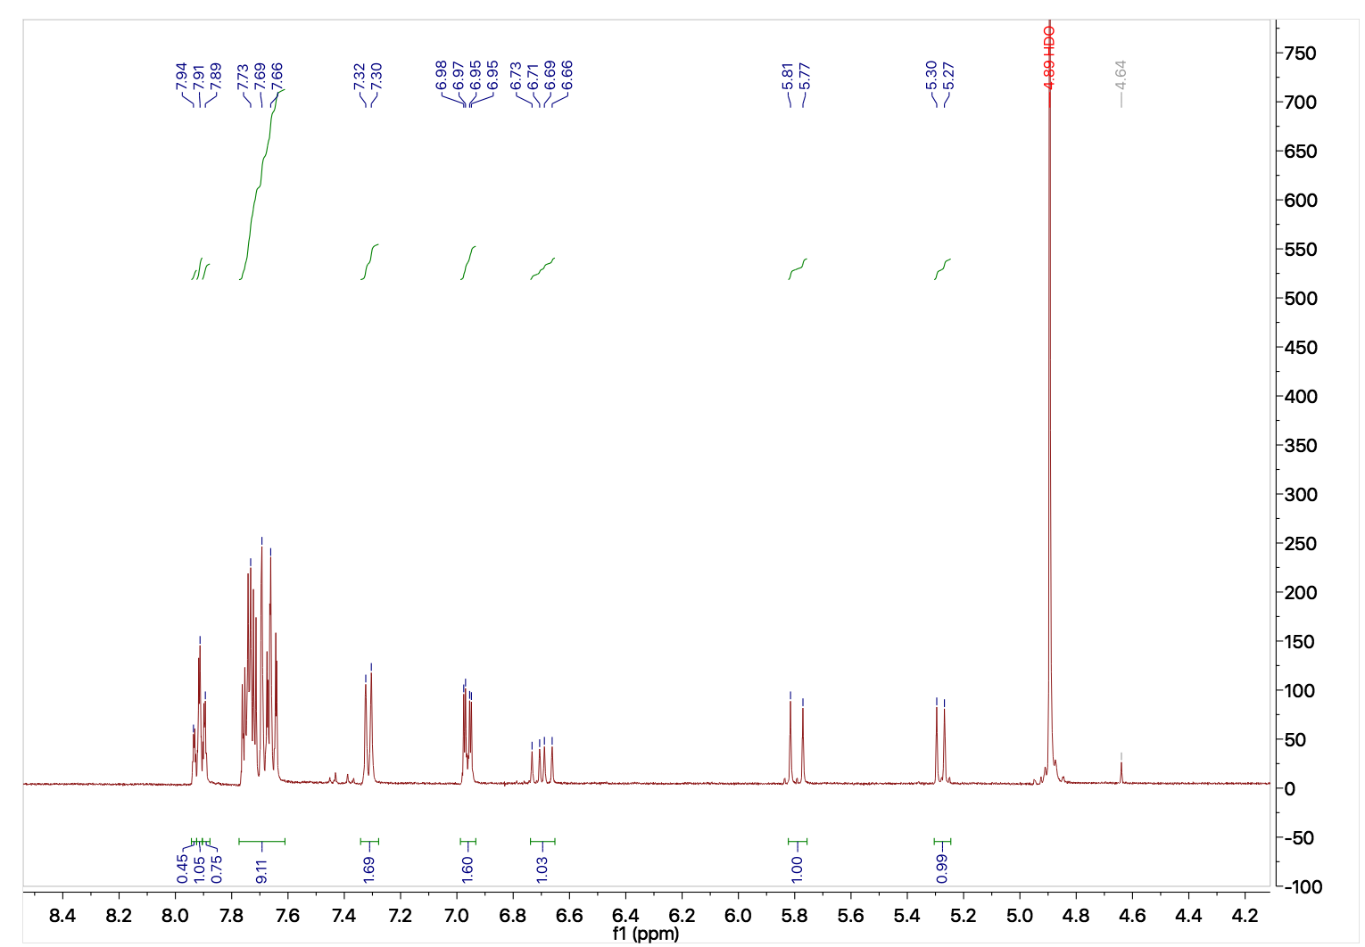
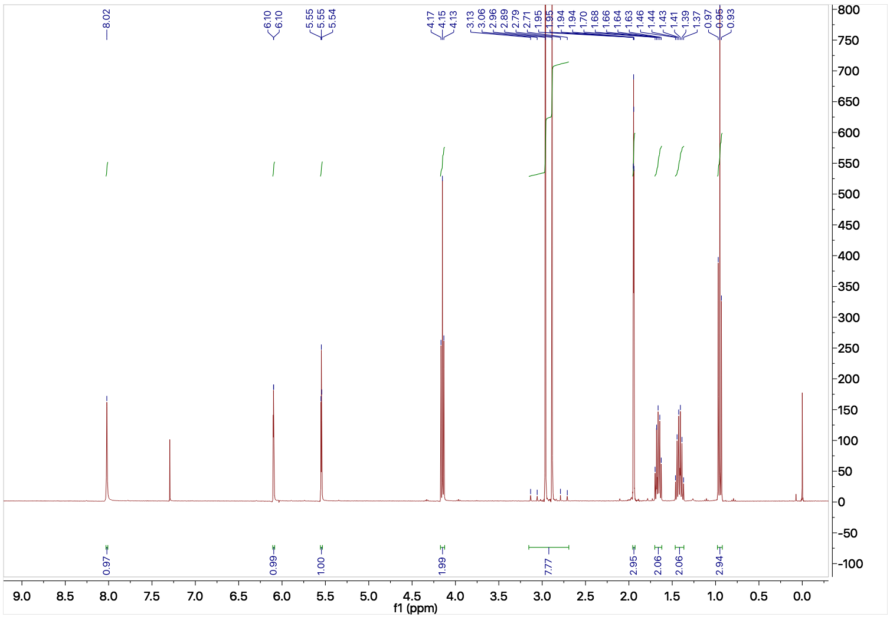
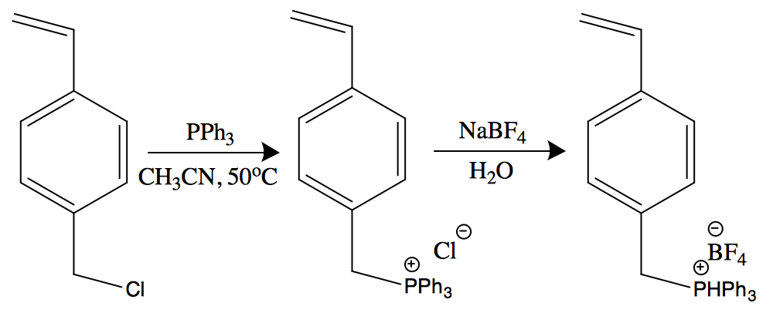
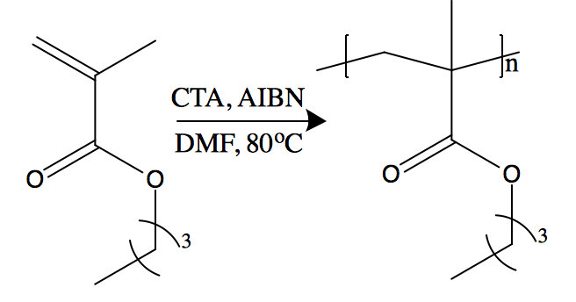
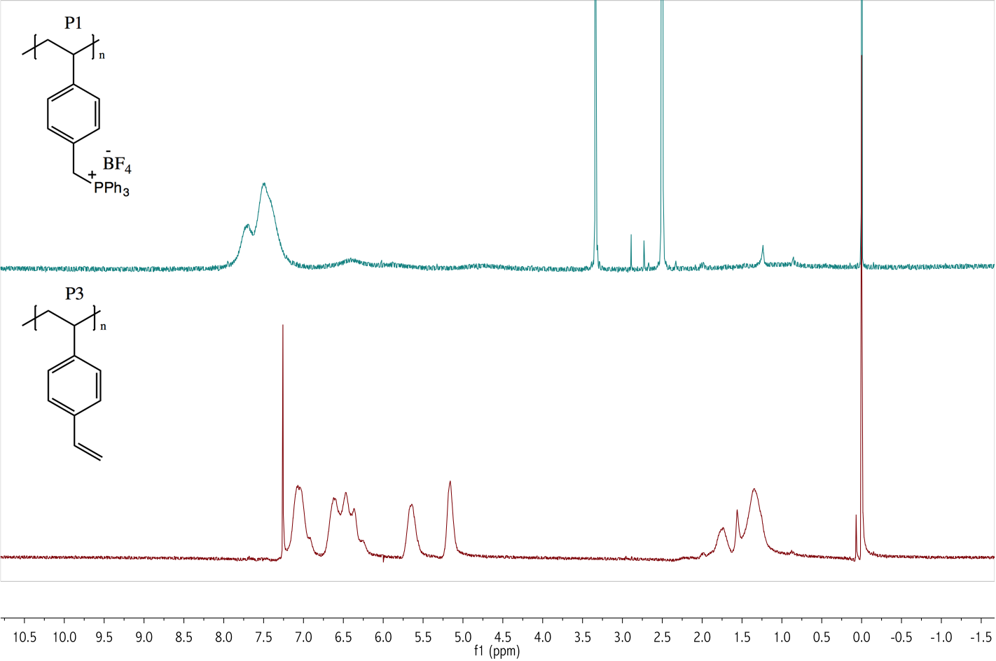
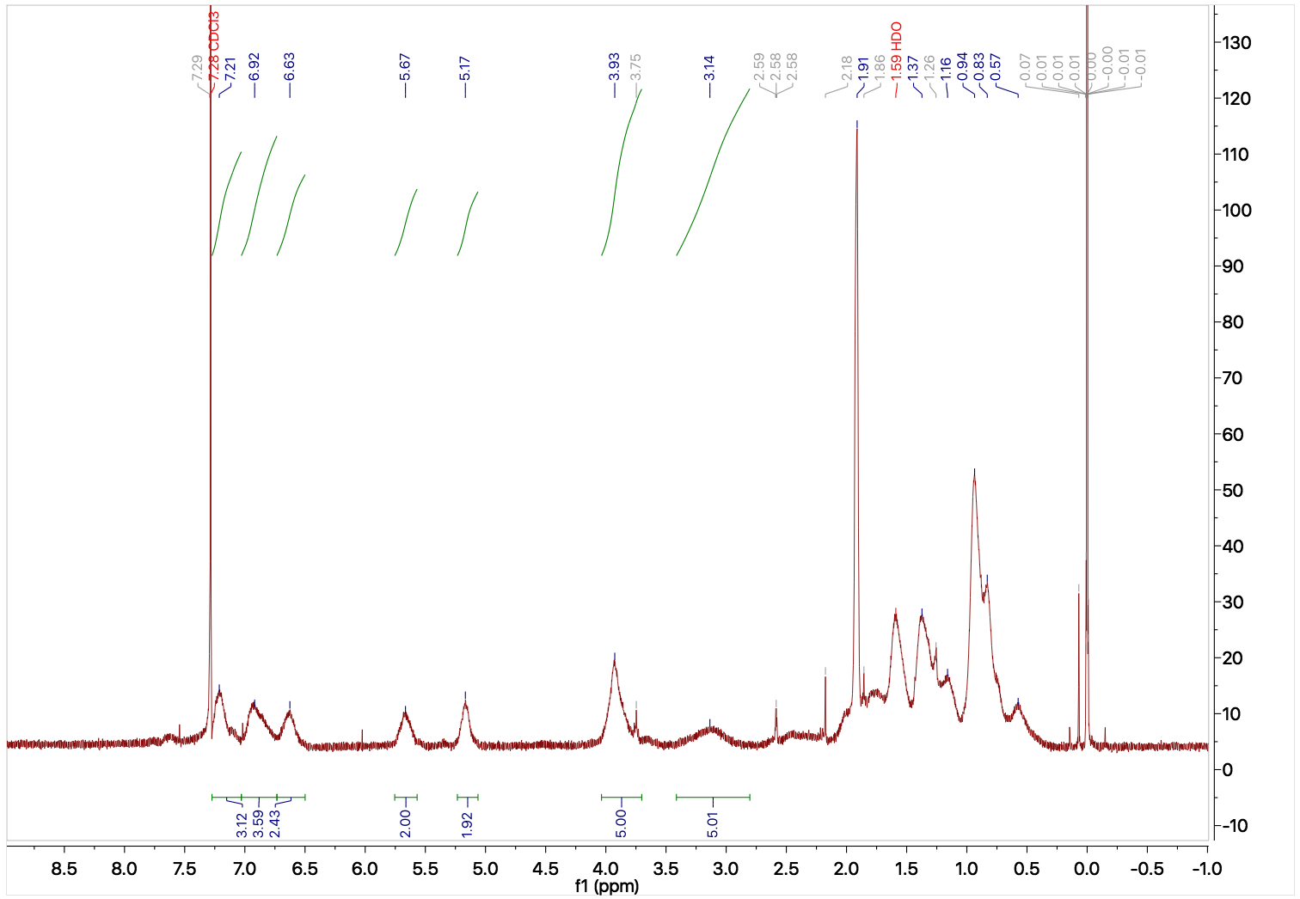
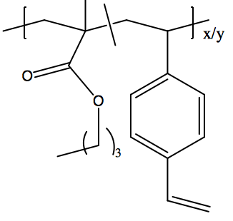
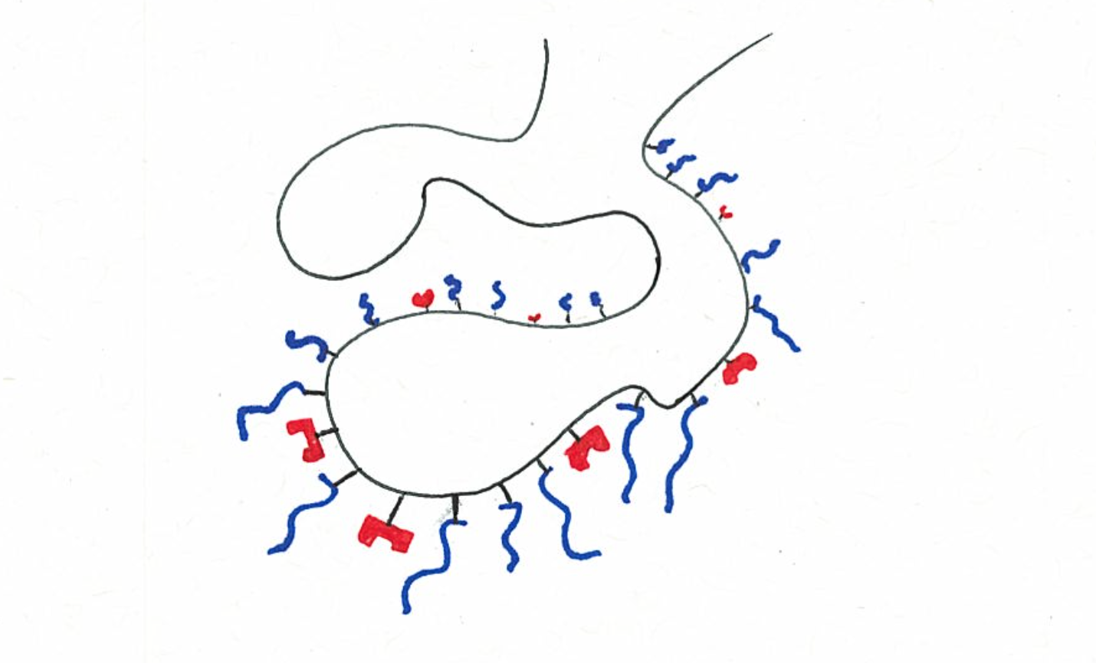
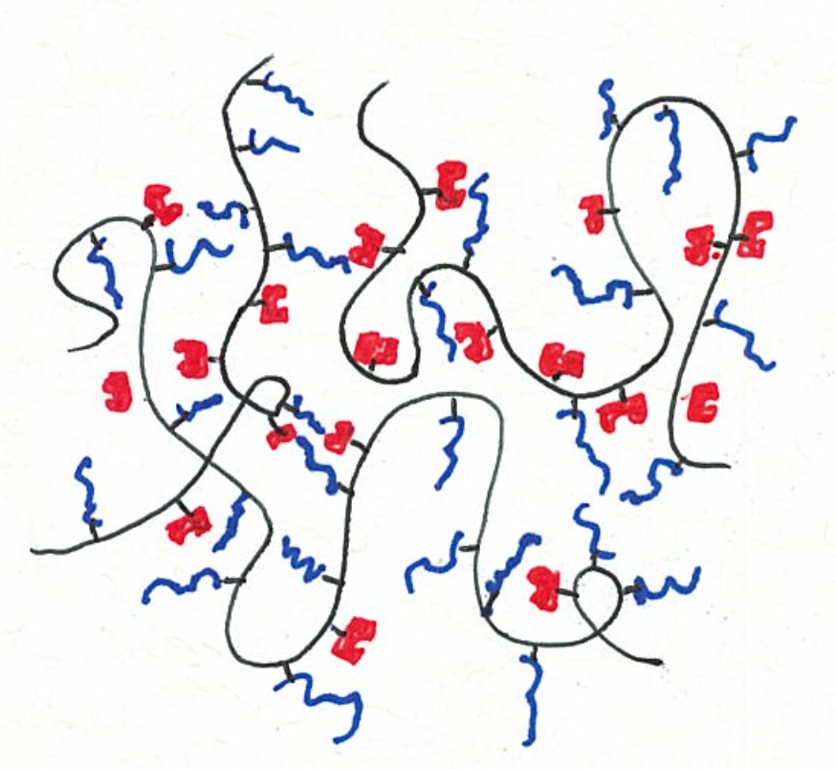
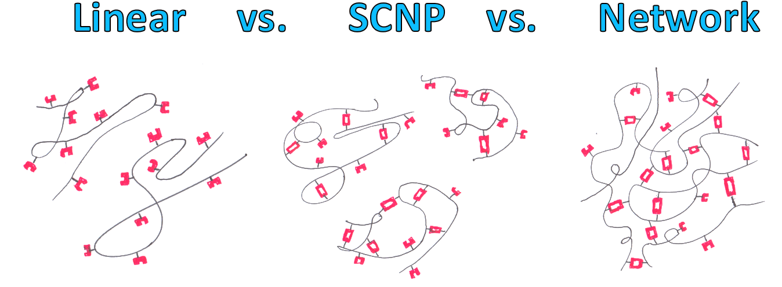
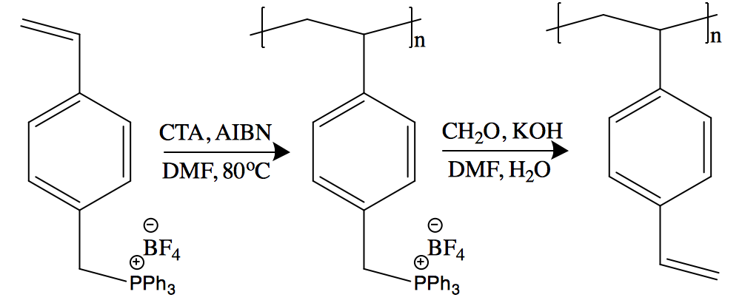
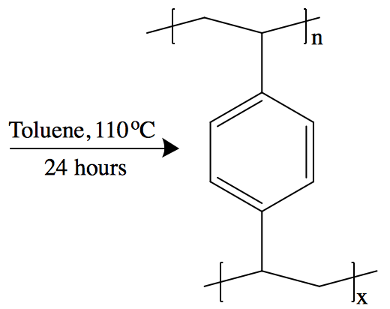
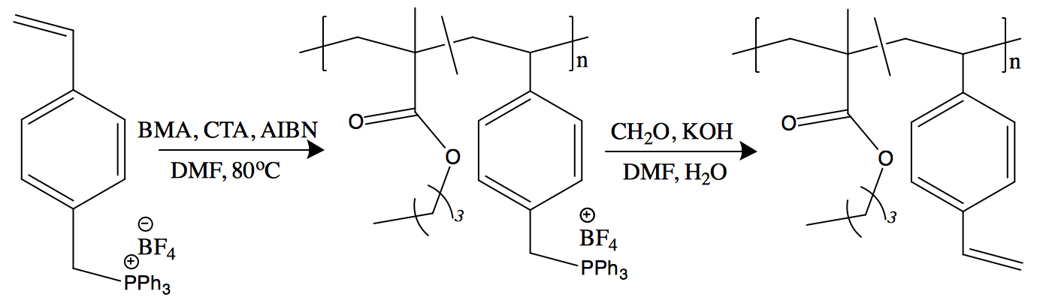
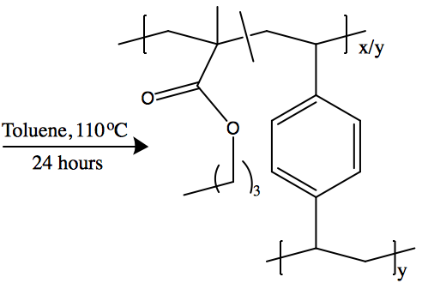
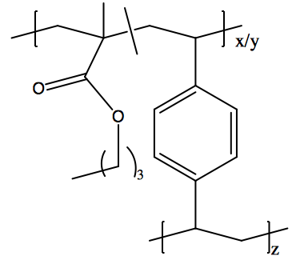
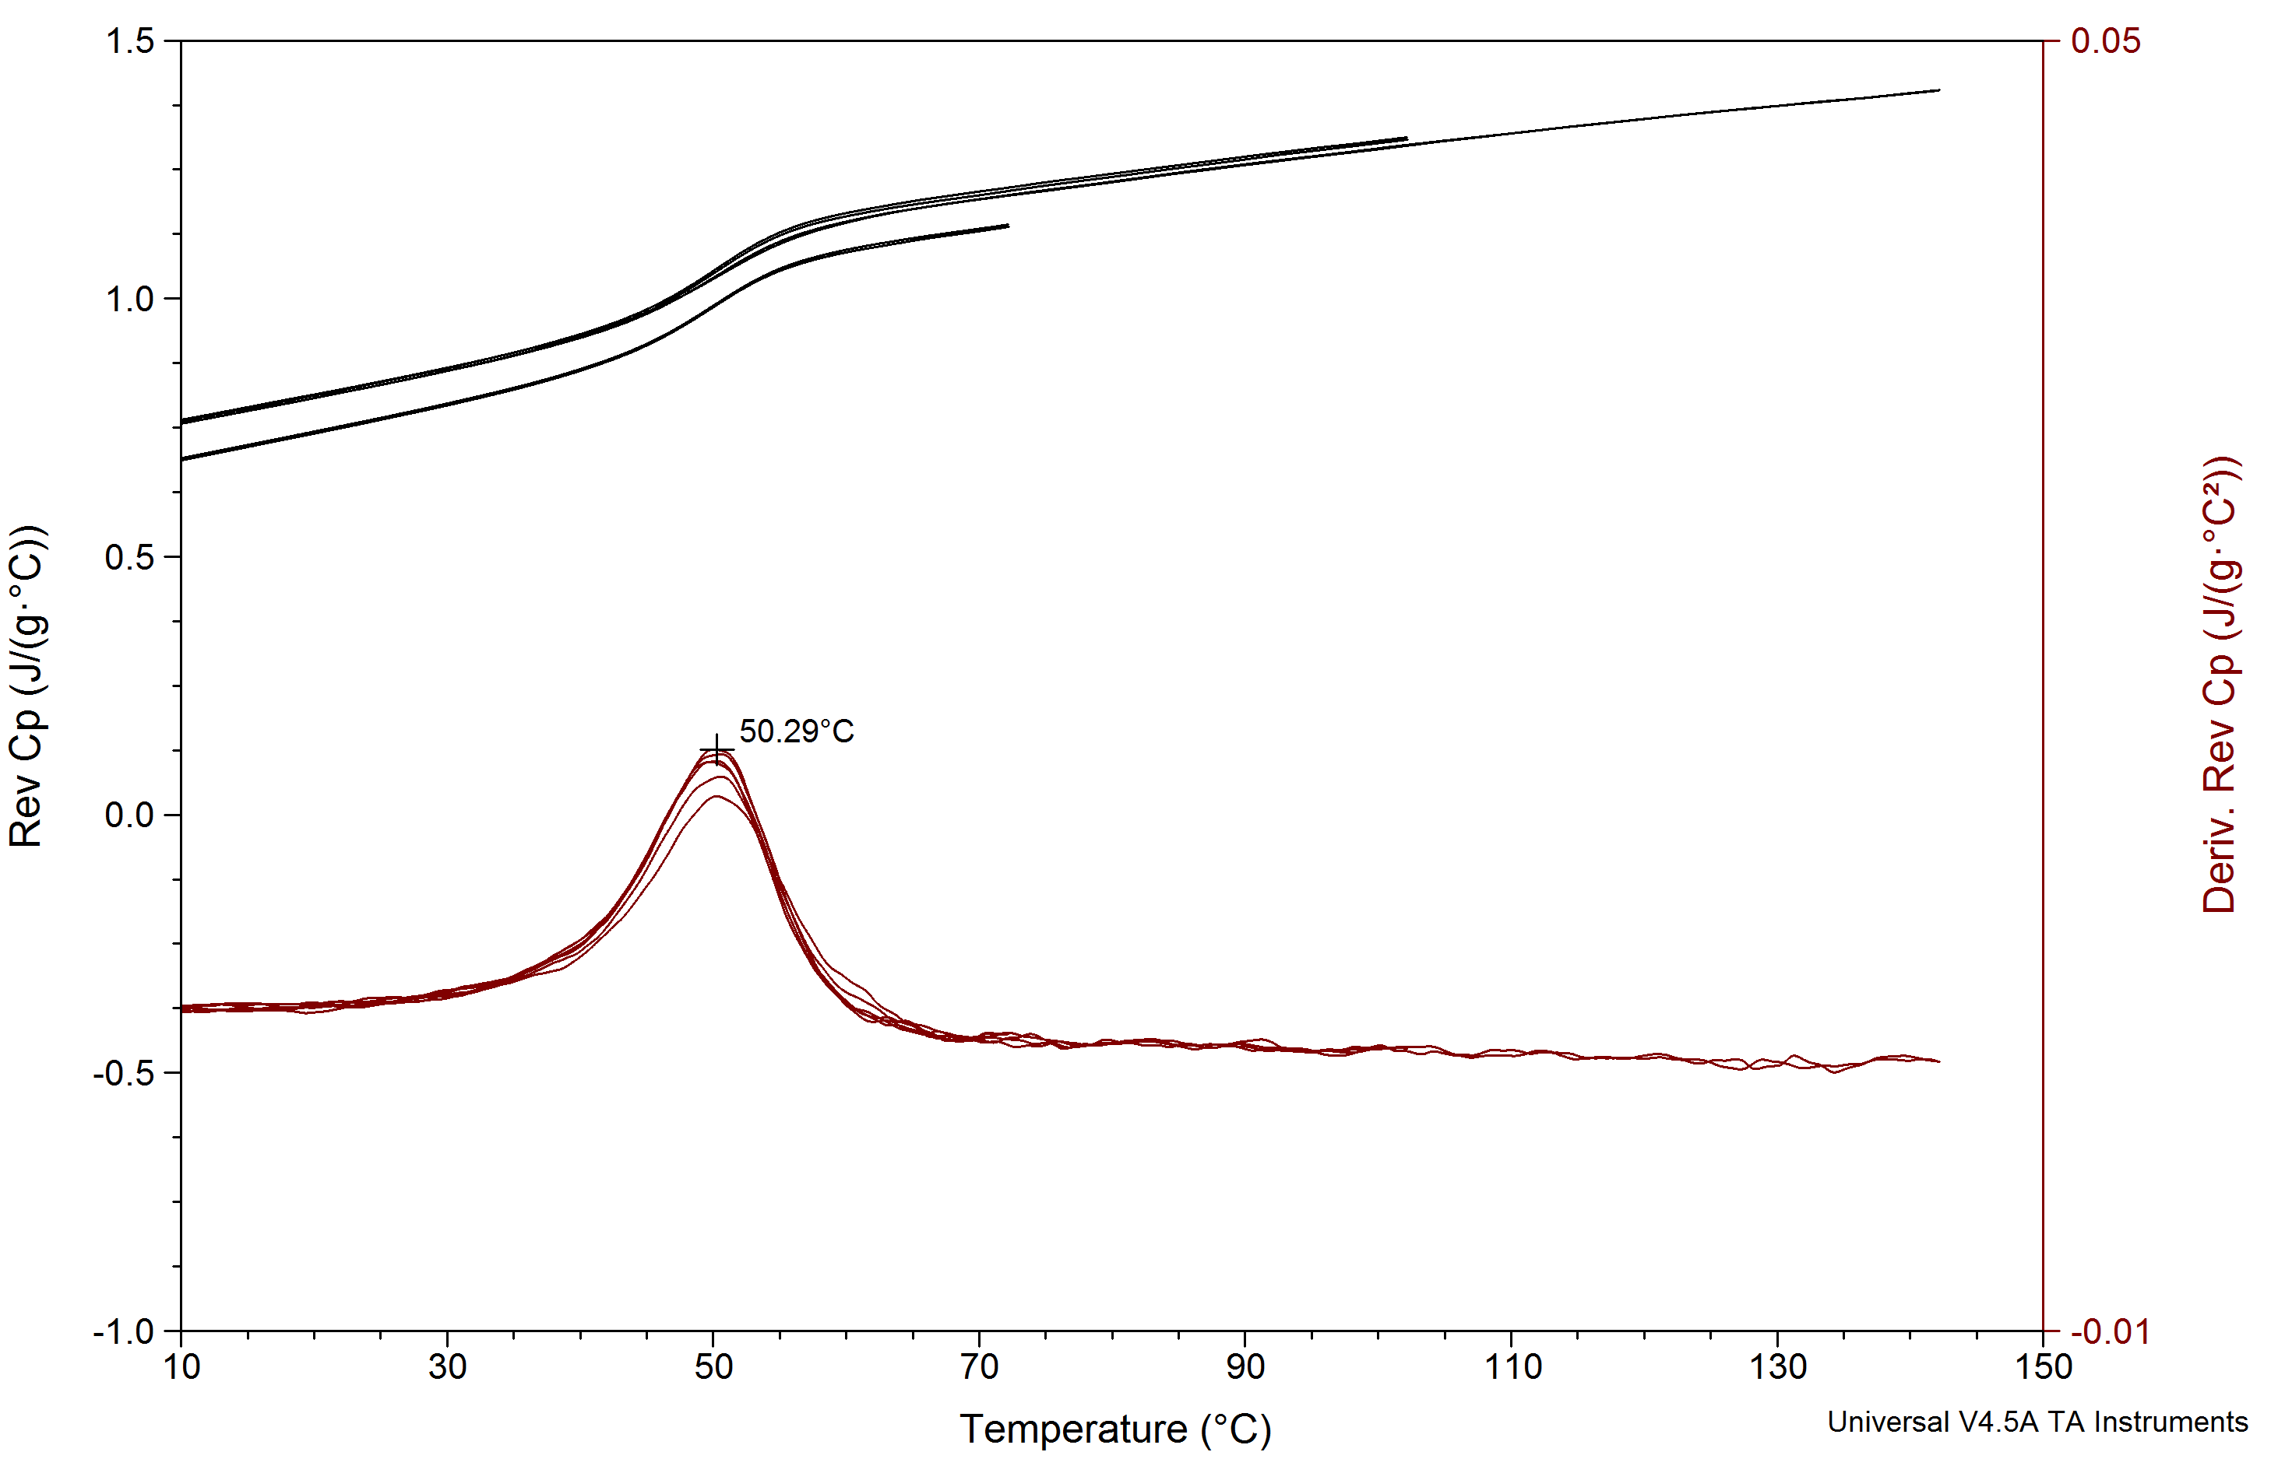
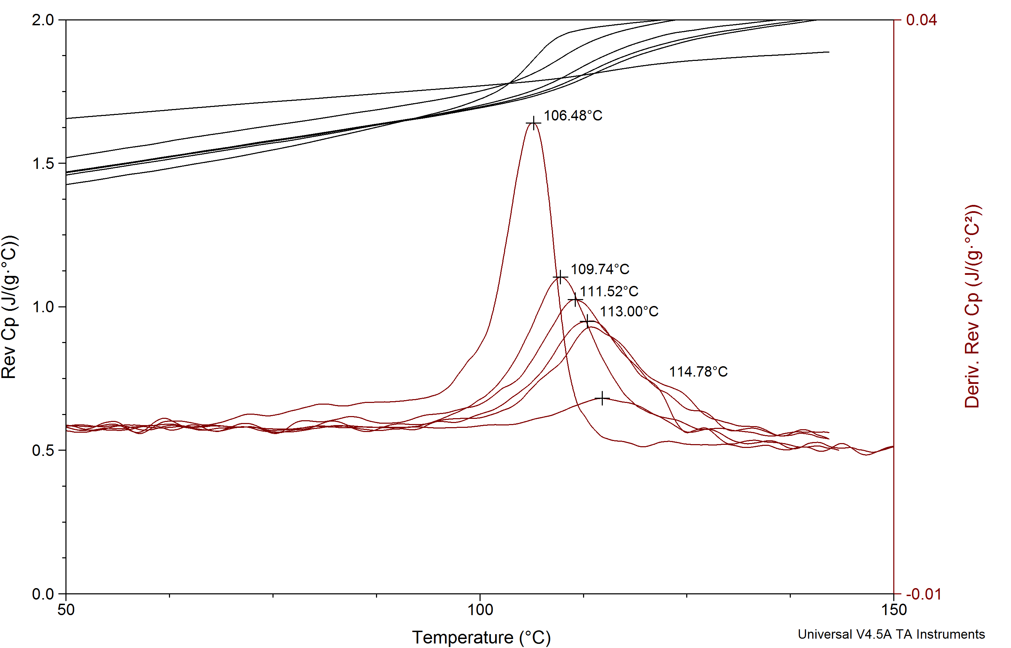
Estimating Network Contribution to Glass Transition Temperature of DivinyIbenzene using SCNPs
Robert Biro, John Tsavalas*, Erik Berda*
rah285@wildcats.unh.edu, Department of Chemistry, University of New Hampshire, Durham, NH
April 20th, 2016
Introduction
The co-polymerization of two vinyl monomers yields a linear polymer chain whose glass transition temperature (T_{g}) can be predicted through their homo-polymer linear chain analogs through the Fox Equation⁽¹⁾. However co-polymerization of a vinyl monomer with a divinyl monomer results in a polymer chain that is cross linked via the pendant vinyl group. This prohibits the decoupling of the linear, intramolecular network, and intermolecular network contributions to T_{g}.
Therefore an experiment was designed to protect a vinyl group of divinylbenzene, a well known cross linker, during polymerizations until it could undergo a post polymerization modification to de-protect it, leaving pendant vinyl substituents unreacted. This allows us to find linear contribution to T_{g}, and by forming Single Chain Nanoparticles (SCNP’s) and polymer networks, the intramolecular and intermolecular contributions to T_{g} can be fully decoupled respectively.
Results
Discussion
The synthesis of P6 was successful, however the synthesis of NP-1 proved to be difficult. The synthesis of both P7 and NP-2 were arduous and by NMR, GPC, and DSC characterization, both syntheses’ failed. Previous work with poly-EMA-co-DVB saw the formation of the network however P7 could not be isolated⁽³⁾. This may be because BMA shields the functional pendant styrene units, allowing neither intra- nor inter-molecular cross linking to take place⁽²⁾. This would explain why P6 was able to be synthesized, because no co-monomer shields the pendant styrene(s), allowing them to cross link.
This would allow for selective cross linking in divinylbenzene containing copolymers into SCNPs or networks based on the choice of co-monomer; a less bulky monomer allowing cross linking, and a more bulky monomer not permitting cross linking.
Shielding Effect in SCNPs
Shielding Effect in Polymer Network
Sample | M_{w} (kDa) | M_{n} (kDa) | PDI | R(avg.) (nm) | MHS (a)
P1 | 26.3 | 24.6 | 1.1 | 6.7 | 1.02
P4 | 30.1 | 26.7 | 1.1 | 5.2 | 0.695
P5 | 30.6 | 28.5 | 1.1 | 5.5 | 0.759
NP-2 | 30.7 | 28.3 | 1.1 | 5.2 | 0.521
Synthesis
Synthesis of monomer, 4-VBTPPBF₄, was followed by a procedure prepared by Tsarevsky. Using Reversible Addition Chain Transfer Fragmentation (RAFT) polymerization P1, P2, and P3 were synthesized. A Wittig Olefination was used to deprotect, forming P4 and P5. The synthesis of networked polymers P6 and P7 was attempted in concentrated solution favoring intermolecular cross linking. NP-1 and NP-2 synthesis was attempted in dilute solution favoring intramolecular cross linking. Each product was characterized by ¹H-NMR, DSC, and SEC if possible.`
P1
Summary and Future Work
Ultimately, the design of the copolymer used did not allow us to estimate the network contribution to T_{g} of divinylbenzene due to the shielding effect of the BMA. In future work, another co-monomer will be used to lower the T_{g} of respective copolymers yet not impede in the polymers ability to cross link both intra- and inter-molecularly⁽³⁾.
With this shielding effect, the collapsing of polymers into SCNPs can be further controlled by careful selection of the co-monomer. Researching SCNP and network formation by varying co-monomers will be studied in order to further understand the shielding effect on cross linking.
P2
P4
P6 / NP-1
P5
P3
P5
P7 / NP-2
NP-2
*No shift in retention time and SEC
data indicate SCNP not formed*
Acknowledgements
I’d like to thank Dr. Tsavalas and my research advisor Dr. Berda for their help on this project. I’d also like to thank graduate students Pei Zhang for DSC instrument help, and current and former Berda Group members Justin Cole and Dr. Chris Lyon.
P5 → P7
P4 → P6
References
(1) T.G. Fox, and P.J. Flory, Journal of Applied Physics 21, 581–591 (1950)
(2) Tsarevsky, Nicolay V. "Low-catalyst Concentration Atom Transfer Radical Polymerization of a Phosphonium
Salt-type Monomer." Polym. Chem. Polymer Chemistry 3.9 (2012): 2487-494. Web.
(3) Wood, Lawrence A. "Glass Transition Temperatures of Copolymers." Journal of Polymer Science J. Polym.
Sci. 28.117 (1958): 319-30. Web.

