Slide 1


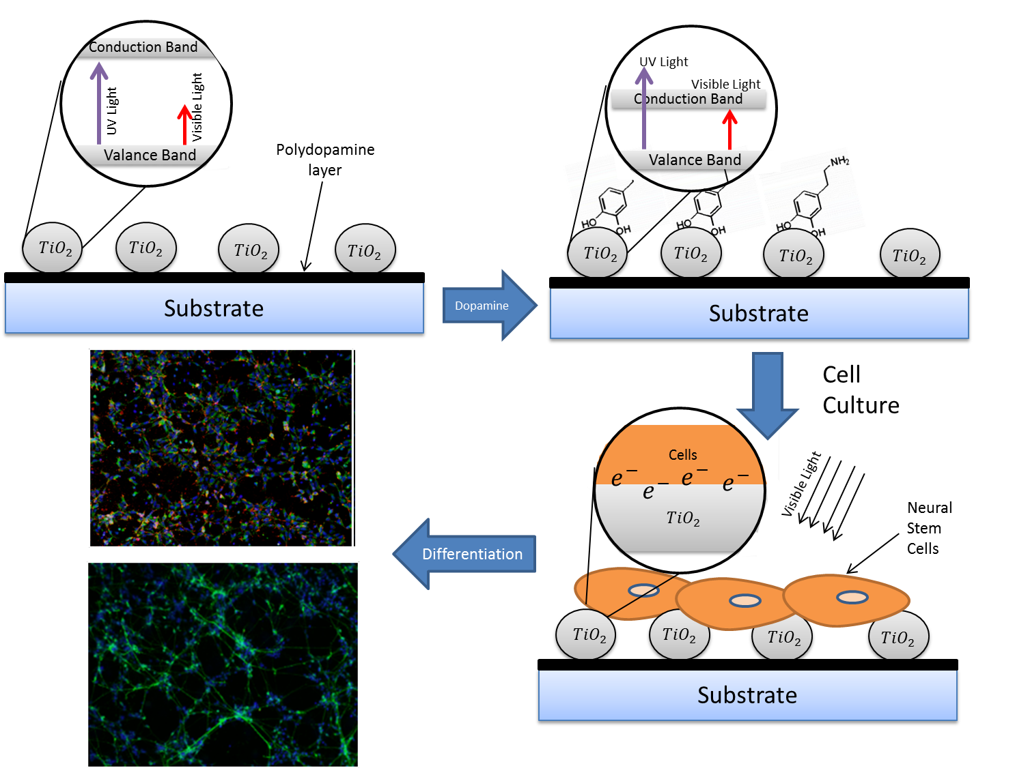
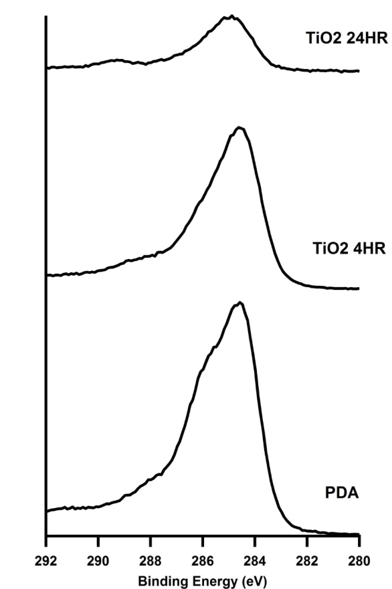
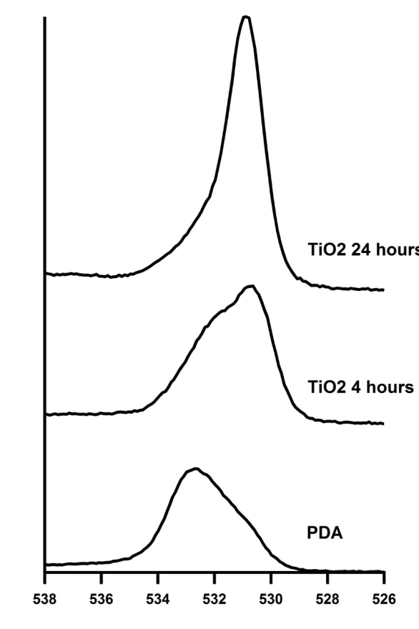
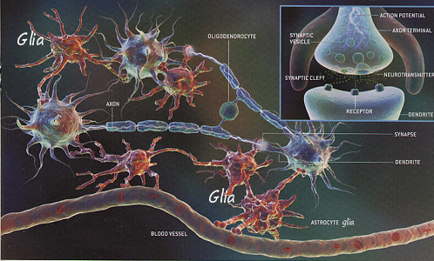
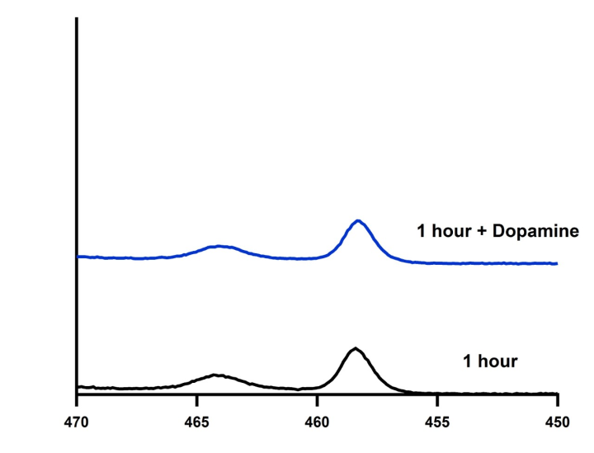
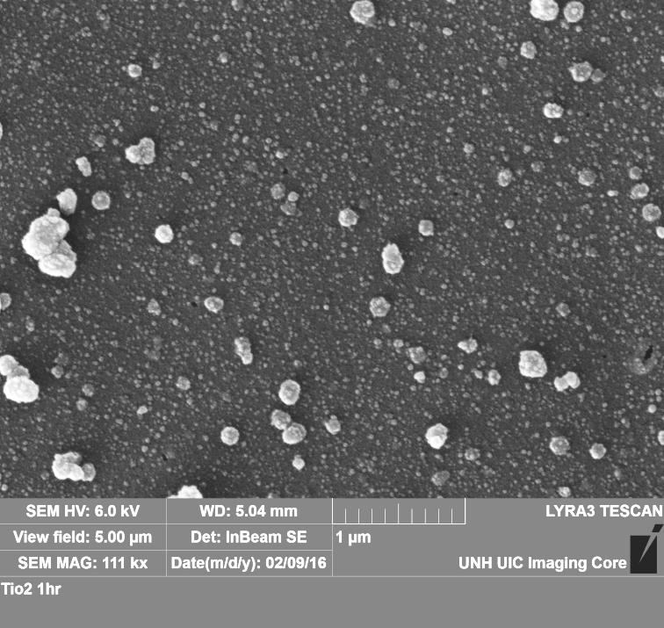
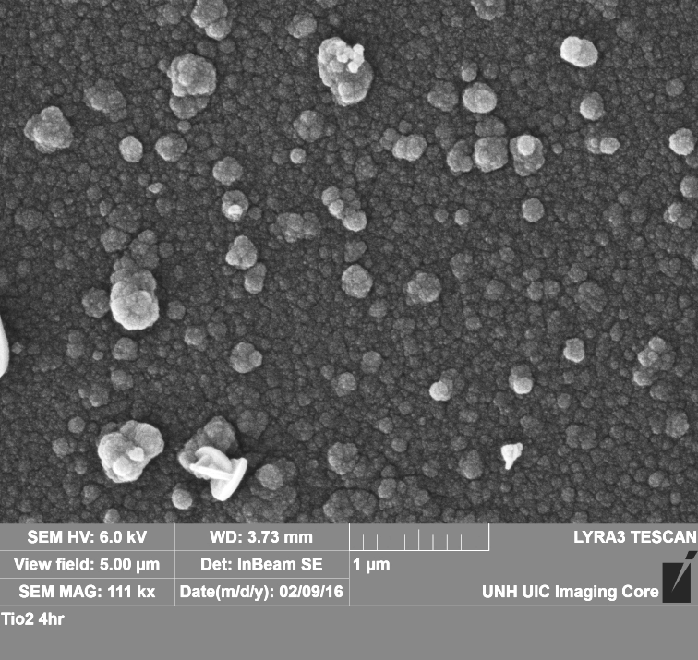
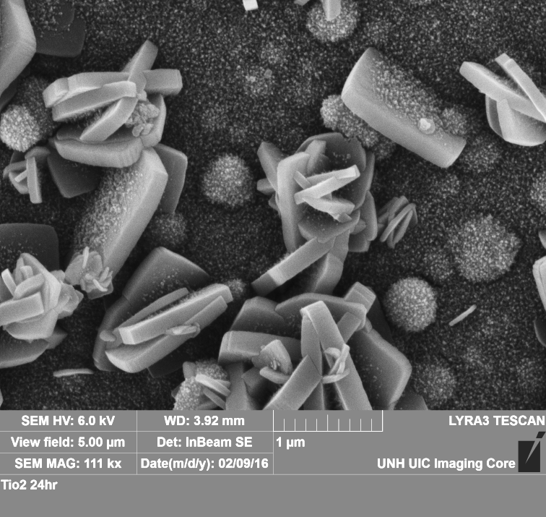
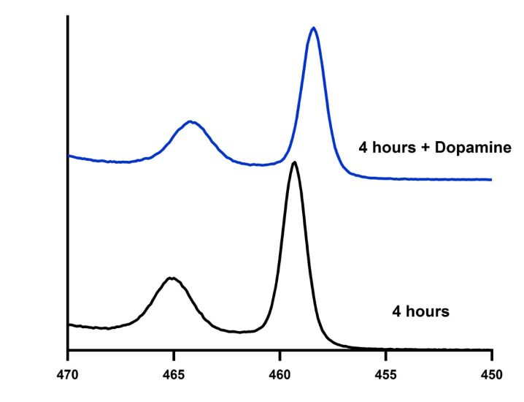
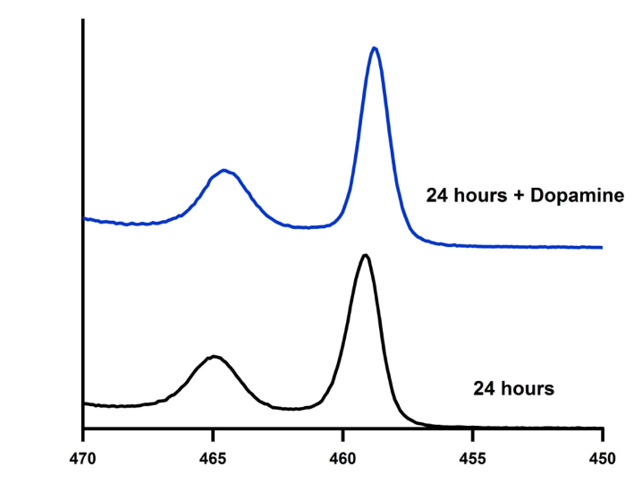
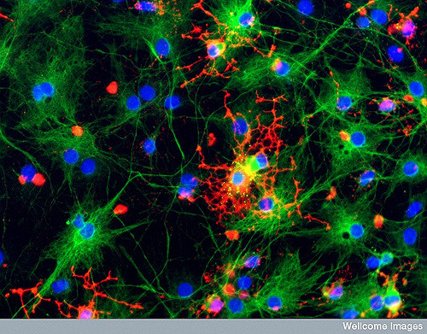
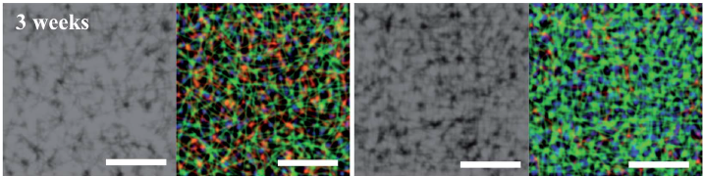
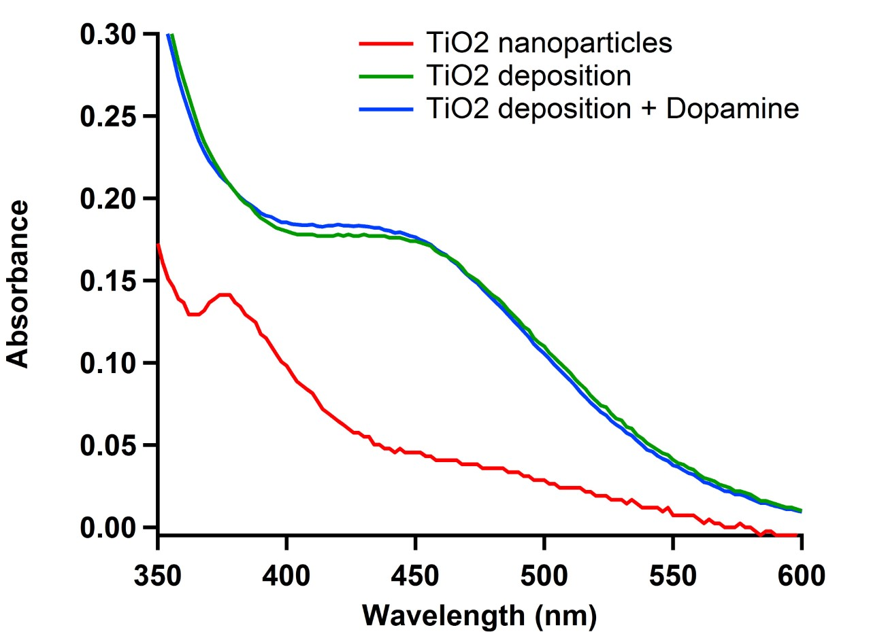
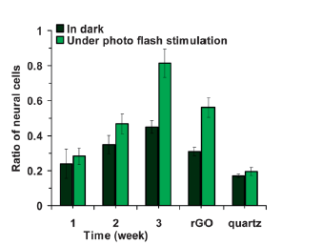
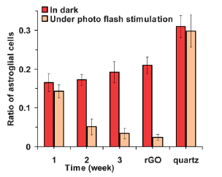
Differentiation of Neural Stem Cells into Neurons by Visible Light‐ Induced Electrical Stimulation
Alison Deyett and Kyung Jae Jeong
Department Chemical Engineering , University of New Hampshire, Durham NH, USA
Abstract
Methods
X-ray Photoelectron Spectroscopy (XPS)
Initial Cell Adhesion
Neural tissue engineering aims to regenerate irreversibly damaged neural systems (either peripheral or central nervous systems) by differentiation of neural stem cells into neurons on three dimensional scaffolds by providing various chemical and physical cues. One physical cue that has received much attention is electrical stimulation by an external electric potential on conducting substrates such as graphene. Electrical stimulation of neural stem cells could also be achieved by UV irradiation on titanium dioxide/graphene substrates. However, UV irradiation is harmful to cells and has many limitations in clinical applications. The goal of this research is to develop a novel method to achieve visible light-triggered differentiation of human neural stem cells (NSCs) into neurons. We have discovered that TiO₂ grown on polydopamine coating shows an absorption peak in the visible light range and that the addition of dopamine shifts Ti 2p peaks to lower binding energy. Visible light-induced free electron generation on TiO₂ and preferential differentiation of hNSCs into neurons will be investigated.
a.
b.
Carbon
Oxygen
d.
c.
hNSCs (passage 3) were added to TiO2-coated surfaces, tissue culture polystyrene (TCPS) coated with a laminin analog (positive control), and unmodified TCPS.
A proliferation assay was run after 24 hours (normalized to the positive control).
TiO₂ (4hour deposition) resulted in 10% proliferation compared to the positive control.
~5 times higher compared to unmodified TCPS.
TiO₂ deposited on a polydopamine coated surface.
TiO₂ cannot be excited by visible light.
b) The addition of dopamine allows electrons to pass under visible light.
c) TiO₂ irradiated with visible light generating surface free electrons, stimulating hNSCs.
d). Fluorescent images of hNSC differentiating
As the reaction time increased the carbon is masked by titanium peak
C1s peaks can be broken into C-C (284.5eV), C-O (~286eV), and C=O (~288eV).
As TiO₂ is deposited on the surface, carbon peak begins to lose some of its characteristic peaks. This is caused by the titanium using the C-O as a binding site.
The oxygen peak changes significantly as the surface is coated with titanium. The bottom peak is representative of what the oxygen peak looks like for polydopamine, while the 24 hour sample peak matches the peak for TiO₂
Background
Summary
Important for the future treatments many neurological conditions: stroke, spinal cord injury, ALS, Alzheimer’s disease, etc.
Scanning Electron Microscopy (SEM )
SEM, EDS, and XPS analyses confirms the growth of TiO₂ on polydopamine coating and the binding of dopamine on TiO₂.
TiO₂ deposition on polydopamine results in a distinct peak in visible range in UV/VIS spectra.
Initial adhesion of hNSCs on TiO₂-modified surfaces is promising.
TiO₂ Deposition - 1hr
TiO₂ Deposition - 4hr
TiO₂ Deposition - 24hr
Titanium
The titanium peak increases with reaction time showing more titanium oxide has been deposited on the surface
The peak also shifts to a lower binding energy in the addition of dopamine.
Future Work
Neural stem cells can be differentiated into two distinct lineages: neurons, or glial cells
Inducing an electric field on the cells can cause them to differentiate toward neurons [1].
Unfortunately inducing electrical field can be cytotoxic [1]
Recently, a novel method to apply an electric field to hNSCs was reported [2].
This method relies on the generation of free electrons on the surface of titanium dioxide (TiO₂) by UV irradiation.
UV which causes chromosomal damages to the cells and has short tissue penetration.
Visible light is not harmful to cells and can penetrate tissue for implantable devices
Further Surface Characterization
XRD to determine if the TiO₂ on the surface is crystalline or amorphous (if want free electrons we need crystalline form)
Further analyze and assess the band gap of the TiO₂ nanoparticles and determine at what wavelength the cells must be irradiated
As the reaction time increased the particle density of TiO₂ also increased.
Crystalline structures begin to form after 24 hours
Energy Dispersion X-ray Spectroscopy (EDS)
TiO₂ Deposited 1hr
TiO₂ Deposited 4hr
TiO₂ Deposited 24hr
Cell Studies
Add YIGSR peptides to the surface to enhance cell adhesion
Perform cell adhesion and differentiation tests to determine the optimum particle density for the cells, analyzed using fluorescence imaging and PCR
Ti peak increases as the reaction time increases.
As the reaction time increases the silicon, oxygen and aluminum peaks decrease.
Overall
Absorbance
380nm (which corresponds to 3.2eV)
References
420-430 nm which corresponds to ~2.8eV
[1] Heo C and Yoo J. "The control of neural cell-to-cell interactions through non-contact electrical field stimulation using graphene electrodes" Biomaterials (2011) 32, 19-27.
[2] Kobelt LJ, Wilkinson AE, McCormick AM, Willits RK and Leipzig ND. “Short duration electrical stimulation to enhance neurite outgrowth and maturation of adult neural stem progenitor cells”. Annals of Biomedical Engineering (2014) 42, 2164–76
[3] Douglas Fields. “The Other Half of the Brain.” Scientific American (2004)
[4] Omid Akhavan and Elham Ghaderi. “Differentiation of human neural stem cells into neural networks on graphene nanogrids.” Journal of Material Chemistry (2013) 1, 6291.
Deposition of TiO₂ on polydopamine substrate results in a peak in the visible light range (420~430nm).
The addition of dopamine slightly increases the peak.
As Reaction time increases:
Carbon- increase
Oxygen- Steady
Titanium Decrease
Acknowledgements
Above: NSCs were differentiated for 3 weeks. Blue represents cell nuclei, green neurons and red glial cells. The surface on the left was not under electrical stimulation while the one to the right was under electrical stimulation
Shujie Hou, Department of Chemical Engineering
Salimah Hussien, Department of Bioengineering
Nancy Cherim, University Instrument Center
Greg Lin, Center for Nanoscale Science, Harvard University

