Slide 1
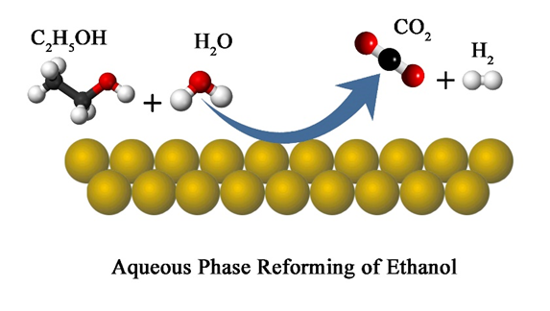

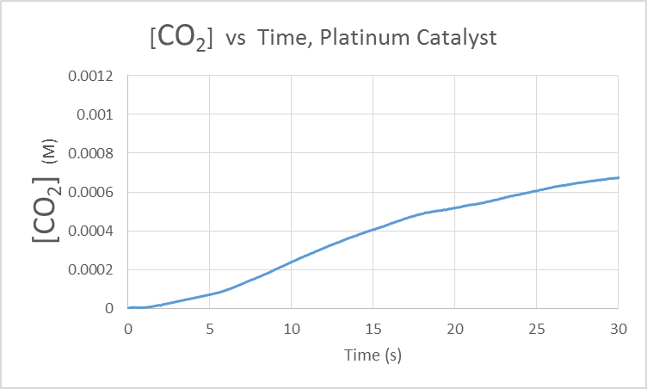
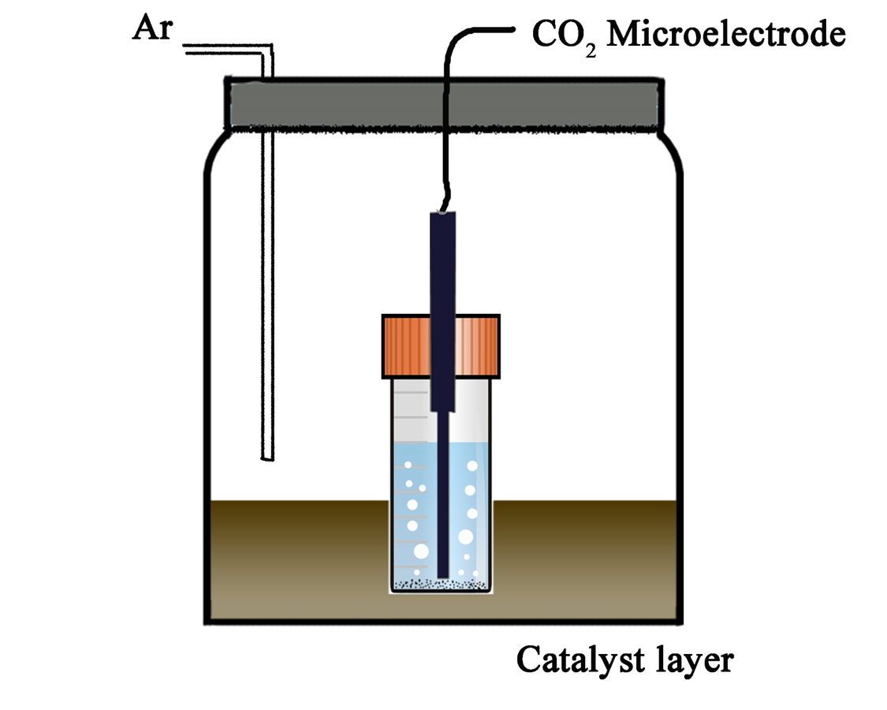
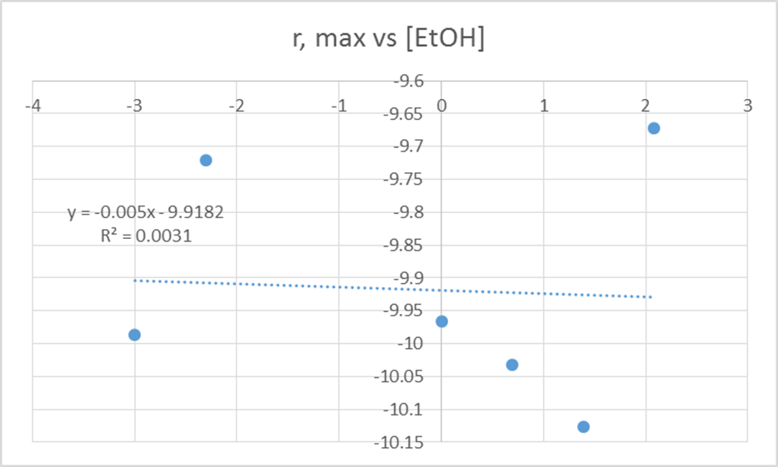
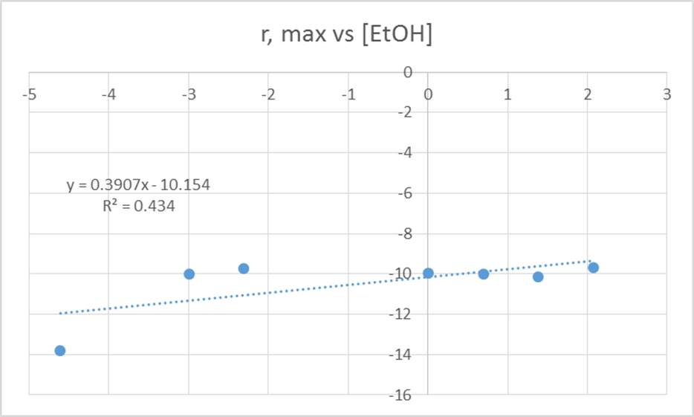
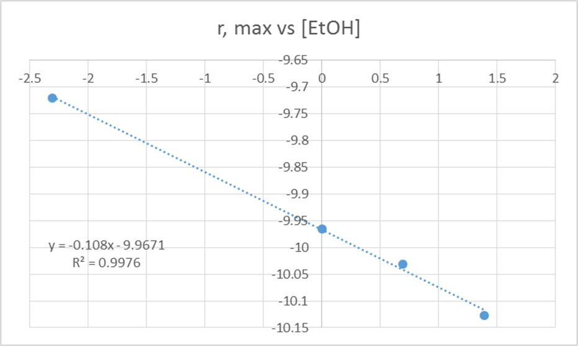
Reformation of Ethanol
Supported by NSF grant #1132648
Stephen Pascucci¹, Xiaowei Teng², Guangxing Yang²
¹Farmington High School, Farmington, NH
²Dept. of Chemical Engineering, University of New Hampshire, Durham, NH
4.0 pH Testing For Acetic Acid
The reformation of ethanol is expected to involve a number of intermediate species, some of which may interfere with the performance of the noble metal catalyst. Catalyst performance is of key concern and the production of an intermediate that would poison the catalyst would be a condition to be identified and dealt with. One intermediate of particular concern is acetic acid (CH₃COOH).
In trial after trial, it was recognized that the catalytic reformation of ethanol was quickly becoming inhibited early on in the process. The decision was made to run trials monitoring the pH of the solution rather than its [CO₂].
This testing yielded pH values in the 2-4 range, which though it is a wide range, strongly indicates that acetic acid, if it is an intermediate species, is present in rather high concentration.
1.0 Background
In 2014, the transportation sector was responsible for 26% of carbon dioxide emissions in the United States (epa.gov). Additionally, the United States imports about a quarter of the oil needed for our domestic transportation sector (eia.gov). In light of the political and social instability in so many oil-producing regions in the world and the ties between oil, the economy, national security, and foreign intervention, there remains the need for a domestic fuel source that will decrease the Unites States’ reliance on imported petroleum products. Additionally, increasing home-grown resource production, while decreasing the volume of imports, will also provide jobs, help keep financial investments in the country, and strengthen the United States economy.
Ethanol is produced through the fermenting of corn and other biomass which are 100% home-grown resources that supports both the agricultural sector and private industry. Because biomass derives its carbon content from atmospheric carbon dioxide, the use of ethanol as a fuel source represents a carbon neutral process. This is very important as we work to limit global carbon dioxide emissions and slow global warming. Additionally, ethanol is relatively less toxic than both crude oil and refined petroleum products such as gasoline making production, transportation and accident response less costly.
The objective of the larger body of research is to enable ethanol use as a fuel in a high-efficiency process that is safe and economical. The production of hydrogen gas from ethanol and its subsequent use as a fuel in a high-efficiency combustion process has the ability to radically change the world’s transportation sector as well as its economy. This research centers around producing hydrogen from ethanol in an affordable, room temperature reaction that can be scaled for automotive use.
3.0 Determining Rate Order
The determination of the reaction rate order for the reformation of ethanol has the potential to give an insight into the reaction mechanism and its behavior. The approach begins with the standard rate equation,
(1) rate = k[CH₃CH₂O]^{n}
rate = reaction rate
k = reaction rate constant
[CH₃CH₂O] = concentration of ethanol
n = reaction order
Using equation (1) as a starting point, a second equation may be derived,
(2) ln r = n ln [CH₃CH₂O] + ln k
Recorded time, t, and [CO₂] data will be used to calculate a maximum reaction rate, r_{max} , for each established [CH₃CH₂O].
5.0 Conclusions
Results from determination of the reaction’s rate order gave n = -.1. While based on limited data, this rate order does indicate a couple of key points regarding the reformation process: 1) the reformation of ethanol likely involves multiple intermediate species involved in multiple reaction steps and 2) the negative value indicates that as the initial concentration of ethanol increases, the reaction rate decreases.
This is consistent with what we know about the ethanol reformation process. The reaction has the ability to produce at least CH₃COOH and CH₃COH. Additionally, it is expected that other intermediates, fragments of the parent compound, are formed to some degree.
One potentially complicating reaction intermediate, acetic acid, is strongly tied to the poor enduring performance of the platinum catalyst. With a rapid initial production of CO₂, it is speculated that H₂ production is also high at first. However, the maximum reaction rate is reached within minutes of starting the reaction. This indicates a degradation of the platinum catalyst as it is increasingly unable to complete the reformation process. This may be the reason why a negative reaction order has been seen for this process—a higher initial ethanol concentration results in a more rapid formation of intermediates that contribute to the poisoning of the catalyst and subsequent slowing of the formation of carbon dioxide and hydrogen gas.
In making recommendations, an nmr analysis of the solution as the reaction takes place may go a long way to providing information about what species are present. Also, a post mortem examination of the catalyst may yield information regarding the nature of the poisoning of the platinum catalyst.
r, max
[CH₃CH₂O] | r, max | ln [CH₃CH₂O] | ln (r, max)
0.01 | 1.00E-06 | -4.61 | -13.82
0.05 | 4.60E-05 | -3.00 | -9.99
0.1 | 6.00E-05 | -2.30 | -9.72
1 | 4.70E-05 | 0.00 | -9.97
2 | 4.40E-05 | 0.69 | -10.03
4 | 4.00E-05 | 1.39 | -10.13
8 | 6.30E-05 | 2.08 | -9.67
2.0 Process
A vial of distilled water will be purged with argon to remove dissolved carbon dioxide so that [CO₂] = 0. Then, a catalyst layer of noble metal (Pt)-coated activated carbon will be deposited on the bottom of the vial. With [CO₂]₀ established, the Ar stream is used to maintain a noble gas atmosphere. An amount of ethanol is added to the solution establishing [CH₃CH₂O]₀ and the reaction is allowed to proceed (duration 4-8 hours).
The progress of the ethanol reformation reaction will be monitored by measuring the concentration of carbon dioxide dissolved in the aqueous solution, [CO₂]_{t} , with a 5s time interval.
From this data, a scatterplot can be made and a linear trend line applied. The Excel-derived equation for the trend line gives a slope, n, where n = reaction order.
In evaluating the data, the R-constant indicating how well the points fit the trend line remained very low, giving a low confidence to the Excel-calculated value n. Because there did not remain enough time to run enough trials to acquire more data points, outliers were removed from the set.
6.0 References
Effects of Re addition upon aqueous phase reforming of ethanol over TiO2 supported Rh and Ir catalysts, Toshiaki Nozawa, Akihiro Yoshida, Shiro Hikichi, Shuichi Naito*
Aqueous phase reforming of ethanol and acetic acid over TiO2
supported Ru catalysts, Toshiaki Nozawa, Yuichi Mizukoshi, Akihiro Yoshida, Shuichi Naito∗
Platinum-Tin Oxide Core-Shell Catalysts for Efficient Electro-Oxidation of Ethanol, Dr. Xiaowei Teng, Guangxing Yang.

