Slide 1
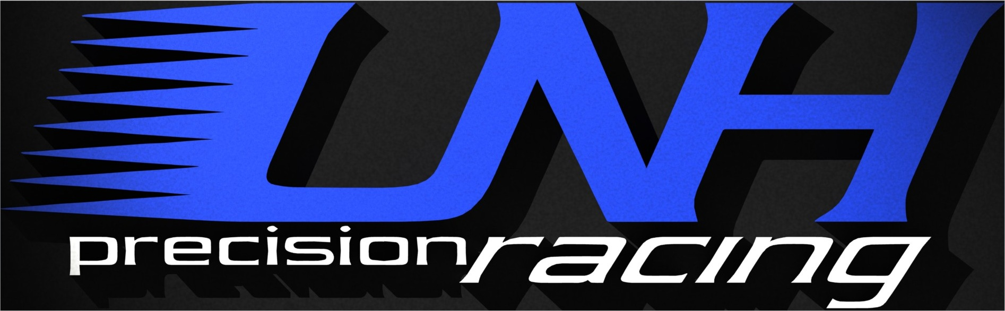
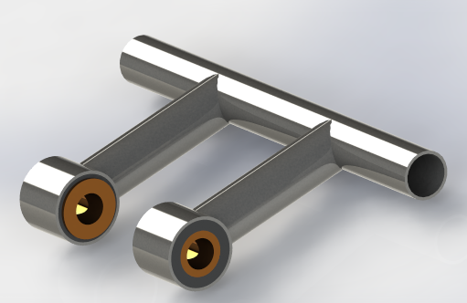
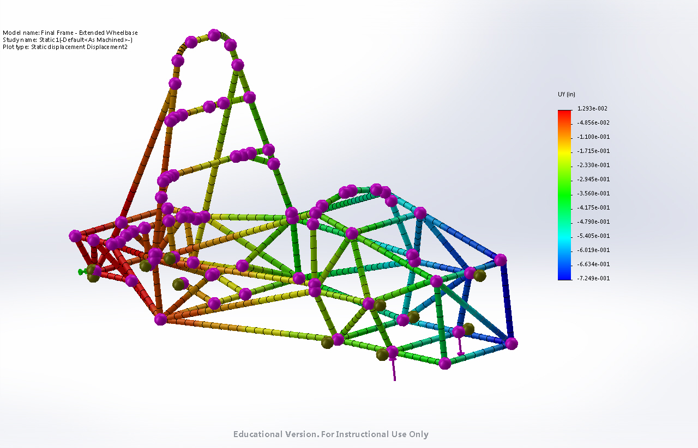
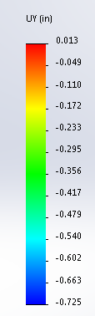

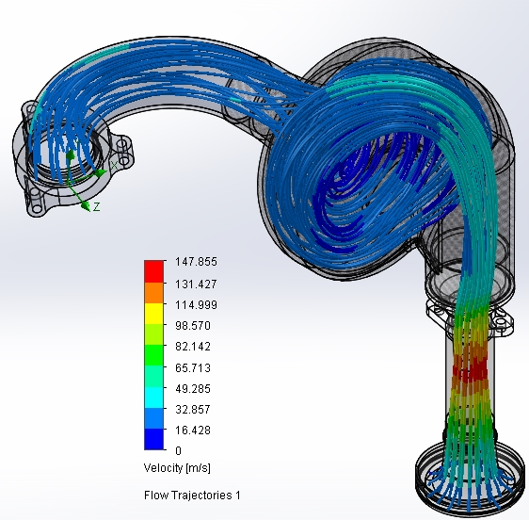
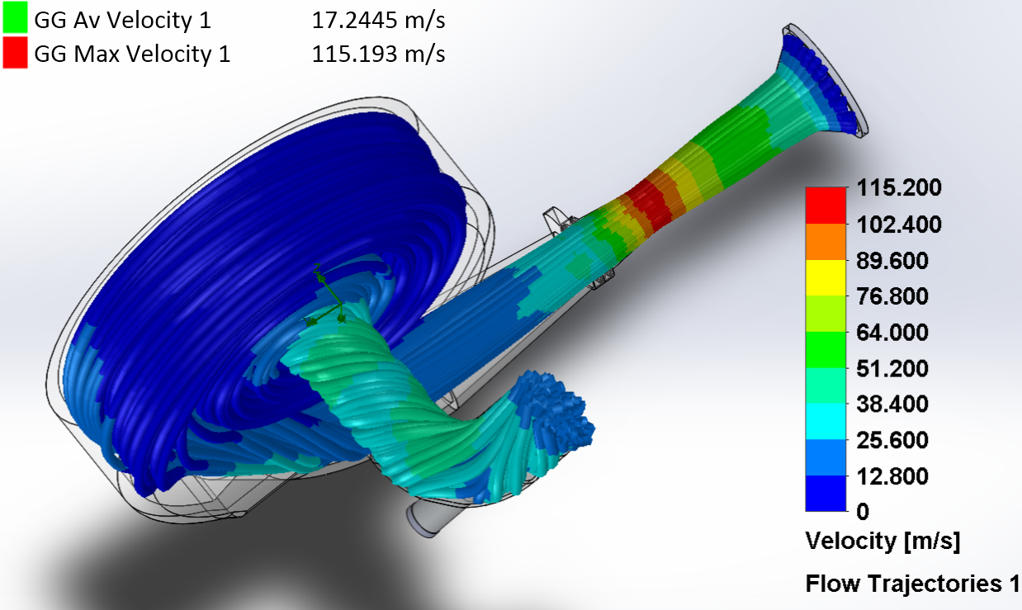
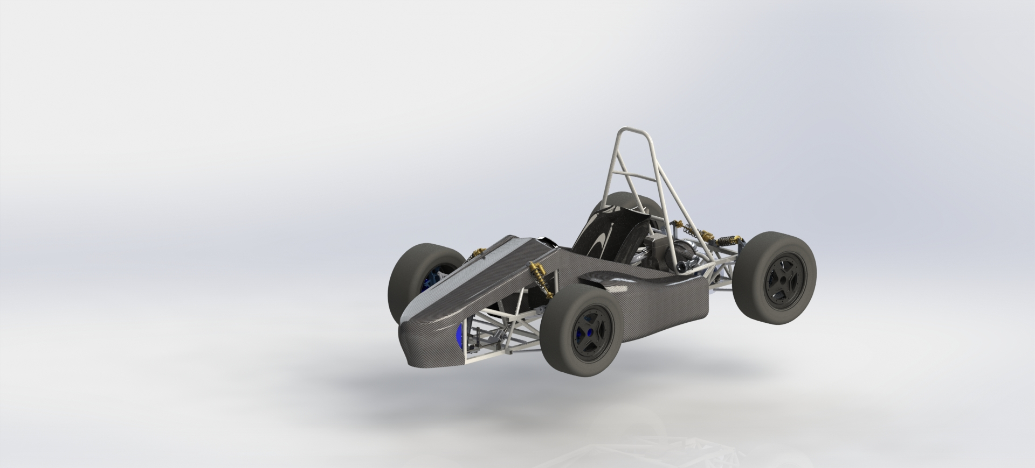
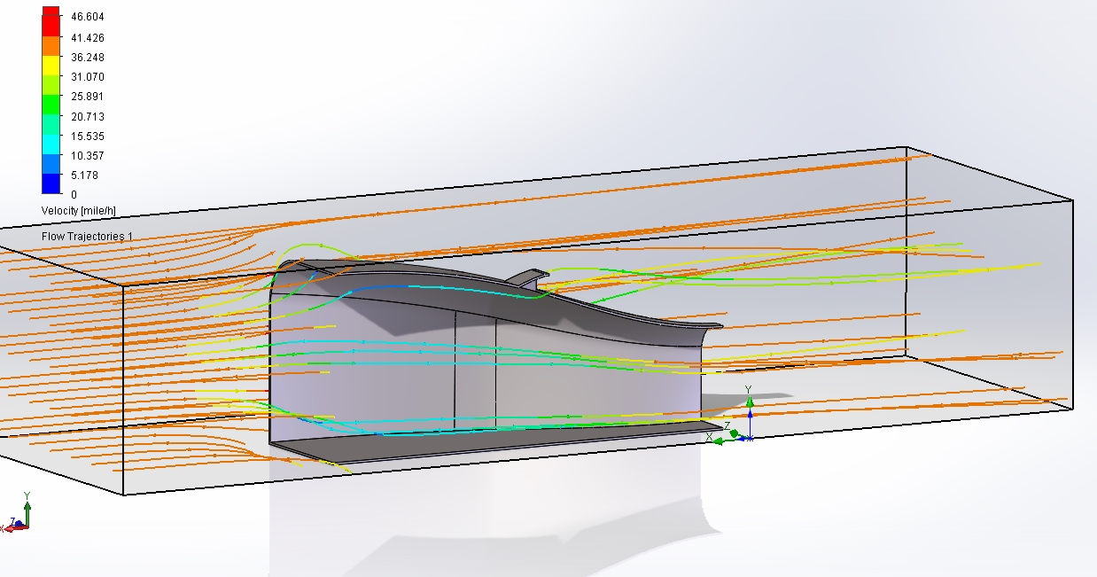
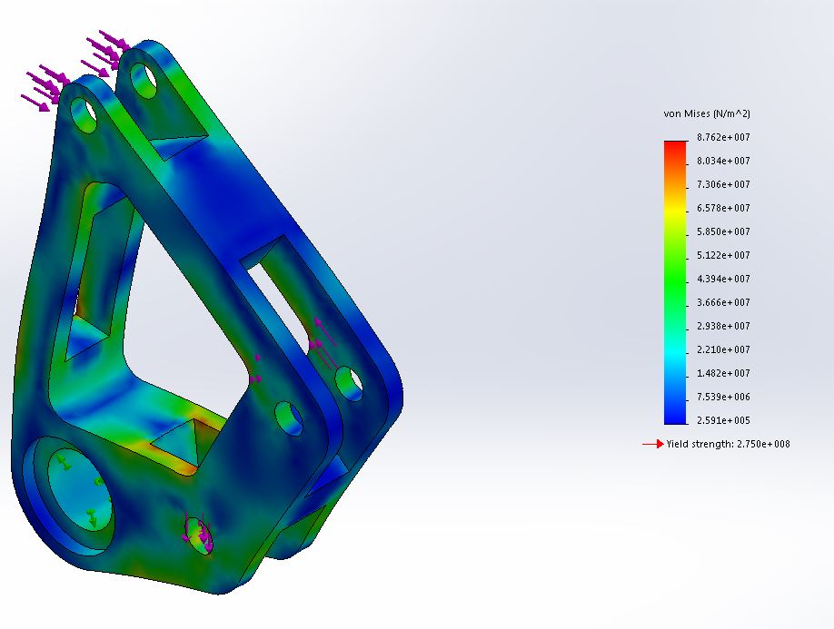
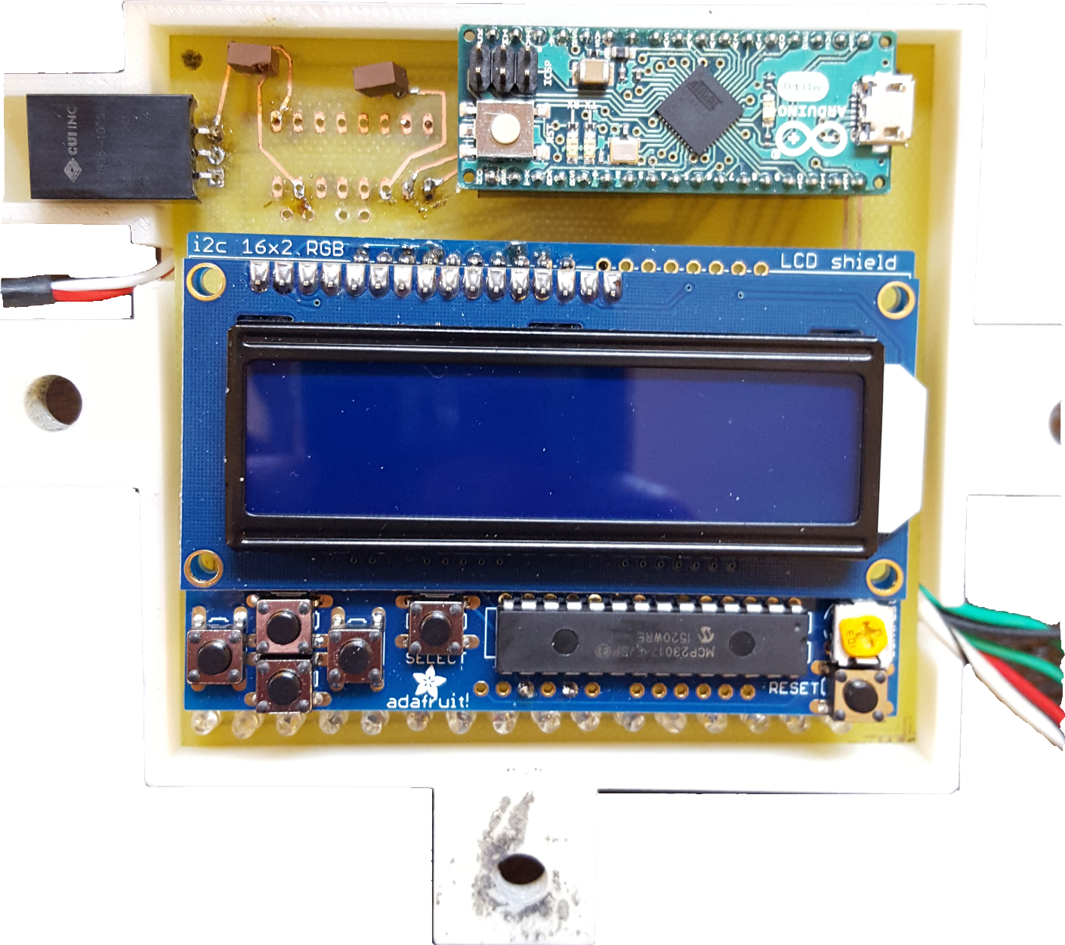
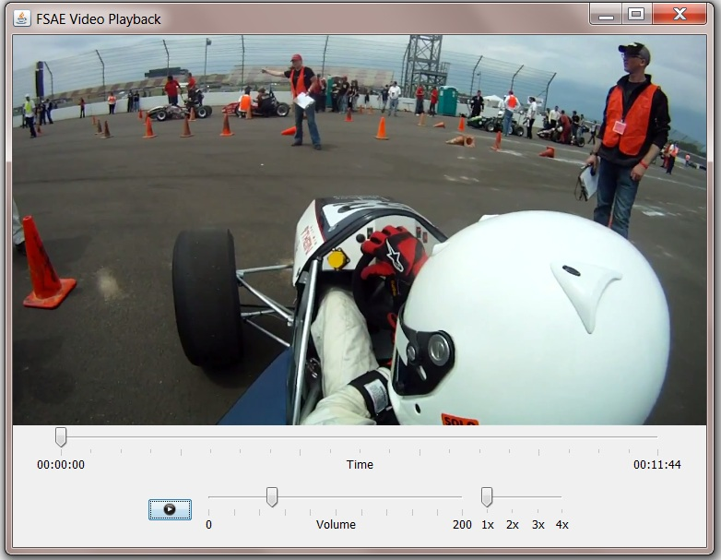
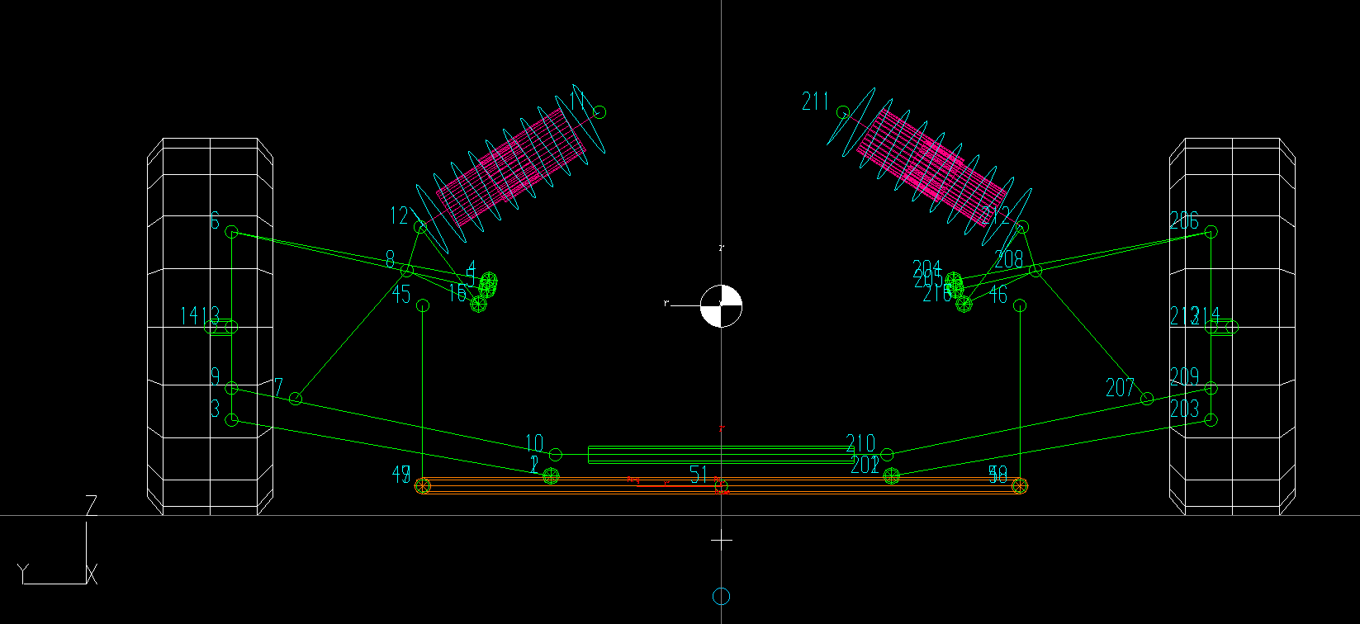
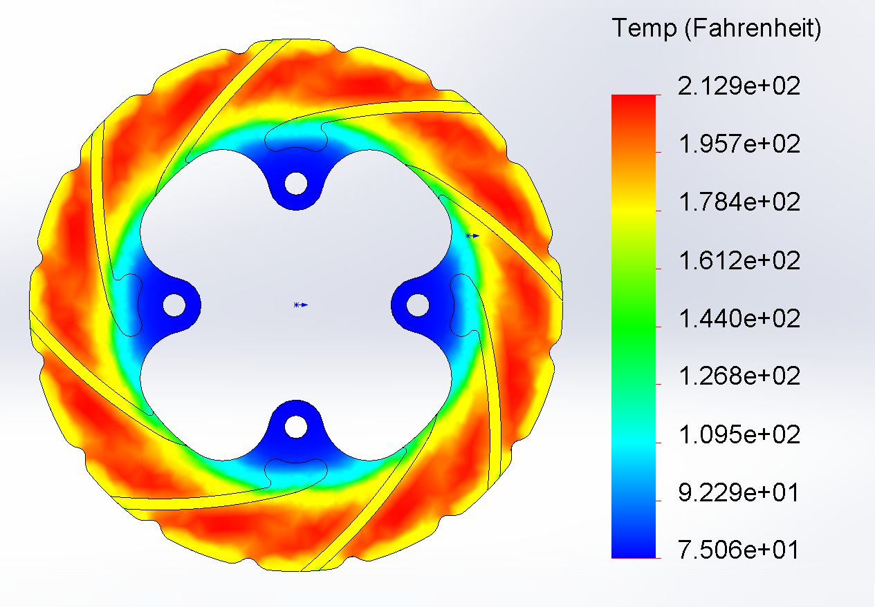
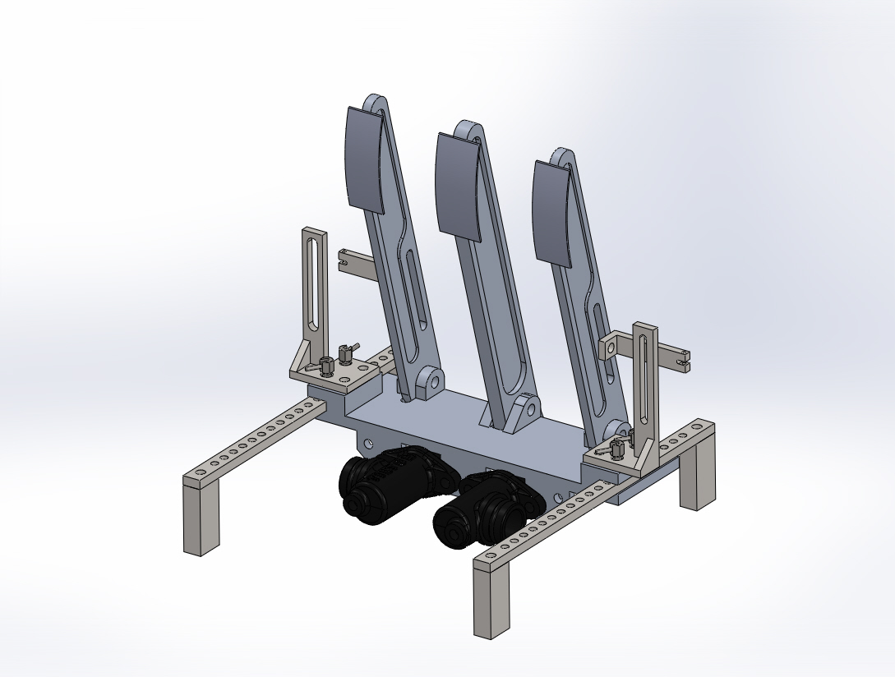


Frame
Engine & Drivetrain
Redesign of rear to accommodate internally mounted differential
Lower center of gravity and decreased torsional rigidity 15%
Frame design optimized with simulation models for stress and deflection
GTAW (TIG) welded joints for high strength and increased productivity
Engine: 2011 Yamaha YFZ-450r:
  Rebuilt entire engine: all new cylinder, head assembly, gaskets and bolts.
Spiral Plenum Design:
  RAM air induction
  Induced vortex for air/fuel mixture turbulent flow
  Matched Helmholtz resonant frequency at max power; 8,000 RPM
Drivetrain:
  Adjustable differential carrier for chain tension and axle placement
  13/40 Tooth Rear Drive ratio calculated to improve drivability and gear efficiency. Top speed increased to 75 mph from 65 mph
  Neoprene engine mounts; dampen engine vibration
Neoprene Engine Mounts
Nodal Torsional Stress Analysis Modeled in SolidWorks
Torque Applied to Frame:
4,215 lb-in
Deflection in Vertical Direction:
0.013 in
Torsional Rigidity: 7,971.8 lb-in/deg
College of Engineering and Physical Sciences
Mechanical Engineering Department
Presented By:
David Bourcier Joe Coleman
Luke Desmarais Nathan Hall
Keith Murray Chris Wall
Brett Gervais Ryan Boulay
Carlton Wolfe Evan Duane
Rob Salisbury Michael Huber
2016 Intake Air Flow Analysis
2014 Intake Air Flow Analysis
Aerodynamics
Faculty Advisor: Todd Gross
All components of body manufactured from E-Glass/Epoxy Composite
Reduced overall body weight by 20%
Streamlined body and nose to reduce drag
Nose cone designed in order to provide air ducting to sidepods
Manufactured using fiberglass gelcoat molds
Manufacturing process provided smooth surface finish without body filler
Reduced overall cost of manufacturing by 54%
2016 Car #022
Flow Velocity Simulation of Sidepod
Suspension
Push-Rod Type Suspension Geometry
  Roll centers optimized for stability in vertical and horizontal direction
  Motion ratios designed for linear movement throughout all wheel travel
Code Developed for Calculation of all Suspension Parameters
  Front and rear spring rates
  Maximum wheel displacement during cornering
New Components Designed
  Front and rear Bell-Cranks constructed from 6061-T6 Aluminum
  3-D Printed front and rear Bell-Cranks constructed from Titanium
Controls
Electronics
Yield Stress Analysis of Rear Bellcrank
Developed Lightweight Mechanical Linkage Shifting System:
  Developed three part, aluminum shift linkage system
  Improved feedback to driver through low friction bearings
  Increased speed of gear change by reducing shift lever travel
Adjustable Three Pedal (Throttle, Brake, Clutch) System:
  Improved ergonomics for different drivers
  Integrated brake-bias to adjust front and rear brake percentages
Designed Slotted Disc Rotors
  Improved safety with increased thermal stress resistance through design and material selection (stainless steel to Durabar-G2 pearlitic gray cast iron)
  Reduced brake fade with HH friction rated sintered copper alloy brake pads
Custom Arduino powered dash display which monitors the following:
  Engine coolant temperature
  Tachometer reading
  Battery Voltage
Set of LED’s which indicate when to shift
Full Custom Wiring Harness With Modular Power Distribution
Custom LCD Dash with LED Indicators
Synced Video Feedback from GoPro
Front Suspension Geometry Modeled in Lotus
Brake Rotor Thermal Load Study
Adjustable Pedal Assembly
Special Thanks to: Hitchiner, NHBB, Hutchinson, Diamond Casting & Machine Co., QA Technology, Wayne Towle Master Finishing & Restoration, EFI Express, Whelen, Dreher, UNH CEPS, Todd Gross, May-Win Thein, Scott Campbell, Tracey Harvey, Sheldon Parent, Sheri Millette

