Slide 1

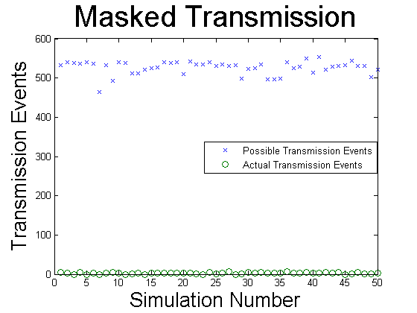
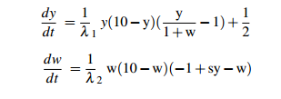
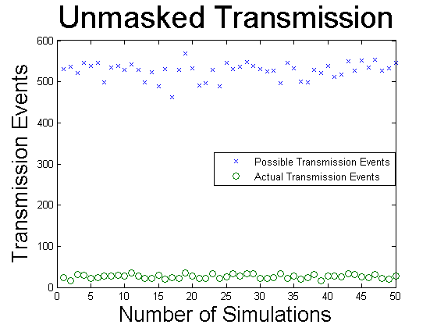
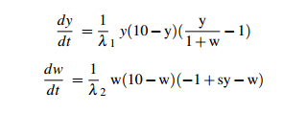
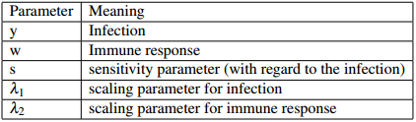
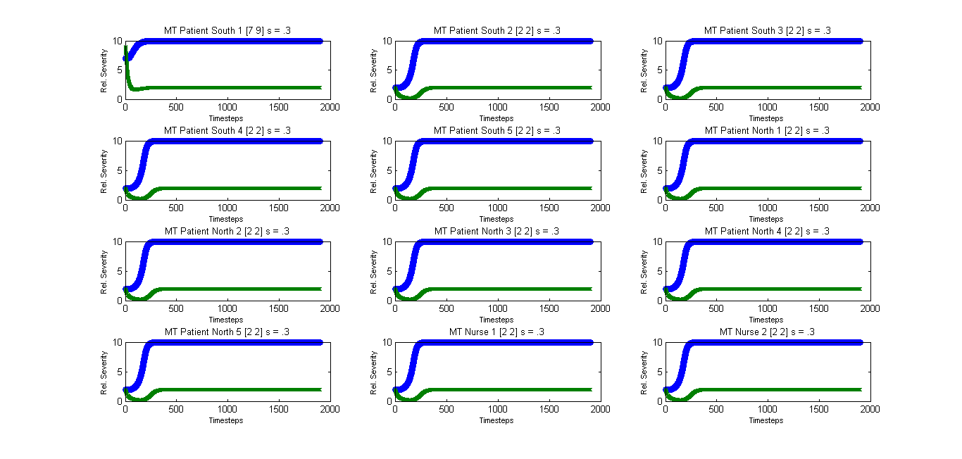
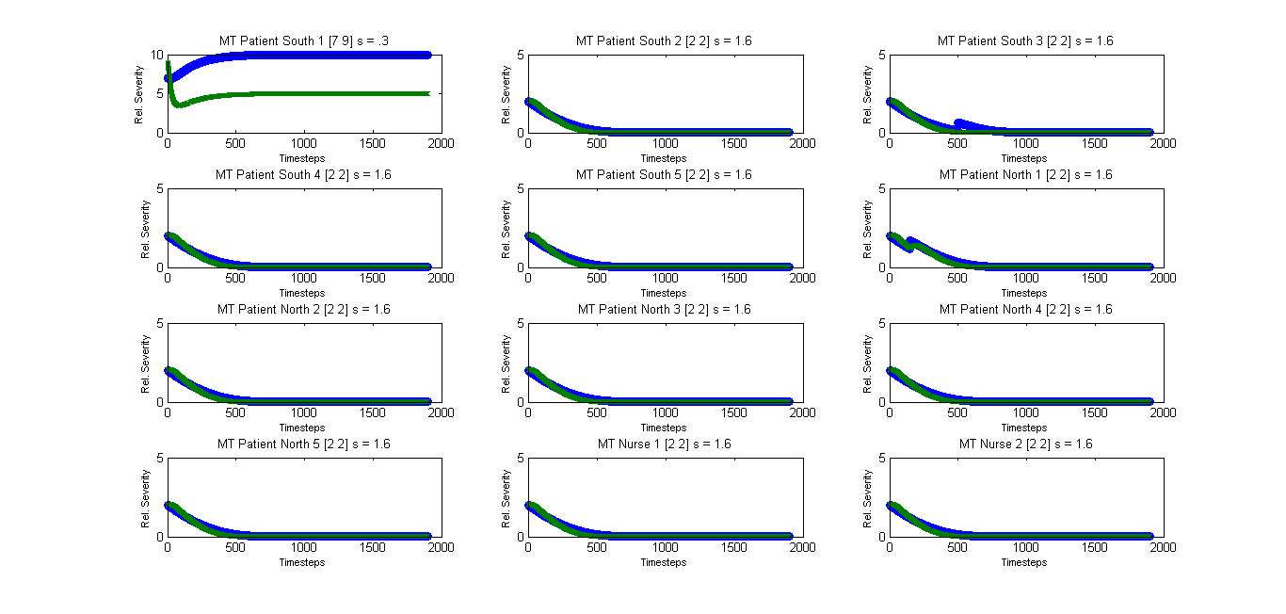
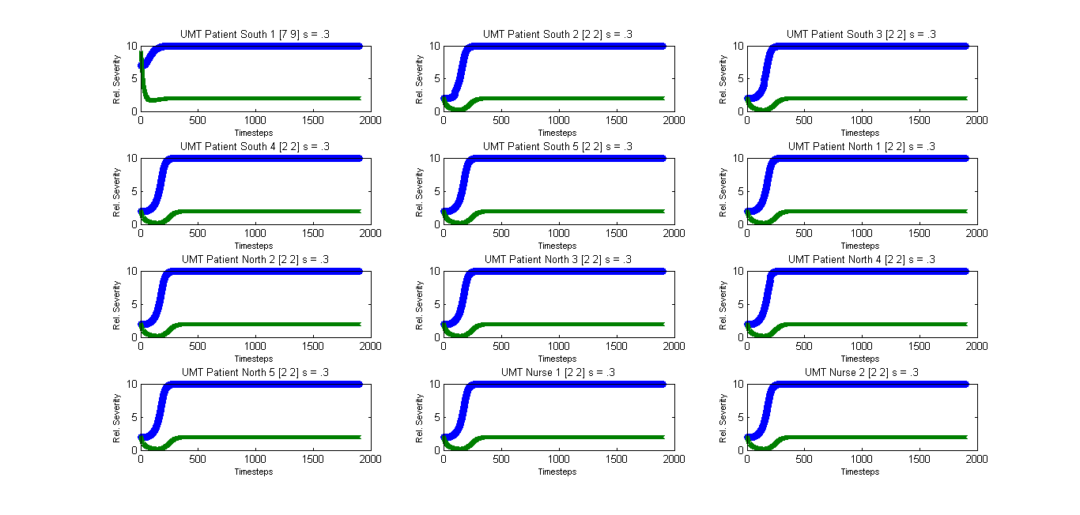
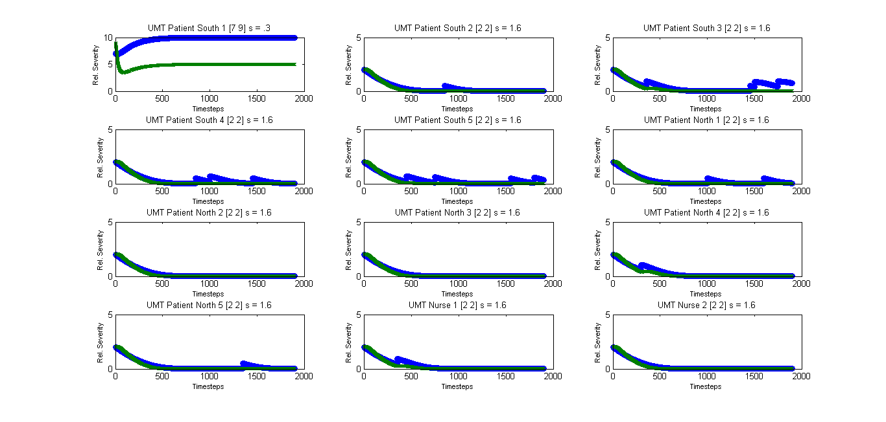
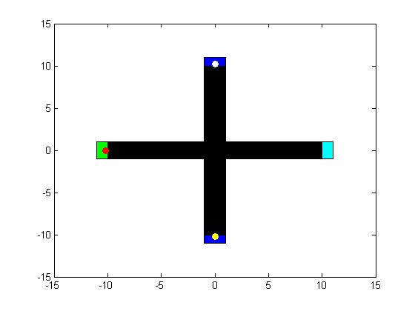
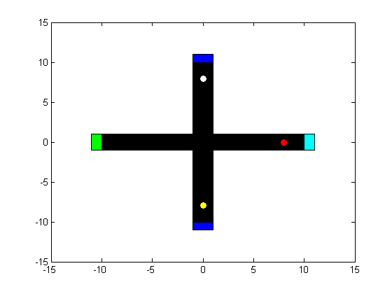
Modeling Nosocomial Disease Outbreaks using Differential Equations and an Agent Based-Modeling Approach
Cody FitzGerald, Adam Boucher
Mathematics Department, University of New Hampshire
ABSTRACT
TRANSMISSION MECHANICS
MASKED VS. UNMASKED TRANSMISSION
A nosocomial infection is an infection that a patient develops while in a hospital or healthcare related setting, also known as a hospital acquired infection (HAI). According to the CDC in 2011, of the patients that developed HAIs nearly 10% eventually died. This project has two foci: firstly to model the progress of a HAI within an individual, then secondly to understand community-level propagation effects of the infection within a hospital ward. An analysis of a novel system of coupled nonlinear ODE's (representing the HAI attack and immune response within an individual) was first completed. After, the dynamic behaviors of these models were fully characterized, an agent based-modeling approach was used to understand community level dynamics in a small hospital ward including the effectiveness of masks to limit successful disease transmission.
There exists one ‘patient zero’ in the system coughing on a schedule .
For a given cough position (x,y), a rectangular “splash-zone” is created.
The “splash-zone” is a unit rectangle centered at the cough location.
If another agent is in the “splash-zone” during a cough, there an associated transmission probability
Transmission probability without masks = 10%
Transmission probability with masks = 1%
If the transmission event is successful, the model changes slightly:
THE MODEL
Equilibria are dependent on s
MASKED TRANSMISSION DYNAMICS RESULTS
FUTURE DIRECTIONS
Vary the value of s depending on agent classes.
Randomize the value of s.
Run the simulation over a longer period of time.
Create more complex multi-agent transmission dynamics.
Adjust the intensity of the “penalty” associated with a transmission event.
METHODS
The system includes 10 patients, 2 nurses, a healthcare worker office, a dining/recreation center, and two bedroom units each housing five patients
Each individual is assigned a randomized schedule and a coupled nonlinear ODE with a sensitivity parameter.
A day is simulated exposing the agents to transmission events without any mask
Another day is simulated with all agents wearing masks to limit transmission events.
UNMASKED TRANSMISSION DYNAMICS RESULTS
RESULTS
AKNOWLEDGEMENTS
I would like to thank Dr. Adam Boucher for offering his time and guidance on this project as well as the University of New Hampshire Honors Program.

