Slide 1

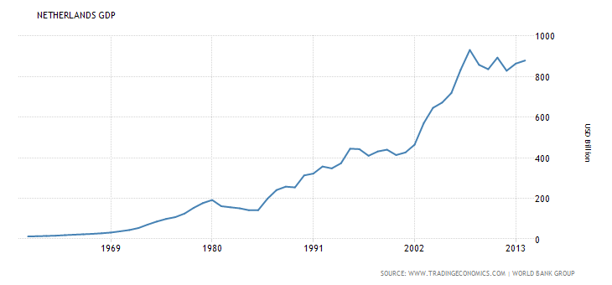
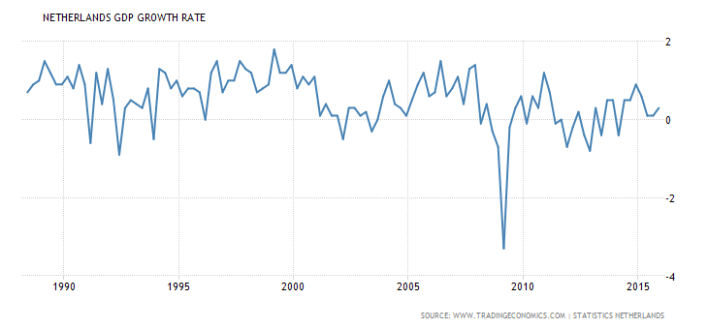
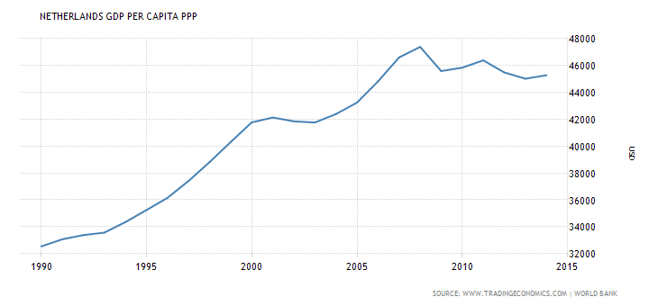
Macroeconomic Analysis of
The Netherlands
Christopher Tveter
Macro-Moneyproject, Econ 611, Dr. Wible, Spring 2016
The Netherlands - Introduction
Graphs
Methods
18th largest economy in the world and uses the Euro as a currency since January 1st, 1999, when the Dutch joined the EMU and switched over from the Gulden.
The Netherlands have a prosperous and open economy, which depends heavily on foreign trade
Netherlands Total GDP 1960-2013
Studied the total GDP of the Netherlands before and after the introduction of the Euro
Studied the GDP growth rate of The Netherlands before and after the introduction of the Euro
Studied the GDP per capita PPP of the Netherlands before and after the introduction of the Euro
Studied the ECB policies to help the EU overcome the Great Recession of 2007-2009
Netherlands GDP Growth Rate 1990-2016
Hypothesis Questions
Conclusions
What impact did switching currencies have on the Dutch economy, and Dutch citizens?
Did lending Greece money help or hurt the Dutch economy?
Should the Netherlands stay with the EU and EMU?
What is the ECB doing to help the European economies ?
In the end, was the Netherlands better of before or after it joined the EU and EMU?
The Dutch total GDP grew exceptionally due to the introduction of the Euro, this can be explained with the Ricardian model of international trade
The Dutch citizens lost a lot of purchasing power due to switching to the Euro
Lending Greece money helped stabilize the value of the Euro, which in the end was better for the Dutch economy according to Nobel Prize winning economist Joseph Stiglitz
The ECB is using negative interest rates to try and let businesses and weaker lenders to borrow money, and hope this will lead to economic growth because of more money being spend than is being saved
Netherlands GDP Per Capita PPP 1990-2015
.

