Slide 1

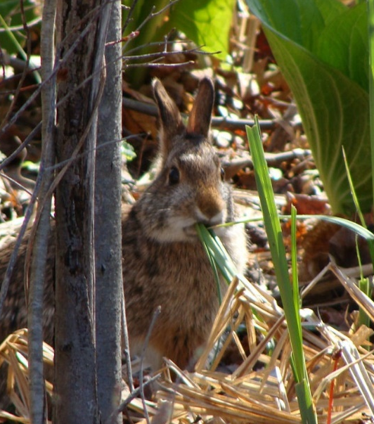
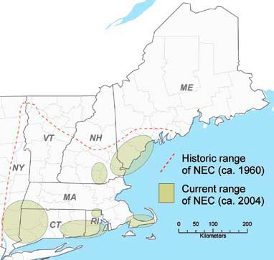
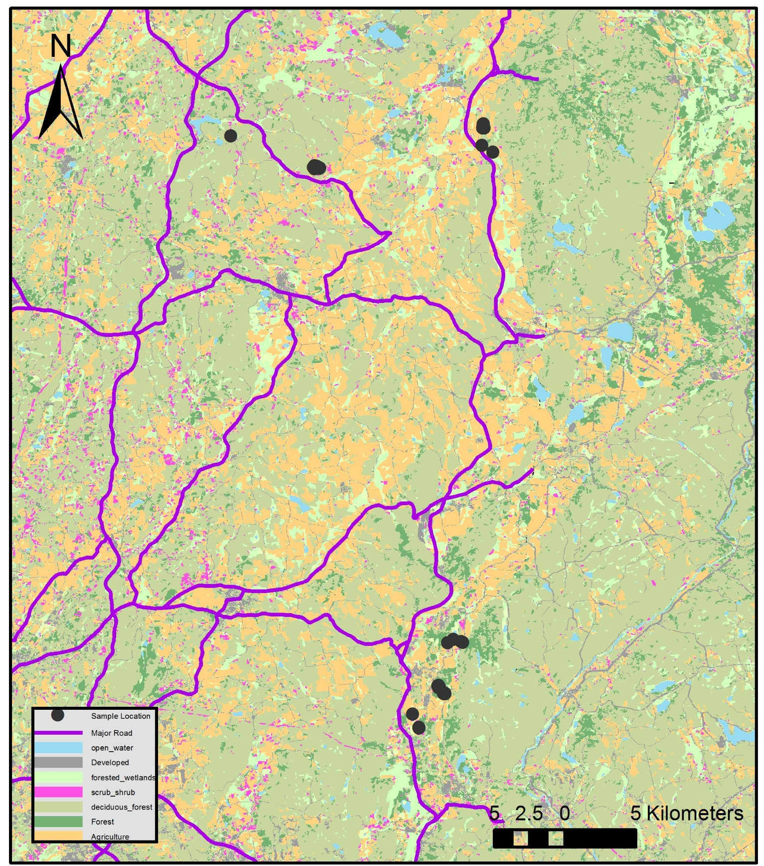
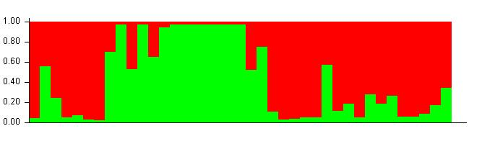
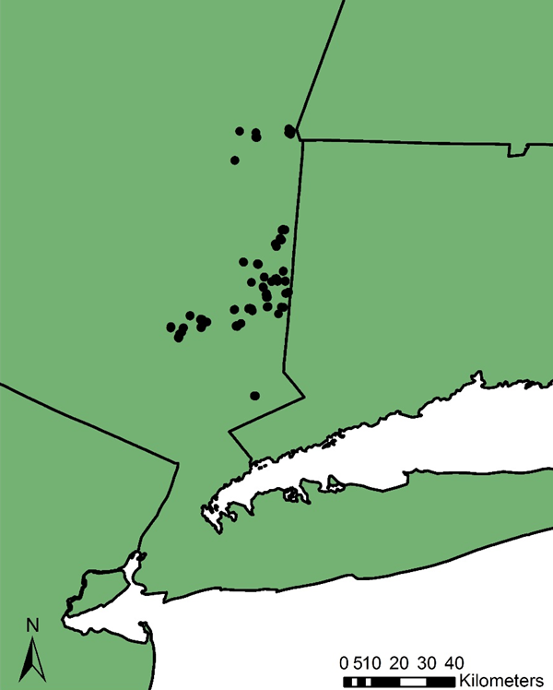
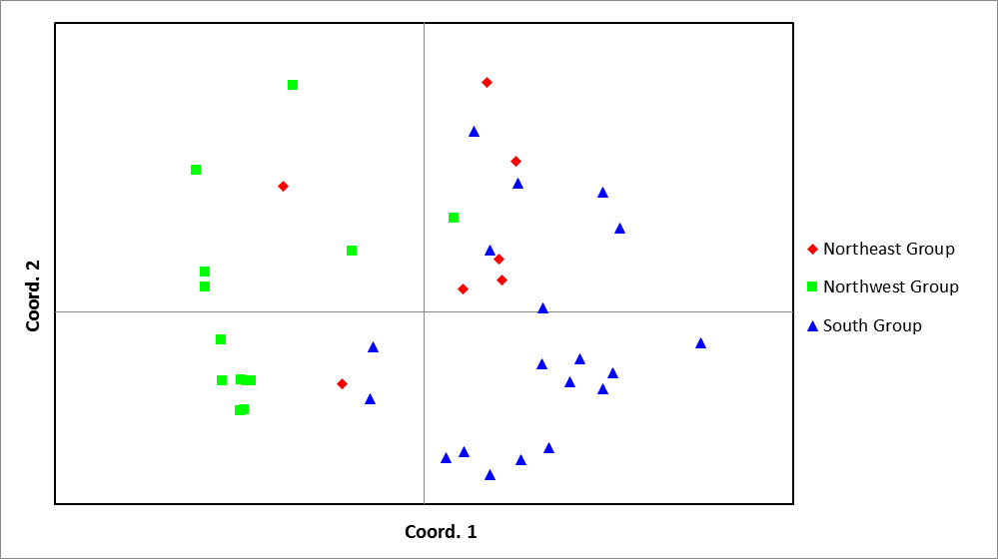
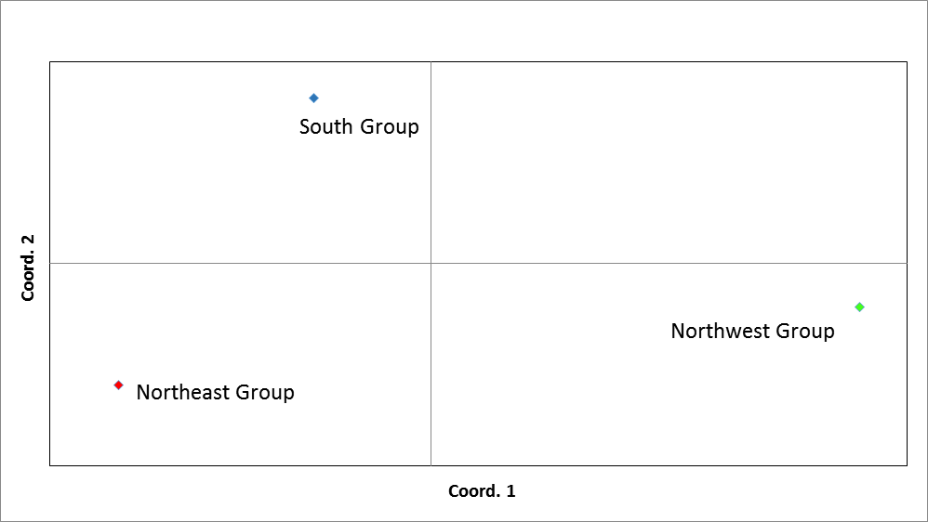
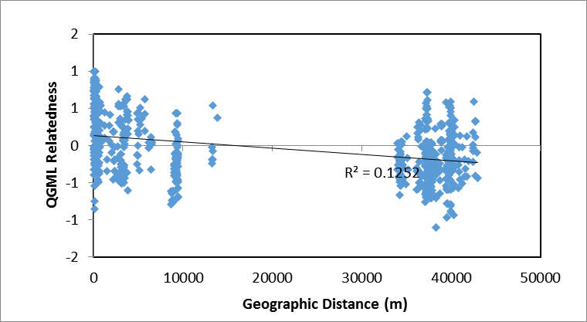
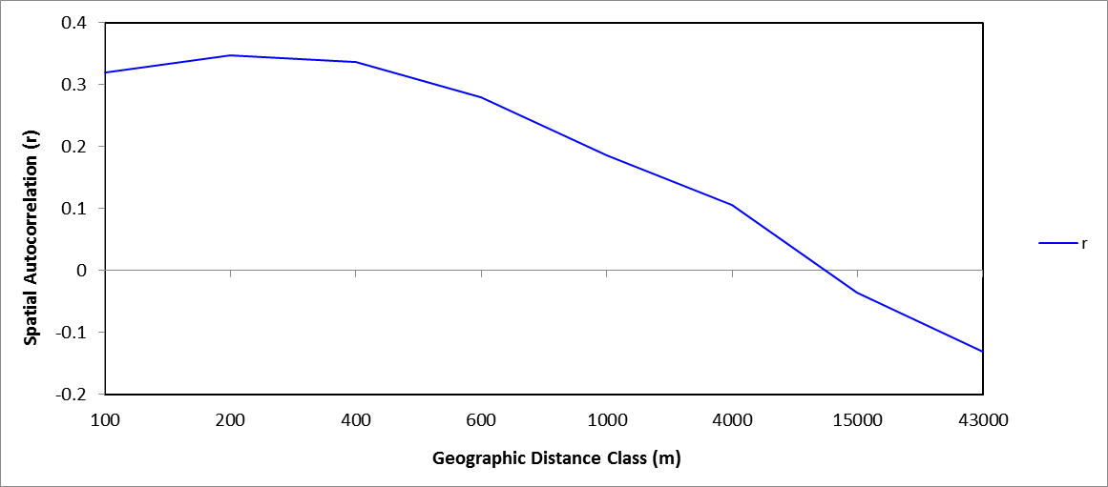




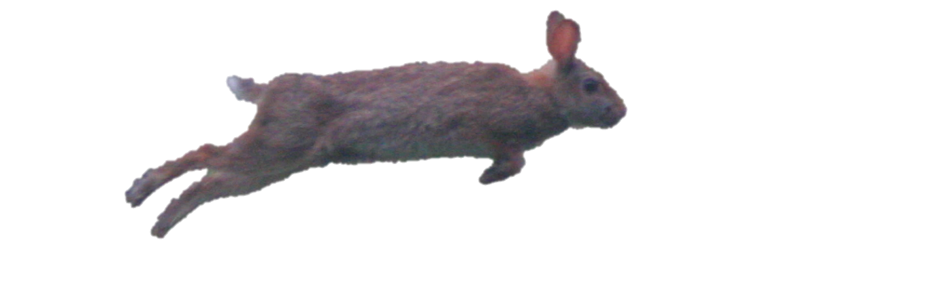
Genetic Structure of an Isolated New England Cottontail Population
Sarah Clements, Melissa Etheridge, Thea Kristensen, Adrienne Kovach
Department of Natural Resources and the Environment, University of New Hampshire
Introduction
Results
The New England cottontail (Sylvilagus transitionalis) is an early-successional obligate lagomorph found exclusively in New England and southeastern New York.
Figure 3. Clustering analysis showed genetic differences between eastern and western groups of cottontails.
The range of this species has contracted substantially as New England’s landscape has changed (Fig. 1)³ and it faces many threats stemming from habitat loss and fragmentation².
The road may be a barrier to dispersal. There may also have been historical connectivity through recently occupied patches on the eastern side.
Figure 1. Current and historic range of the New England cottontail
In New York, roads and geographic isolation separate cottontail populations (Fig. 2).
Cottontails may be affected by an array of issues associated with small population size, such as genetic drift, vulnerability to environmental and demographic stochasticity, and inbreeding depression.
Limited dispersal of individuals between populations could exacerbate these problems.
Figure 2. Location of cottontails in New York; focal area circled in yellow
Fig. 4. Principal coordinate analysis of pairwise genetic distances between individuals showed overlap between the northeast group and both other groups, and little overlap between the northwest and south groups.
Fig. 5. Principal coordinate analysis of pairwise population F_{ST} shows that all three groups are different, but the south and northeast groups are more similar to one another than to the northwest group.
Objective
Characterize genetic structure and diversity of New England cottontails in New York in relation to landscape features.
Hypotheses
Geographic distance drives genetic differentiation.
Major roads are barriers to dispersal and impact population structure.
p=0.01
Methods
DNA was extracted from New England cottontail fecal pellets¹ using a QiAmp DNeasy Stool Kit (Qiagen)
Fig. 7. Genetic relatedness decreases with geographic distance (Mantel test), showing a pattern of isolation by distance.
Fig. 8. Spatial autocorrelation shows fine-scale isolation by distance, with a genetic neighborhood of about 10 km.
39 samples were genotyped at 11 microsatellite loci
  P_{ID}: 2.4E-07 P_{SIBS}: 1.1E-03
Table 1. Comparison of genetic variation for a priori population groupings based on east-west separation by the road and north-south separation by geographic distance.
Genetic population structure was analyzed using STRUCTURE⁴
Genetic diversity measures were calculated using GENALEX⁵
 | Grouped by Road (East-West) | Grouped by Distance (North-South)
F_{ST} | 0.049 | 0.062
Heterozygosity | East – 0.368 | North – 0.434
 | West – 0.528 | South - 0.394
Heterozygosity, relatedness, F-Statistics
Relationship of geographic and genetic distance was evaluated using Mantel tests and spatial autocorrelation in GENALEX
References
Kovach, A.I., M.K. Litvaitis, and J.A. Litvaitis. 2003. Evaluation of fecal mtDNA analysis as a method to determine the geographic distribution of a rare lagomoph. Wildlife Society Bulletin 31: 1061-5.
Fenderson, L., A. I. Kovach, J. A. Litvaitis, and M. K. Litvaitis. 2011. Population genetic structure and history of remnant populations of the New England cottontail (Sylvilagus tranitionalis). Conservation Genetics 12: 943-958.
Litvaitis, J.A., J.P. Tash, M. K. Litvaitis, M. N. Marchand, A. I. Kovach, and R. Innes. 2006. A Range-Wide survey to determine the current distribution of New England cottontails. Wildlife Society Bulletin 34: 190-1197.
Peakall, R. and Smouse P.E. (2006) GENALEX 6: genetic analysis in Excel. Population genetic software for teaching and research. Molecular Ecology Notes 6: 288-295.
Pritchard, J., M. Stephens, and P. Donnelly. 2000. Inference of population structure using multilocus genotype data. Genetics 155: 945-959.
Conclusions
The New England cottontail population in southeastern New York is structured both by geographic distance and dispersal barriers.
Major roads and other geographic barriers may prevent dispersal between eastern and western groups, or historical connectivity may explain some of the similarity among groups.
The poor dispersal ability of the New England cottontail and fragmentation of shrubland habitat prevent gene flow between populations and result in population subdivision and isolation.

