Slide 1


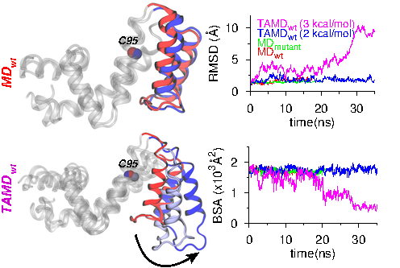
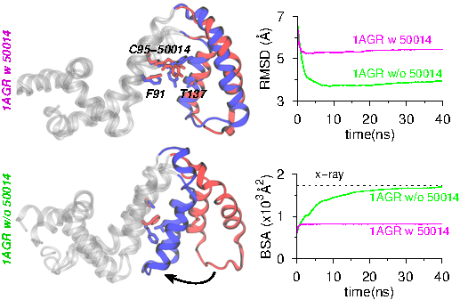
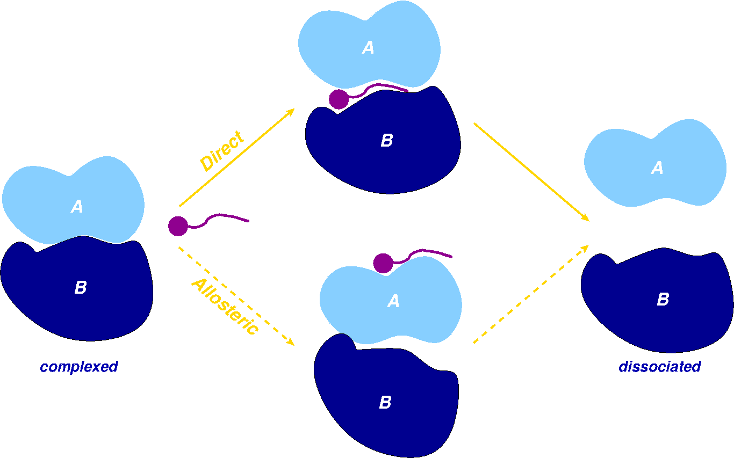
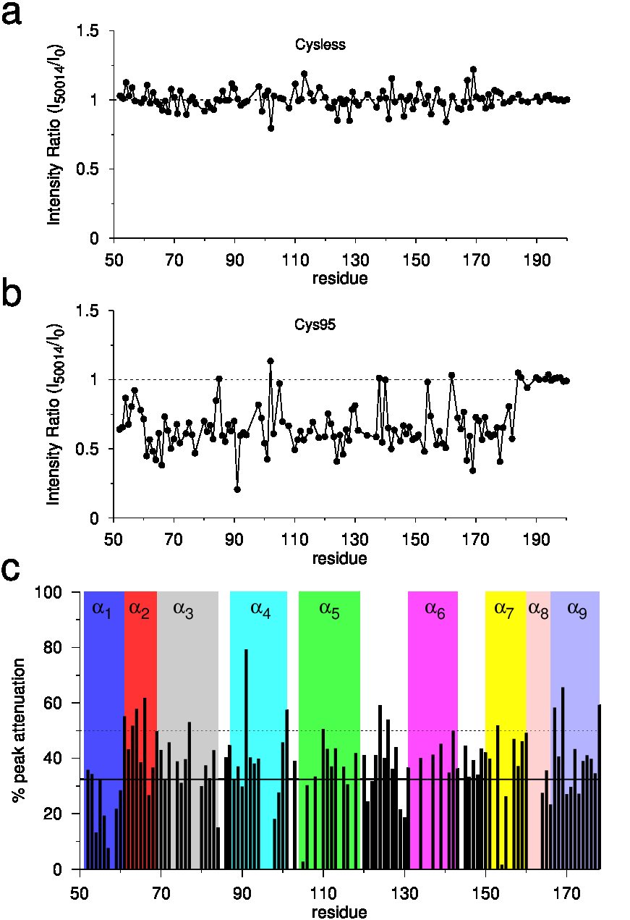
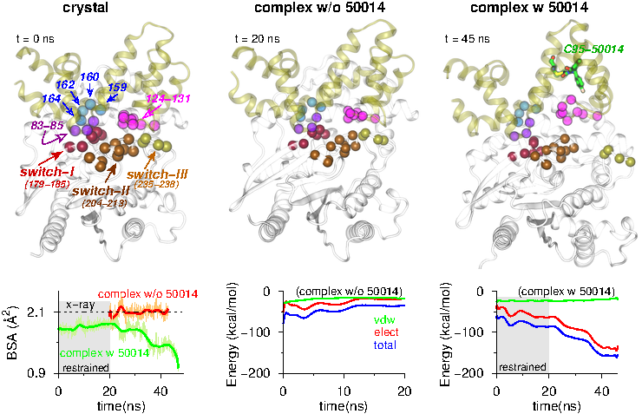
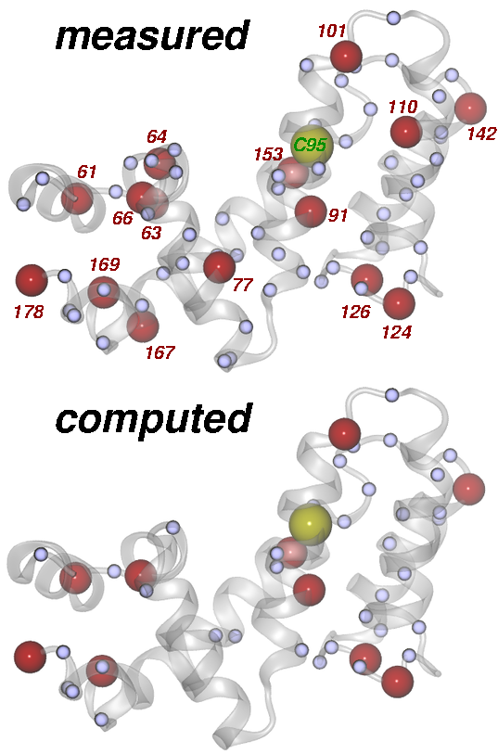
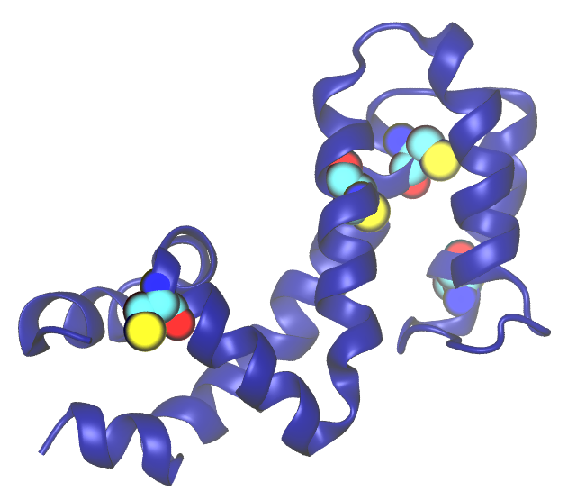
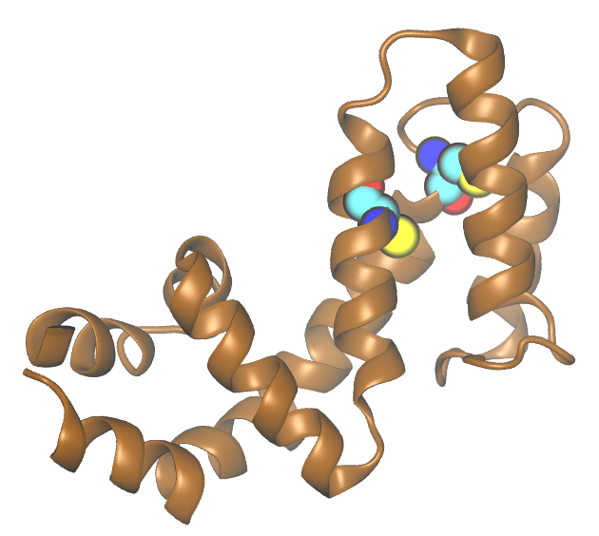
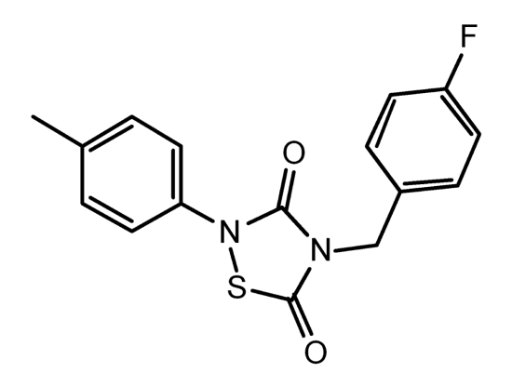
Allosteric Targeting of Protein-Protein Interactions
Harish Vashisth
(harish.vashisth@unh.edu; +1-603-862-2483)
Department of Chemical Engineering—University of New Hampshire—Durham, NH
SUPPORT: National Science Foundation CHE—1508595
ABSTRACT
RESULTS: Atomistic Simulations of RGS4 Structures in Apo and Liganded States
Intermolecular interactions are central to all cellular processes as many diseases can be directly linked to aberrant interactions between a pair of molecules, which makes it essential to design drugs that can reverse such malignant biophysical processes. Among these several protein-protein interactions (PPIs) represent critical therapeutic targets, but designing potent inhibitors to directly block such interactions remains significantly challenging. These challenges stem from difficulty in overcoming the binding energy associated with PPIs by a small molecule and targeting the large, relatively featureless interaction interfaces that commonly lack well-defined pockets into which small molecules can be targeted. Therefore, targeting allosteric sites may provide greater specificity and importantly remove the need to compete with the protein binding partner. In this work, we present the mechanism of action of one such allosteric inhibitor of an intracellular regulator of G-protein signaling protein that was investigated using atomistic simulations and NMR studies. Particularly, we find that the binding of inhibitor to a buried cysteine residue perturbs the protein-protein interface via an allosteric mechanism.
MOTIVATION: Inhibition of Protein-Protein Interactions
Classical (MD) and enhanced sampling (TAMD; temperature-accelerated molecular dynamics) simulations of apo-RGS4
MD equilibration of TAMD-generated states of RGS4. Data with and without inhibitor are shown.
Change in root-mean-squared-fluctuations (ΔRMSF) on binding of CCG-50014
RESULTS: NMR vs. MD Simulation Analysis of Residue Perturbations
RESULTS: Allosteric Inhibition of RGS4-Gα Protein-Protein Interaction
BACKGROUND: RGS4 vs. RGS8
RGS4 CCG-50014 RGS8
CCG-50014: cysteine-specific inhibitor
CCG-50014: over 20-fold more selective for RGS4
CCG-50014: RGS4 IC₅₀ 30nM
Q1: How does inhibitor access buried cysteine residues--mechanism?
Q2: What are molecular origins of selectivity difference?
Hypothesis: Flexibility in helices facilitates inhibitor access
CONCLUSIONS ACKNOWLEDGEMENTS
Conformational change in α5-α6 helical bundle allows access to buried
cysteine residue
Inhibitor binding perturbs residues in RGS-Gα interface allosterically
Inhibitor can spontaneously access buried cysteine in conformationally-open states of RGS4 and RGS8
We thank Prof. Rick Neubig (Michigan State University) for a fruitful collaboration on NMR studies.
Effect of inhibitor binding on the ¹H-¹⁵N HSQC spectra of RGS4.
Perturbed residues are mapped for RGS4: Measured (NMR experiments) and Computed (MD runs)

